Slide 1



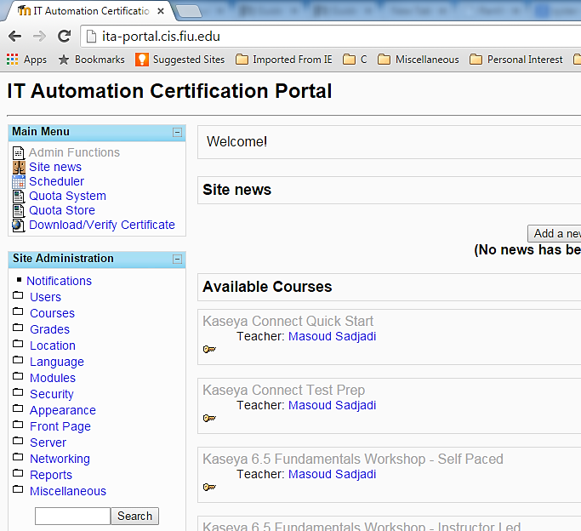
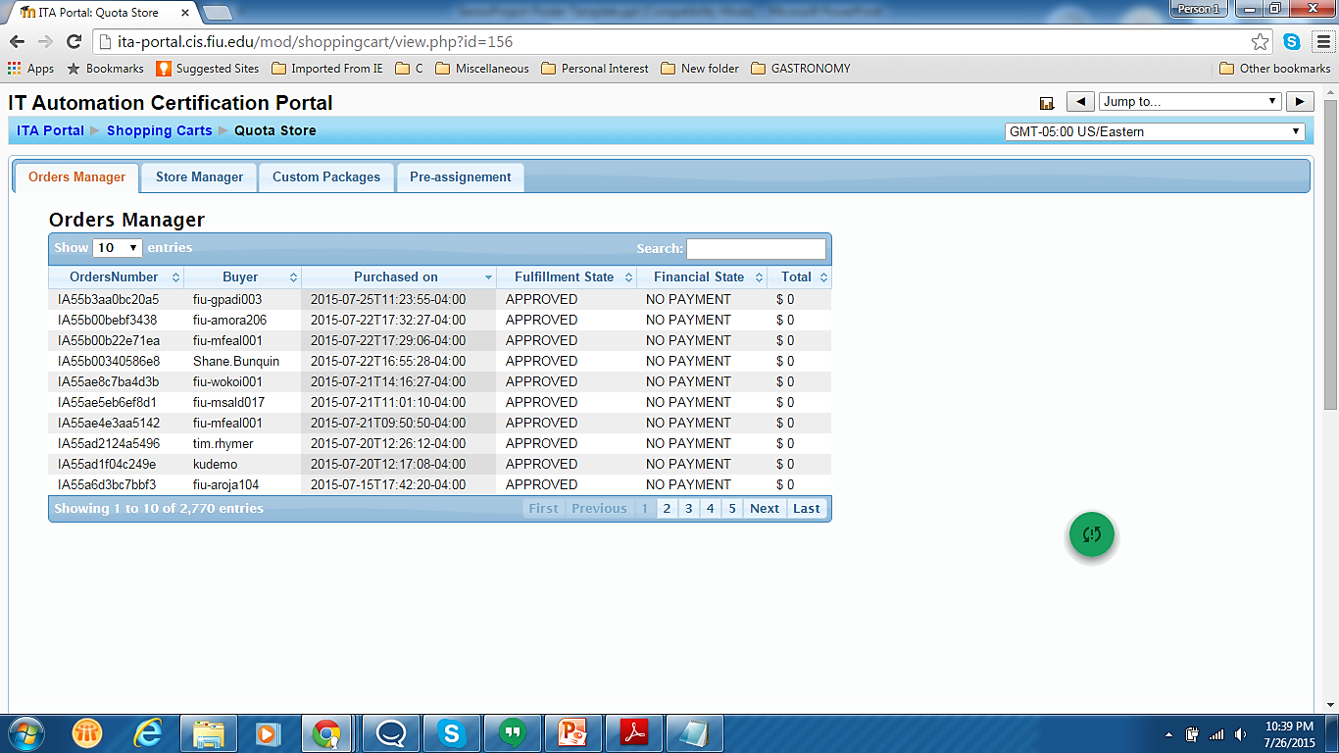
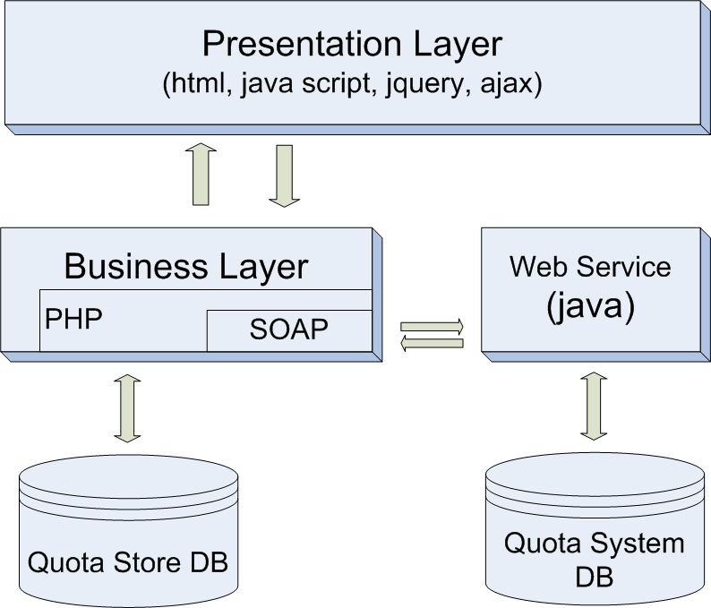
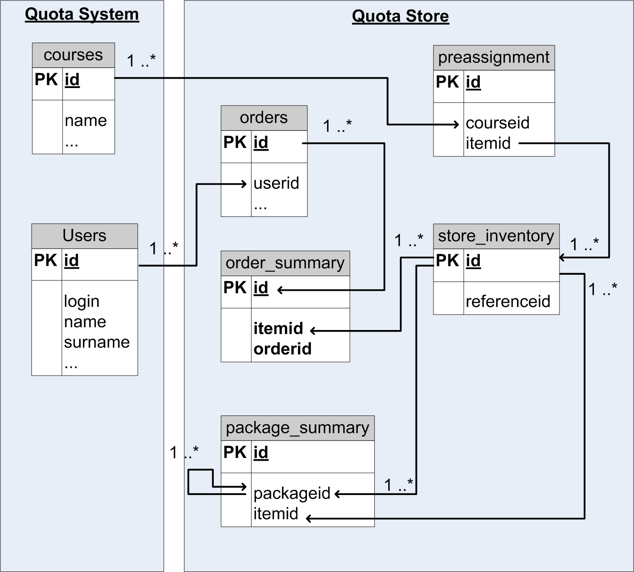
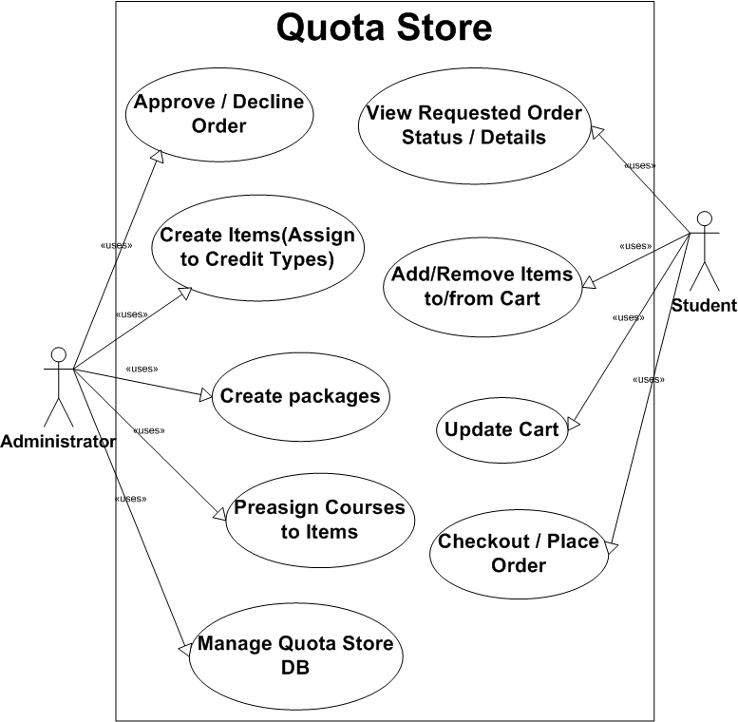







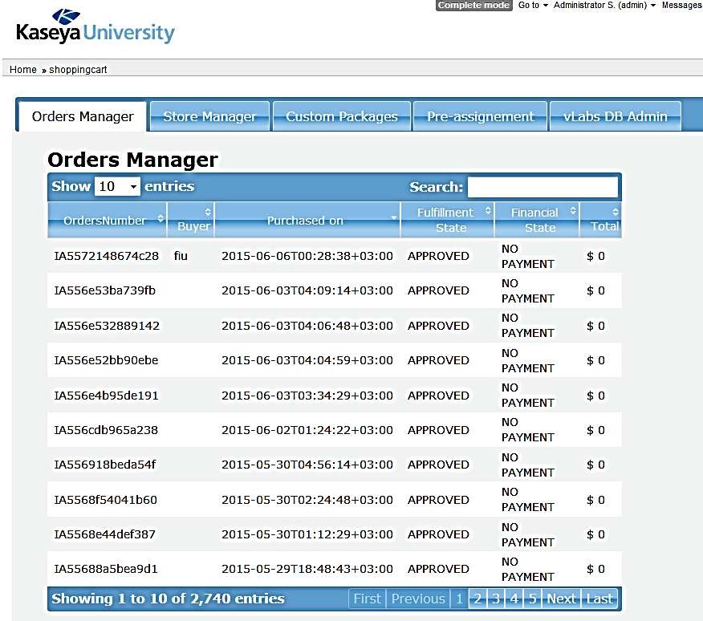



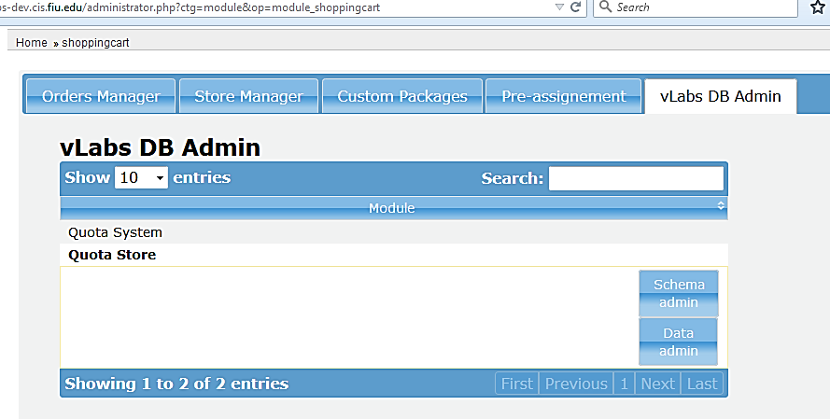
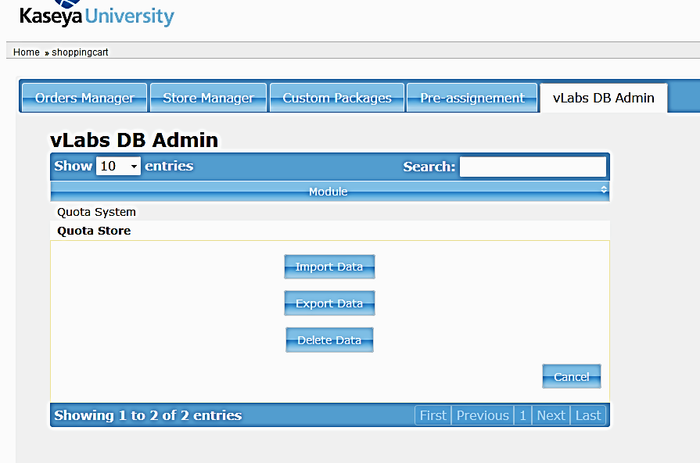
School of Computing & Information Sciences
Senior Project, Summer 2015
Virtual Labs 7.0
Student: Johann Henao, Florida International University
Mentor: Dr. Masoud Sadjadi, Florida International University
Instructor: Masoud Sadjadi, Florida International University
Problem
Current System
Requirements
“IT Automation Certification Program” is a Moodle based solution that hosts several resources such as the Quota System, Quota Store, Scheduler and others. The Quota System allows the management of Credit Types which are virtual labs resources. The Quota Store allows the request and management of Credit Types.
Because the virtual labs resources are hosted in the eFront platform the product owner wishes to migrate the Quota Store to eFront as a module to keep all functions in the se same system.
The current Quota Store system does not have data referential constraints configured which can lead to data integrity problems.
Migrate Quota Store from Moodle to eFront and setup DB referential constraints.
Implement eFront themes compatibility on the Quota Store.
Implement a separate tab for DB administration functions of the Quota Store such as import and export of data and schema.
Users currently use this Moodle Interface to request virtual labs resources and Administrators can approve or reject those requests.
System Design
Object Design
Implementation
Migrated/Implemented Use Cases:
Quota Store is a Web solution based on a three tier design architecture. JS, Ajax and PHP are used for data passing from and to the Quota Store DB. SOAP is used to retrieve Credit type data from the Quota System.
Technologies used:
Verification
Screenshots
Summary
Validation of the deliverables was done on the following most commonly used browsers:
The migration of the Quota store system from Moodle to eFront was achieved successfully. The look and feel from the original system was preserved while maintaining compatibility with the eFront theme selection feature.
The DB admin was implemented with the same look and feel of the rest of the tabs so its usability is pretty intuitive and follows the slick slide up and down of the table records.
All mayor functionality works as expected and look and feel is pretty consistent across browsers.
The only issue encountered was that the export data/schema buttons on the DB admin tab do not work in IE but work ok on chrome and Firefox.
Due to the new referential constraints put in place for the Quota Store, a data consistency clean up needs to be done to import already existing data from the production system.
Acknowledgement
The material presented in this poster is based upon the work supported by Dr. Masoud Sadjadi. I am thankful to the help that I received from my group members: Crystal Rivera, Trung Ngo, Juan Riano and Daniel Gonzalez.

