Slide 1

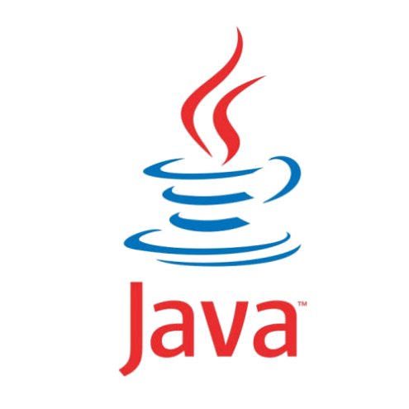

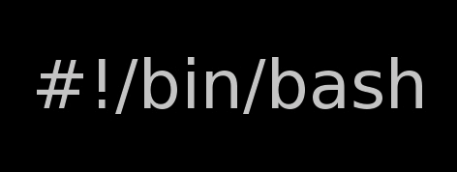
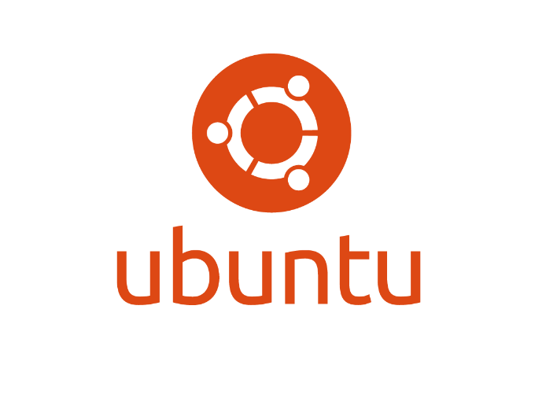

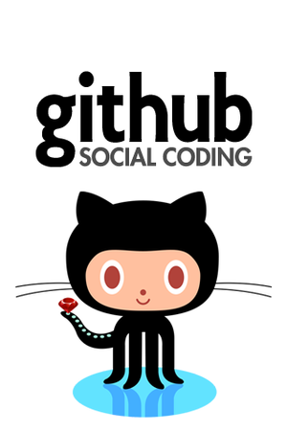

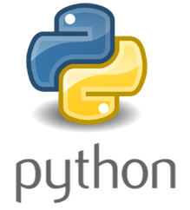
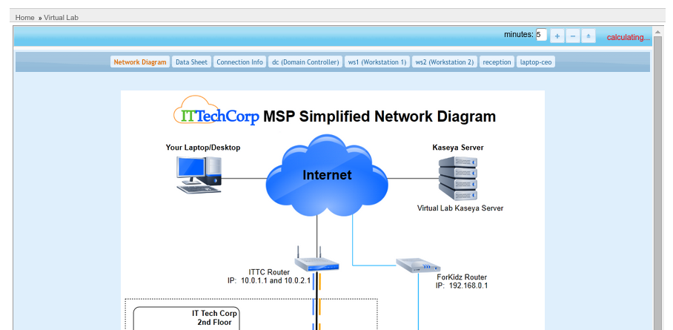
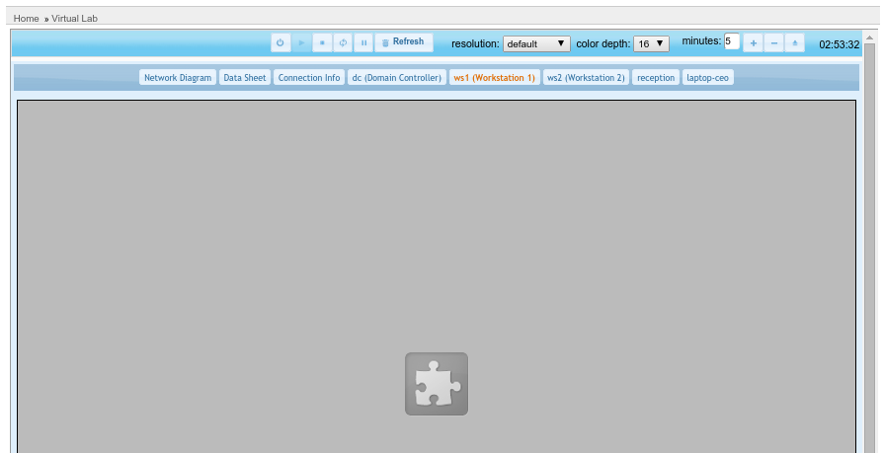
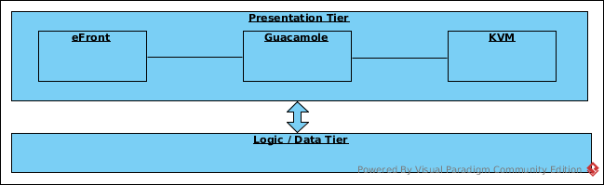
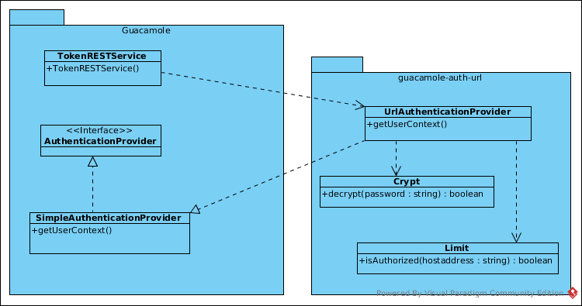
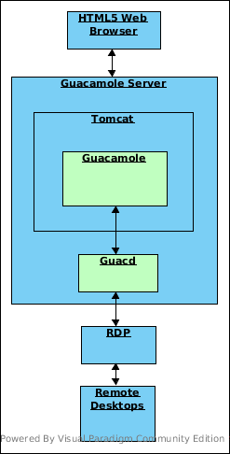
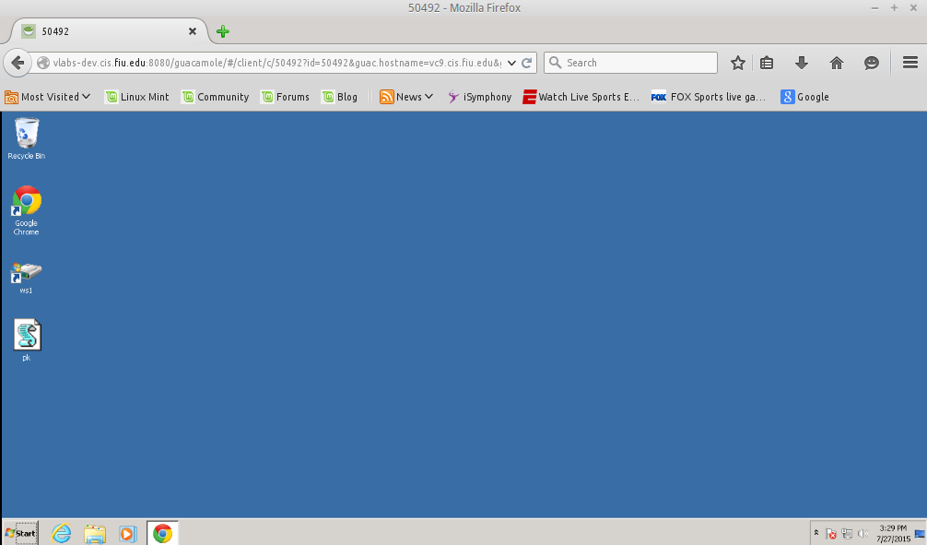
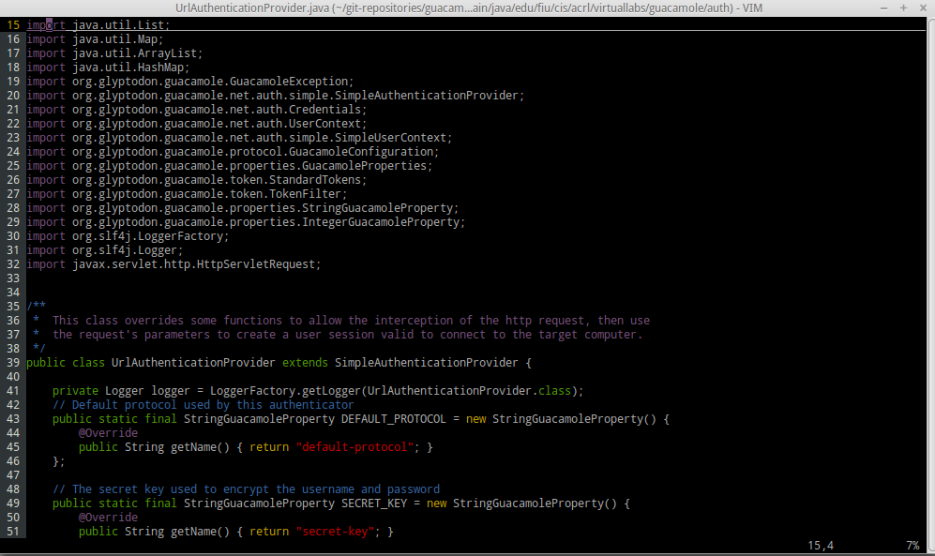
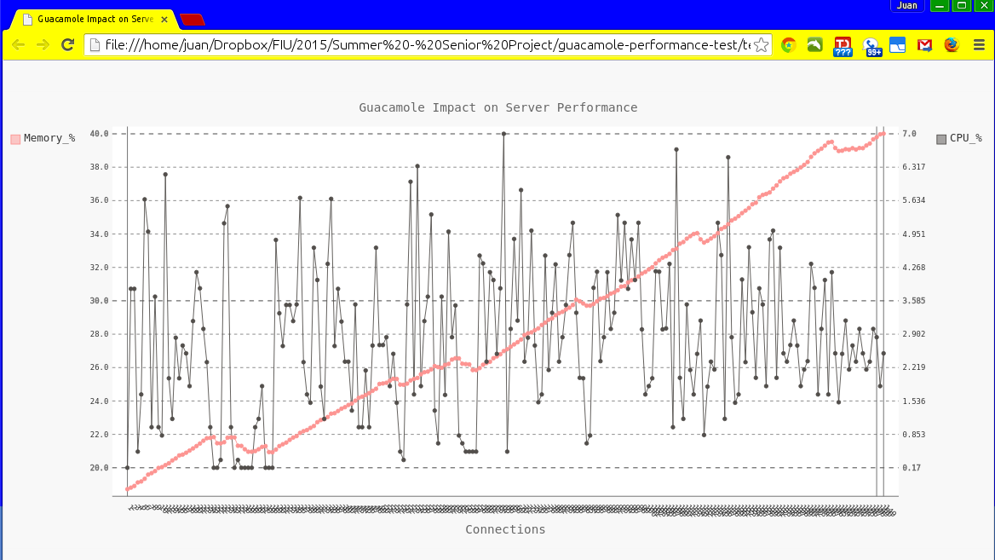
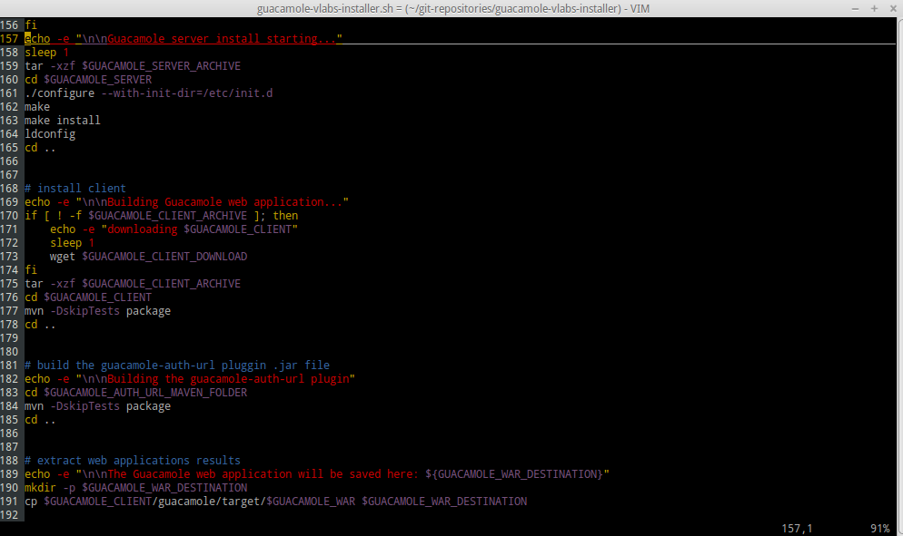
School of Computing & Information Sciences
Senior Project, 2015, Summer
Virtual Labs 3.0
Student: Juan C. Riano. FIU Mentor: Masoud Sadjadi, PhD. FIU Instructor: Masoud Sadjadi, PhD. FIU
Problem
Current System
Requirements
Virtual Labs offers students of the IT Automation class a virtual environment where they can practice their newly learned skills.
The current implementation of Virtual Labs uses Java applets to make the virtual environment available via a web browser.
With the NPAPI plugins been phased out of all main stream web browsers, Virtual Labs was rendered unusable without browser hacks.
I was put in charge of searching for and implementing a solution that would allow Virtual Labs to serve the virtual environment via a web browser once again.
The current system is a very complete implementation hosted by Kaseya.
Functional:
The new system shall:
Establish RDP sessions.
Accept all required settings via the URL.
Perform password decryption.
Allow window resizing.
Allow different color depth settings.
Allow different DPI settings.
However, due to the phased out Java Applets, RDP sessions no longer work.
Non-Functional:
The new system shall:
Be an HTML5 implementation.
Work in all major web browsers.
Be able to handle 100+ concurrent RDP sessions.
Have an extensive API.
Be well documented.
System Design
Object Design
Implementation
There were 3 major tasks in this solution:
Selection and stress testing of gateway.
Development of the plugin.
Development of the installer package.
The stress test was done via a Python script that monitored and logged the server’s resources during the test.
The core features of the plugin are:
Intercepts the http request parameters.
Validates if the requested connection is permitted.
Creates a user context with the parameters.
Tries to establish the RDP session.
The installer is a Bash implementation that sets both Guacamole and the plugin.
The Virtual Labs project is implemented with a 3 Tier architecture My work was restricted to the presentation tier as I was in charge of implementing a solution to display RDP connections via a web browser.
Guacamole comes by default with the SimpleAuthenticationProvider.
In order to implement additional functionality required by Virtual Labs, A new authentication plugin was developed called
guacamole-auth-url.
Verification
Screenshots
Summary
The Guacamole gateway was subjected to a stress tests where 45 bare metal computers established 145 concurrent RDP sessions while the server resources were been monitored by a Python script. The results were very satisfactory.
Extensive integration testing was applied to the guacamole-auth-url authentication plugin to make sure it did blend well into the Guacamole environment.
The Guacamole and guacamole-auth-url installer was tested in all possible installation scenarios, including clean install, upgrade of previous version, and removal and reinstallation with new configurations.
The guacamole-auth-url plugin and the Guacamole gateway have given Virtual Labs a new and hassle free way to deliver RDP connections via a web browser.
Since Guacamole is an HTML5 implementation, Virtual Labs will not face again an issue like the one caused by the phasing out of Java browser plugins.
The setup of Guacamole is somewhat time consuming an error prone, due to the fact that configuration files need to be changed and saved in specific locations.
The scripts developed to automate the installation of Guacamole and the guacamole-auth-url will make deployment easier, faster and error free.
Acknowledgement
The material presented in this poster is based upon the work supported by Dr. Masoud Sadjadi. I am thankful to the help that I received from my group members, Crystal Rivera, Trung Ngo, Johann Henao and Daniel Gonzalez.

