Slide 1



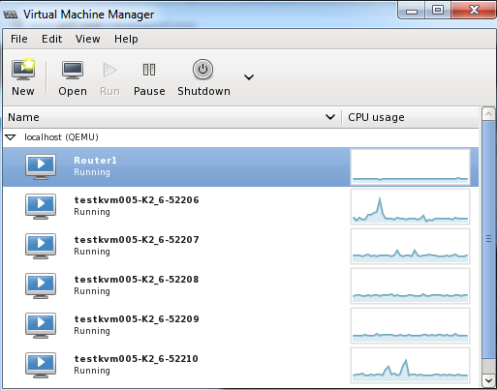


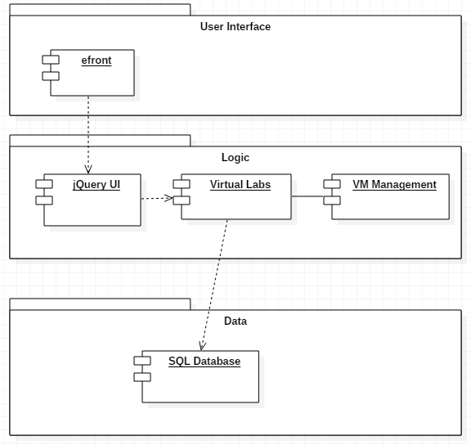
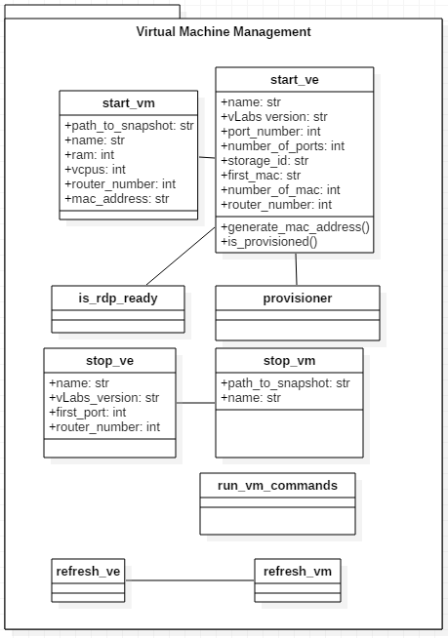
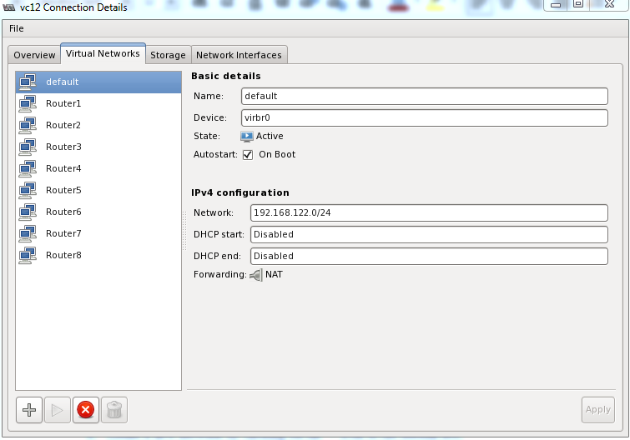
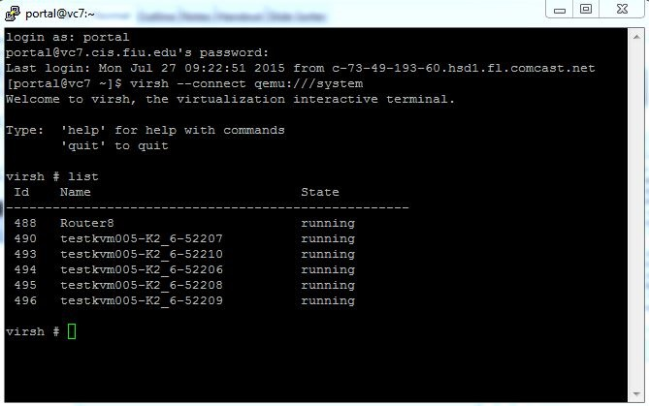
School of Computing & Information Sciences
Virtual Labs 7.0
Student: Daniel Gonzalez, Florida International University
Mentor: Masoud Sadjadi, Florida International University
Instructor: Masoud Sadjadi, Florida International University
Problem
Current System
Requirements
The Virtual Labs environment has been using the proprietary service VMware
It was decided that Virtual labs would migrate from VMware to Kernel-based Virtual Machine (KVM).
KVM is an open source infrastructure that converts the Linux kernel into a hypervisor
All previous scripts and software that had been written to manage VMware's array of Virtual Machines must be updated to support KVM.
The current system is a hybrid of VMware and KVM, with two of the thirteen virtual clusters using KVM and the rest have yet to be converted.
Be able to convert existing VMware virtual environment to KVM.
  Convert an individual's virtual environment.
  Convert the gold images.
  Convert the routers.
Have scripts that start and stop the KVM virtual environments.
Confirm that the IP's are properly routed.
System Design
Object Design
Implementation
The most time consuming task is the conversion of existing VMware virtual environments to KVM. Because of this a script was made in python to automate the process.
Python was also used to make scripts that start, stop, and otherwise control the virtual machines.
These python scripts would interact with the main java program which communicates with the database.
Verification
Screenshots
Summary
Test Case | SLTC-002 (Sunny Day)
Purpose | The purpose of this test is to verify that a virtual labs environment is saved when stopped.
Test Setup | User has logged into efront. User has successfully started a vLabs session.
Input | The user hits the eject symbol signifying the suspension of a vLabs.
Expected Output | The virtual lab environment has stopped and each virtual machine's state has been saved. The user views a sign off screen.
Actual Output | The same as the expected output.
The intent of this project was to convert the existing VMware implementing Virtual Labs into one using KVM.
To facilitate this migration a script that automates the conversion process from VMware to KVM was created.
Many other scripts that control the virtual machines were updated in order to support KVM.
In addition each virtual cluster had to be updated to support KVM.
Acknowledgment
The material presented in this poster is based upon the work supported by Dr. Masoud Sadjadi. I am thankful to the help that I received from my group members, Crystal Rivera, Trung Ngo, Juan Riano, and Johann Henao

