Slide 1


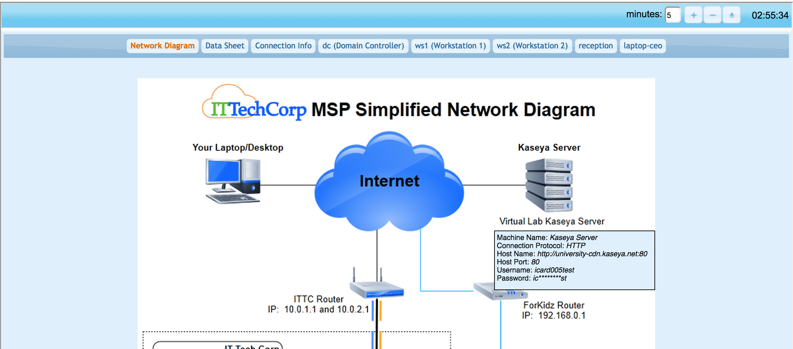

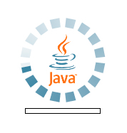












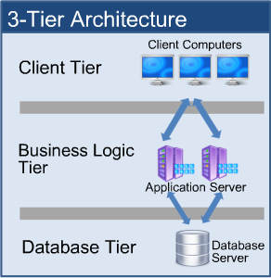
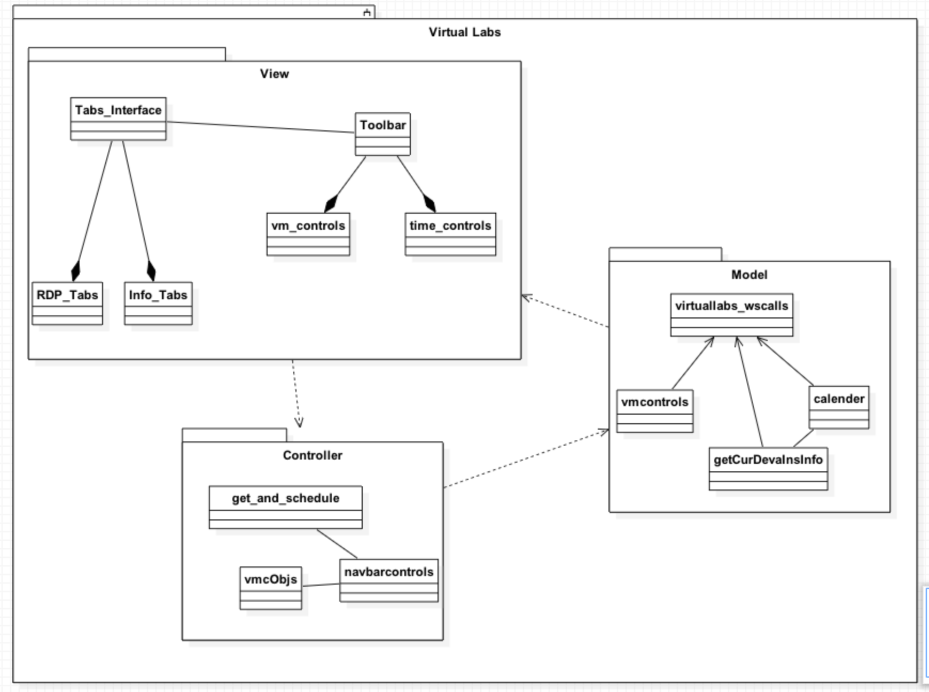
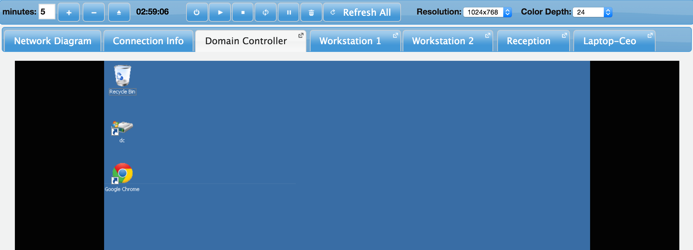




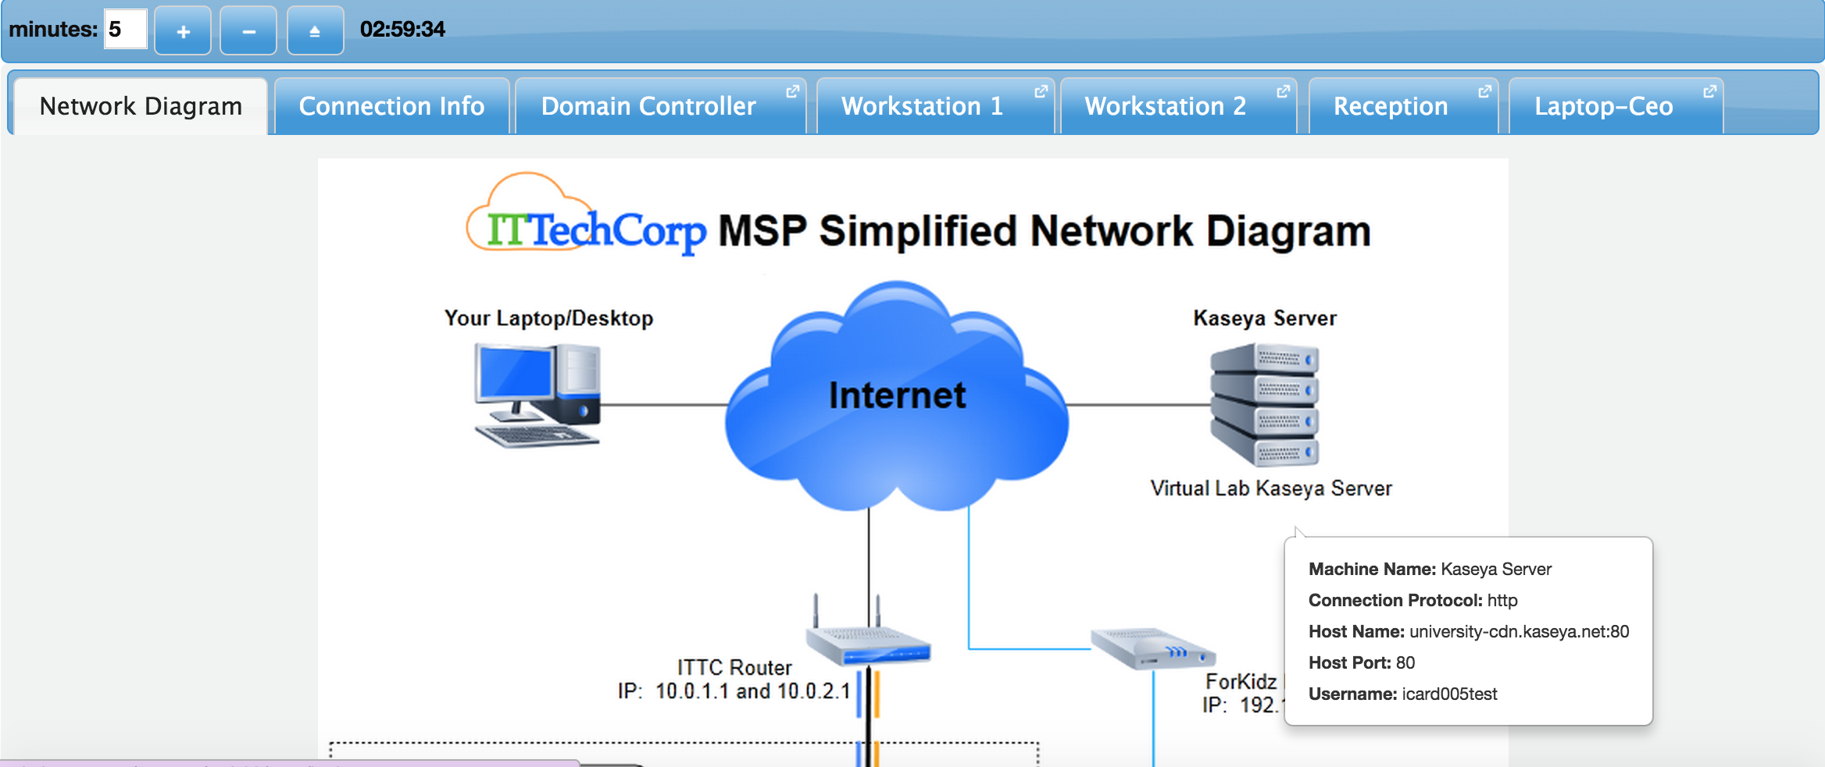

School of Computing & Information Sciences
Senior Project, Summer 2015
Virtual Labs 3.0
Student: Crystal Rivera, Florida International University
Mentor: Dr. Masoud Sadjadi, Florida International University
Instructor: Masoud Sadjadi, Florida International University
Problem
Current System
Requirements
The current system provides an interface through Moodle that allows students to reserve different types of resources which include virtual labs, mentoring and certificate exams.
Virtual Labs and its associated services currently are hosted through ‘Kaseya University’ which interfaces with Moodle for its modular functionality.
Eliminate all Moodle dependencies
Refresh look and feel using the latest jQuery UI and other frameworks
Replace applet implementation of RDP sessions to display the Guacamole HTML5 RDP Gateway connections
However, integrating with Moodle is an unnecessary step since these modules can be built within the eFront framework itself
In addition, the Virtual Labs module uses Java applets to present the RDP sessions, and most major browsers are phasing these out.
Implementation
The user interface is built using jQueryUI and jQuery 1.X which is quickly becoming outdated.
Technologies used:
System Design
Object Design
Using eFront, a learning system like Moodle, I was able to migrate Virtual Labs over to eFront and remove all Moodle dependencies.
To construct the user interface, I made the decision to keep with jQuery UI as the primary framework, but also took advantage of other libraries such as Bootstrap and qTip2 to assist in making it as smooth and modern as possible.
This system was developed using a three-tier architecture; my focus was on the client and business logic tier, since the majority of my time was spent on the user interface and the associated logic behind the functionality.
Verification
Screenshots
Summary
For verification, my focus was set on cross browser consistency.
The intention of this release was to revamp the current system to remove any Moodle dependencies from the implementation, and to redesign the Virtual Labs module’s user interface.
All implemented use cases were tested on various browsers to verify whether the functionality was working as expected.
As implemented, the new system’s Virtual Labs presents a cleaner, more modern interface to the user but keeps the structure of the older implementation to give a sense of familiarity as well.
Findings were as follows:
Chrome & Firefox: all other functionality working as expected
Safari: some inconsistency in iframe focusing
IE: iframe focusing not functional and the color depth/resolution selects do not update when reading from database.
* tab rerouting errors in network diagram and conn info onclick
Acknowledgement
The material presented in this poster is based upon the work supported by Dr. Masoud Sadjadi. I am thankful to the help that I received from my group members, Daniel Gonzalez, Johann Henao, Juan Riano, and Trung Ngo.

