Slide 1



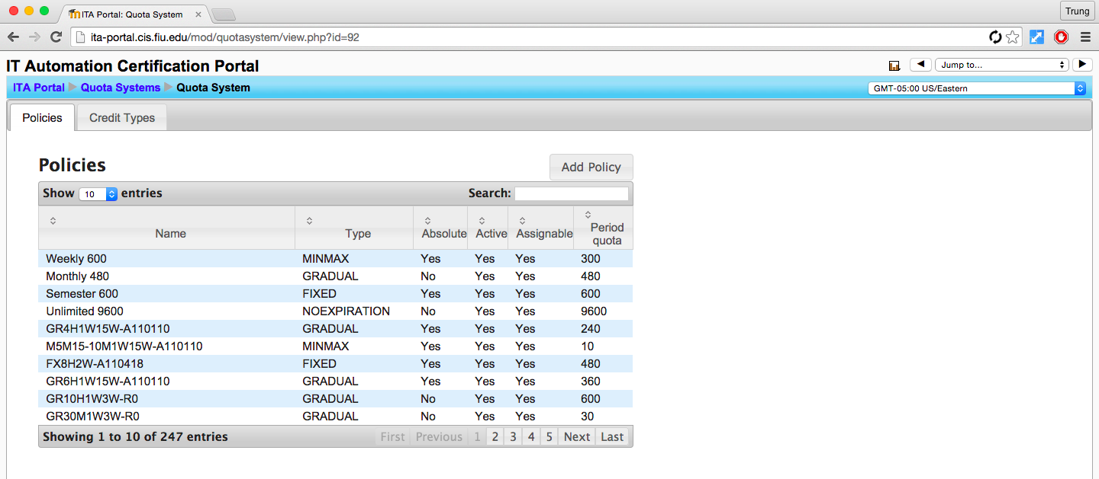
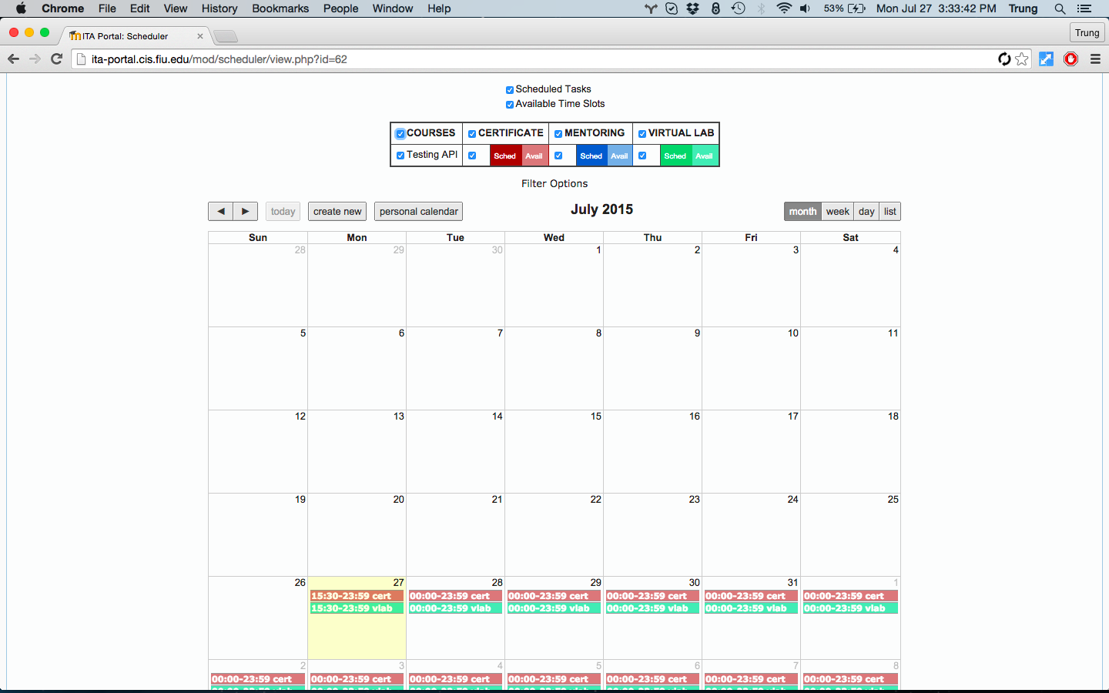
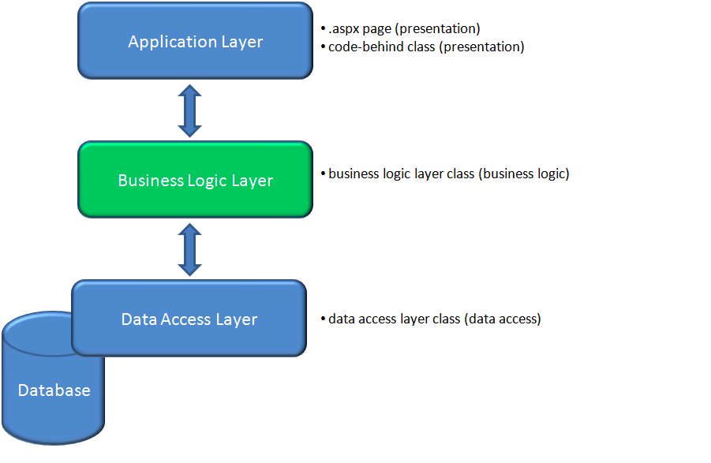

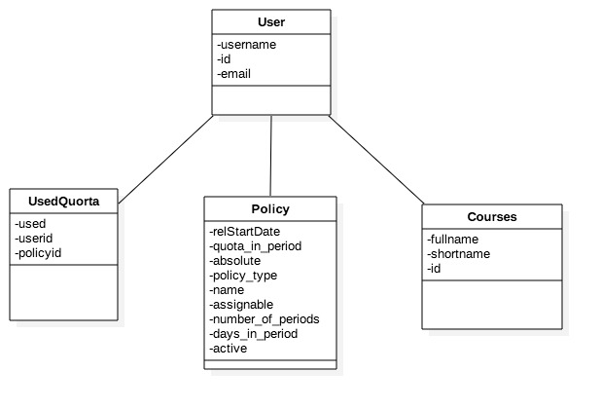
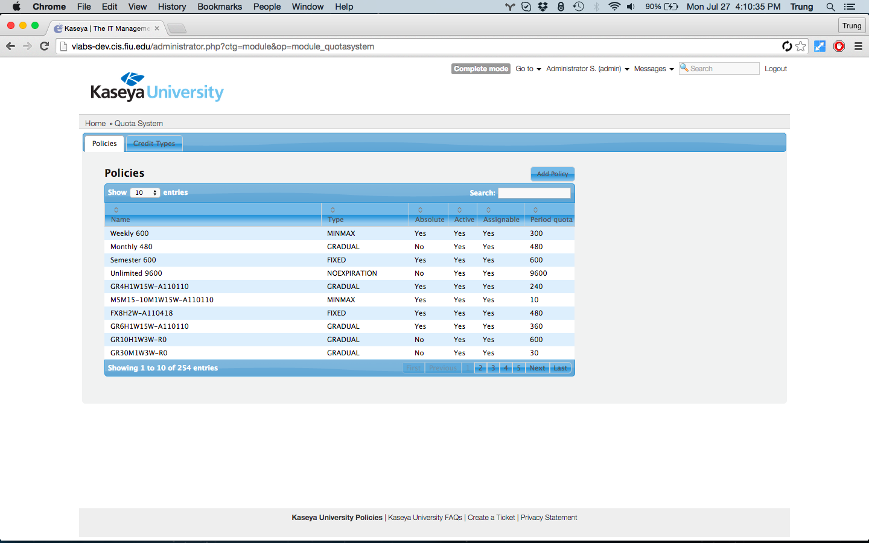

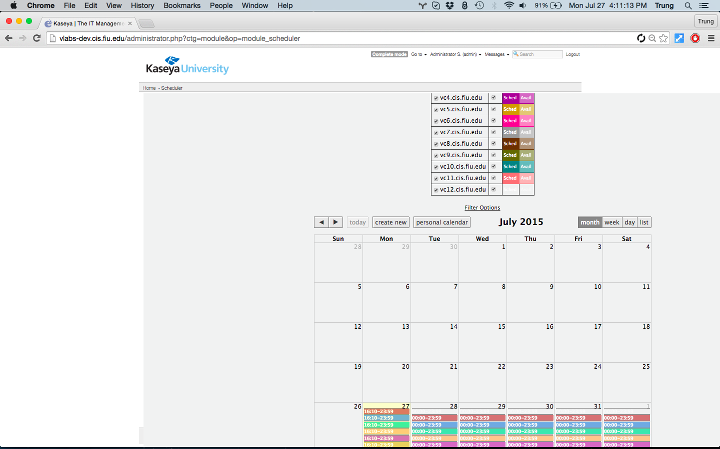

School of Computing & Information Sciences
Senior Project, 2015, Summer
Virtual Labs 7.0
Student: Trung Ngo, Florida International University
Mentor: Dr. Masoud Sadjadi,, <Affiliation>
Instructor: Masoud Sadjadi, Florida International University
Problem
Current System
Requirements
The problem is to develop a solution to an issue that Google has presented, the discontinued support of Java Applets. During this transition, Virtual Labs will be converted from its existing version of Moodle to eFront.
The reason for this transition is to reduce the overhead of having the solution in two places, mainly eFront and Moodle as, currently, eFront provides the application solution and Moodle provides the appointments to allow access for the application.
Migrate the Quota System module from Moodle to eFront
Migrate the Scheduler module from Moodle to eFront
Implement theme compatibilities for each module
Maintain database constraints for tables related to each module
Users are given these interfaces to allow them to manage usage of their resources. Admins are given an overview of all resources.
System Design
Object Design
Implementation
Technologies used:
Using eFront, an LMS like Moodle, it was possible to maintain the database as well as implement the theme compatibility.
As such, using eFront’s modular design approach to development, implementation of the Quota System and Scheduler module were expedited.
The Quota System module is a Web based solution that uses a three-tier architecture. This is achieved by using Javascript, AJAX, PHP and SOAP calls to pass information between the Presentation Layer and the Business Layer.
Verification
Screenshots
Summary
Verification was focused on maintaining previous functionality of Moodle modules. The results of test cases were as expected for all features tested on Selenium, with browsers including Mozilla Firefox, Google Chrome, Internet Explorer, and Safari.
The intention of this release was to remove Moodle dependencies as well as remove any Java applet dependencies.
As implemented, newer versions of the Quota System and Schedulers were developed while maintaining previous versions and removing said dependencies.
Acknowledgement
The material presented in this poster is based upon the work supported by Dr. Masoud Sadjadi. I am thankful to the help that I received from my group members, Crystal Rivera,
Daniel Gonzalez, Juan Riano, and Johann Henao

