Slide 1






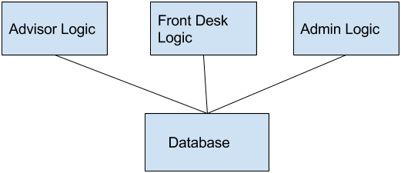
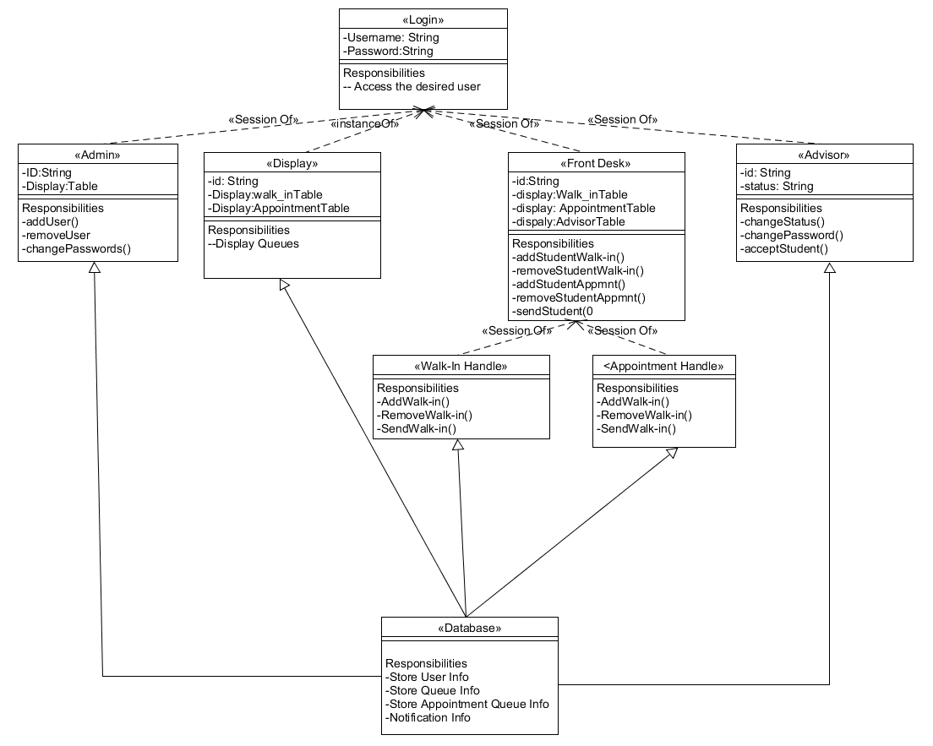
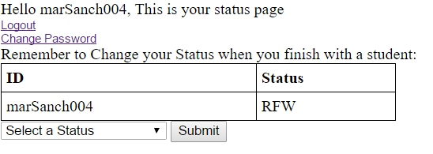
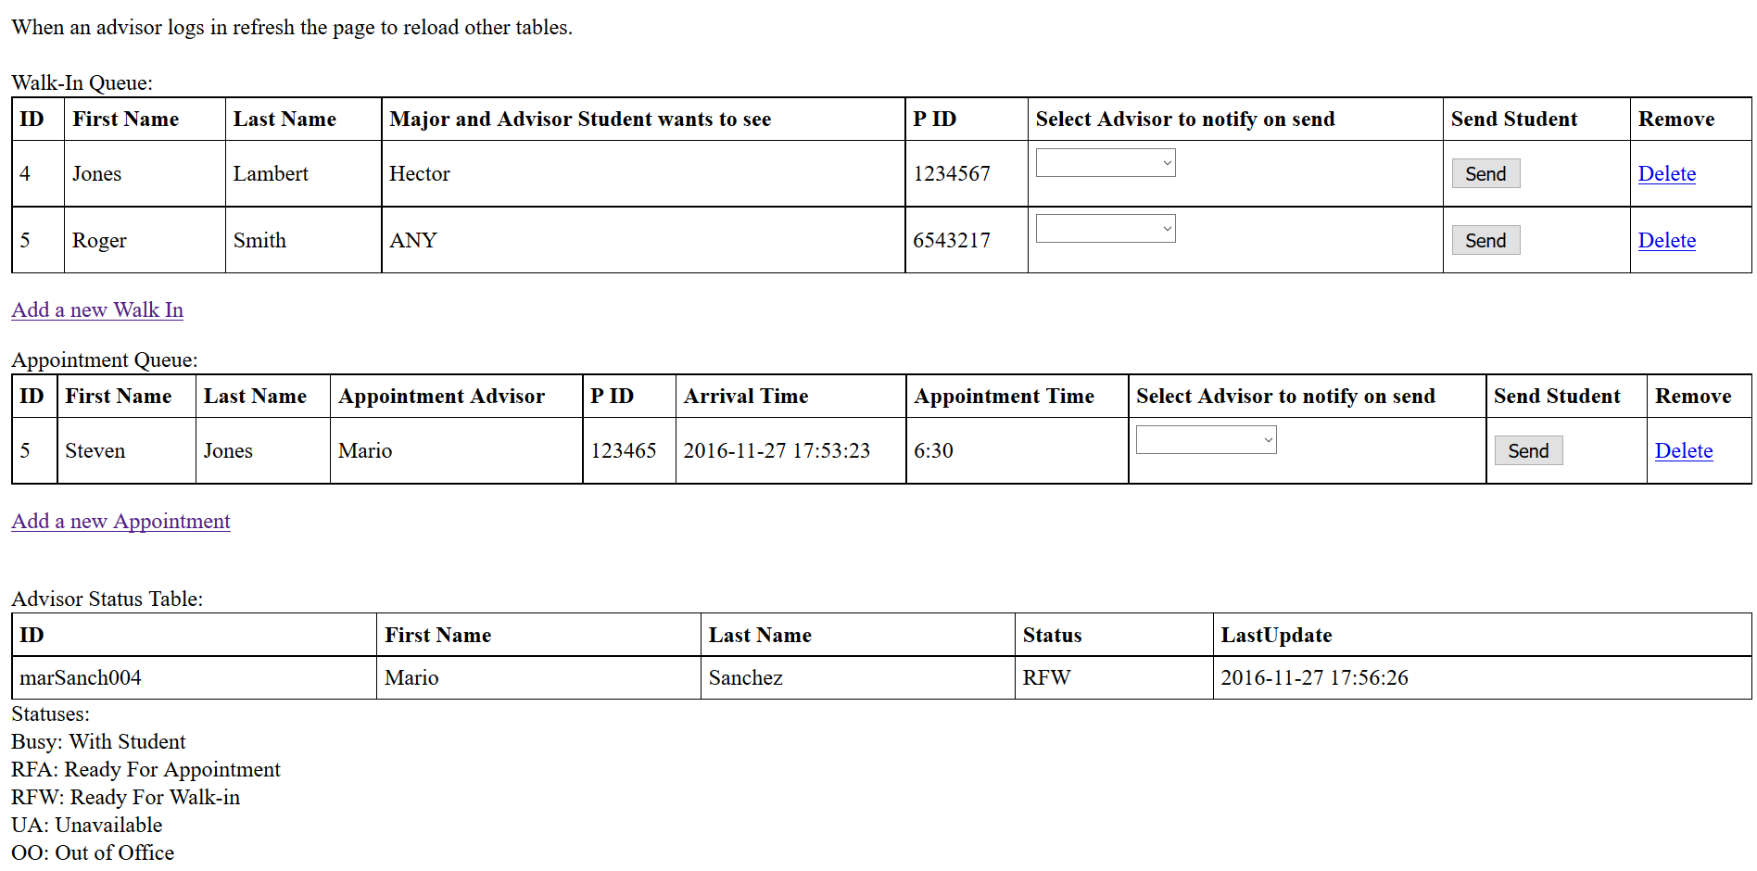
School of Computing & Information Sciences
Senior Project, 2016, Fall
Advisor Availability System v1.0
Student: Hector Borges, Florida International University
Mentor: Mohsen Taheri, Mario Sanchez
Instructor: Masoud Sadjadi, Florida International University
Problem
Communication between front desk and advisors at their office is very inefficient currently. The front desk attendant has to walk over to each advisor in order to alert them of an incoming student. This is very time consuming, especially if the number of advisors increases.
Current System
Currently Our system is capable of:
Front Desk can send Student to Advisor
Advisor is notified
Advisor Can Change status
Front desk is notified
Appointment and Walk-in queue implemented.
Requirements
The System should allow:
Advisors to change their status
Advisors to change their Password
Front Desk to add and remove students from appointment and walk-in queues
Front desk to be notified with sound each time advisors changes status to Ready
Admins to add/ remove/ accounts and change passwords for each account
Solution
Create a website in conjunction with a database to store information about an advisor's current status of availability and for the front desk to be able to view such information and send students from a queue into the advisor's office.
System Design
2-tier Client/Server Architecture
Implementation
The system is implemented using:
A 2 tier client/server architecture.
XAMPP v3.2.2 Control panel
MariaDB SQL database version: 10.1.16-MariaDB
Web Server: Apache/2.4.23 (Win32) OpenSSL/1.0.2h PHP/5.6.24
Object Design
Verification
The systems was verified via a number of manual and automatic system and unit tests.
Screenshots
Summary
The purpose of our project is to provide an easier solution to the problem of communication between advisors and the front desk. So that students could be sent to the office of an advisor without the front desk attendant having to walk to each advisor office. For this project I mainly worked on the notification and queue implementation section of it.
Acknowledgement
The material presented in this poster is based upon the work supported by Masoud Sadjadi I am thankful to the help that I received from my group member Jean Tovar.
Notes:
1

