Slide 1








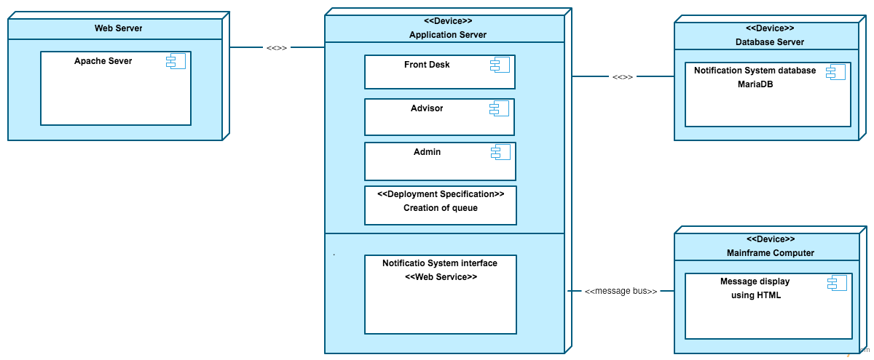
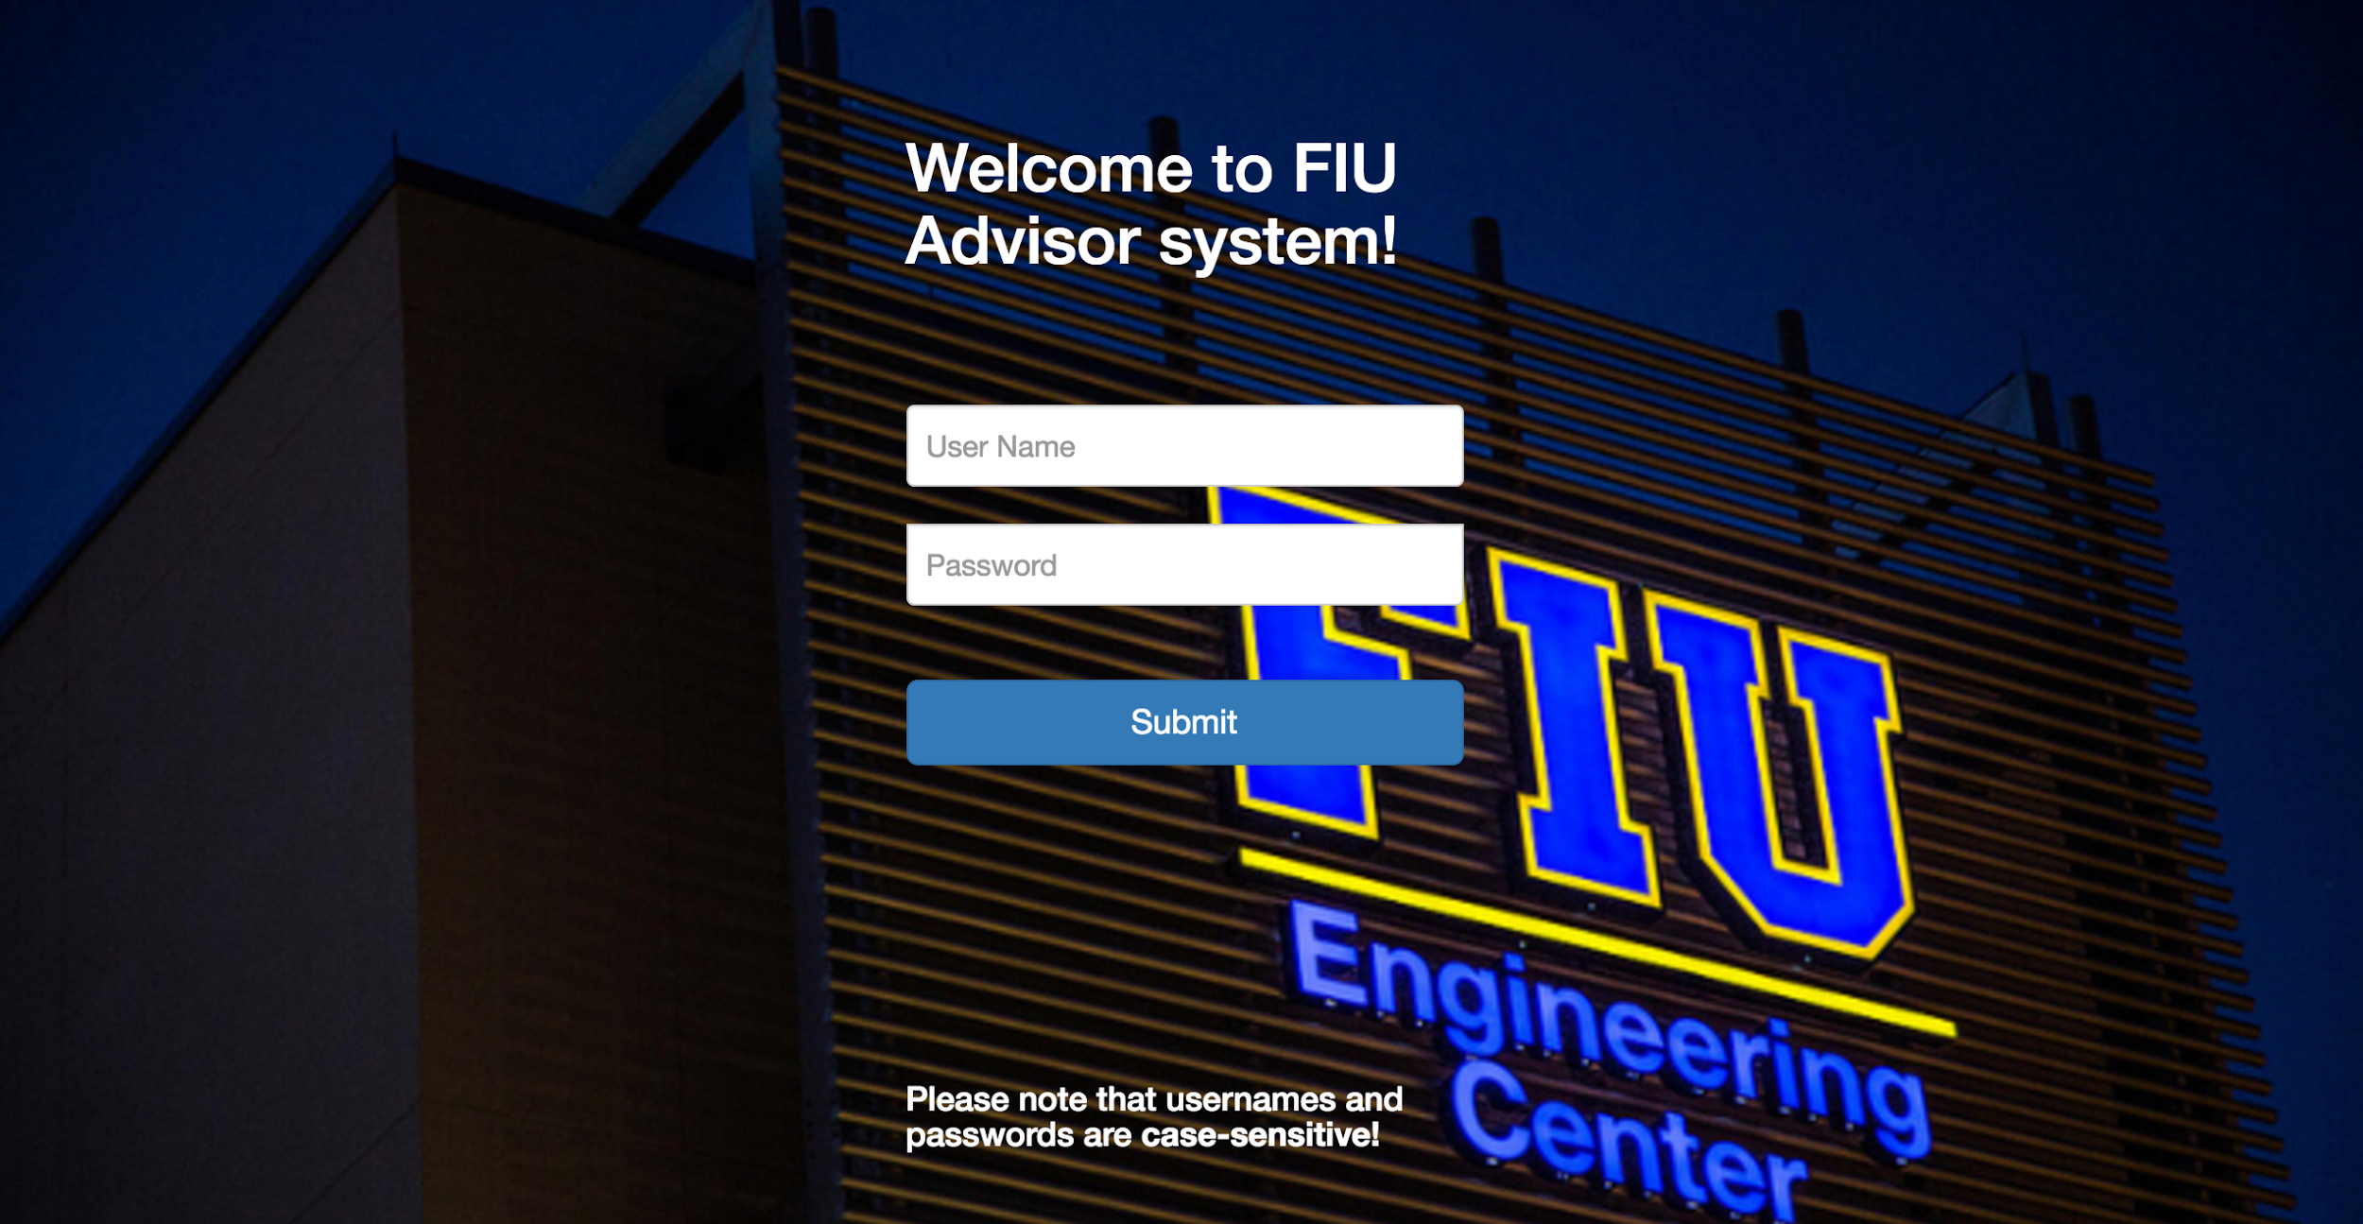
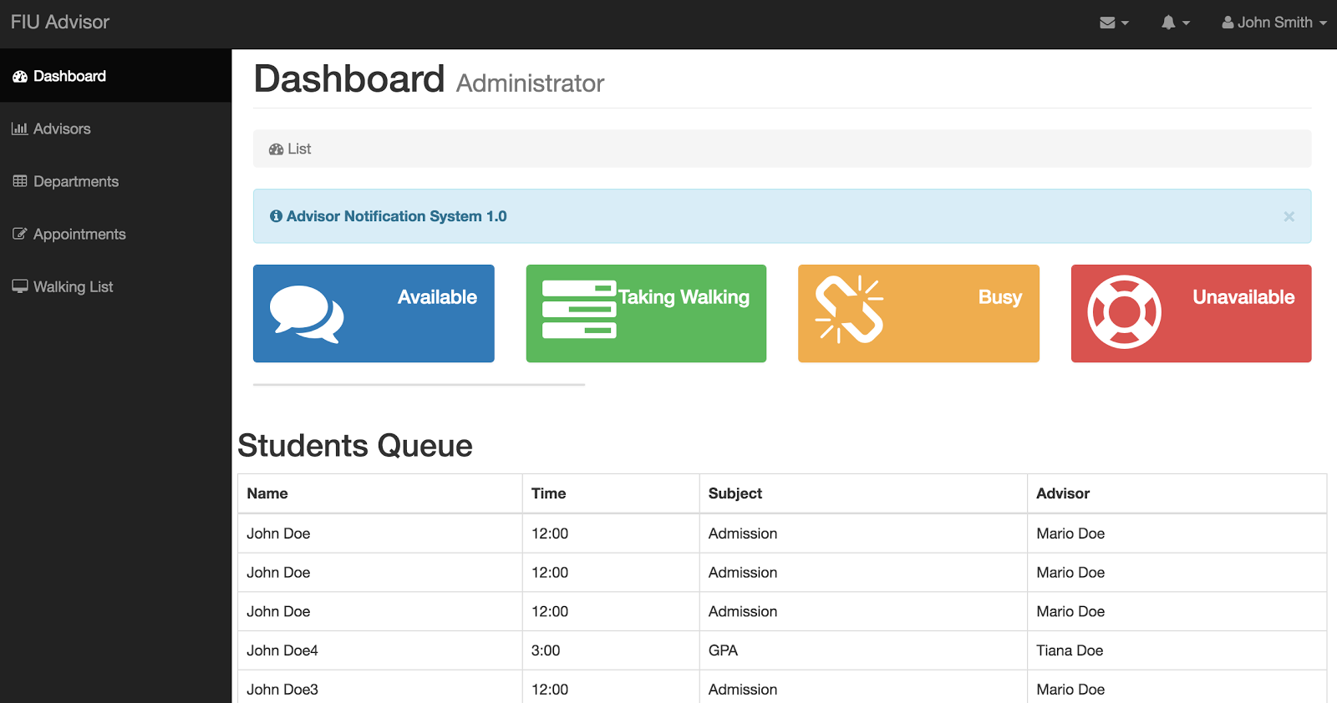
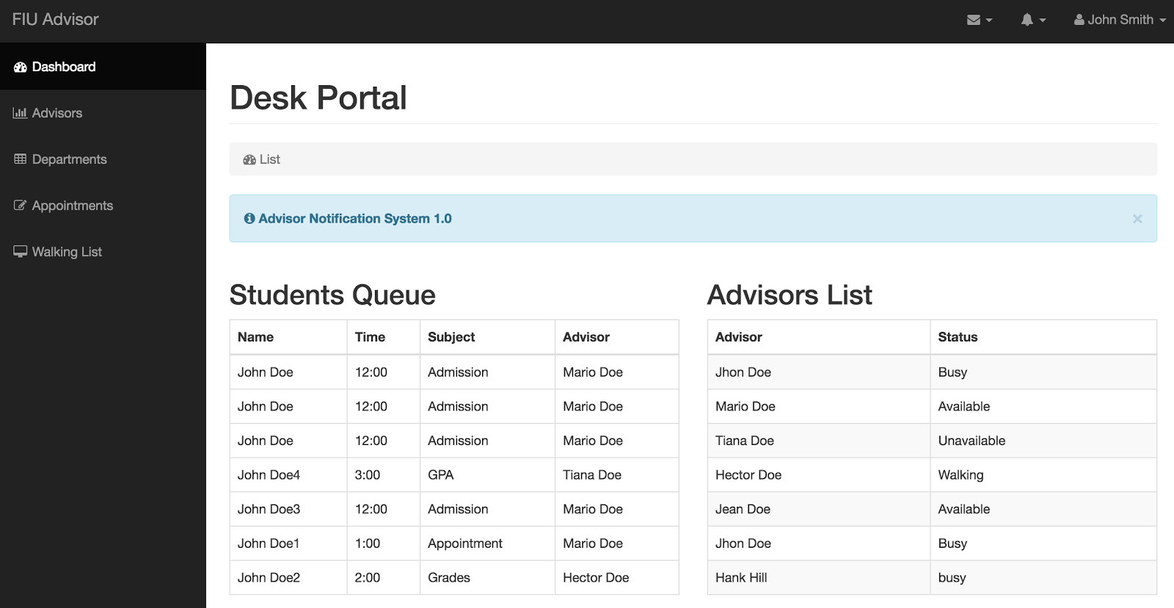
School of Computing & Information Sciences
Senior Project, 2016, Fall
ADVISOR AVAILABILITY NOTIFICATION SYSTEM
Student: Jean Tovar, Florida International University
Mentor: Mohsen Taheri, Mario Sanchez Florida International University
Instructor: Masoud Sadjadi, Florida International University
Problem
Current System
Requirements
College is a time of major transition for most students. Having just left the rigid organization of high school, or trying to re-enter the academic community after an absence. Research has found that 75% of students enter college without having final decisions made about their careers, or even majors that is why most college students are in a state of great change and in need of good advice.
When advisors are done advising student, they would either have to call the Front Desk by phone (many times the Front Desk line is busy) or walk to the Front Desk themselves to look at the list of walk-in students or appointments and call their name out loud. This takes time, reduces productivity and can be annoying.
Create a cross-platform application
User-friendly
Front Desk can see availability of the advisor and notify them.
Advisor can login in a system where they can inform to front desk their availability to advised.
Show in a clear way all the advisor available at the moment to advised.
Object Design
Verification
Solution
Sunny Day
We need to create a system where The advisors should be able to alert the front desk staff member via some kind of display visually and audibly (it can get noisy and busy at the front desk) that a specific advisor is now available to see a student. Also, the front desk attendant should be able to see on the display that a specific advisor is idle / busy with students / unavailable.
Purpose | Login into the system
Precondition | User exists in database and students are waiting.
Input | Front Desk username/password Student registration by front desk Student in queue to be advised.
Expected Result | Advisor available and notification is showed in advisor screen
Rainy Day
Purpose | Login into the system to advised
Precondition | User exists in database and students are waiting.
Input | Advisor username/password Advisor send notification to front desk Advisor is available to advised.
Expected Result | Notification never reached front desk screen.
Implementation
Netbeans IDE were used to create a cross-platform system
Rules and Data are stored in an MariaDB database in plain English
Apache is used as a web server to host the system.
PHP is used as a programming language to communicate with database.
HTML is used as a User Interface and as a language to show the system.
Jquery is used as a system to send notifications to user.
System Design
Screenshots
Summary
This project is the first release of Advisor notification system. The result provided by the rule engine can be modified after collecting data from the users.if the department grow and more advisor are available, the system can grow at the same pace as the department desire, so this become a very reliable system.
Acknowledgement
The material presented in this poster is based upon the work supported by Jean Tovar. I am thankful to the help that I received from my group member, Hector Borges, mentors, Mohsen Taheri, Mario Sanchez, and our instructor, Masoud Sadjadi.
Notes:
1

