Slide 1




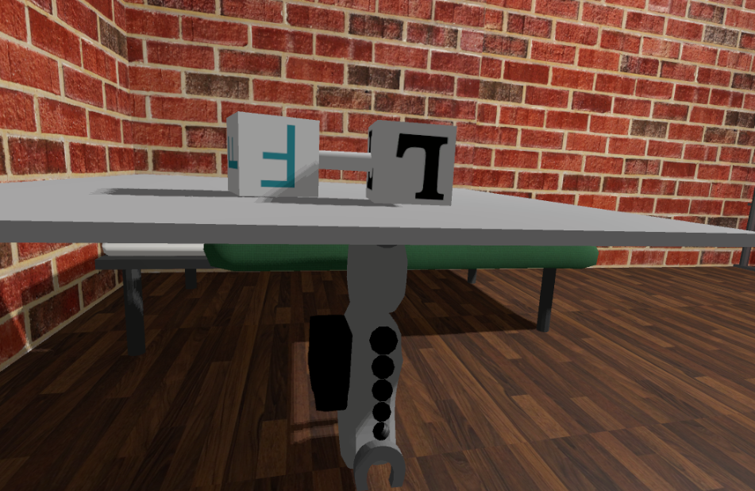
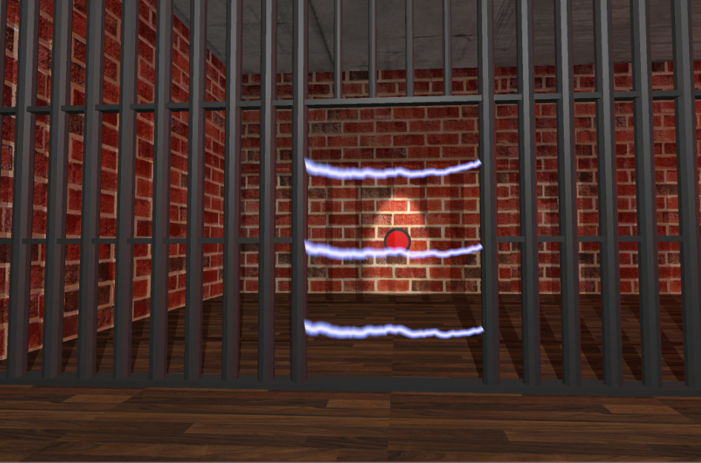
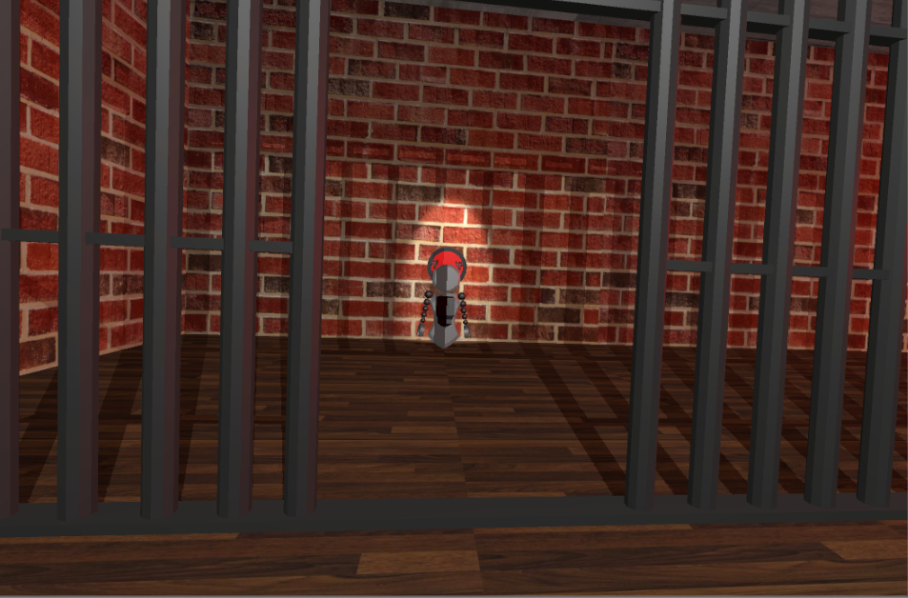
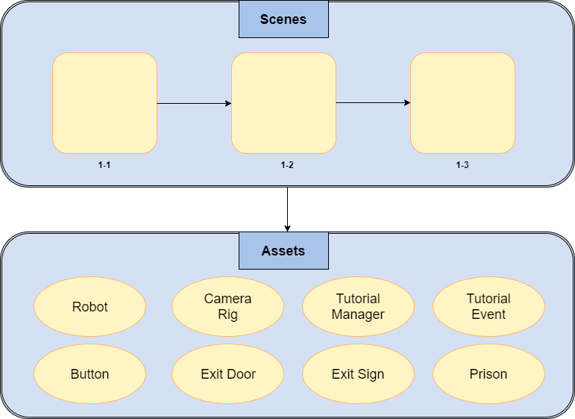



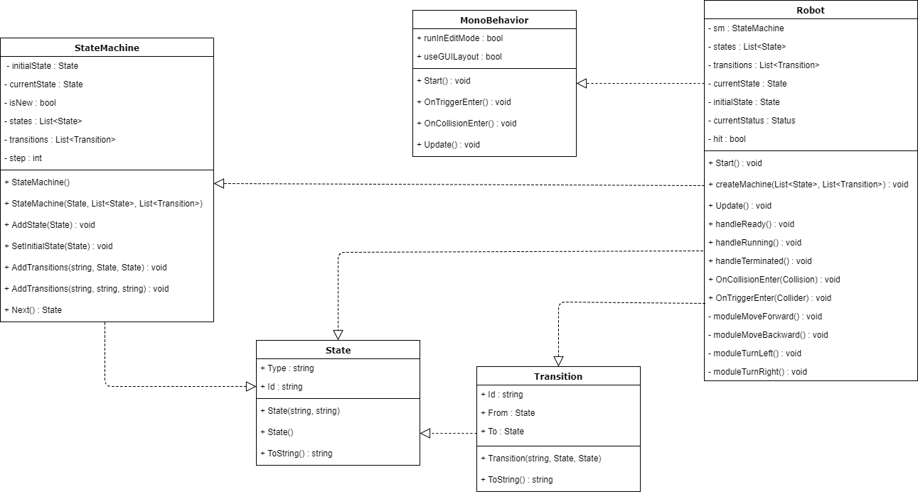
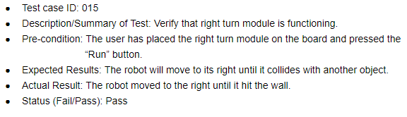
School of Computing & Information Sciences
VIP Senior, 2017, Fall
AR-VR-VE for Computer Science Education 1.0
Student: Nicolette Celli, Florida International University
Mentor: Francisco Ortega, Florida International University
Instructor: Masoud Sadjadi, Florida International University
Problem
Many students are intimidated by the difficulty of computer science
The retention rate in Computer Science is low
We need a simple introduction to computer science concepts that instills confidence in students
Solution
Video games can teach computer science concepts implicitly
Computer science becomes a more approachable topic for various students
Virtual reality allows for engaging and creative problem solving
Current System
User builds a state machine with modules to direct the robot to the button
The user creates transitions between modules to link directions
Currently consists of 3 levels
The first level has a tutorial
Screenshots
Requirements
Robot moves based on the state machine the player creates
Linking modules evaluates to changing direction
Objective is completed when the user successfully navigates the robot to the button
The game must be easy to understand and play
Tutorial is simple for players to follow
System Design
Implementation
HTC Vive
SteamVR Plugin
Unity3D Engine
C# Programming Language
Blender
Verification
For each user story, several tests were run to verify that said features were working and to prevent bugs. Below is an example:
Object Design
Summary
A video game that teaches computer science concepts makes this field more accessible
New students will be drawn to computer science
Instills confidence and proves that programming is achievable
Acknowledgement
The material presented in this poster is based upon the work supported by Nicolette Celli. I am thankful of the help that I received from my group members, Lukas Borges, Cristian Cabrera, Hamilton Chevez, Kevin Delamo, Filip Klepsa, and Francisco Lozada.
Notes:
1

