Slide 1



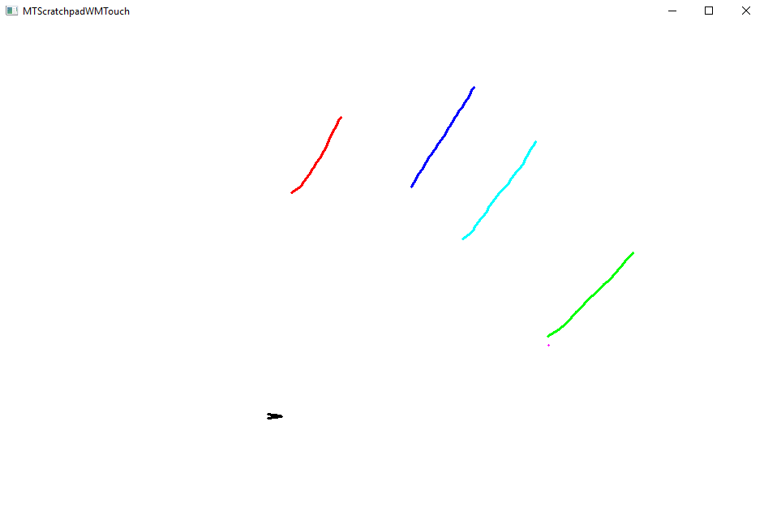
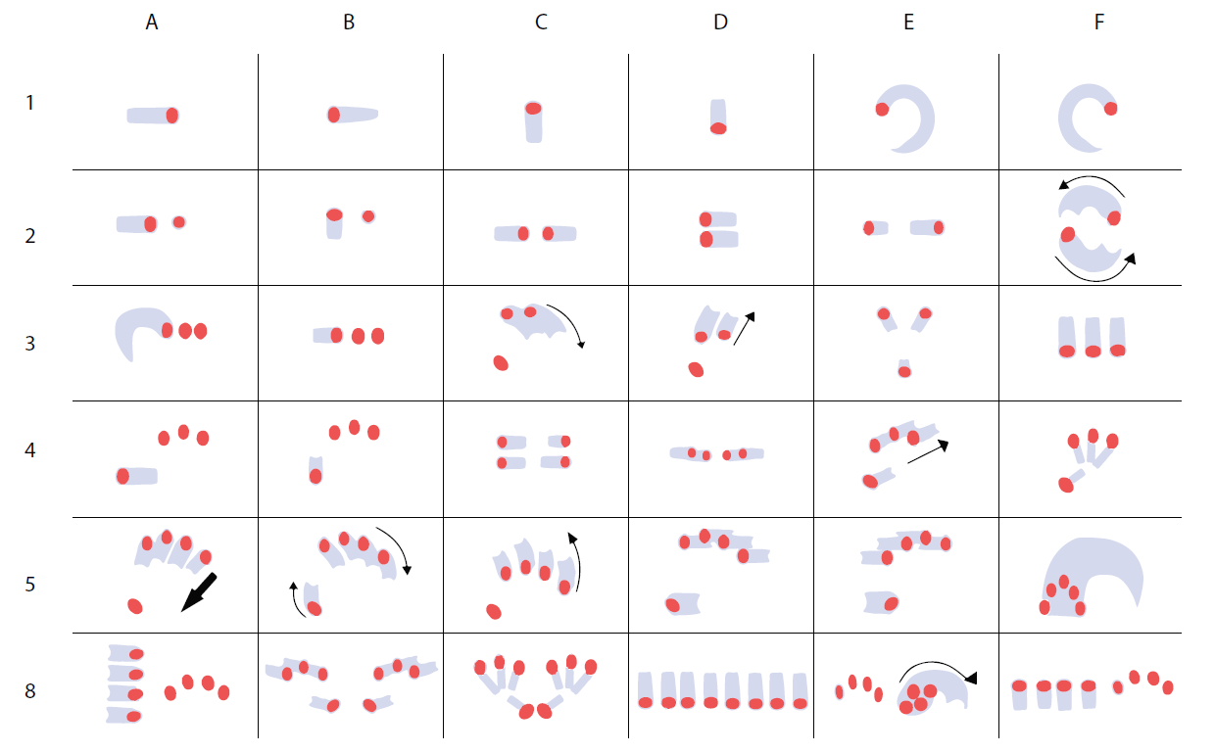
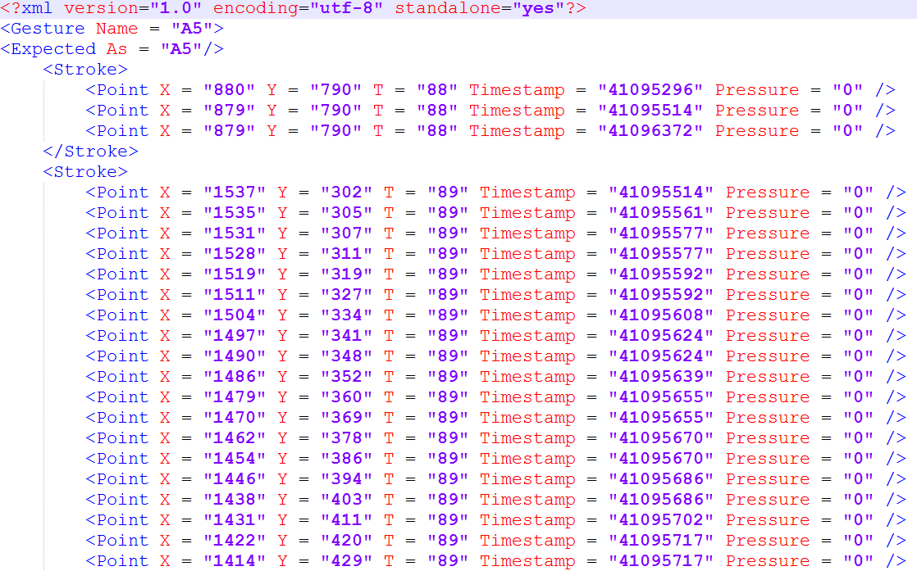
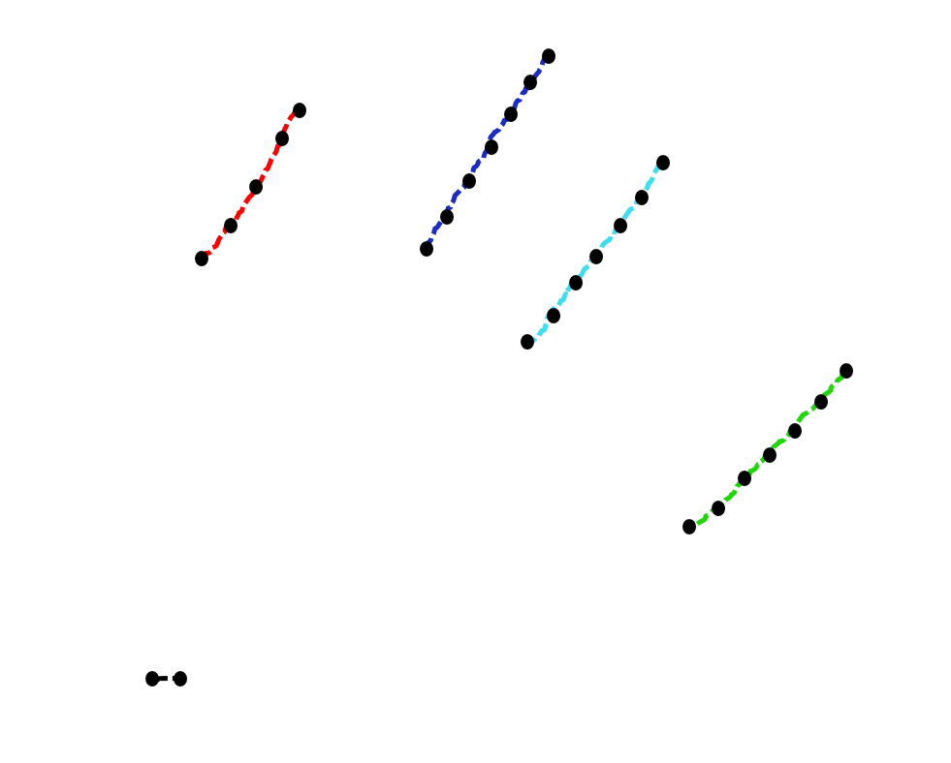
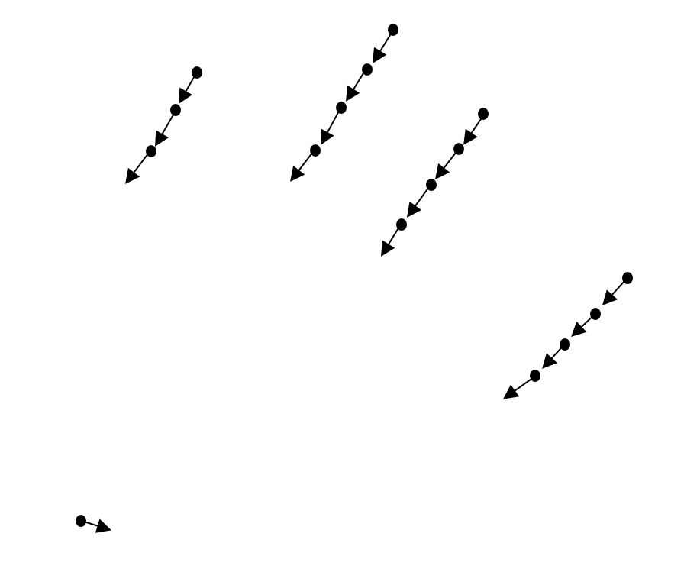
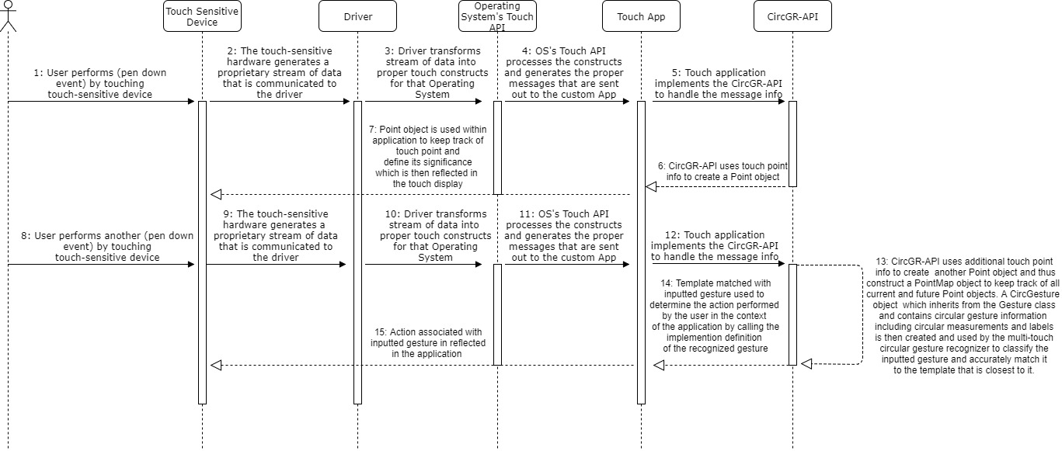


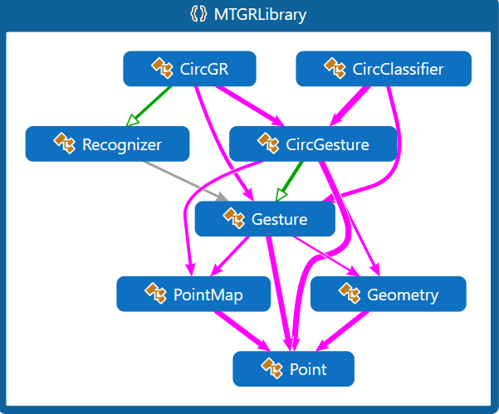

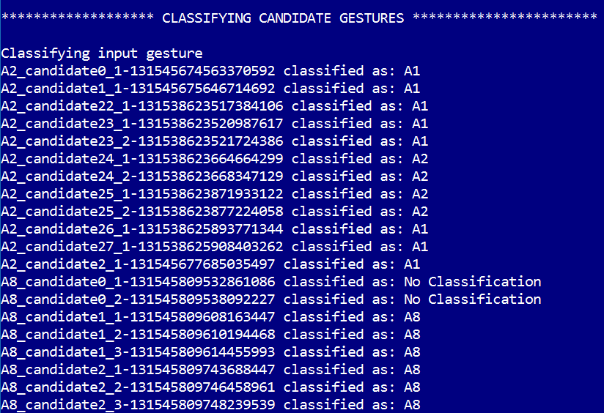
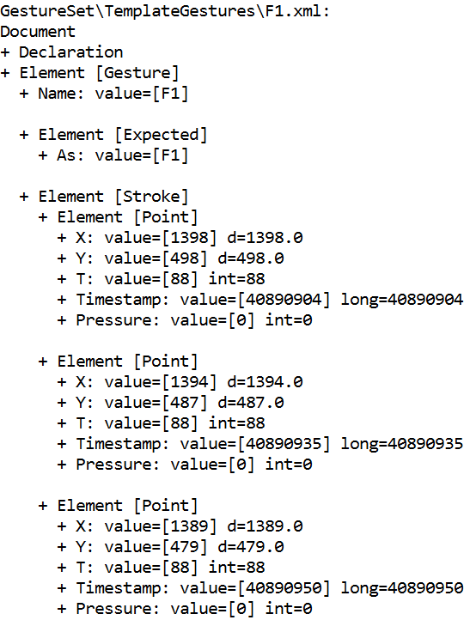
School of Computing & Information Sciences
AR-VR-VE for Computer Science Education:
Multi-Touch Circular Gesture Recognition C++ API
Student: Francisco Lozada, Florida International University
Mentor / Product Owner: Francisco R. Ortega, Florida International University
Instructor: Masoud Sadjadi & Francisco R. Ortega, Florida International University
VIP Senior, Fall 2017
Problem
Rewrite the multi-touch circular gesture recognizer as a C++ API which provides the following benefits:
Cross platform support
More lightweight; binaries are much smaller than C# after compilation
Faster performance
More interoperability and maintainability
Overall better solution to gesture designers
The multi-touch circular gesture recognizer solution created last semester was written in C# which presents the following limitations:
Mainly targets the Windows operating system making it more platform dependent
Contains a lot of overhead and included libraries before it will compile
Performance can be improved
Solution
Current System
C++ API for multi-touch, non-symbolic circular gesture recognition
API exhibits same worst-case time complexity as the one previously written in C#
API also contains same functionality as the one previously written in C#
Improved performance in parsing serialized gestures
Recognition Accuracy level still needs work to increase up to ACC 99% and MCC 0.95
Figure 1: Scratchpad Application Created to Input Candidate Gestures Using Touch-Capable Device
Figure 2: Complete Gesture Set Used For Testing the API
Figure 3: Serialized gesture using XML DOM structure
Requirements
System Design
Implementation
The translation to C++ should have the same following qualities as the preexisting C# implementation:
Same functionality
Same level of accuracy when detecting multi-touch circular gestures
Same overall worst-case time complexity
Translated over 3,000 lines of C# code to C++ to recreate the multi-touch circular gesture recognition API.
Figure 4: Sequence Diagram of Multi-touch Circular Gesture Recognition API being Implemented on the Scratchpad
Verification
Object Design
Summary
Parsed and set the complete gesture set in Figure 2 as the “template” gestures for the multi-touch gesture recognizer.
Parsed all inputted “candidate” gestures collected last semester and compared against template gestures to determine best match using the C++ API.
Created C++ API.
Implemented a gesture parser using the TinyXml library to obtain raw point input data from previously serialized gestures.
Provided insight into the shortcoming of translating from C# to C++ and what major modifications must be done in the class structures to improve performance and maintainability.
Figure 4: Classification Results for Comparison of Inputted Candidate Gestures Against Template Gestures
Figure 5: Parsed Gesture Printed to Standard Output
Figure 6: Class Dependencies
Acknowledgement
The material presented in this poster is based upon the work contributed by Ruben Balcazar, Francisco R. Ortega, Katherine Tarre, Armando Barreto, Mark Weiss, and Naphtali D. Rishe. I am thankful for the help I received from my product owner Francisco R. Ortega who guided me in the right direction whenever I was presented with a challenge.
Notes:
1

