Slide 1



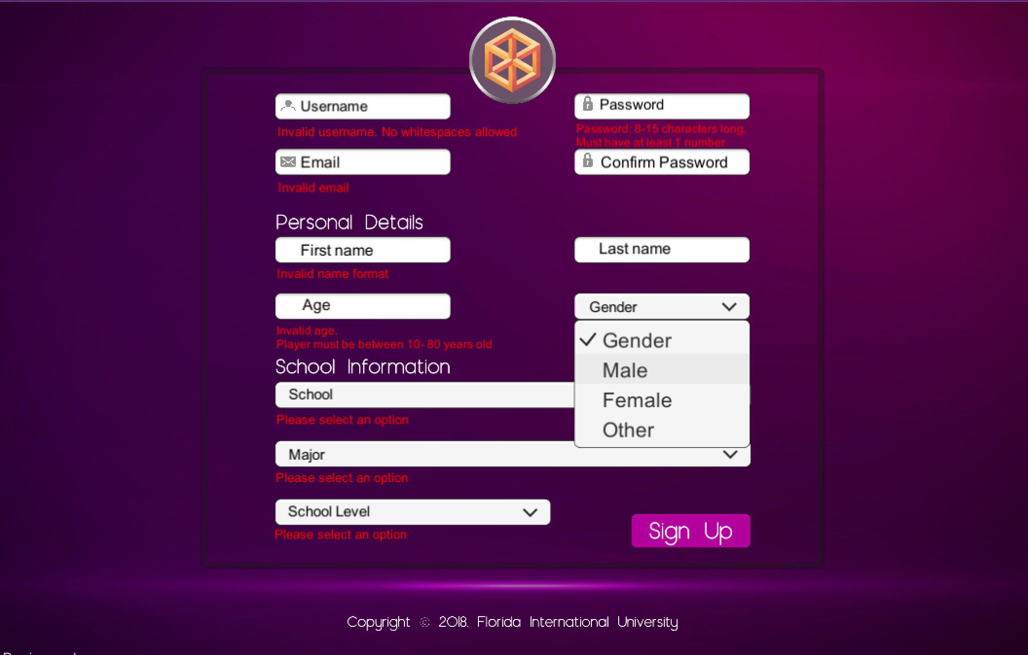
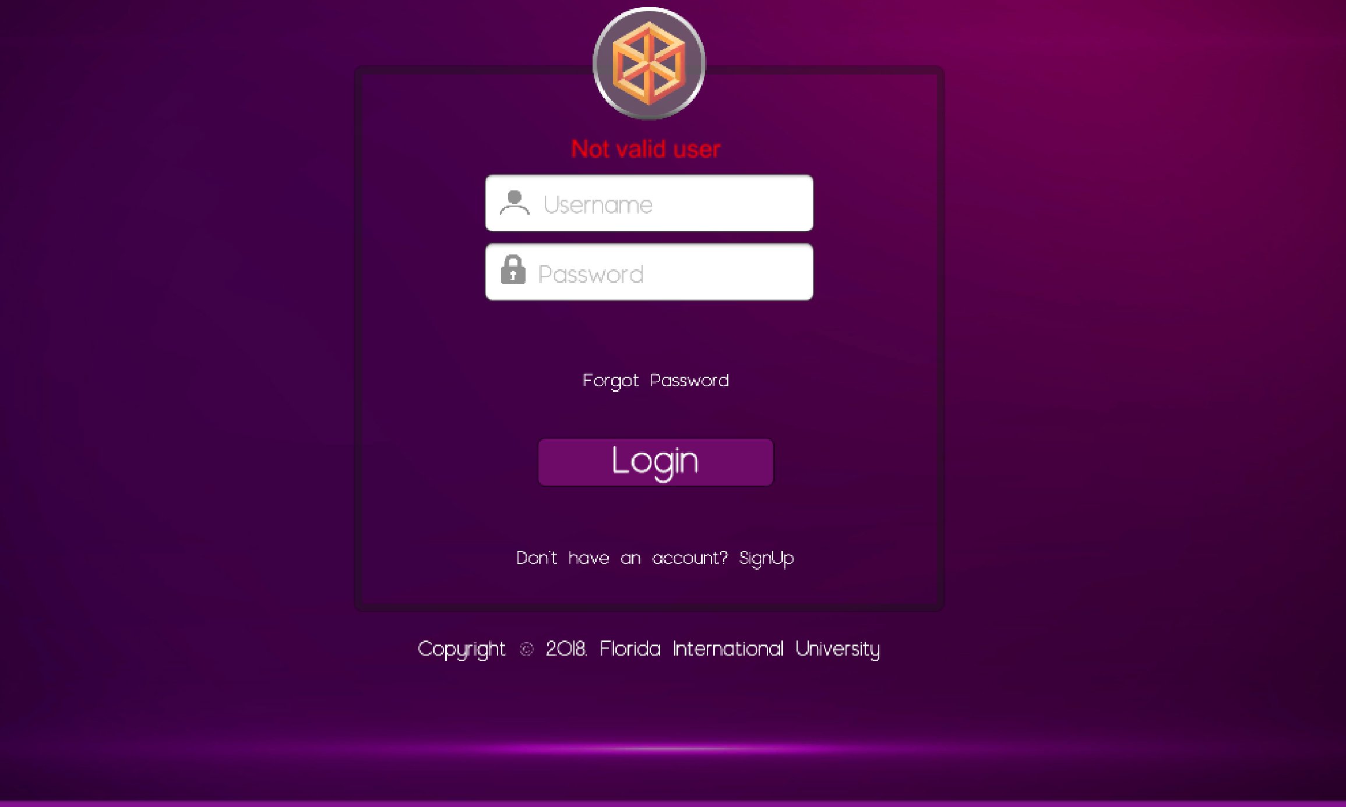



Senior Project 2018, Spring
AR-VR-VE for Computer Science
Student: Samira Tellez, Florida International University
Mentor: Dr. Francisco Ortega, School of Computing and Information Sciences
Professor: Masoud Sadjadi, Francisco Ortega, Florida International University
Problem
Computer Science and the tech industry in general has been showing lack of diversity in college level as in the workplace in spite of the increasing number of jobs available in the field. Women are one of the group most underrepresented. There are several reasons behind this issue.
Solution
The education system is key in bringing diversity. We developed a video game that goes into very basic programming concepts.
1.We need to provide users an appropriate user interface to enter their information, which will help us to make further conclusions about the underrepresentation issue.
2.Music background and sound effects to engage players with the flow of the game.
Current System
Current version :
1.Made in VR and not widely accessible.
2.It teaches just a few basic concepts in programming.
Screenshots
Requirements
Before users start playing, it is required for them enter some information (personal and school information) through a validated registration form:
1.Name, Last name, Unique username
2.Email
3.Password
4.Confirmation password
5.Age(to be between 10-60)
6.Gender
7.Major, School Year, School
Implementation
Unity engine for basic layout
C# for scripts on layout and validation of registration forms
GitHub
Verification
1.Dropdown menus were used to guide users on options to select, decreasing the probabilities of blank fields.
2.Users need to provide valid information that is sent to the backend, otherwise it is notify with warming messages .
3.Sounds effects are used when wrong data is entered and/or successful data is entered to make more understandable the whole registration process.
Summary
As part of the education process needed to include more people into computer science , the development of this game is a very effective approach. The goal is to bring more young students from colleges in other majors and help finish the women underrepresentation.
Acknowledgement
The material presented in this poster is based upon the work supported by Arelys Alvarez, Mairim Barrios, Fidel Hernandez and Carlos Martinez. I am thankful to the help that I received from my group members, … .
Notes:
1

