Slide 1











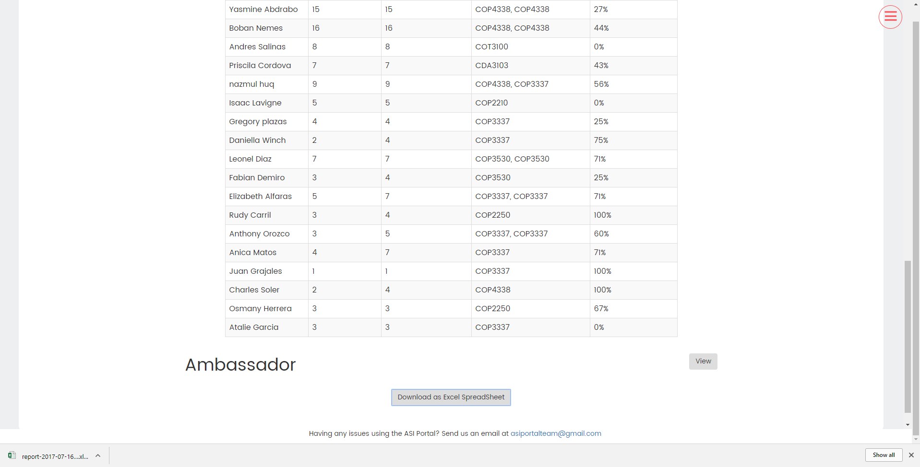
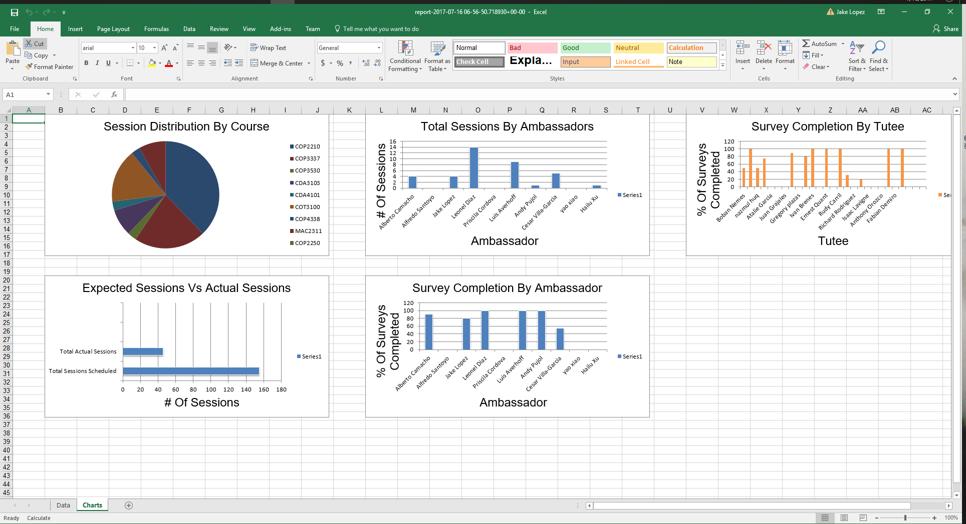
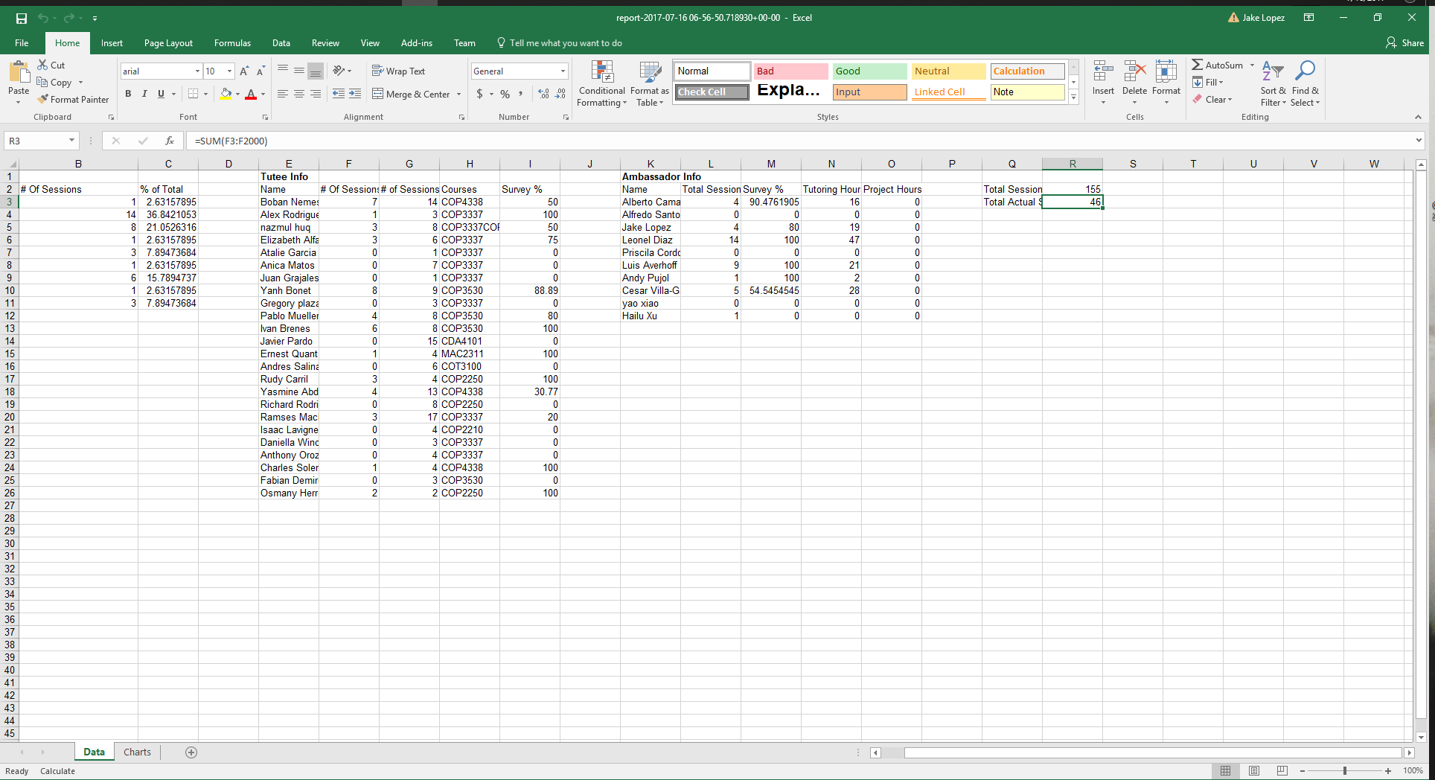
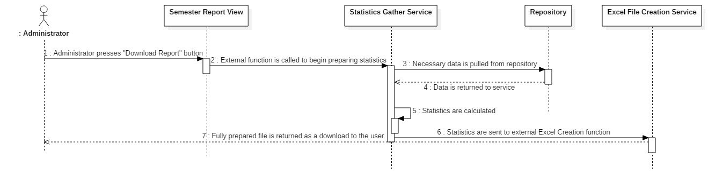
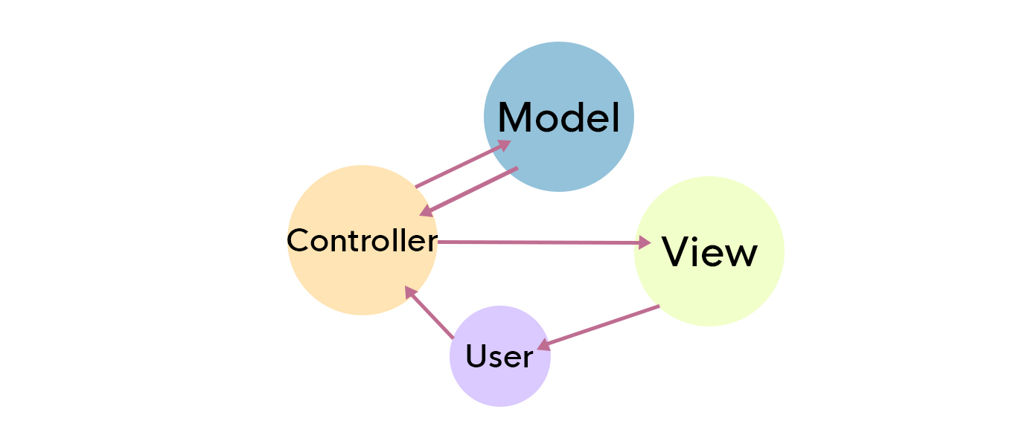
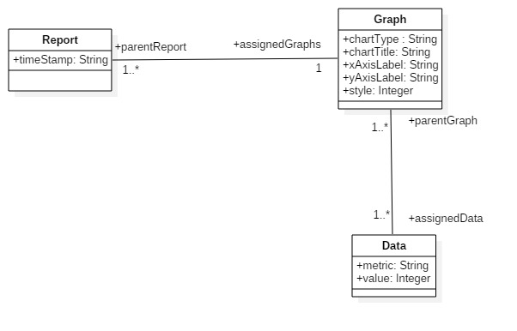
School of Computing & Information Sciences
VIP, Summer, 2017
ASI PantherCentric 1.0
Student: Jake Lopez, Florida International University
Mentor: Francisco Ortega, Instructor
Instructor: Masoud Sadjadi, Florida International University
Problem
Reports about the organization are time consuming to create.
These reports are currently made manually.
If the report is needed at a moments notice then there is no way to generate one.
Solution
There should be a way to download an Excel spreadsheet with the report.
The report should contain statistics of everything up to the date of generation.
Current System
Reports are created by a single employee, the Logistic Director.
It is a laborious and time consuming process.
It may take days to complete an accurate and detailed report.
Screenshots
Requirements
Output should be an Excel spreadsheet.
The raw data as well as charts should be included.
The data should be from beginning of semester till point of generation.
System Design
Implementation
Django - a python based web framework.
PostgreSQL - a relational database.
Redis - an in memory database.
Openpyxl - python library for creating and manipulating Excel documents.
Verification
Automated tests were written using the Django test runner and the unittest python library to confirm the accuracy of the statistics functions.
Testing the resulting excel files for accuracy was done manually.
Object Design
Summary
The addition of these new features will allow for less time to be spent in gathering and preparing reports and more time to be spent tutoring.
These features will also allow for a more concise way of tracking progress and effectiveness of the ASI program.
Acknowledgement
I would like to thank Myrian Herlle for her input and involvement in this project. I would like to thank my team members Alfredo Santoyo, Priscilla Cordova, and Rolando Moreno for their contribution to this project. I would like to thank Dr. Francisco Ortega for offering direction in how to improve this project as well as Dr. Masoud Sadjadi the instructor of this course.
Notes:
1

