Slide 1












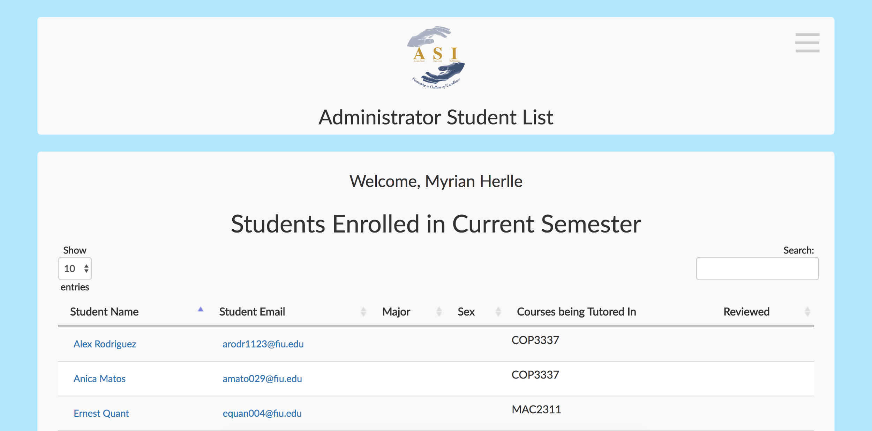
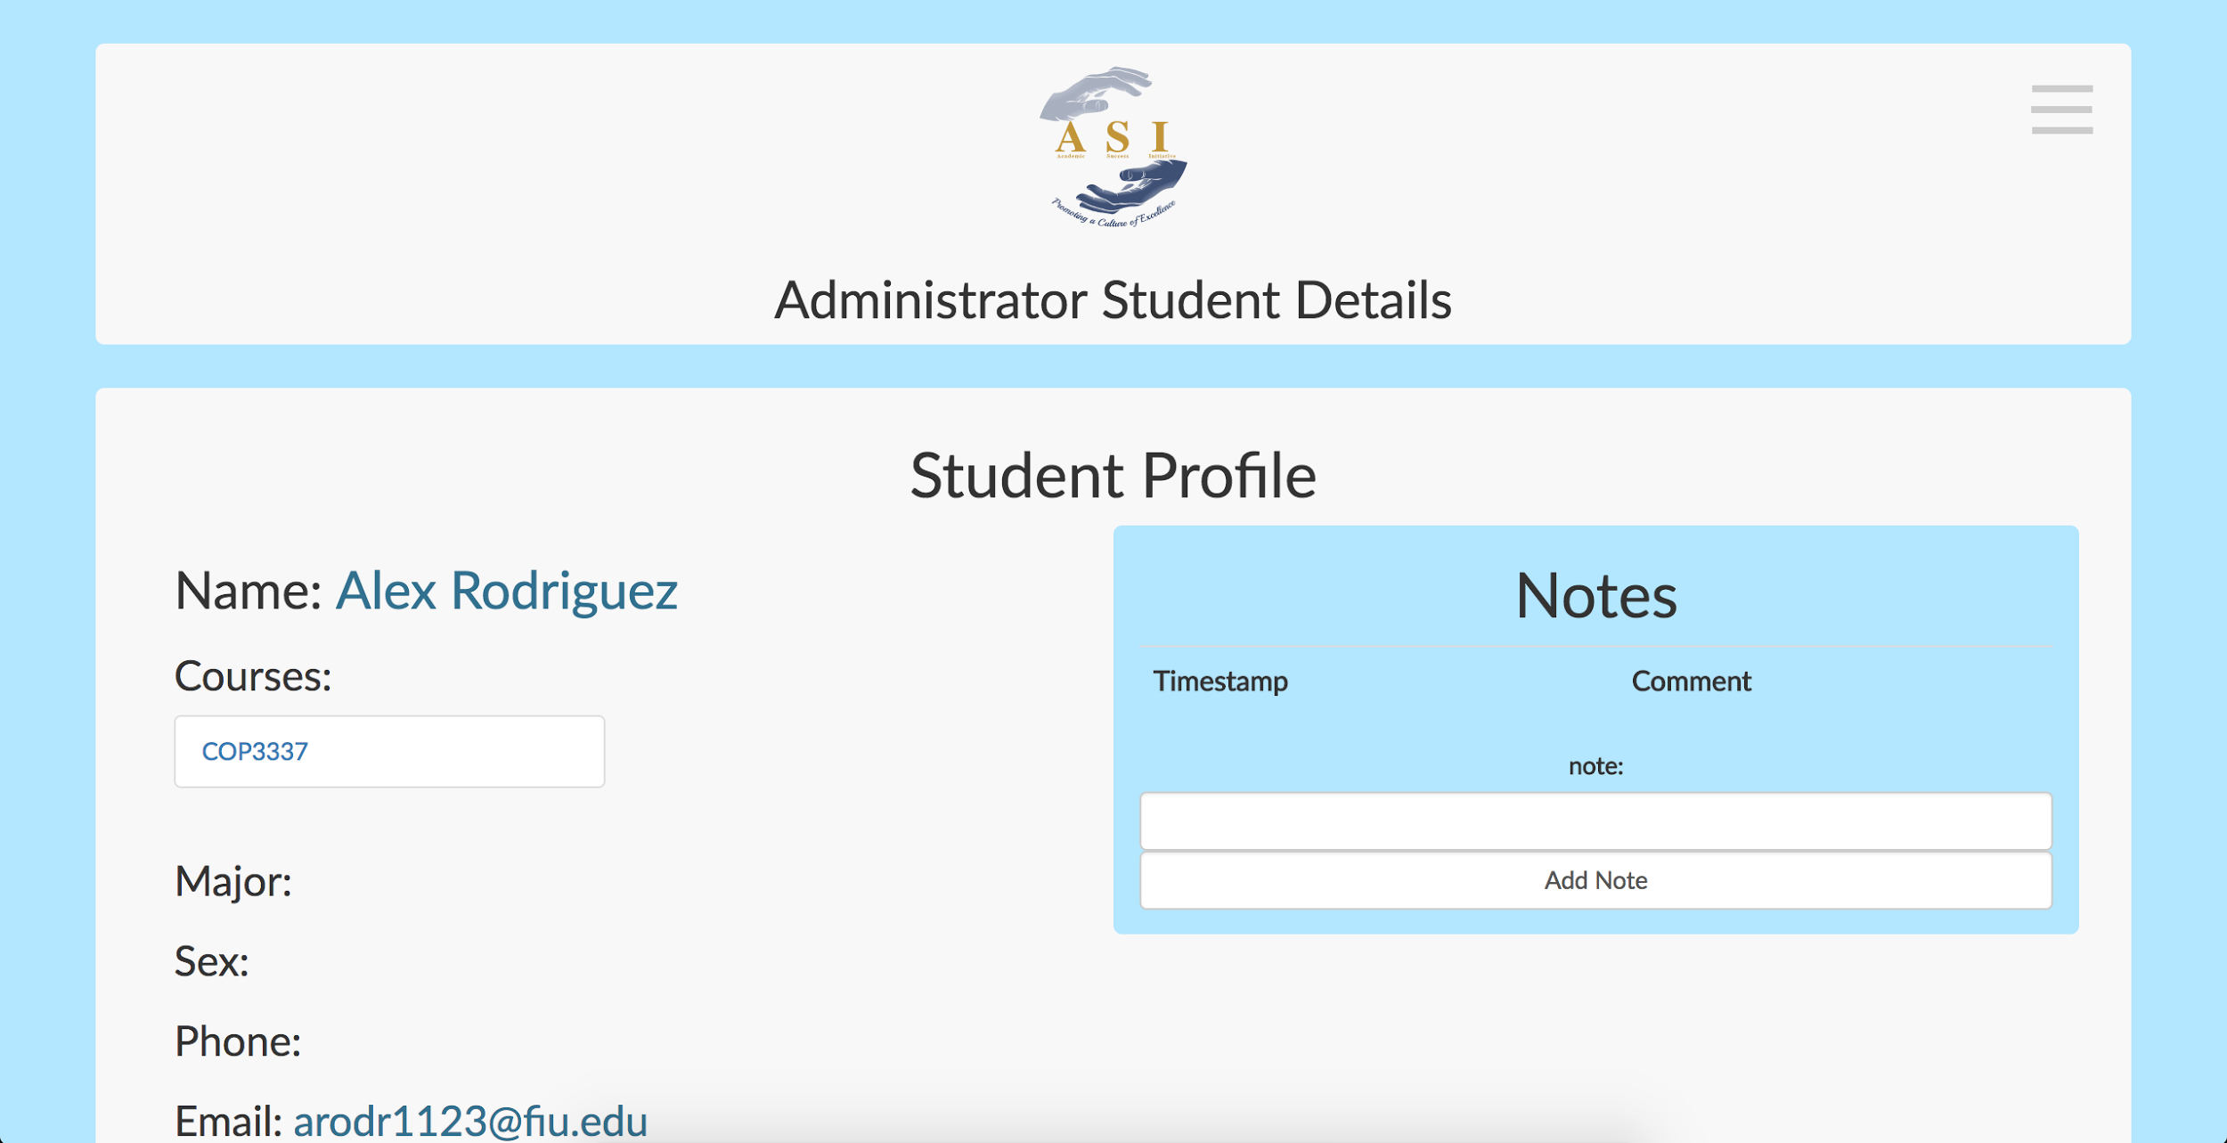
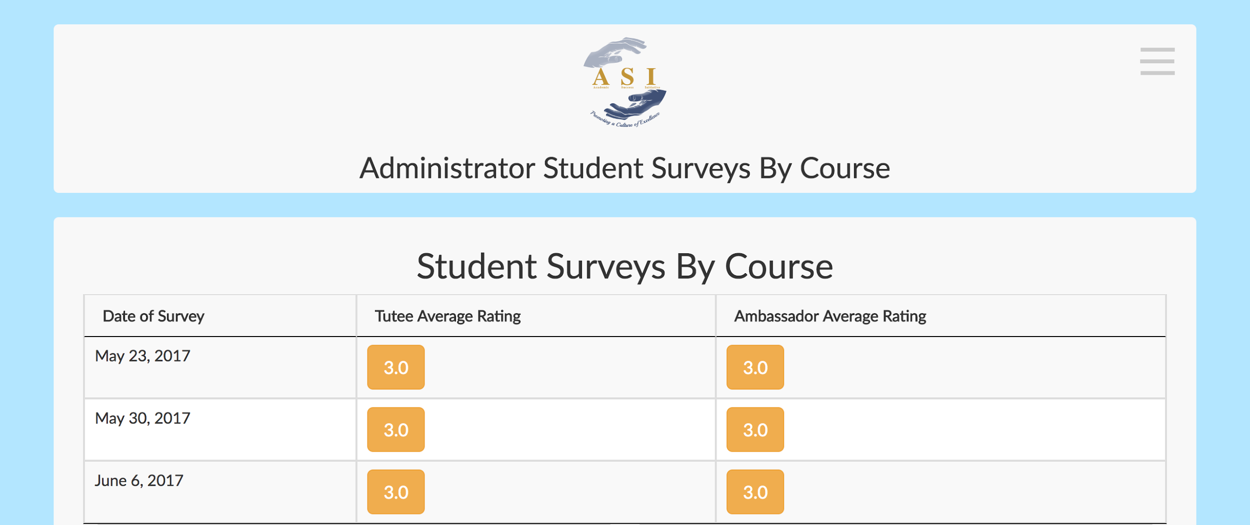
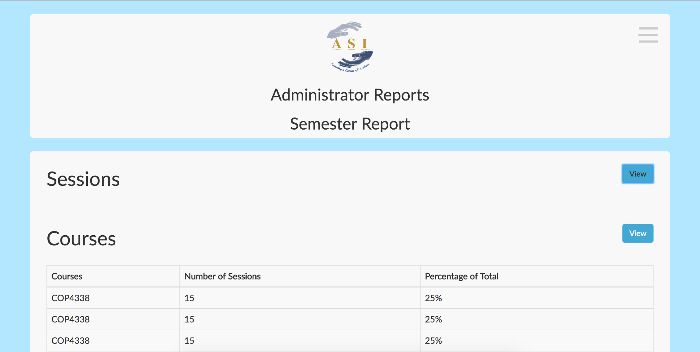
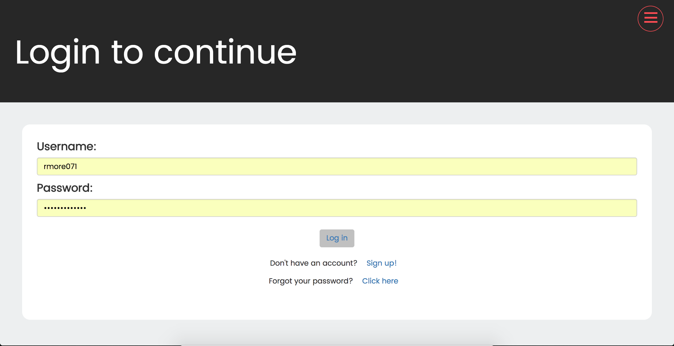
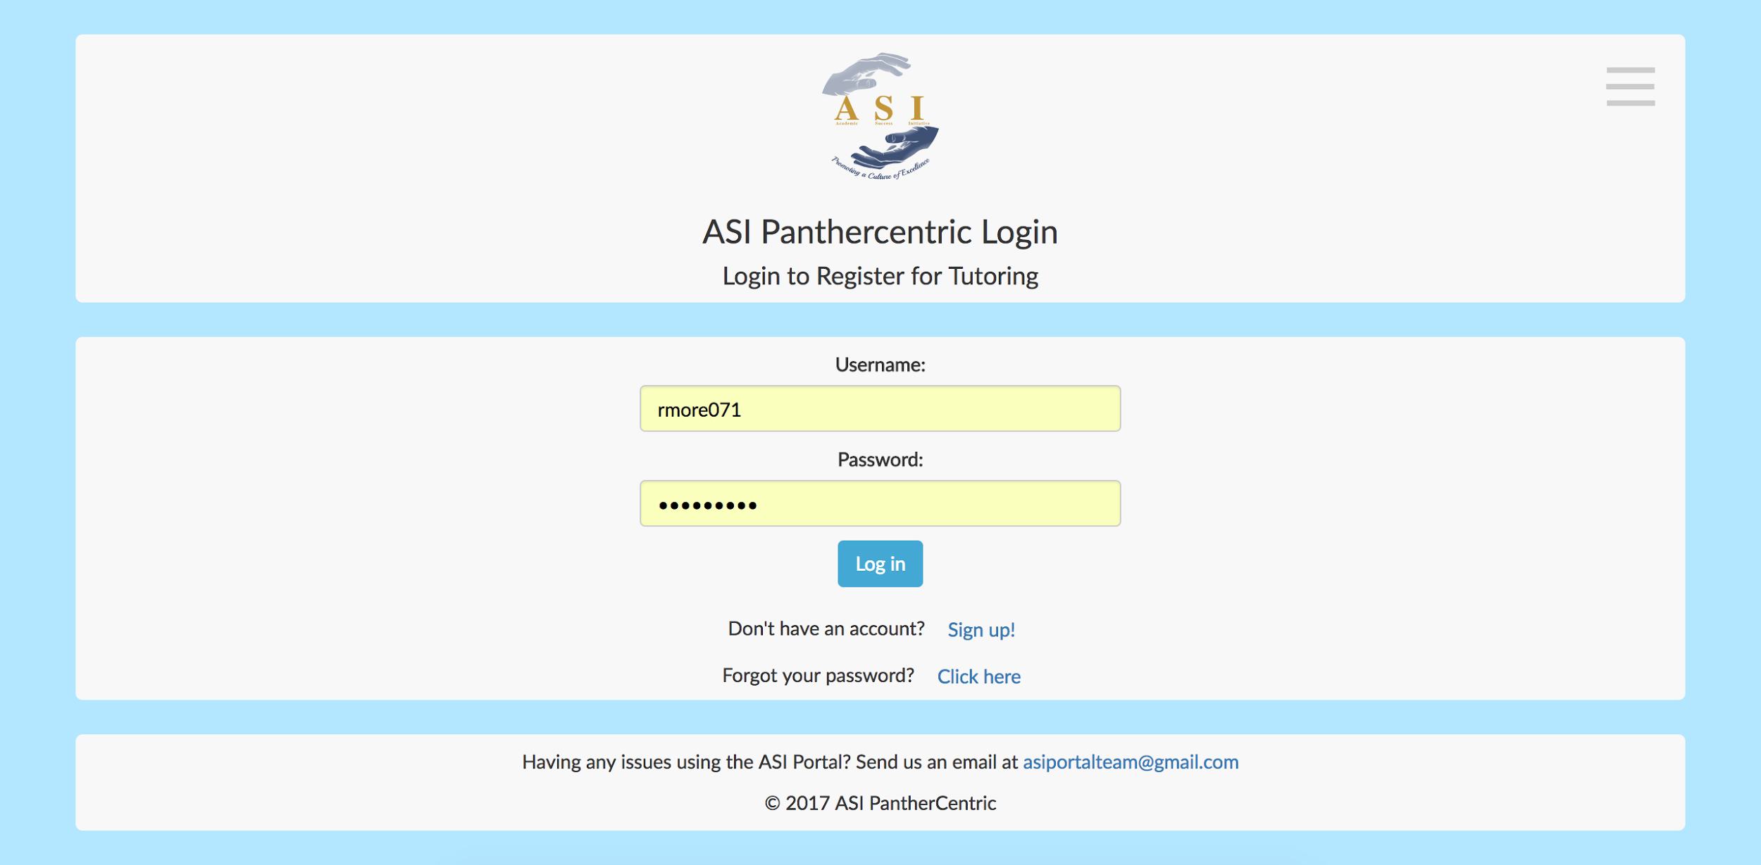
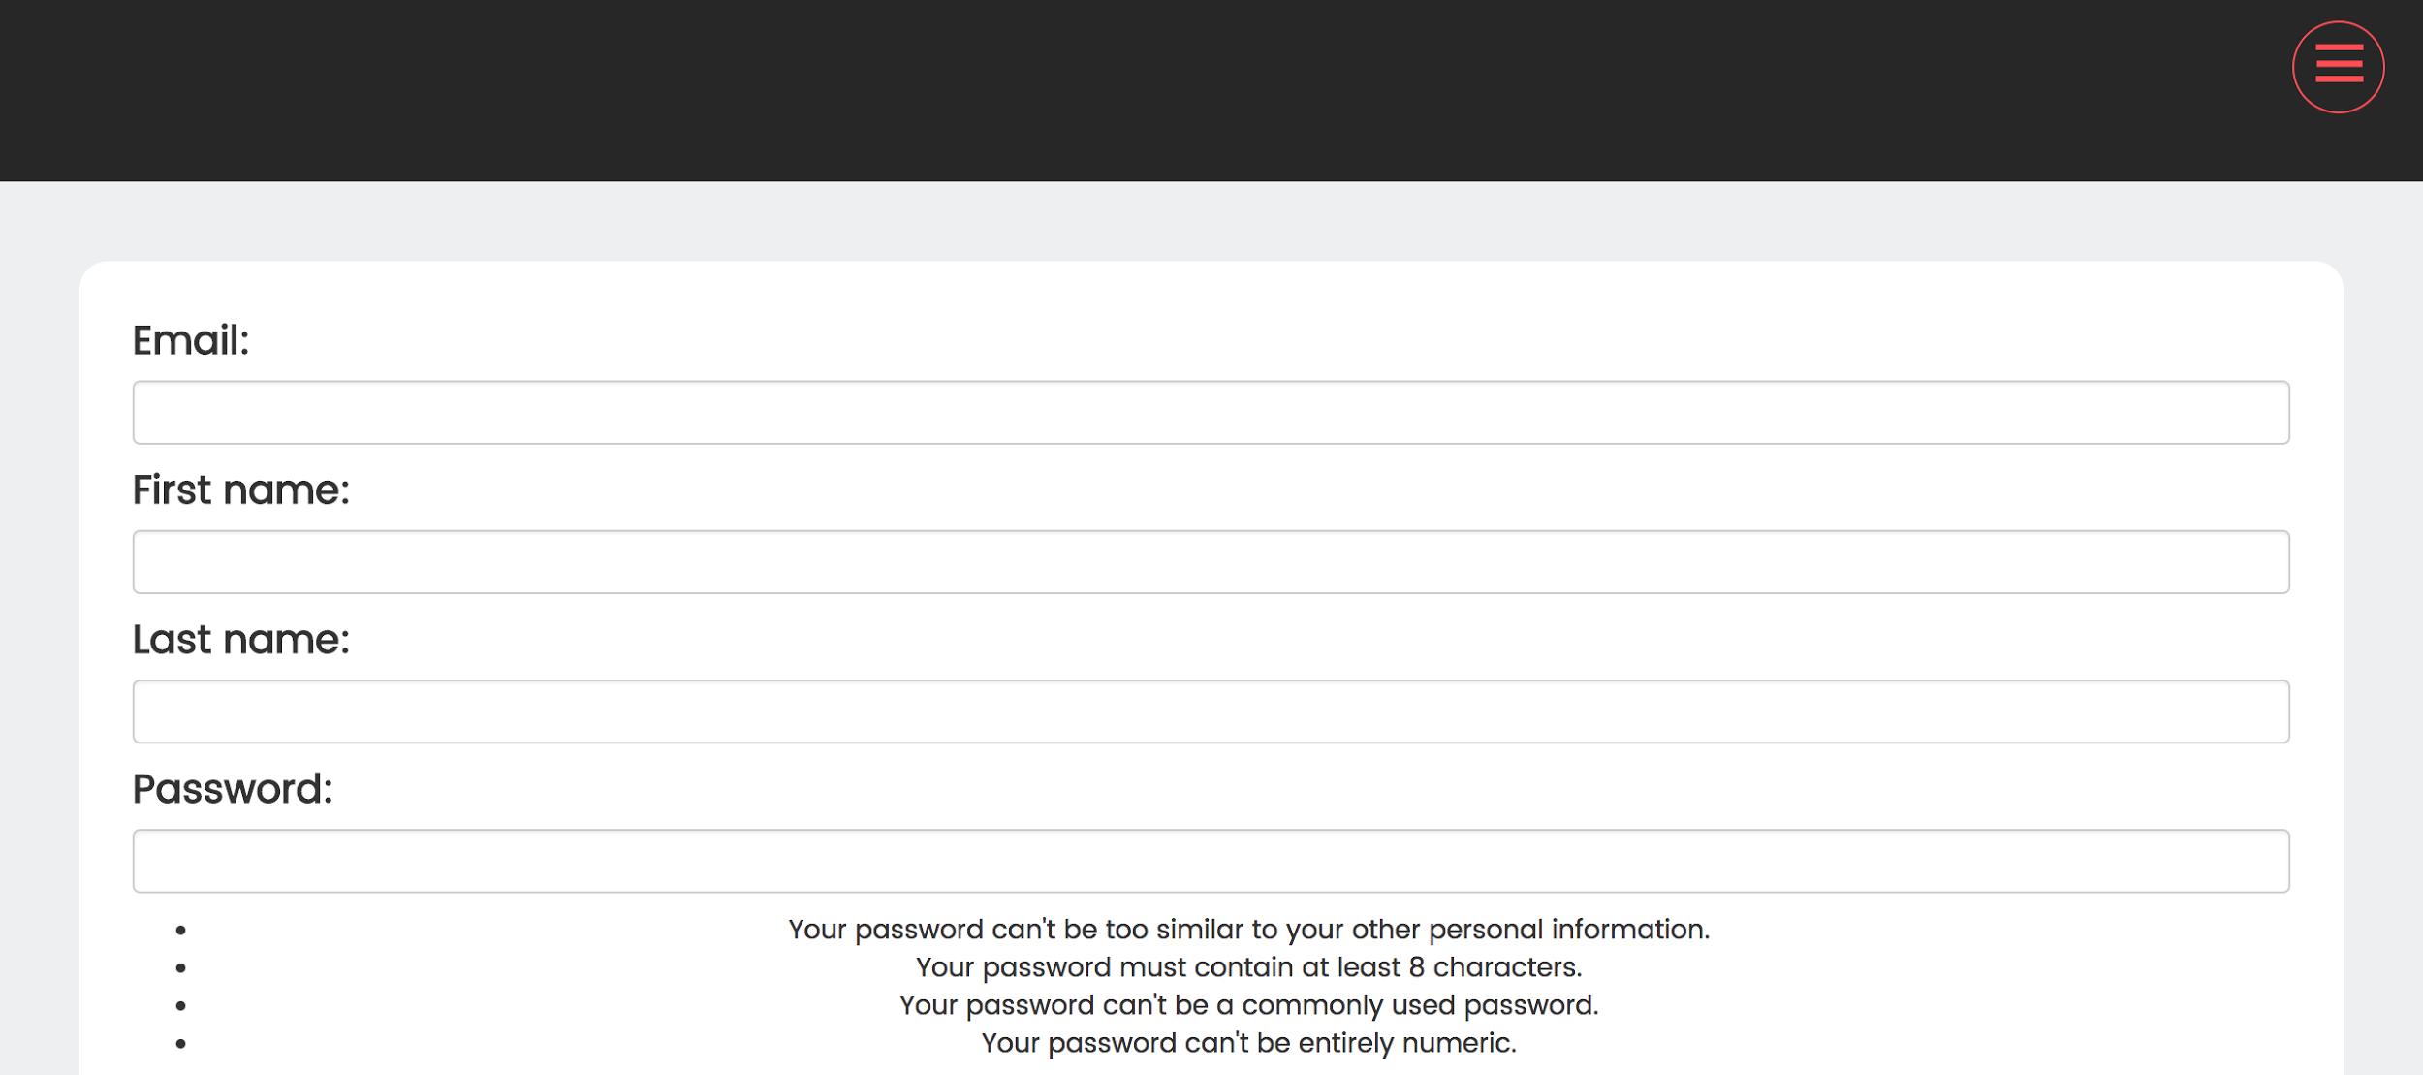
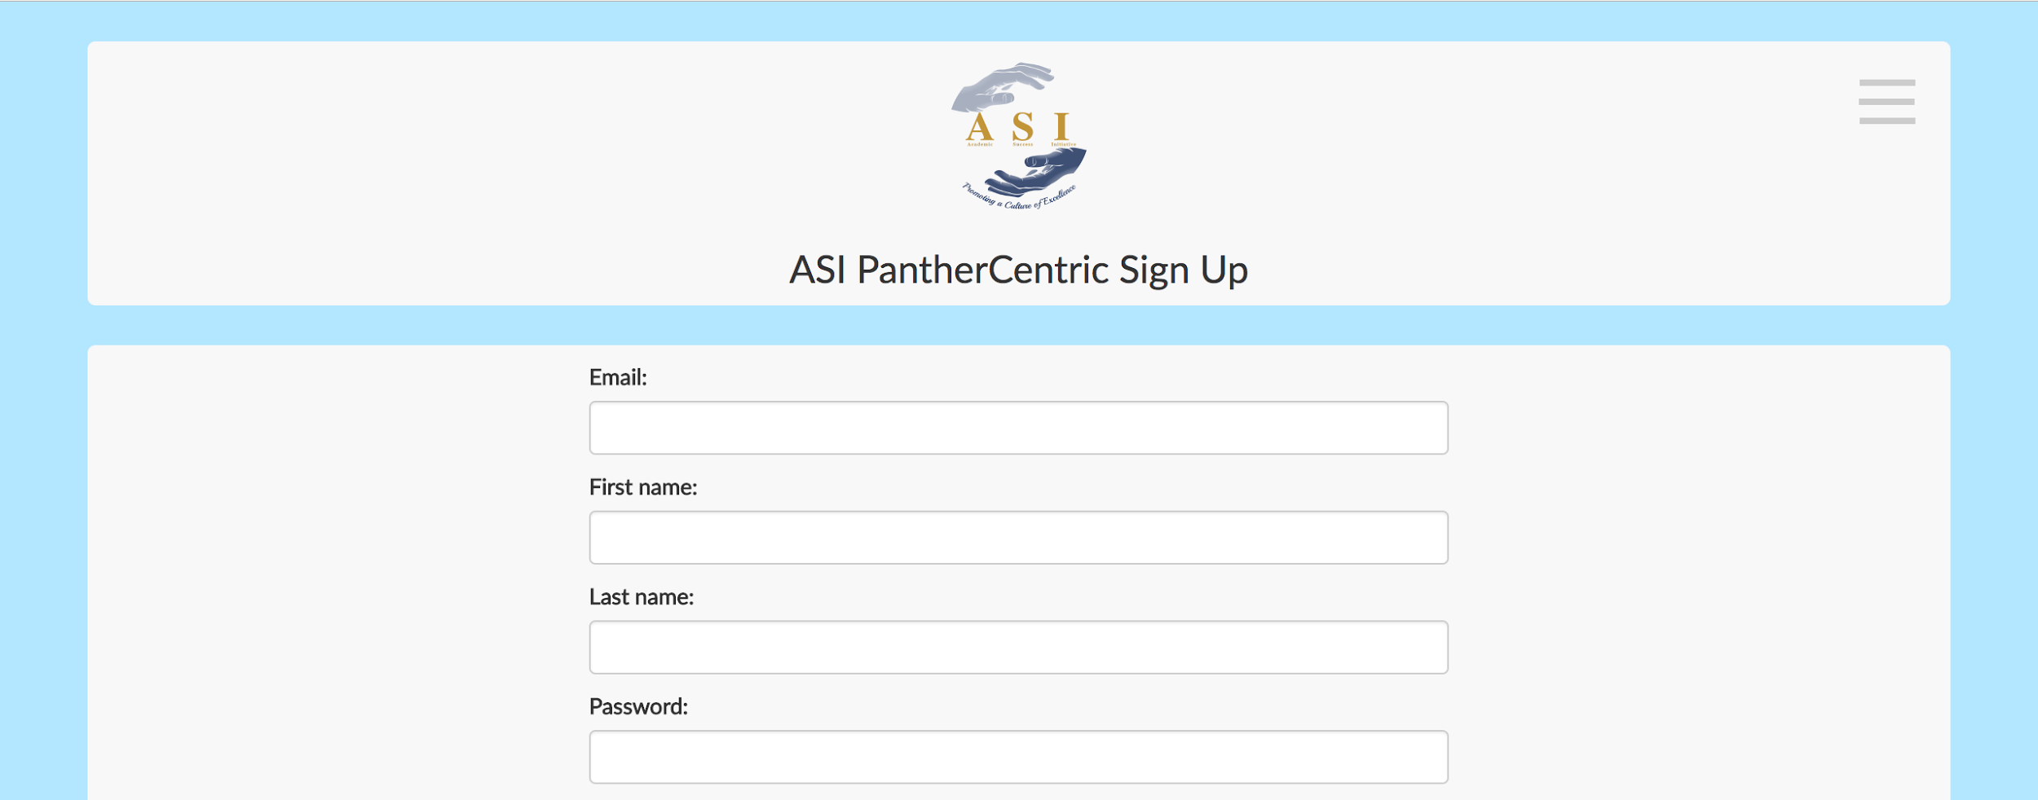
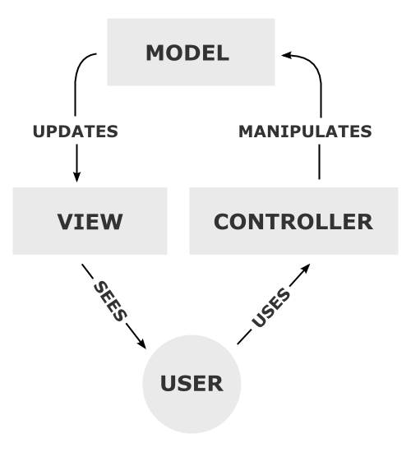
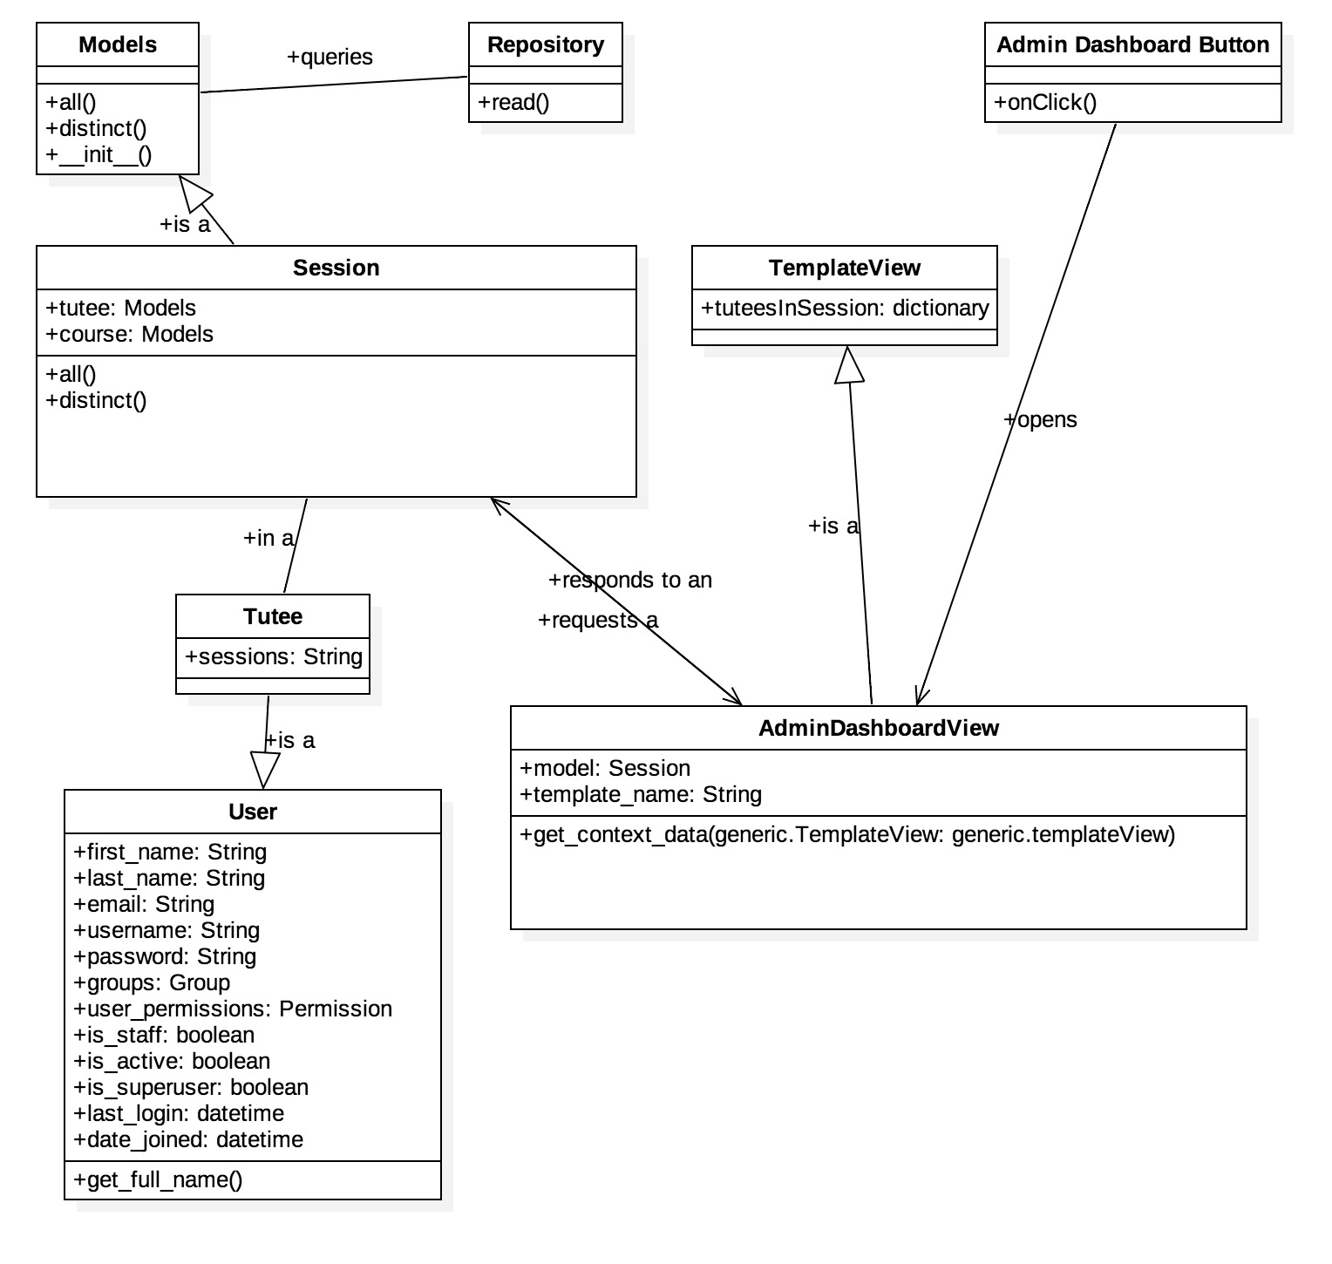
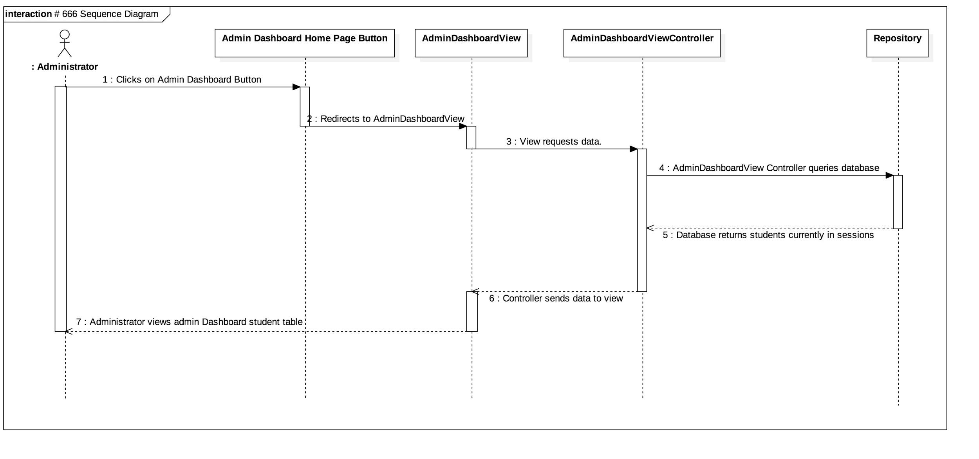
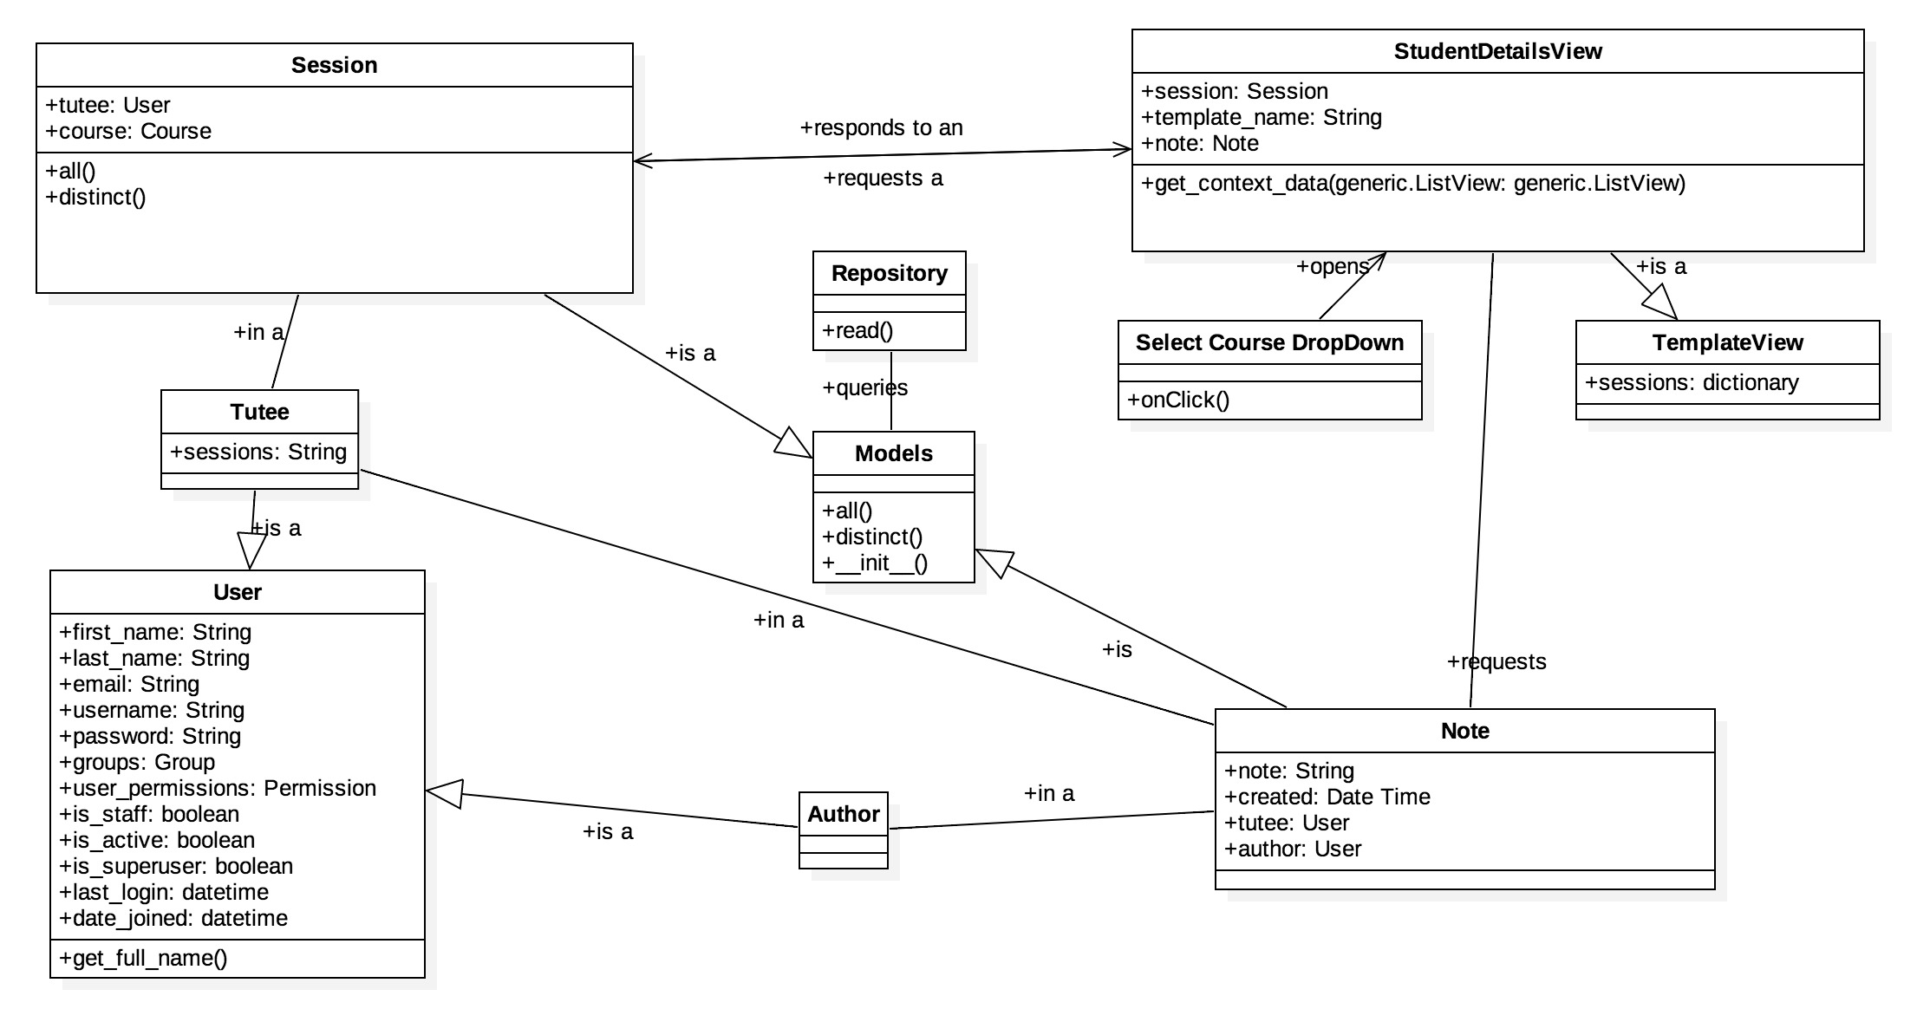
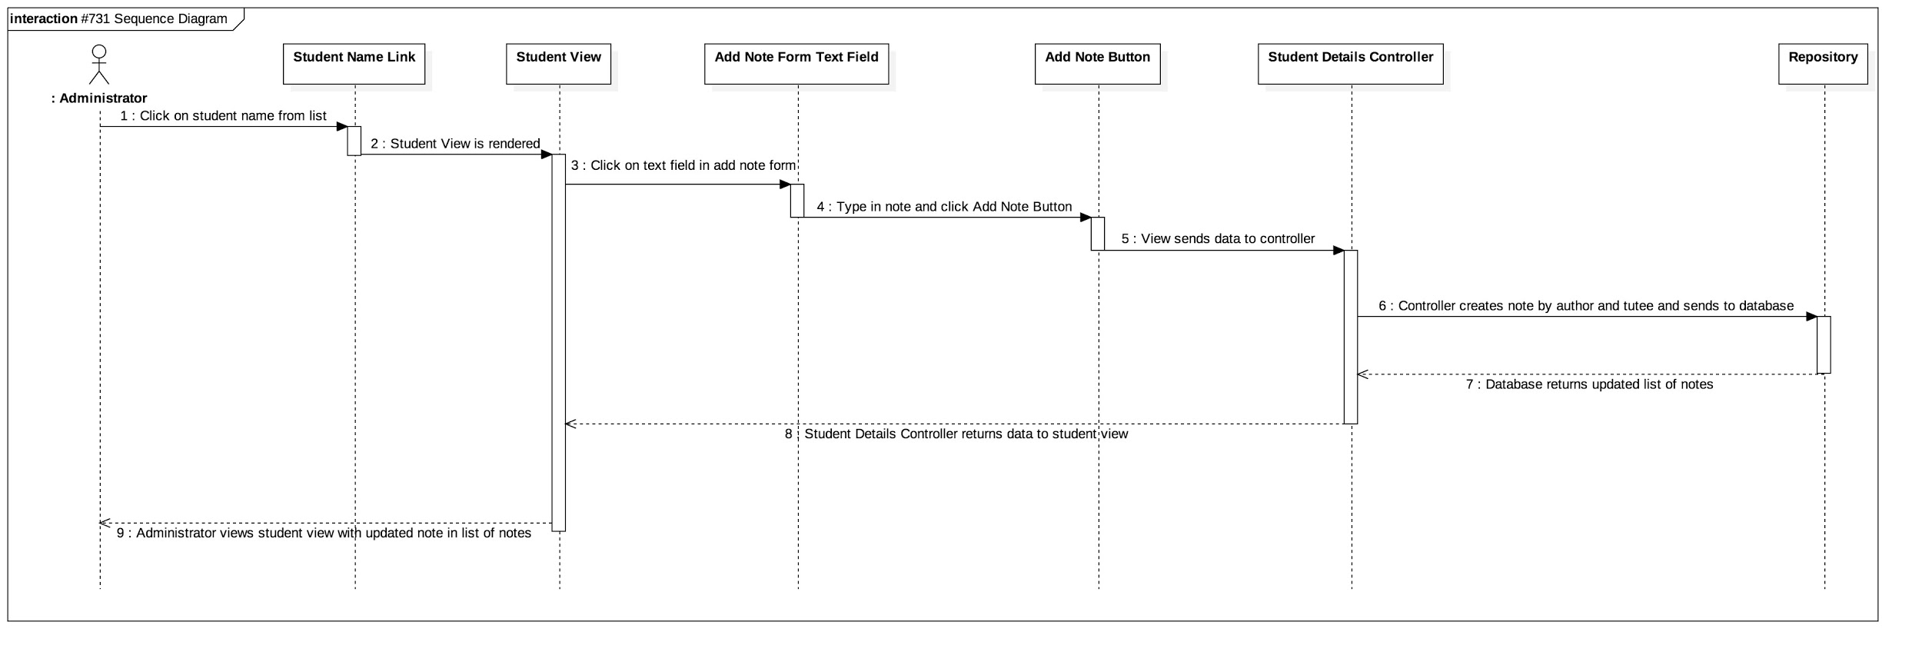
School of Computing & Information Sciences
VIP, 2017, Summer
ASI PantherCentric 1.0
Student: Rolando Moreno, Florida International University
Mentor: Francisco Ortega, Instructor
Instructor: Masoud Sadjadi, Florida International University
Problem
Director of ASI seeks to centralize metrics for evaluating success of students using tutoring service.
Director also needed to determine of usability of current web application was suitable for attracting and retaining new potential users.
Solution
Provide an administrative dashboard which contains all key metrics for evaluating individual and overall success of the program.
Provide new users an updated user interface to enhance their ability to register and apply for tutoring with great ease of use.
Current System
Reports for summary of semester are manually created.
Application currently does not provide a dashboard to obtain key metrics to evaluate.
System UI provides non-responsive interface, primarily for desktop.
Screenshots
Requirements
Functional Requirements:
View List of Tutees in Current Semester
View average rating of tutee and ambassador per session in surveys by course
Show information about courses for the semester
Non-Functional Requirements:
Change Administrator UI
Change Login UI
Change Signup UI
System Design
Implementation
ASI PantherCentric is developed with:
Repository-
PostgresSQL
Backend-
Docker
Django Framework
Built on Python Programming Language
Frontend-
HTML5, CSS3
JQuery, Bootstrap Framework
Verification
Object Design
Summary
ASI PantherCentric is a tutoring scheduling system at the core but can evolve into a repository of important data metrics to determine how students can improve their academic success. This implementation along with our research, is the first step in improving a platform where students can achieve this goal.
Test Case: View Tutees in Current Semester
Purpose: Test that the table only show tutees in the current semester
Preconditions: At least one tutee must be enrolled in tutee session
Action: Selenium runs current tutees views
Expected Results: Selenium asserts tutee against test tutee in database
Acknowledgement
I would like to thank Alfredo Santoyo, Priscilla Cordova and Jake Lopez for their contribution and support for this project. I would like to thank Myrian Herlle for her guidance and feedback throughout the project. Finally, thank Dr. Francisco Ortega for guidance on how to improve ASI PantherCentric and Dr. Masoud Sadjadi, our instructor.
Notes:
‹#›

