Slide 1
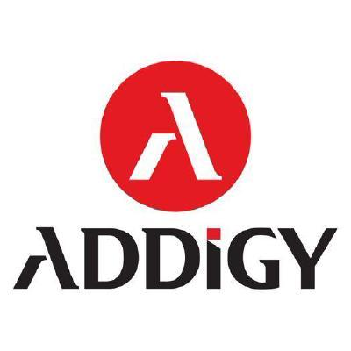

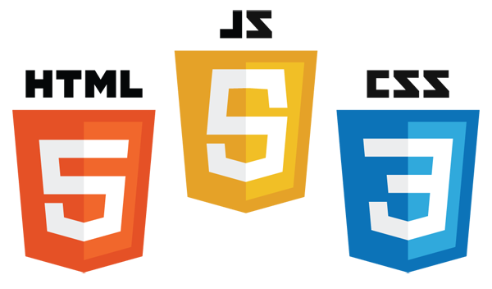




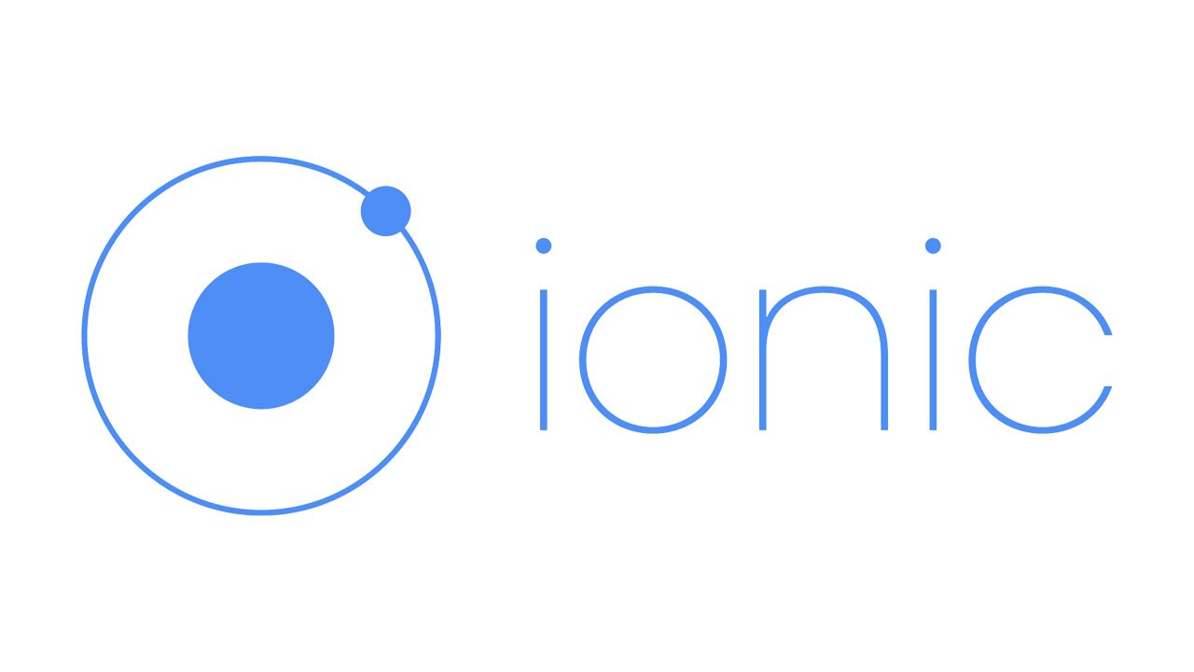
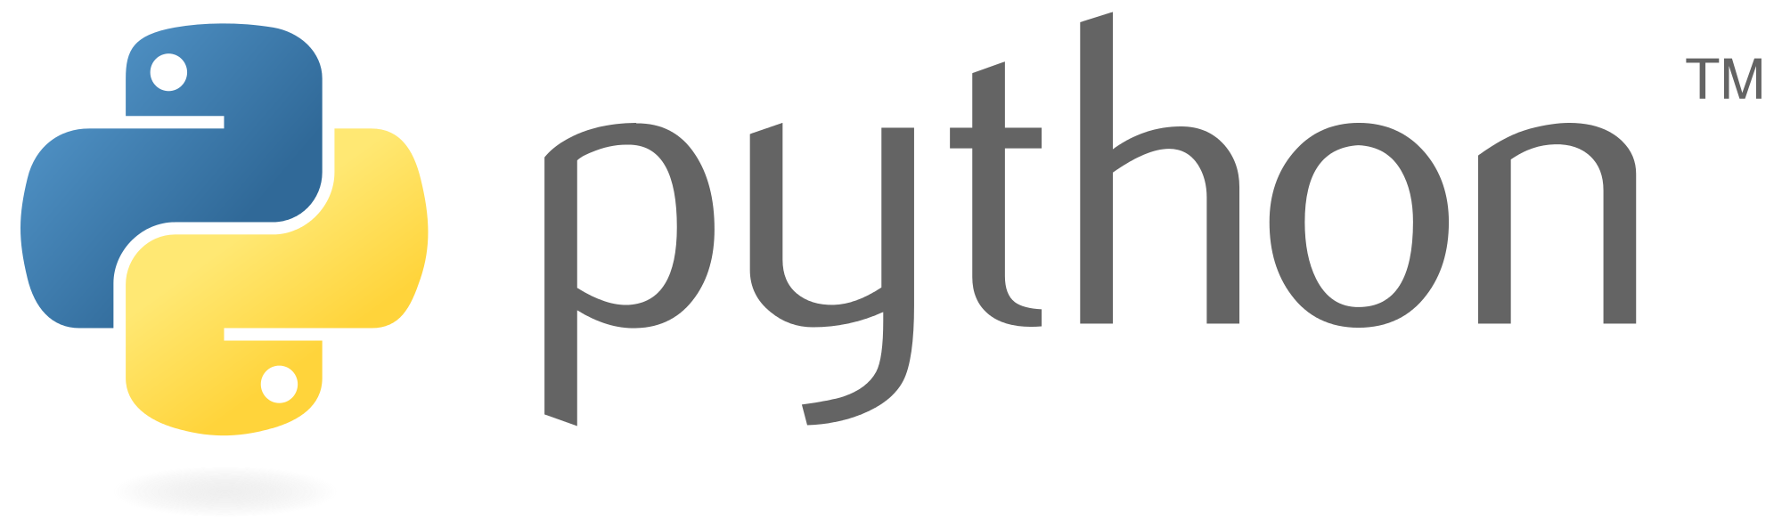
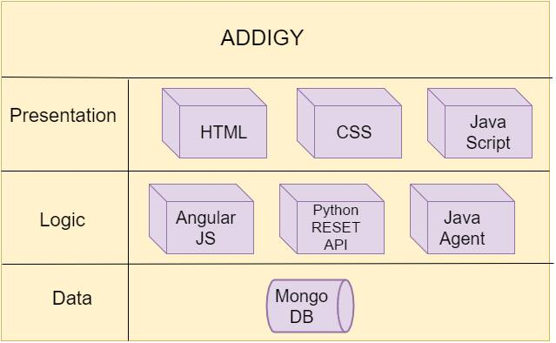
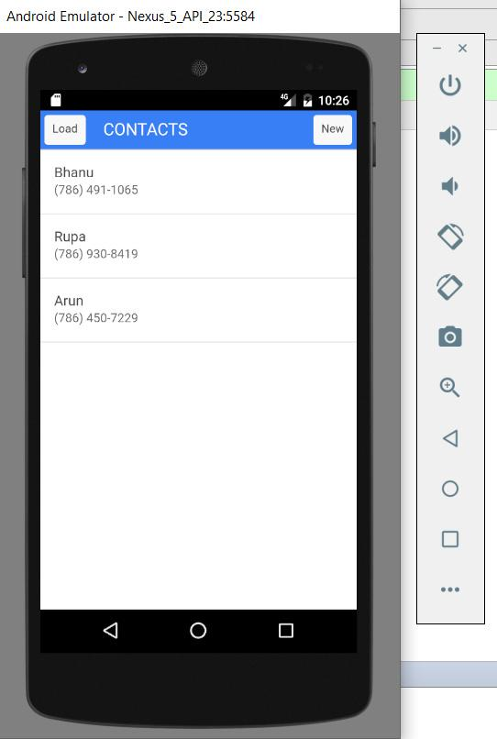
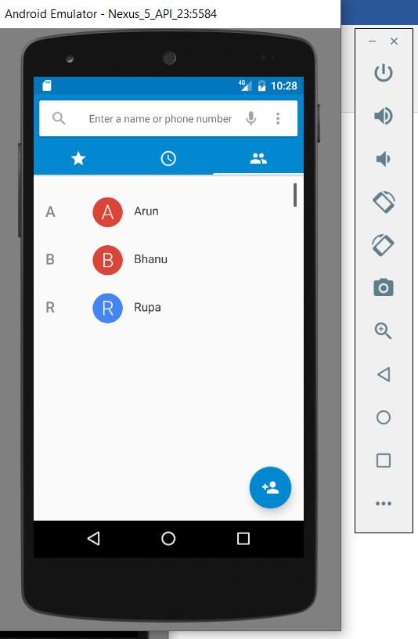


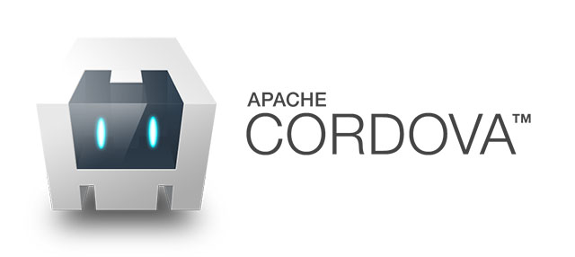
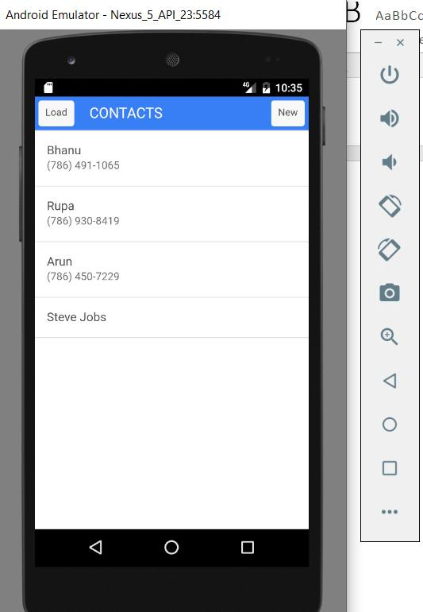
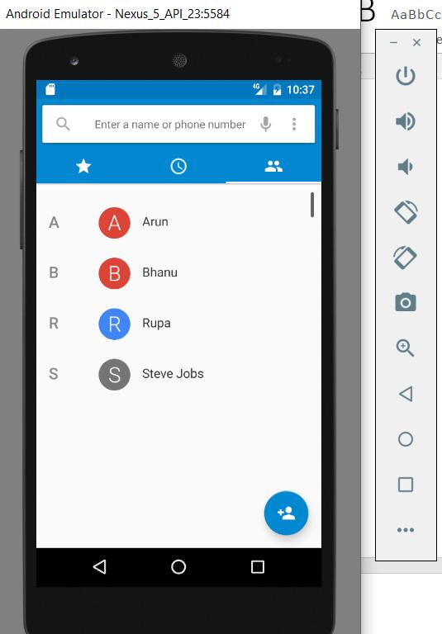
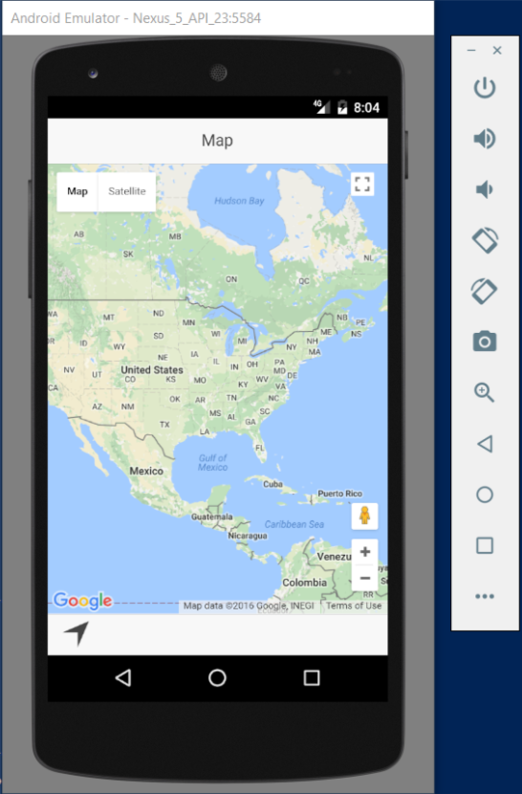
School of Computing & Information Sciences
Advanced Software Engineering, 2016, Fall
ADDIGY 6.0
Student: Bhanu Boredha, Florida International University
Mentor: Mohsen Taheri,
Jason Dettbarn, Addigy
Instructor: Masoud Sadjadi, Florida International University
Problem
Addigy is a Mobile Device management System.
The purpose of the project is to create a system able to remotely monitor and apply configurations to mobile devices(IOS and Android).
The project consists of two mobile applications (one for android and one for iOS) that communicate to a web service to report monitoring data and retrieve configurations.
It will also need a website component where an administrator can see the monitoring data and setup configurations.
Current System
1. Addigy current system is a cloud based Mac Management platform that simplifies Mac IT Management.
2. Asset Management – Encryption,
Security & File Vault Keys.
3.OS & Application management –
OS versions, Updates & Apps.
4. Policy Management/ Deployment -
Take Control.
Requirements
The system that can remotely monitor the mobile devices.
The system that can apply required configurations to mobile devices.
The system consists of applications that work on mobile devices and communicate to a web service to report monitoring data and retrieve configurations.
The system administrator needs a website component to setup configurations and monitoring data.
System Design
Screenshots
.
Implementation
Works on Android and IOS Platforms .
Uses Ionic Framework to create hybrid applications.
The user interface uses Angular Html and CSS.
Verification
Test Case(Sunny Day)
Result: The image should be set as the background image.
Purpose: User should be able to set an image from the gallery as the wallpaper.
○ Precondition: User should go to the settings page and select ‘change background option’.
○ Input: User should select an image to set as background image.
○ Expected Result: The image should be set as the background image.
○ Actual Result: The image set as the background image.
○ Status: SUCCESS
Test Case (Sunny Day)
○ Purpose: User pushes the load button and app fetches the contacts from the device
phonebook.
○ Precondition: User should open the Contacts app.
○ Input: User pushes the load button.
○ Expected Result: The app should load contacts from the device phonebook.
○ Actual Result: App loads the contacts
○ Status: SUCCESS
Summary
Mobile phones have become one of the most valuable assets nowadays. IT intelligence at scale provides some sort of intelligence to assist when taking decisions regarding these assets.
My contribution to Addigy’s System.
Learned to build hybrid mobile applications using Ionic framework.
Application that fetches images from gallery and setting image as the wallpaper.
Application that fetches contacts from the device phonebook and adds contacts to the device phone book.
Application that integrates google maps to the ionic application.
Acknowledgement
I am thankful to the help that I received from our mentors Mohsen Taheri and Jason Dettbarn and my team mate Rupa Kotha
Notes:
1

