Slide 1
IT Intelligence at Scale
Introductory Video
Team Members
Matthew Saunders, Developer, Tester and Document Creator
Ayme Morrina, Developer, Tested and Document Creator
Product Owner
Jason Dettbarn

Slide 2
Problem Definition
The market for IT monitoring tools has been growing in the past years, but there is still a lack of:
Robust IT alerting tools for Mac computers.
IT monitoring solutions that scale.
Visualizes data in a meaningful way from multiple sources.
Collects software usage.

Slide 3
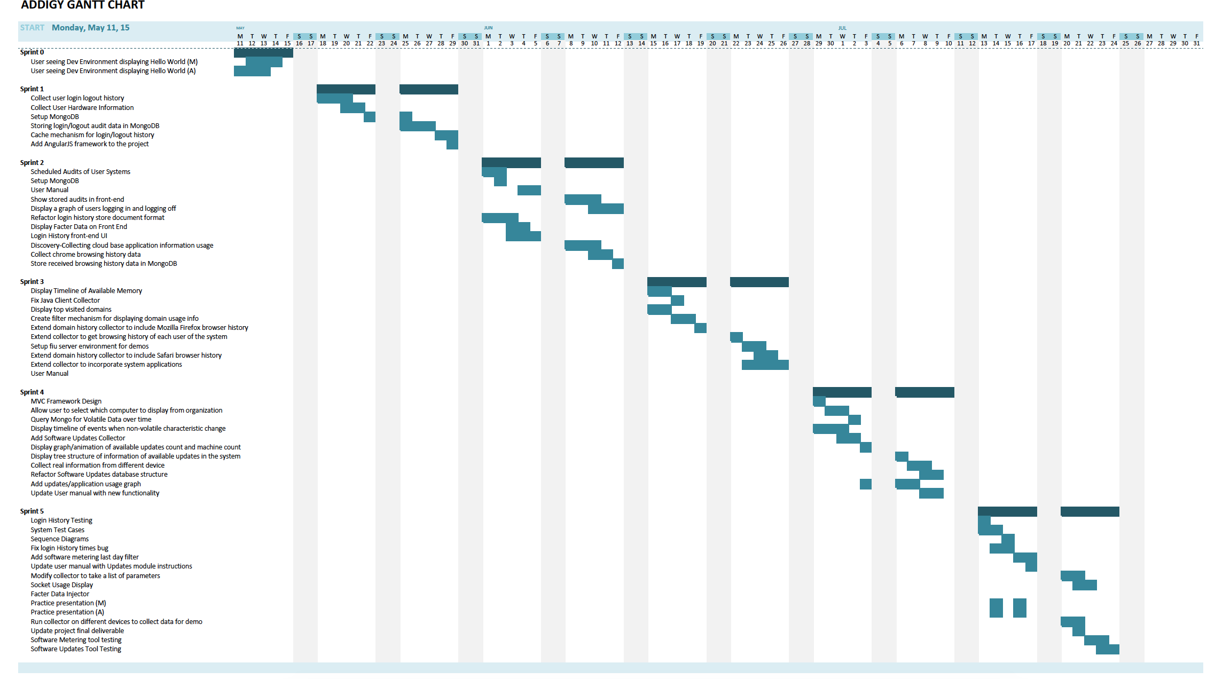
Gantt Chart

Slide 4
Requirements: User Stories implemented
Collect user login/out activity.
Collect user applications usage.
Collect device available updates.
Collect user hardware information.
Create collector caching mechanism.
Create server mechanism to receive data from collector.
Store facter data in MongoDB.
Store applications in MongoDB.
Store software updates in MongoDB.
Store users login/out activity.

Slide 5
Requirements: User Stories implemented
Display users login/out activity.
Display available software updates in tree structure.
Display applications usage of those related to software updates.
Display Facter Report.
Display Socket Usage.
Display CPU and Memory Usage.
Display Non-volatile Event Timeline.

Slide 6
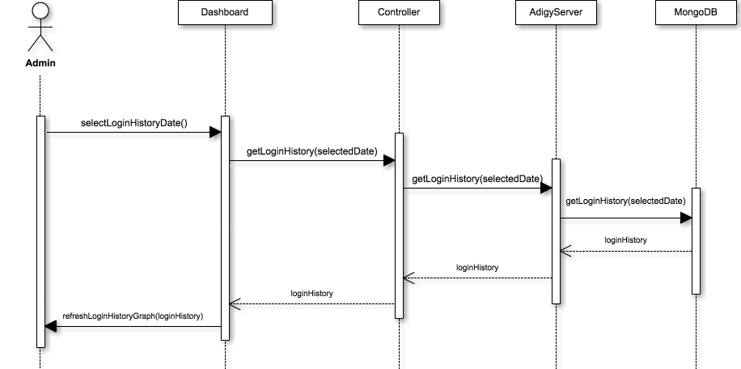
UML Sequence - Display Selected Date Login History

Slide 7
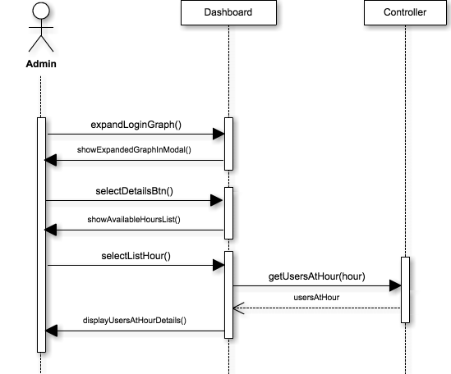
UML Sequence - Display Users Per Hour details.

Slide 8
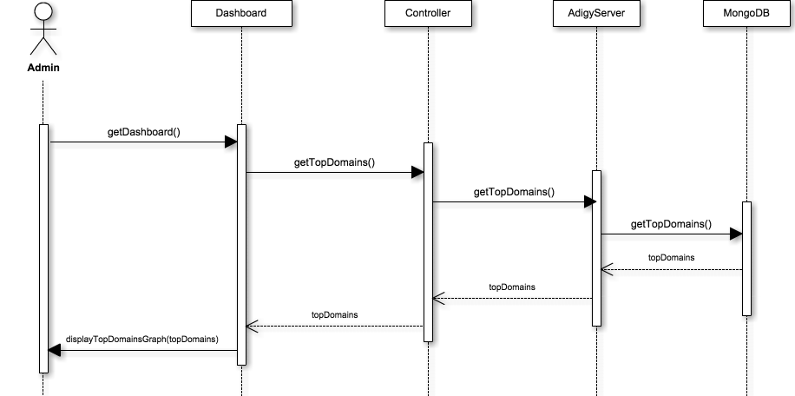
UML Sequence - Display Top Visited Applications

Slide 9

UML Sequence - Get Filtered Applications

Slide 10

UML Sequence - Display gauges of available updates count and machine count

Slide 11
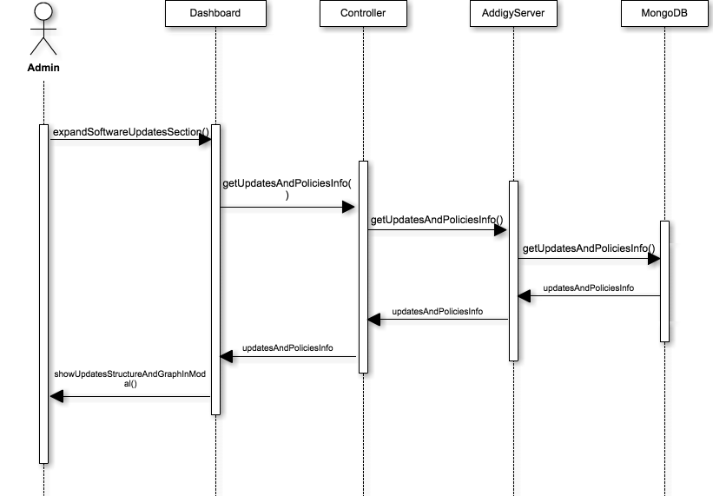
UML Sequence - Display software update details

Slide 12

UML Sequence - Tenants

Slide 13
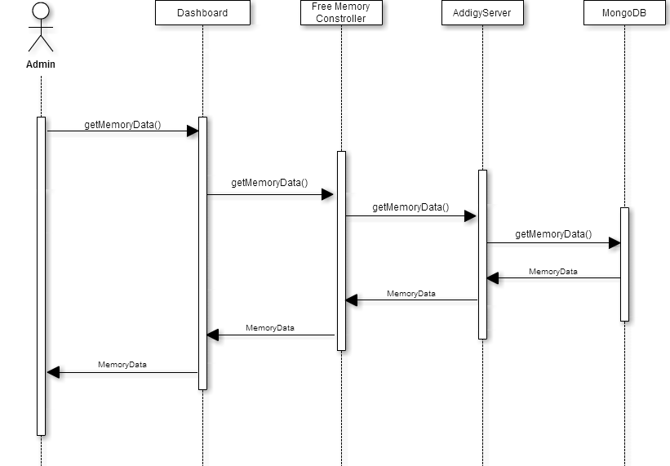
UML Sequence - Volatile Data

Slide 14
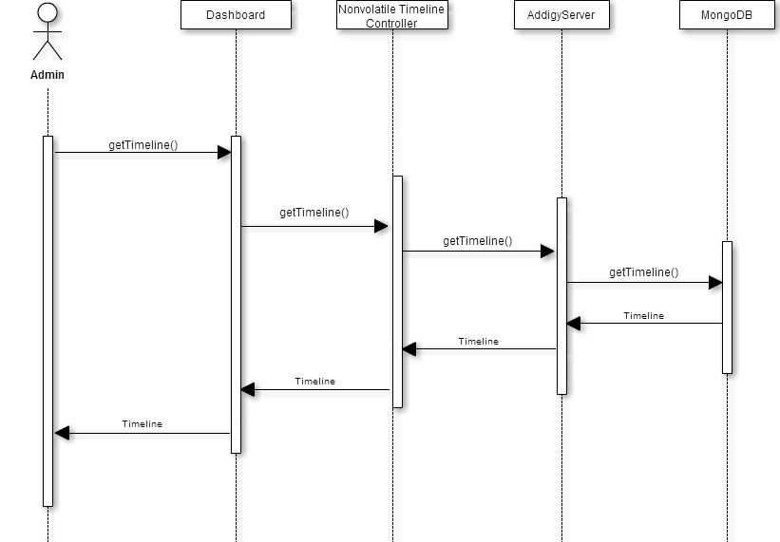
UML Sequence - Timeline

Slide 15

UML Sequence - Socket Data

Slide 16

UML Sequence - Volatile Data

Slide 17
System Design: System Decomposition
Architectural Patterns
Agent: Implemented using a Java package to collect and send system data.
Server: Implemented using Django framework of Apache, MongoDB, Python and Ubuntu to receive the data from the Agent, connect to the database to store it and retrieve it to the dashboard.
Dashboard Controller: Implemented using AngularJS Framework. Used to connect to the Server to retrieve information and to handle administrator’s interactions with the dashboard.
Web Dashboard View: Implemented using HTML and CSS. Uses frameworks such as BootStrap and JQuery to display functionalities and data.
Model-View-Controller architecture.
Caching mechanism.

Slide 18
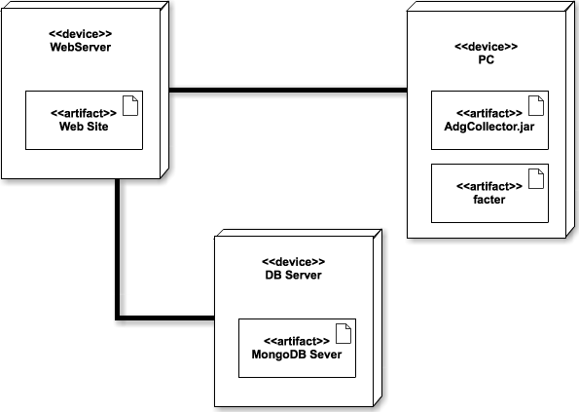
System Design: System Deployment
Hardware Requirements:
Linux based server
Software Requirements:
Django
Python
Java
AngularJS
JavaScript
MongoDB
Facter

Slide 19
System Design: Persistent Data Design
This project does not use persistent data in this version

Slide 20
System Design: Security and Privacy
Designed to be done over SSL

Slide 21
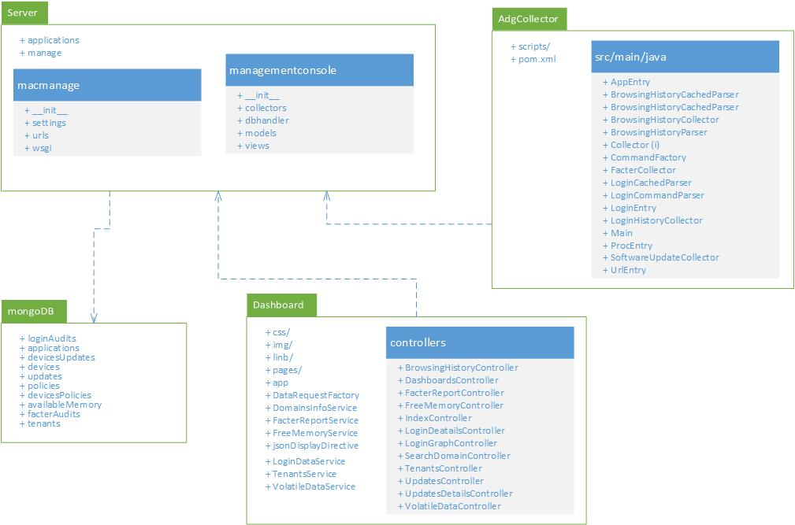
Detailed Design: Class Diagram

Slide 22
Detailed Design: Design Patterns
Factory Method: Used in collector agent running on the machines in order to achieve platform independence by having a factory object generate different commands depending on the platform in which the machine is running.
Front Controller: Python server provides a centralized entry point for handling all the requests.

Slide 23
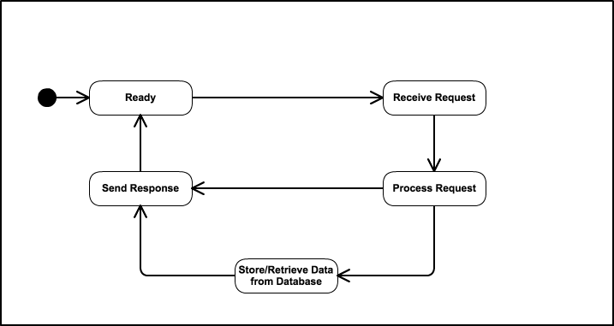
Detailed Design: Main Control Object
The Server is the main control object.
The state machine is shown for a single process in the system.

Slide 24
Select Application Algorithm
Application name is selected by user from list.
Selection is sent from view to controller to service to data request factory in AngularJS.
Data Request Factory makes a REST web service call to the Django server.
Django processes the request and queries MongoDB for records of selected application.
Records are returned to Angular Data Request Factory.
Records are sent from factory to service to controller.
Controller parses records to display data format.
Data is passed from controller to view.
View updates display with selected application data.

Slide 25
Test Cases: Sunny Day - Select Application
Identifier | TC05_SelectDomain
Purpose | To ensure that applications graph refreshes automatically reflecting the selected application’s activity
Setup | -Navigate to the dashboard2. -Expand the Software Metering Module.
Input | Select a Applications in the Applications drop-down menu.
Expected Output | Applications graph automatically refresh reflecting the selected application’s activity.

Slide 26
Test Cases: Rainy Day - Select Application
Identifier | TC05_SelectDomain
Purpose | To ensure that applications graph refreshes automatically reflecting the selected application’s activity
Setup | -Navigate to the dashboard2. -Expand the Software Metering Module.
Input | Select a Applications in the Applications drop-down menu.
Expected Output | Applications graph automatically refresh reflecting the selected application’s activity.
Actual Output | Graph did not reflect the requested changes. Ran into a JSON parsing issue when attempting to parse the data.

Slide 27
Automated Test Scripts
Cronjob: Installed on all client machines to automatically run the collectors and send or store data depending on the caching mechanism.

Slide 28
Demo
This demo encompasses all user stories completed for this project.

