Slide 1
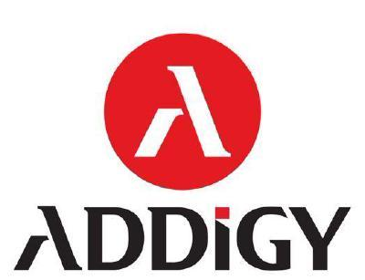












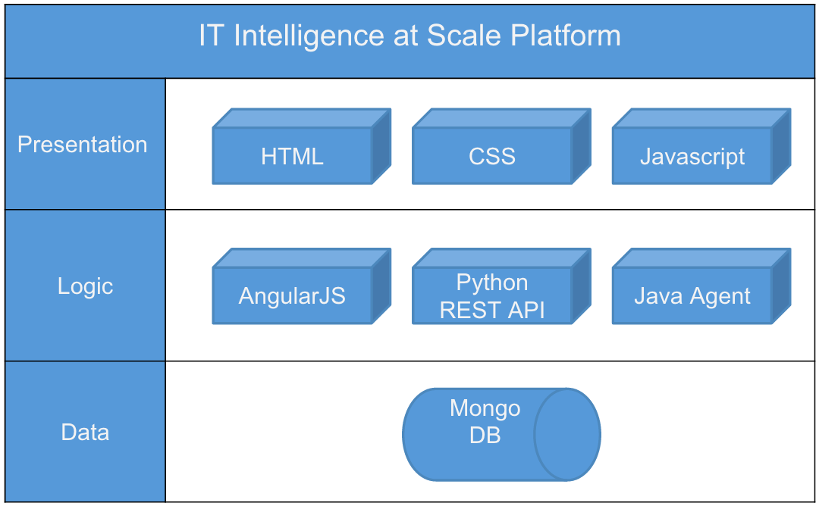
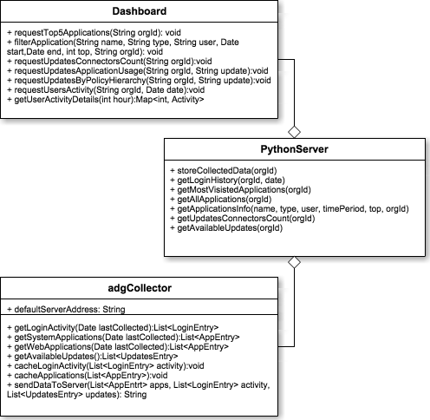
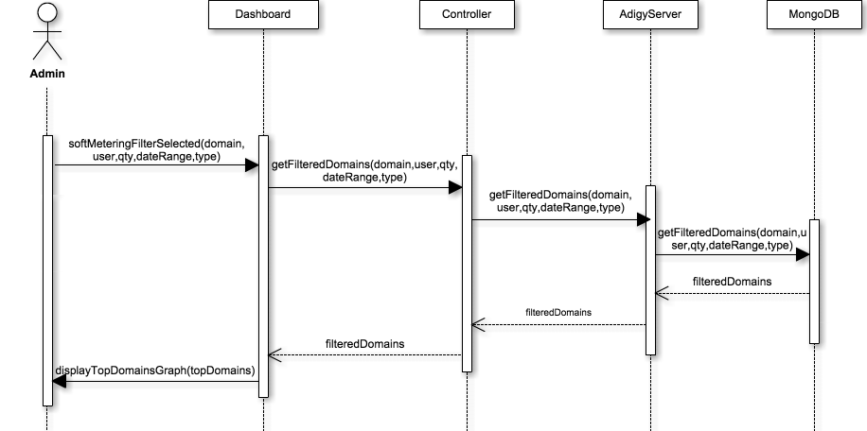
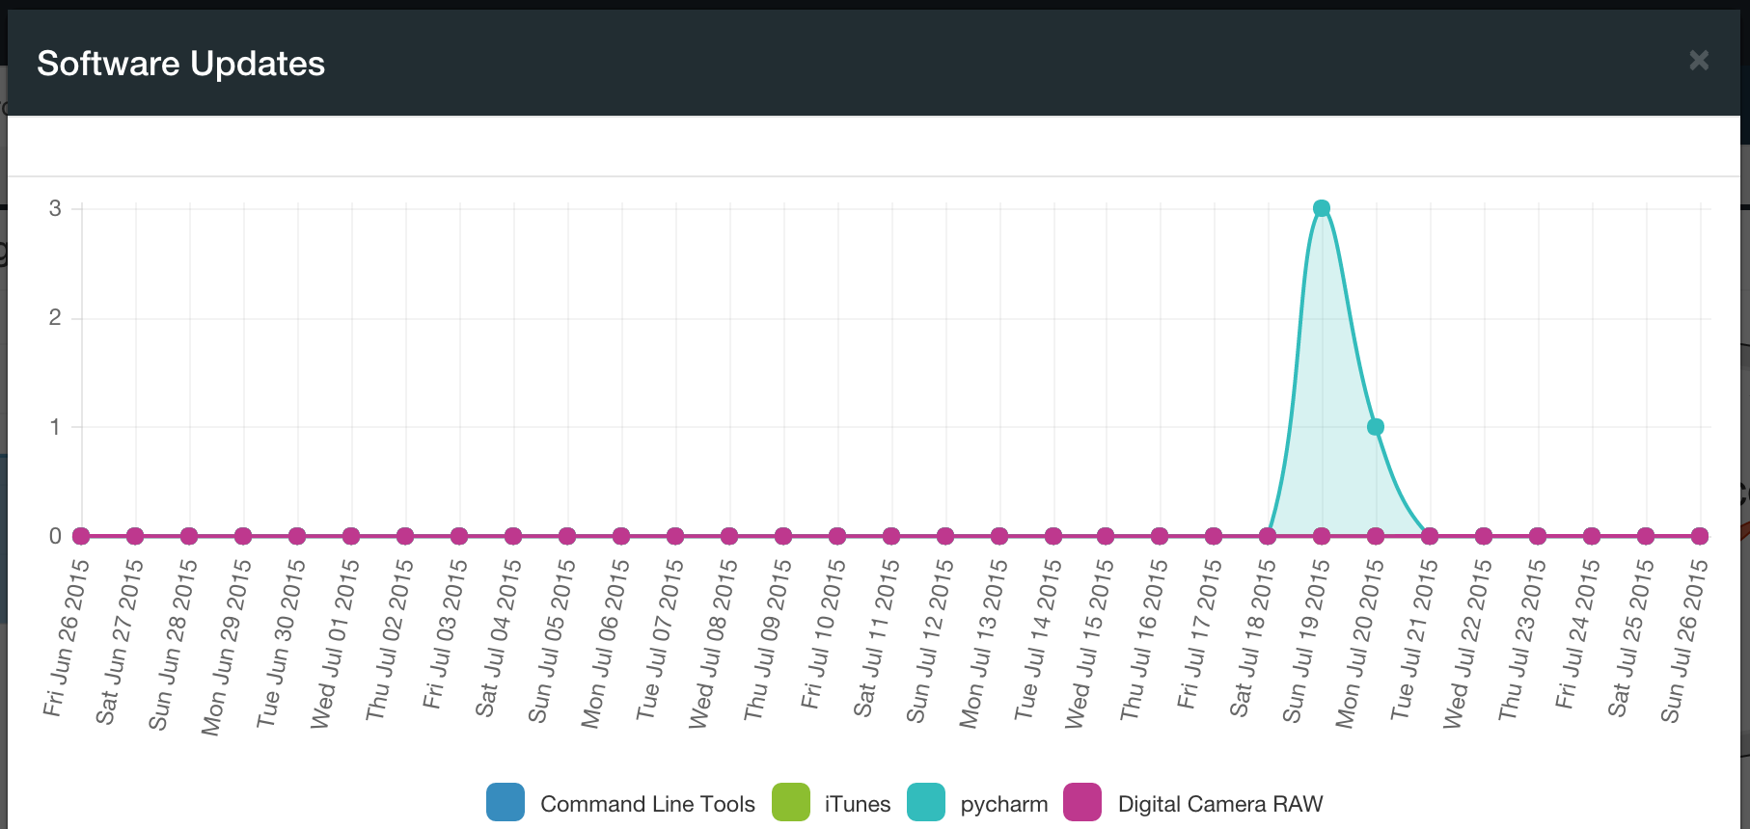
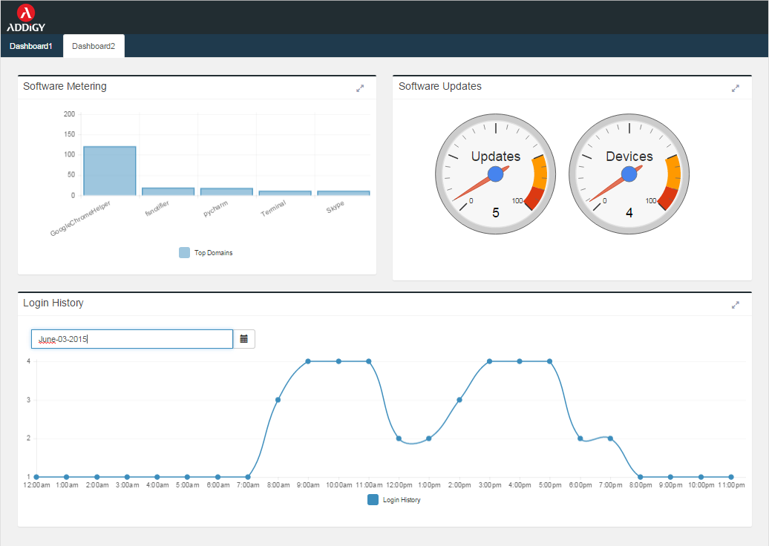
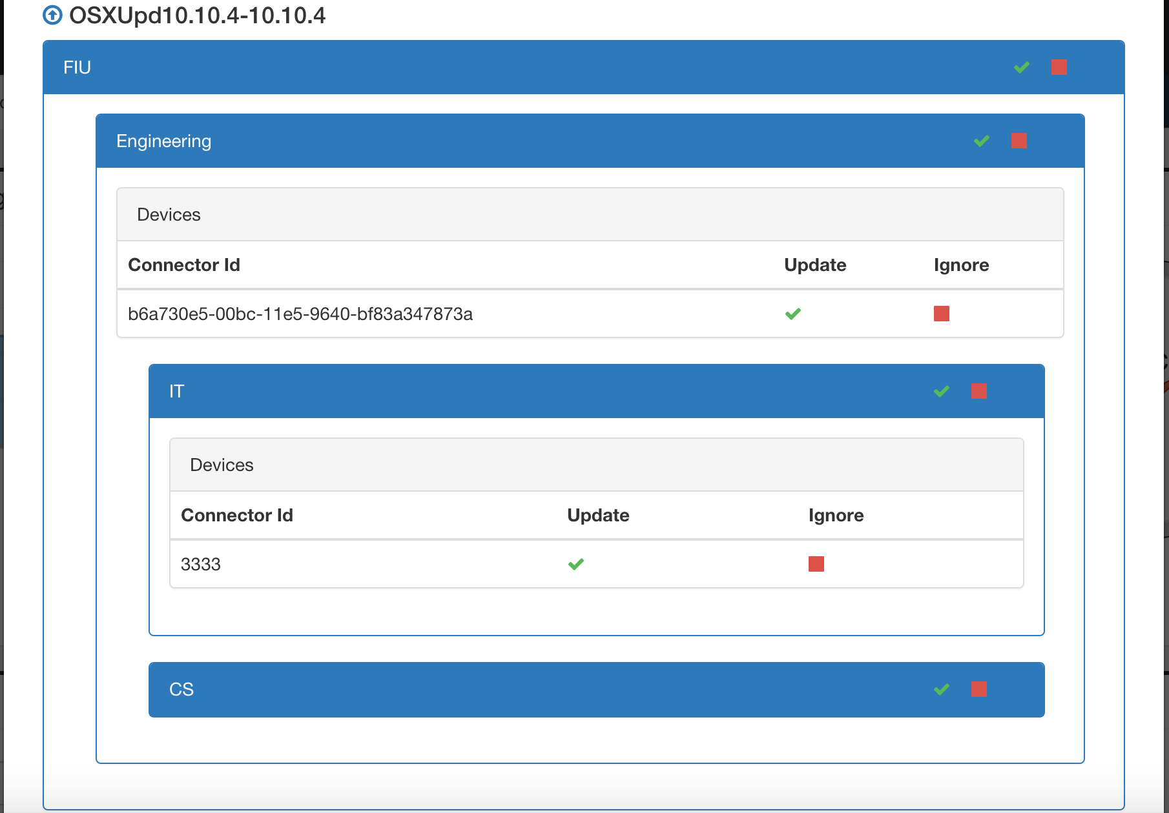
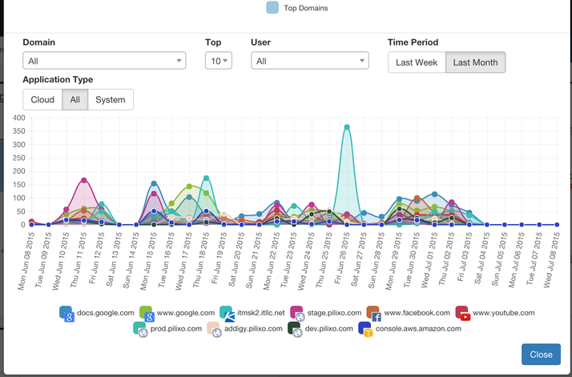
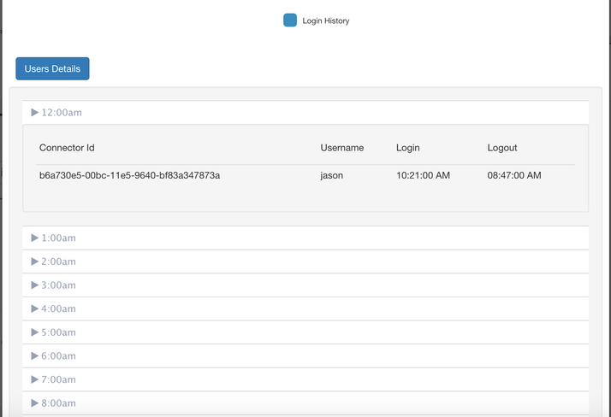
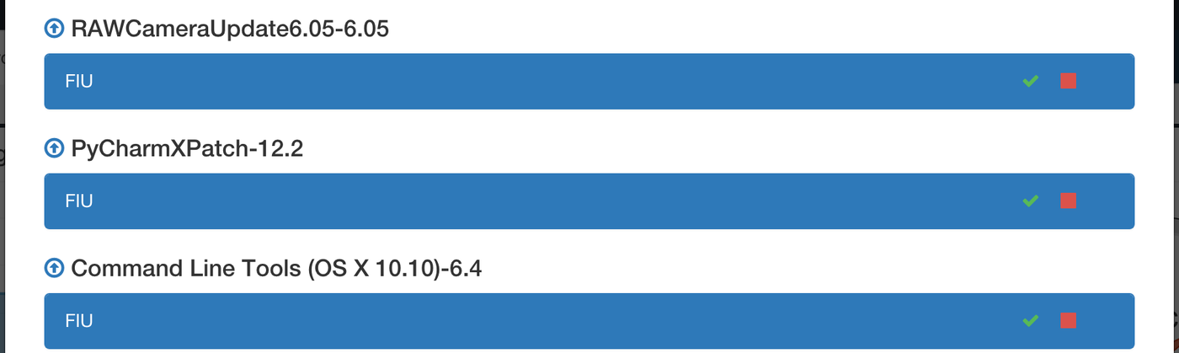
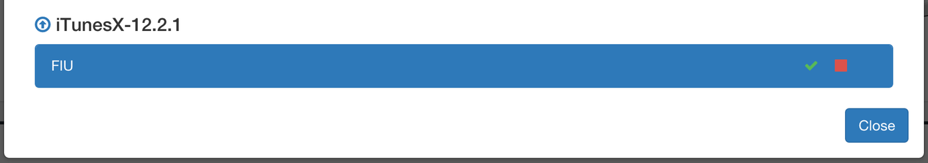
School of Computing & Information Sciences
Senior Project, 2015, Summer
IT Intelligence At Scale
Student: Ayme Morrina, Florida International University
Mentor: Jason Dettbarn, Addigy
Instructor: Masoud Sadjadi, Florida International University
Problem
Current System
Requirements
Users can only view the latest data sent from a machine.
Users cannot view a timeline of data for a system or collection of systems.
Old data records are removed once new data is received from a machine.
Report data is not stored in a database.
Addigy current system has a web dashboard that displays all relevant computer information in a given company.
The dashboard contains a view showing an overview of all computers in the company and statistics regarding processor, memory and disk usage.
It also contains an individual view for each machine which shows the same information limited in reference to that machine.
All report data for the system resides in the cloud using Amazon Web Services (AWS)
The system shall be able to collect device information including users login/out activity, system/web application usage and software updates.
The system shall display a graph of web/system applications usage.
The system shall display a graph of users login/out activity.
The system shall display users login/out activity details.
The system shall display the software updates in a hierarchical way according to the company policies.
The system shall display a graph of applications usage of those related to the available software updates.
The system shall refresh and display the correct data when filters are selected.
System Design
Object Design
Implementation
A Client-Server architecture was used to handle one-to-many communication between the devices collector written in Java and administrator dashboard, using AngularJS from a browser with the server.
Verification
The agent running on the devices uses a factory architecture in order to achieve platform independence by having a factory object generate different commands depending on the platform of the machine.
The dashboard is built using HTML5, JavaScript, CSS3, Bootstrap, and AngularJS, using a Model-View-Controller architecture in order to keep the dashboard up to date.
Manual exploratory testing was used to test the different components of the system.
Developer tools in the browser and debugging tools in the IDEs assisted in finding and fixing a variety of errors including: Json formatting errors, JavaScript parsing errors, network errors, CSS faulty rules among others.
Screenshots
Summary
Computers have become one of the most valuables assets for companies nowadays. IT Intelligence at scale provides some sort of intelligence to assist when taking decisions regarding these assets.
Contribution to the project:
Software that run on the machines silently reporting machine specific information.
Caching mechanism in the software to alleviate network traffic.
Platform independence for every feature of the system.
Software Metering tool for the administrator using the dashboard to measure web and system applications usage.
Software Updates tool for the administrator using the dashboard to determine updates relevance and to manage updates at different organizational levels.
Login History tool for the administrator using the dashboard to analyze user’s activity.
Acknowledgement
I am thankful to the help that I received from my group member Matthew Saunders and mentor Jason Dettbarn
Notes:
‹#›

