Slide 1




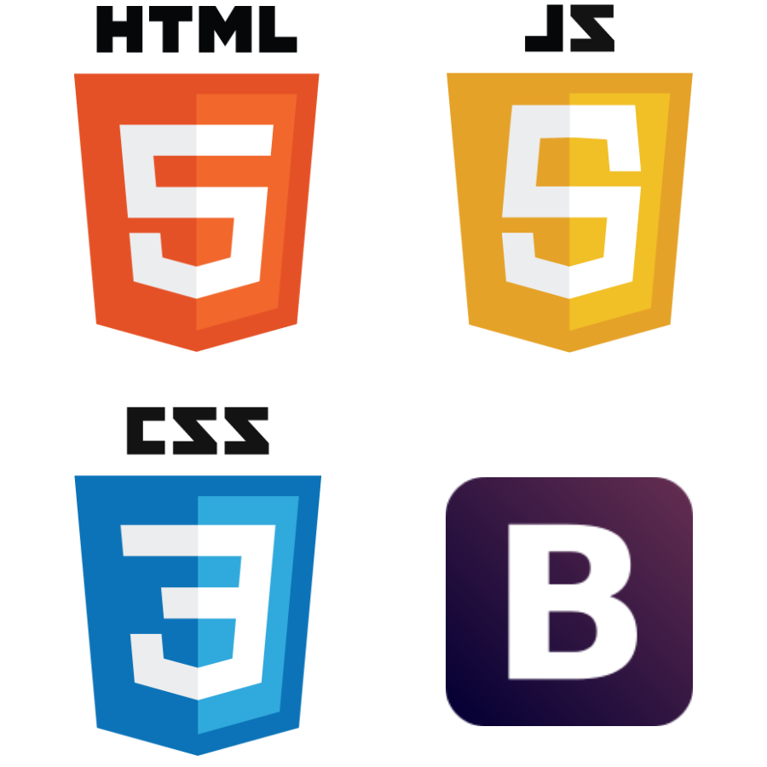

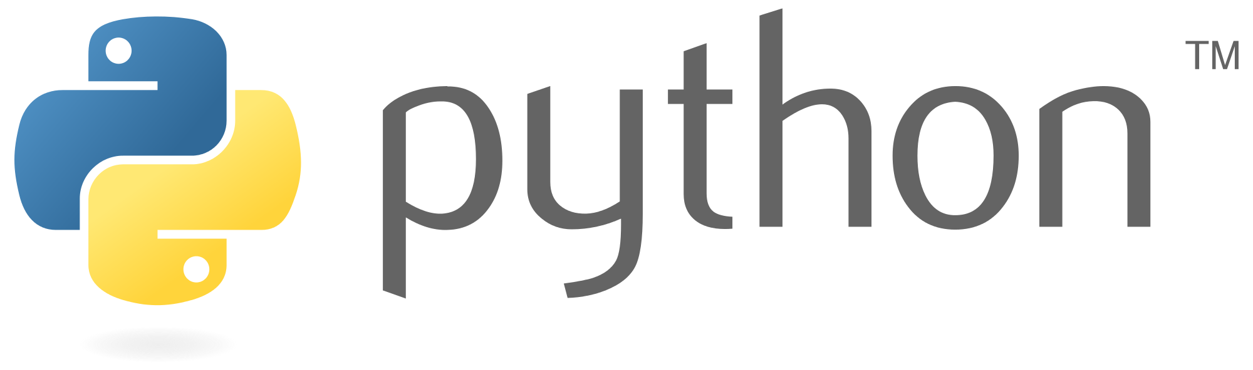


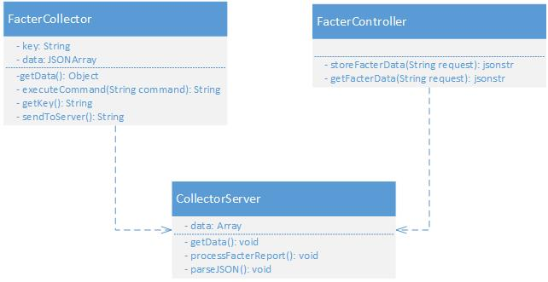
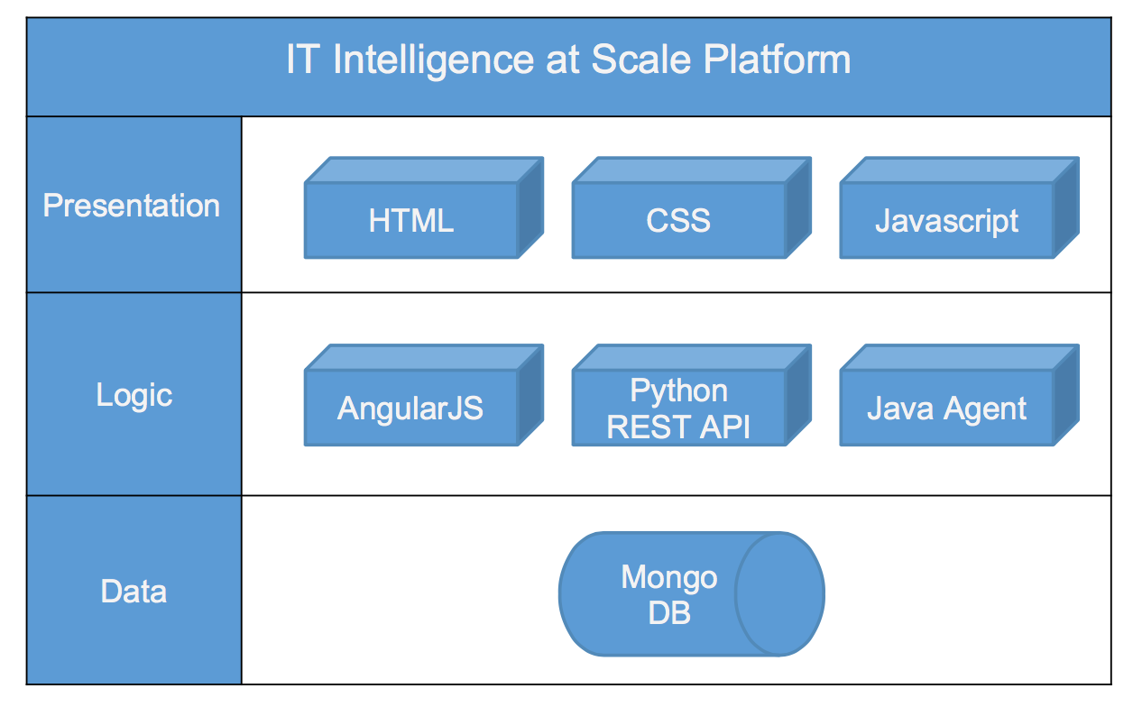
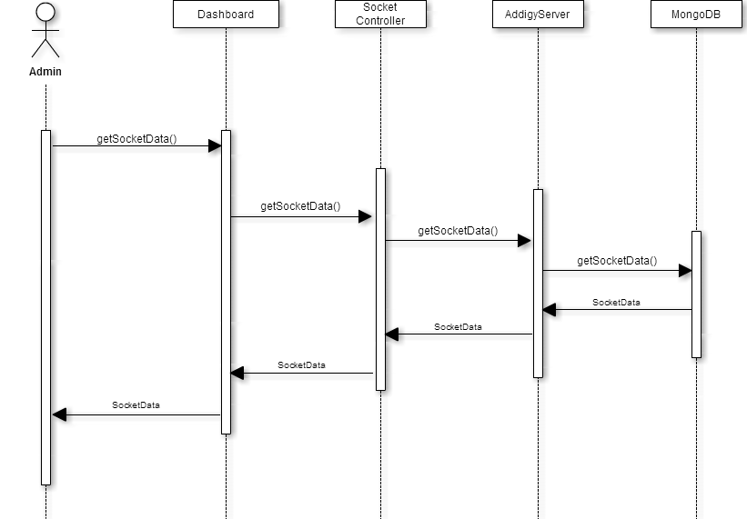
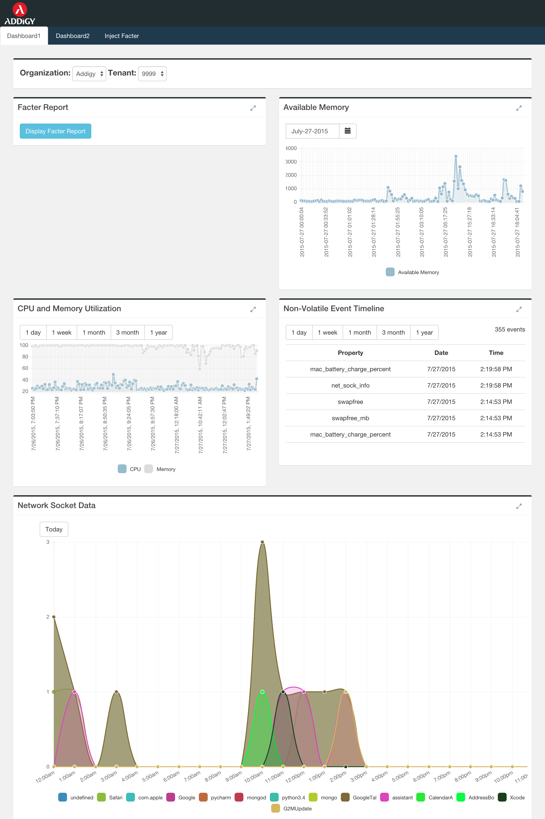
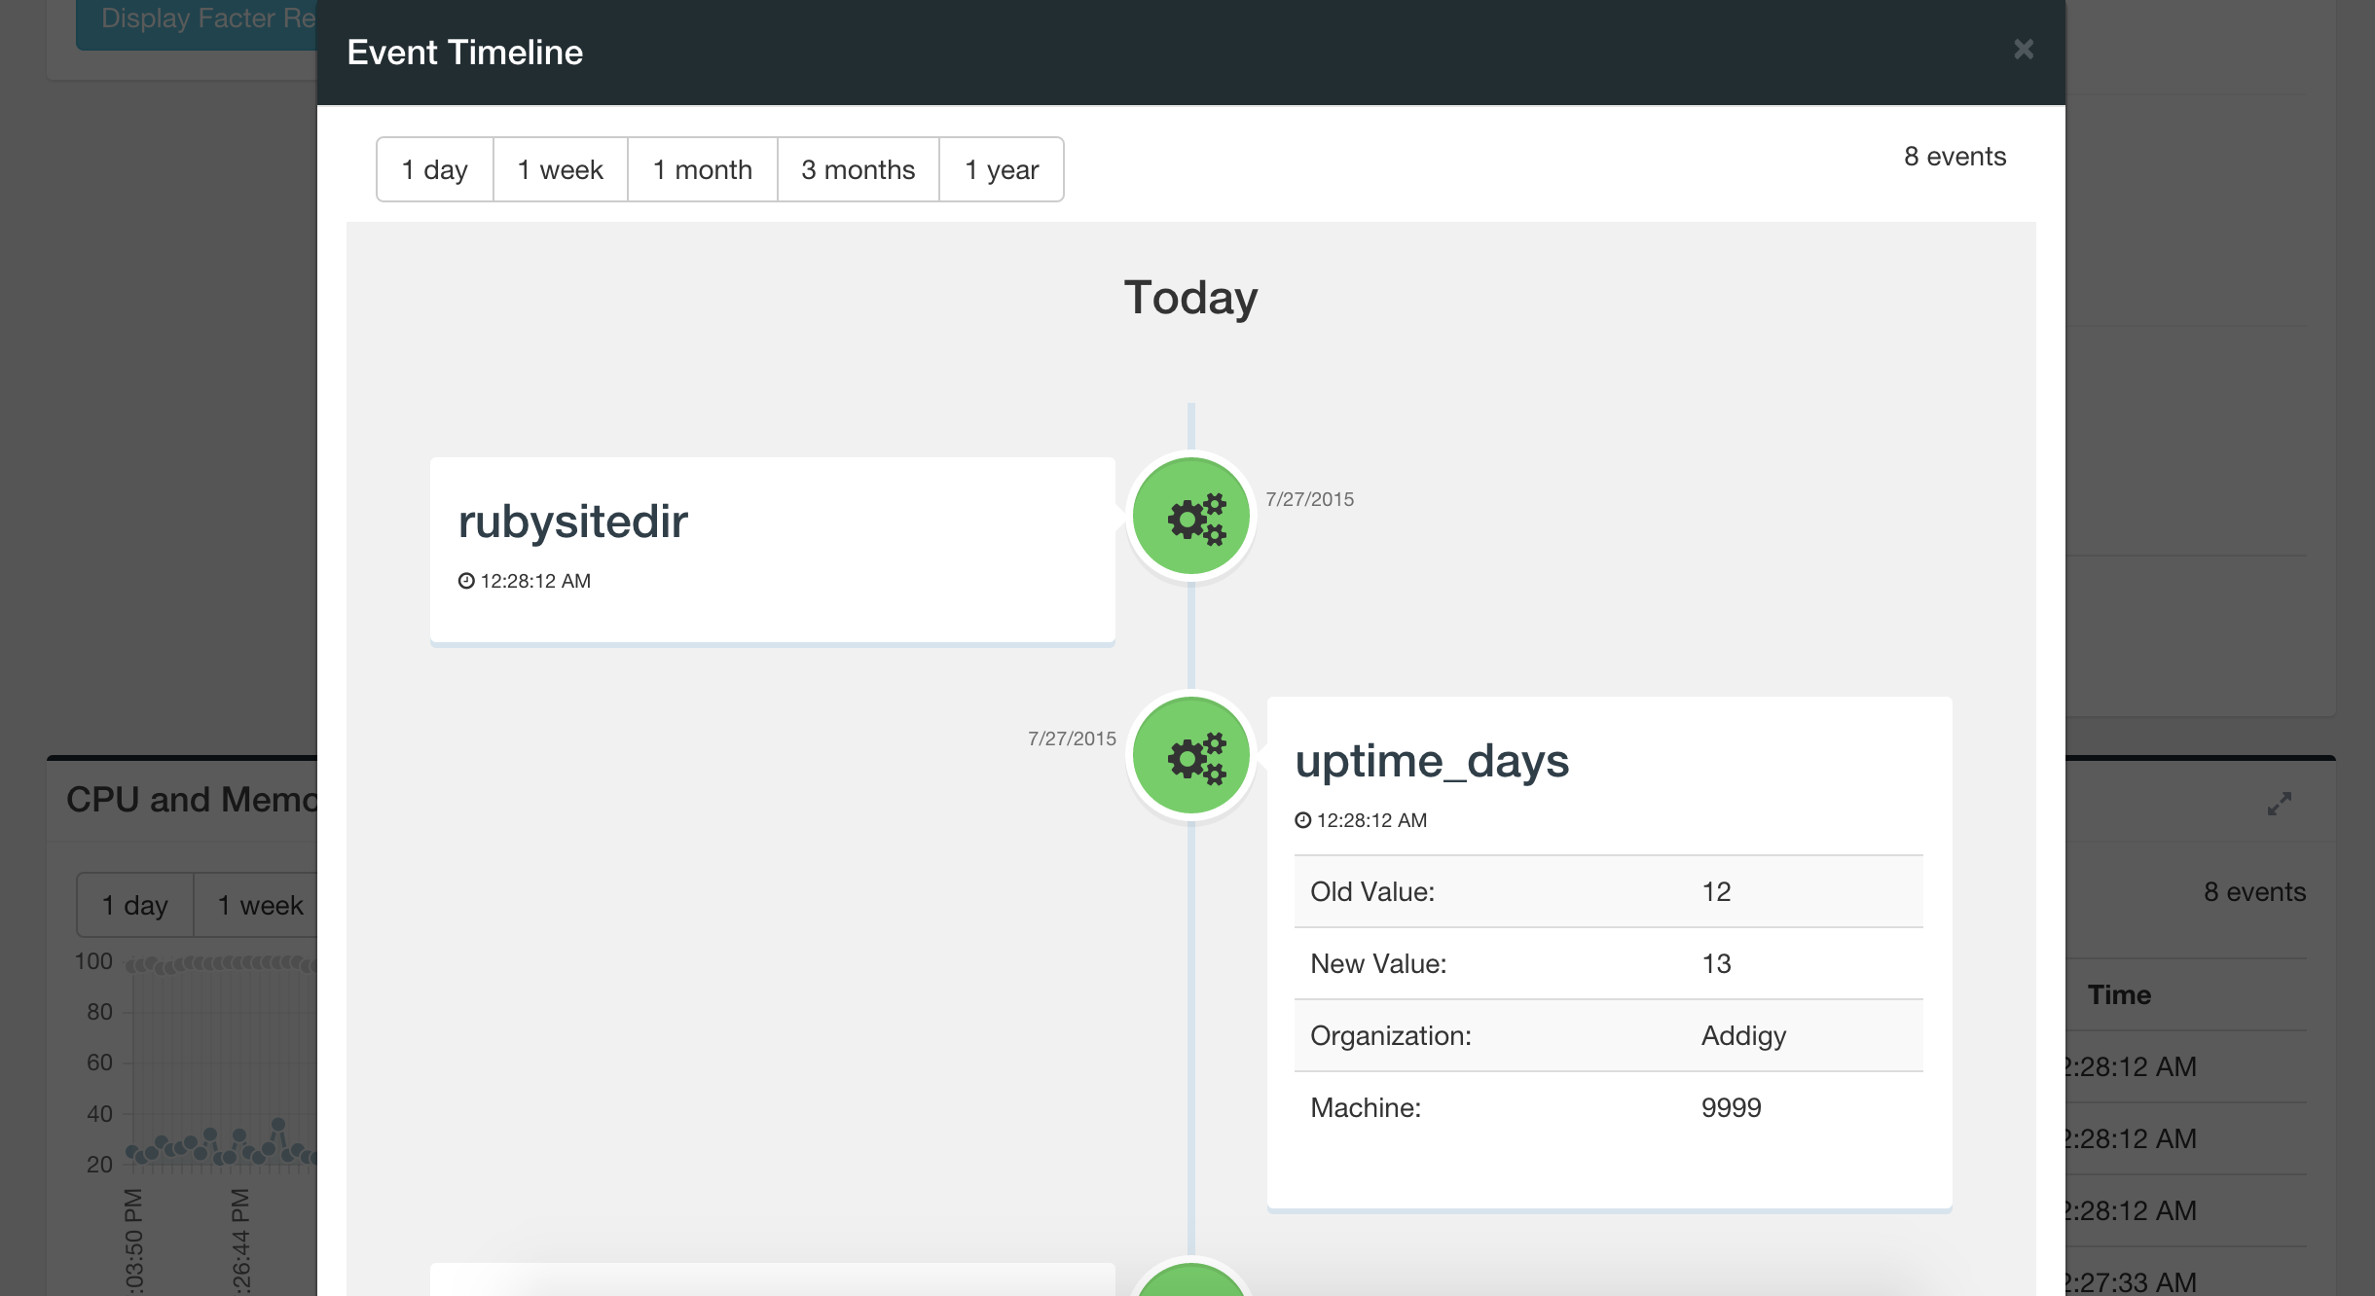
School of Computing & Information Sciences
Senior Project, 2015, Summer
IT Intelligence At Scale
Student: Matthew Saunders, Florida International University
Mentor: Jason Dettbarn, Addigy
Instructor: Masoud Sadjadi, Florida International University
Problem
Current System
Requirements
IT Administrators need a robust IT monitoring tool for the Mac platform that provides the following functionality.
Scales as the organization grows
View historical information or previous reports for systems in their organization.
View a timeline of data for a system or collection of systems.
Store old data records instead of removing them once new data is received from a machine.
Include the date and time in storage when each piece of datum was received.
Enable the IT administrator to make important decisions by correlating data from multiple source into one central dashboard.
The current system has a web dashboard that displays all relevant computer information in a given company.
The dashboard consists of two views:
Company view - shows an overview of all computers in the company and statistics regarding processor, memory and disk usage.
Individual view - shows the same information limited in reference to that individual machine.
The system shall…
Collect hardware and configuration data from every machine in an organization.
Display raw reports collected from the machines.
Display volatile data, like CPU Usage and Available Memory in graphs.
Display a timeline of non-volatile data changes that occur for all systems in an organization.
Display socket usage by machines in an organization including the source, socket number, and machines having sockets open to that source.
Allow the IT Administrator to choose which systems data to display.
Store data as JSON documents in a database.
Store and retrieve data from a central server using a REST API.
Object Design
System Design
FacterCollector runs on the client machines to collect facts about each system.
CollectorServer stores data sent by the FacterCollector and sends data for requests sent by the FacterController.
FacterController requests, processes, and displays data to user.
Implementation
The system is implemented with an MVC framework using AngularJS and Django, and uses the Front Controller pattern to provide a centralized entry point for all requests.
The sequence diagram shows the the AngularJS Controller requesting data from the Front Controller of the Django server.
The data collector is implemented in Java and runs on each individual machine. The collector implements a Factory pattern to generate different collector objects based on the machines OS.
The application is implemented using an MVC architectural pattern. The following frameworks were used in the implementation:
Angular JS
A MVC framework in JavaScript used for data binding and application display logic.
Django
A web server framework used to implement the application’s REST API.
Screenshots
Summary
Verification
IT Administrators need a way to easily digest the large volume of data about the systems in their organization so that they can easily diagnosis problems and make decisions.
To accomplish this, I created:
A collector to collect hardware and configuration data about machines in an organization.
A dashboard that displays relevant volatile and non-volatile data about the system in their organization.
A socket usage view for identifying security threats to the organization’s machines.
A NoSQL database to store collected information for historical views.
A REST API to send and receive data from a central server.
Manual verification was used to test the application. Test data was generated by running the collector. To add large amounts of data, a cronjob was used to run the collector periodically.
Data was also injected into the database to force non-volatile data to change values.
Acknowledgement
The material presented in this poster is based upon the work supported by Jason Dettbarn and Javier Carmona. I am thankful to the help that I received from my group member Ayme Morrina .

