Slide 1




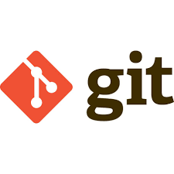
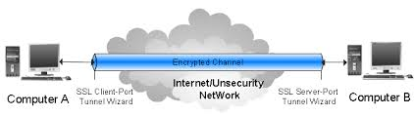









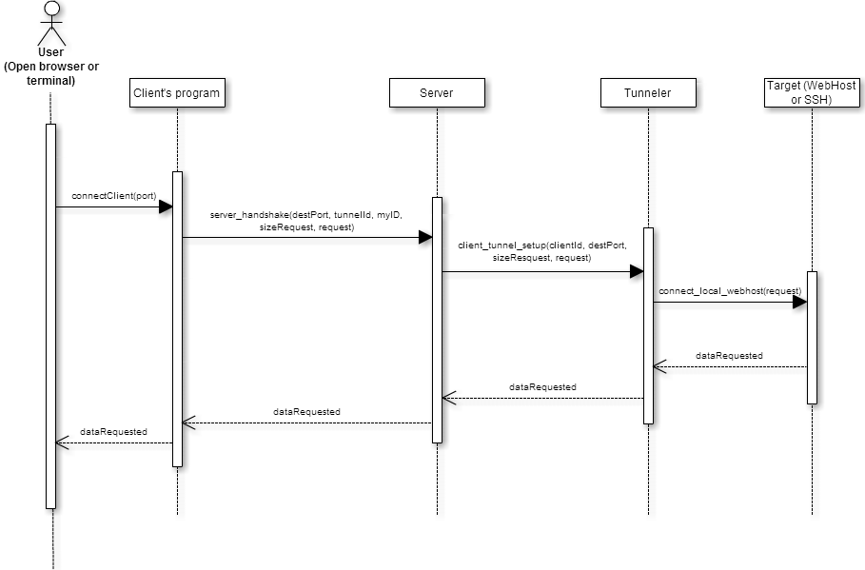
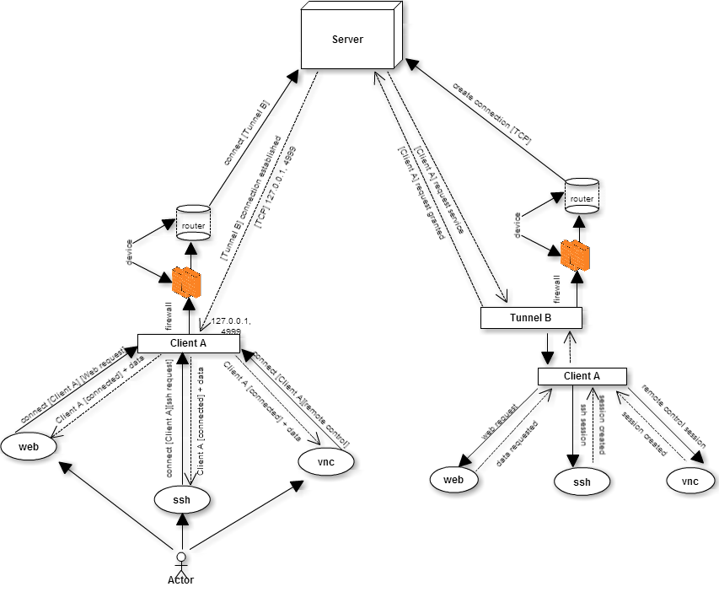
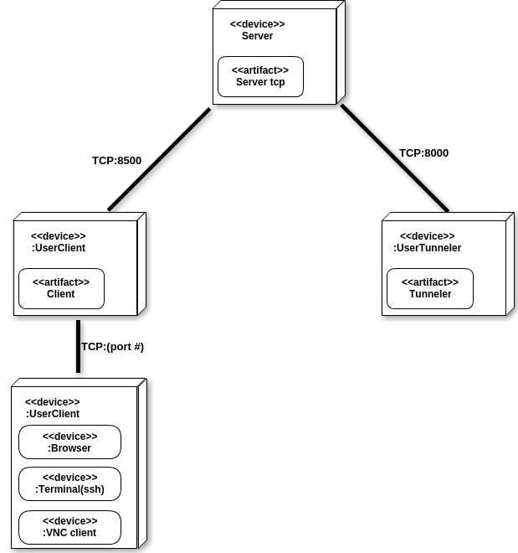
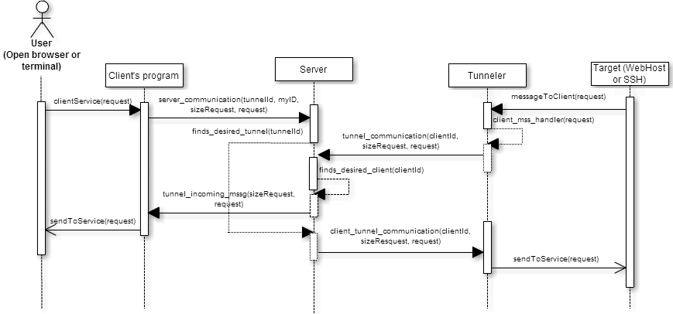
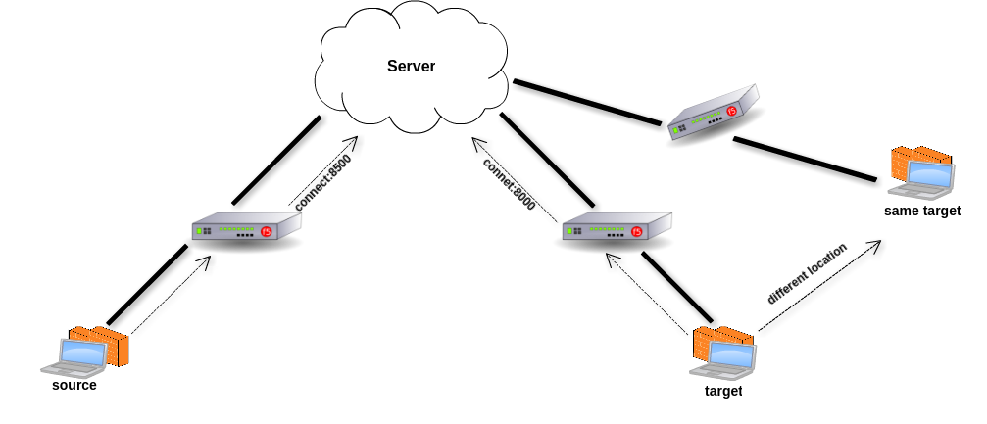
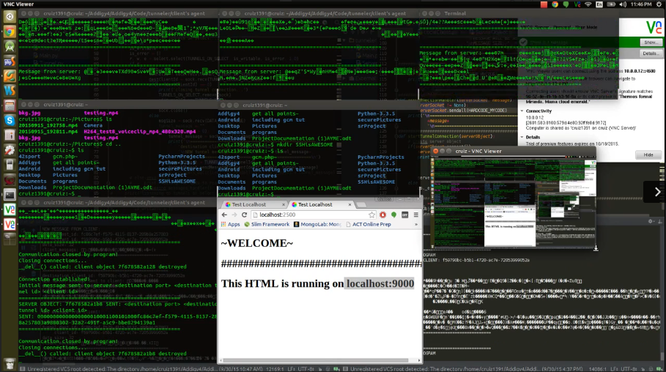
School of Computing & Information Sciences
Senior Project, 2015, Fall
Tunneler
Student: Carlos Ruiz, Florida International University
Mentor: Jason Dettbarn, Addigy
Instructor: Masoud Sadjadi, Florida International University
Problem
Current System
Requirements
Peer-to-Peer communication is complicated to achieve.
There are technical steps to follow in order to be able to create a remote control session
Users without technical experience find these procedure almost impossible to be done.
It is not flexible or practical for users that move around.
Audigy’s system currently doesn’t support any of the following features, ssh session or remote control session.
Juniper networks is one system which currently exist and that provides the feature of tunneling network connections. It provides a clientless VPN user experience, serving as an additional remote access mechanism to corporate resources using an IVE appliance.
Configuration requires IVE to have a NC license.(paid)
Long and complicated configuration and settings.
Not a practical solution for users who are currently moving to different networks
Client/Tunneler software shall be able to create a TCP connection to the server.
Server shall be running all the time and be able to handle disconnections without interruption.
Client software shall be able to accept connections from local software such as web browser, terminal for ssh or vnc client for remote control.
Tunnel software shall be able to receive requests from different Clients
System Design
Server is the middle component which redirects connections and data
Client is the source component which initializes the session
Tunnel is the target component which receives request from different clients
Implementation
This sequence diagram shows how Client start communication with Tunnel
Object Design
Deployment Diagram
This sequence diagram depicts the flow of the communication once the connection was already established.
Screenshot
Summary
Verification
Project contribution to Addigy’s system:
  New system features like starting ssh, remote control using vnc and web sessions.
  Scalable and personalize server communication system.
  Simple system design which follows client-server subscription design.
  Flexible software system that can be integrated and used into existing systems.
Manual testing was used to test and explore the different functionalities of the system.
Debugging tools in PyCharm helped with the testing of the system by providing detailed information of step by step procedures and data errors that were being sent or received.
Simple high level system design showing communication and connectivity from source to target
Acknowledgement
The material presented in this poster is based upon the work supported by Jason Dettbarn, Javier Carmona and Ayme Morrina. I am thankful to the help that I received from my group member David Romero.
Notes:
12/05/15
Network Connect takes all traffic to and from the client and transmits over the secure Network Connect tunnel. The only exception is for traffic initiated by other IVE-enabled features, such as Web browsing, file browsing, and telnet/SSH. If you do not want to enable other IVE features for certain users, create a user role for which only the Network Connect option is enabled and make sure that users mapped to this role are not also mapped to other roles that enable other IVE features. When Network Connect runs, the client effectively becomes a node on the remote (corporate) LAN and becomes invisible on the user’s local LAN. The IVE appliance serves as the DNS gateway for the client and knows nothing about the user’s LAN. Users may define static routes on their PCs to continue to access the local LAN while simultaneously connecting to the remote LAN. For security consideration, because the PC traffic goes through the Network Connect tunnel to internal corporate resources, make sure that other hosts within that user’s LAN cannot connect to the PC running Network Connect

