Slide 1



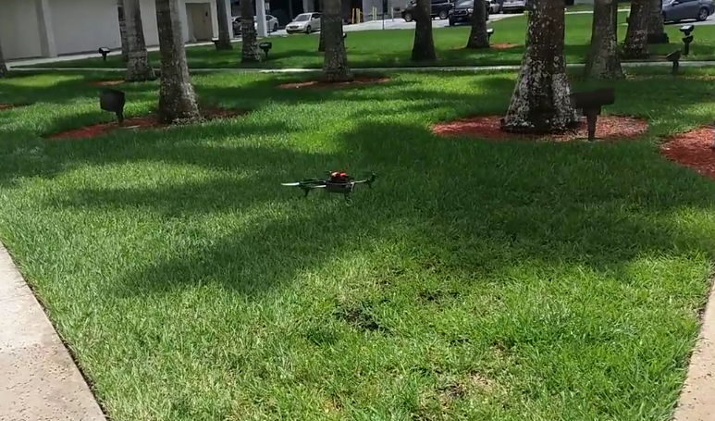
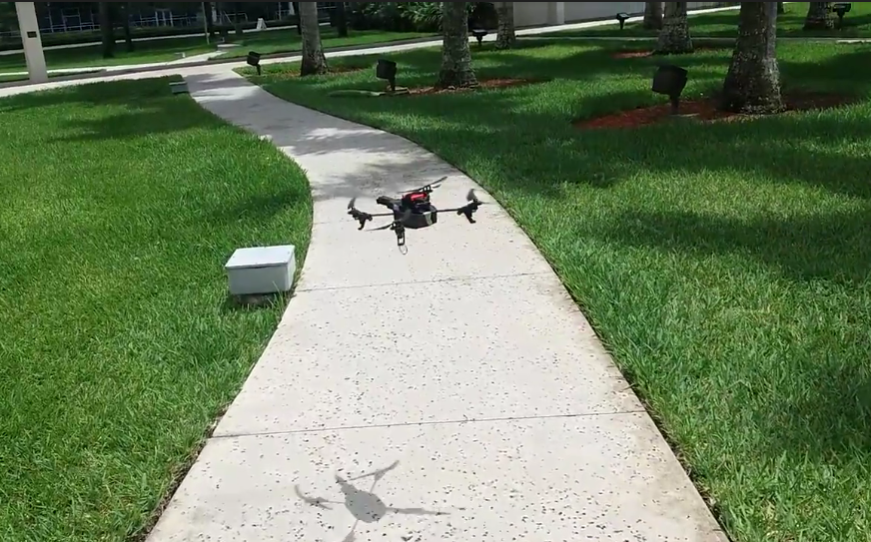
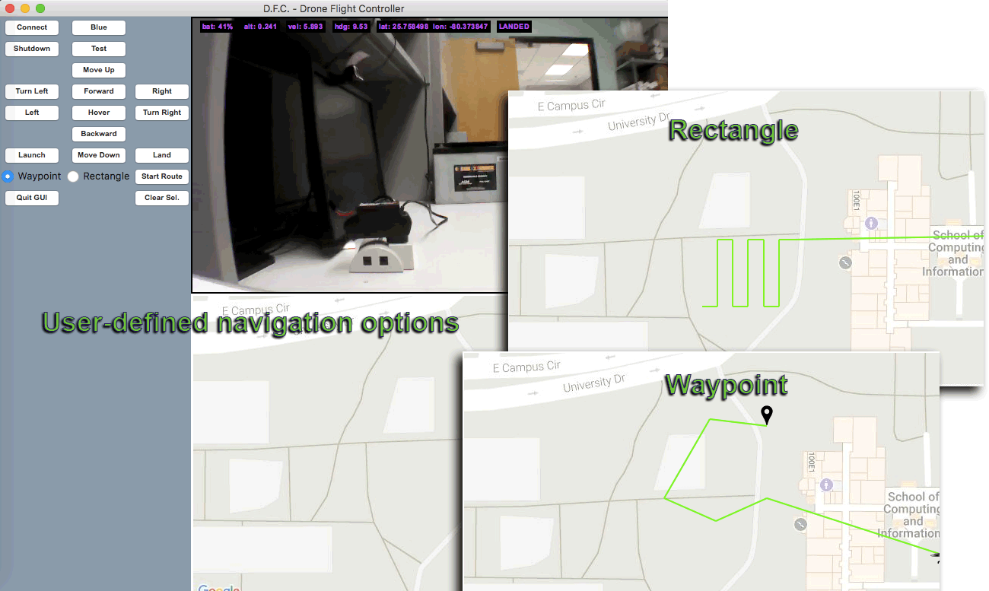
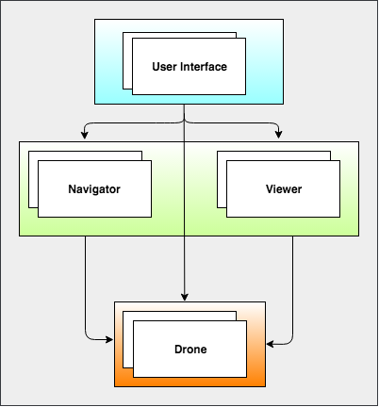
School of Computing & Information Sciences
CIS 4911, 2017, Summer C
Agricultural Robotics 3.0
Student: Christian Silva, Florida International University
Mentor: Dr. Leonardo Bobadilla, Florida International University Instructor: Masoud Sadjadi, Florida International University
Problem
Studies of horticultural characteristics of tropical agriculture require large data sets for adequate research of (HC).
Gathering data manually is inefficient(i.e. researchers physically survey areas of agricultural cultivation).
Current System
Web application written in Javascript.
Front-End utilizes pre-existing Android mobile client for drone controller interface.
Back-End utilizes Django framework for storing data dispatched from the drone.
Computer vision enabled with openCV.
Requirements:
Drone Controller interface shall be written in Python 2.7
Interface shall provide manual flight controls.
Interface shall implement OpenCV to include live camera display and color detection.
Interface shall include interactive map that allows path planning (i.e. operator selects map locations the drone will navigate).
Solution
Develop software platform combined with drone hardware to produce research data.
Drone deployment will collect horticultural characteristics, and process sensor data.
Provide stakeholders with visualization of data analysis using different interfaces.
Project Contribution
Develop a graphical user interface to command drone hardware.
Implement interface navigation options that allow pre-defining paths for autonomous drone flight.
Display useful sensor data within user interface.
System Design
Verification
All testing was performed manually with drone grounded or in-flight.
Grounded testing included path selection feedback. The drone operator would select multiple points on the provided map area, and selections were rendered and updated in a list of locations.
In-flight testing executed multiple movement commands. The drone operator would select a move command (e.g. “forward,” “turnright”), and the drone continuously performed each action until new command was dispatched.
Implementation
Graphical user interface is implemented using Tkinter for interface between Tk GUI toolkit and Python 2.7.
Control of drone hardware through gui controller is implemented using third-party Python 2.7 Parrot AR.Drone 2.0 API¹ .
Controller display of drone camera output is implemented with OpenCV 3 computer vision library.
Summary
Agricultural Robotics version 3 concentrates on designing a research tool component, written in Python, for processing sensor data, and providing autonomous navigation. This component would extend drone operability, allowing stakeholders to survey larger agricultural areas.
The material presented in this poster is based upon the work supported by Dr. Leonardo Bobadilla. I am thankful to the help that I received from my group member, Sean Monroe.
1. Philipp de Graaff, J., “PS_DRONE Programming a Parrot AR. Drone 2.0 with Python - The Easy Way,” www.playsheep.de/drone, 2014
Acknowledgement
Notes:
‹#›

