Slide 1
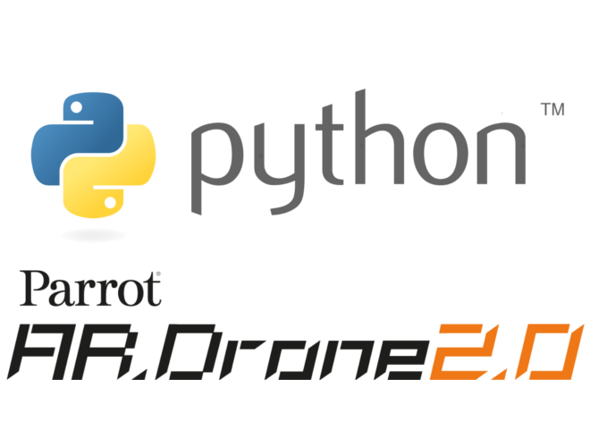

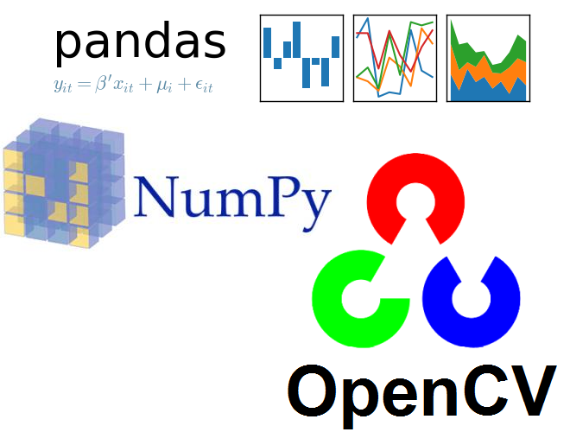
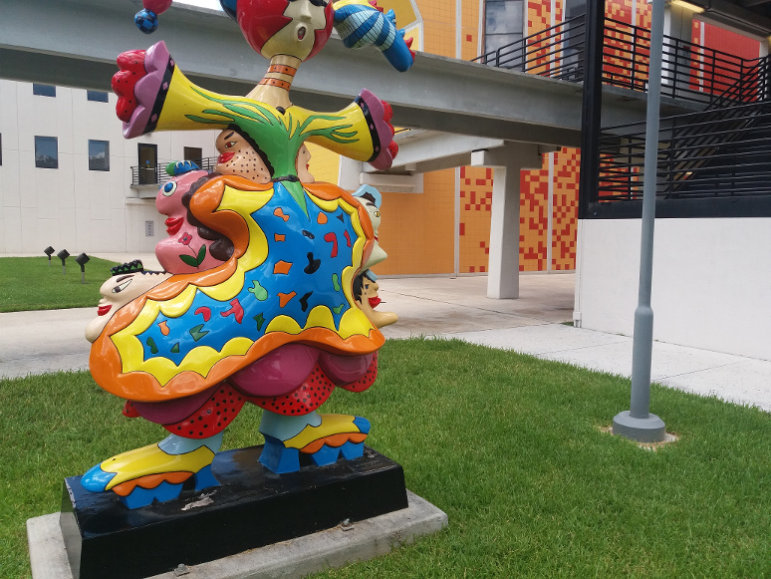

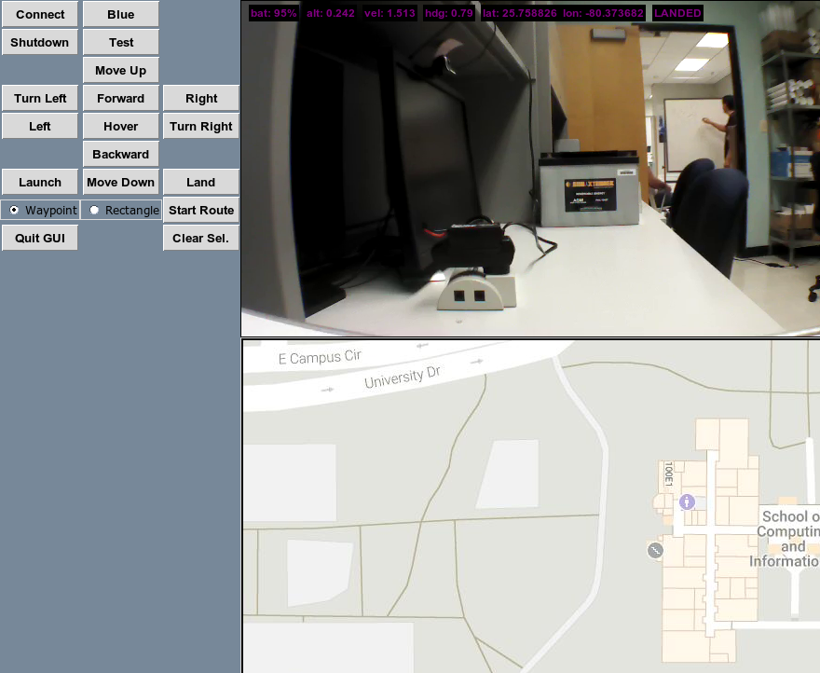
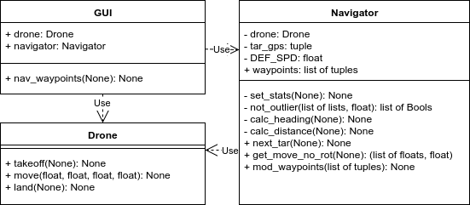
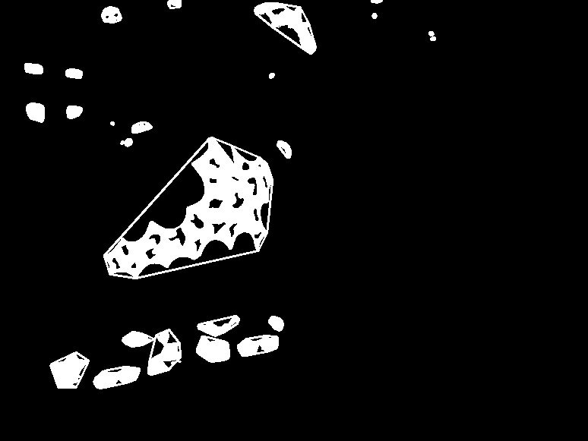
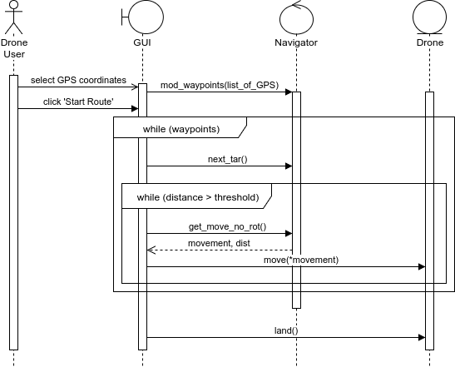
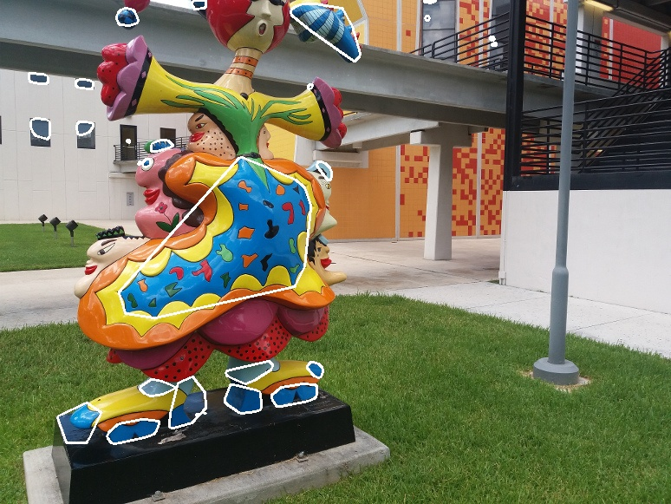
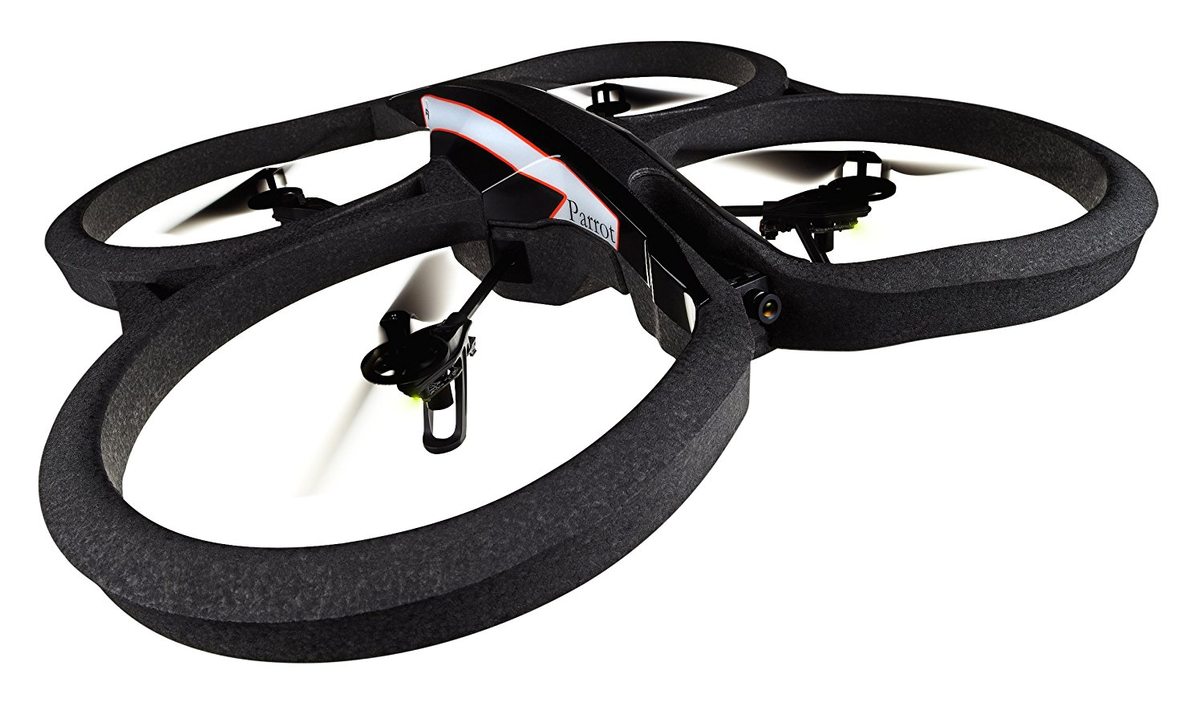
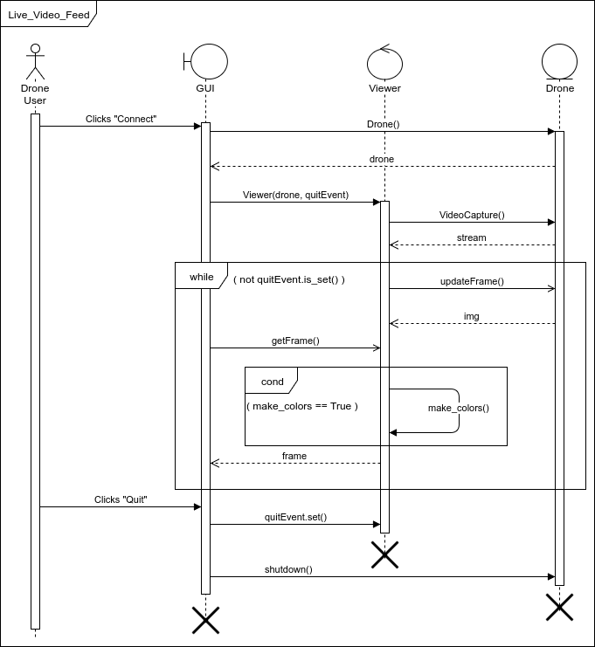
School of Computing & Information Sciences
CIS4911, 2017, Summer C
Agricultural Robotics 3.0
Student: Sean Monroe, Florida International University
Mentor: Dr. Leonardo Bobadilla, Florida International University
Instructor: Dr. Masoud Sadjadi, Florida International University
Advanced study of horticultural characteristics (HCs) of tropical agriculture is arduous and costly.
Obtaining large data sets is required for adequate research of HCs.
Current data gathering is performed manually.
Current System
Problem
Engineer a software system that controls a commercial drone to build data sets autonomously.
Stream live sensor data and a camera feed to a GUI.
Implement navigation options that allow manual and autonomous drone flight.
Solution
Web service stack using Node, Django and PHP.
Mobile application for drone controller interface.
Forks of existing solutions’ repositories.
Feature detection with OpenCV and Convolutional Neural Network model.
Navigator
Features of Interest
System Design
Navigator
Features of Interest
User Interface
Threshold mask and contour finding
Controllers
Navigator
Viewer
Contour drawing on original image
Implementation
Requirements
Uses the Parrot AR Drone 2.0
Users can engage in manual flight
Users can start and override autonomous activity
Users can view real-time sensor data
Users can view a live video feed
Users can enable object detection within the video feed
Users can select a navigation area using a map
Implementation
Files are written in Python 2.7
The PS-Drone library allowed full access to Navigation Data after a GPS patch
OpenCV v3 was compiled to have VideoCapture support and run on Python 2.7
Pandas and NumPy provided data structures and statistical functions to manipulate images and process sensor data
Requirements
Viewer
System Design
Functional testing was done indoors with simulated, overridden, or ignored sensor data to validate fault avoidance and tolerance.
Performance and acceptance testing were done outdoors against simulated cases to evaluate performance and precision of sensors, as well as fine tuning timed events in autonomous navigation.
A Navigator object makes available preprocessed sensor data and autonomous pathing functionality. A Viewer object makes available preprocessed camera images with scalable computer vision capabilities.
This is all done in Python 2.7 to provide a clear and simple foundation for further work.
Acknowledgements
Verification
Summary
The material presented in this poster is based upon the work supported by Dr. Leonardo Bobadilla and the Discovery Lab of FIU.
The original PS-Drone library is the work of J. Philipp de Graaff.
I am thankful for the help that I received from my group member, Christian Silva.
Notes:
1

