Slide 1


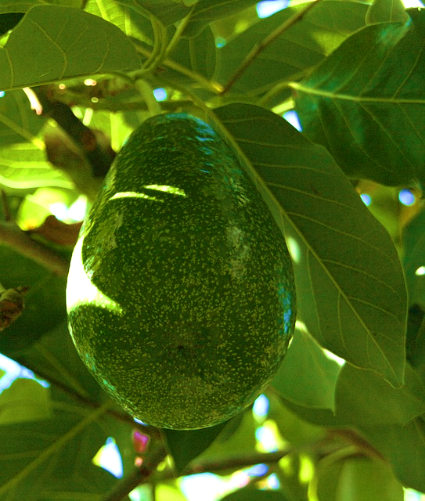
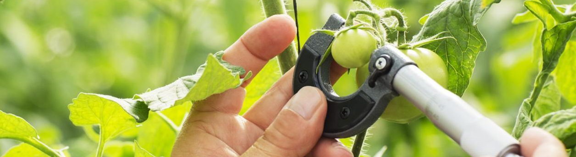
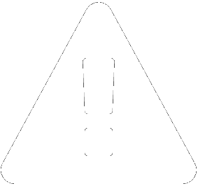





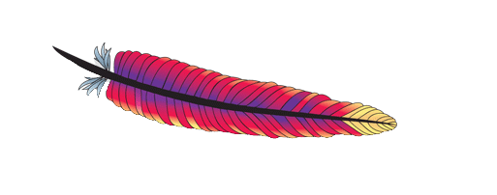







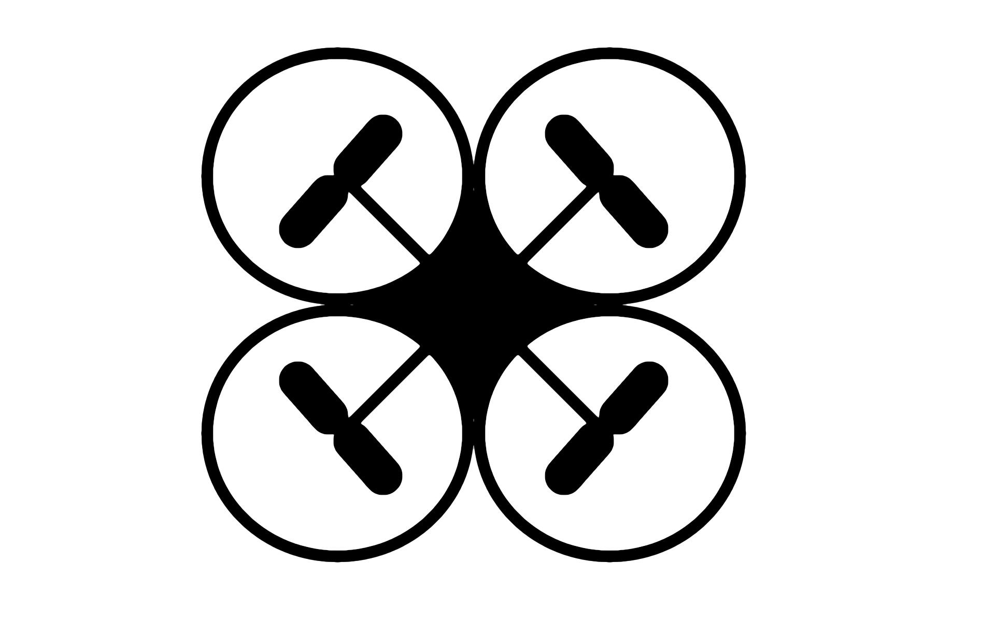


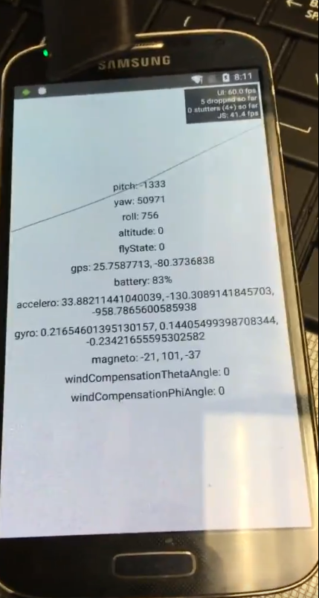
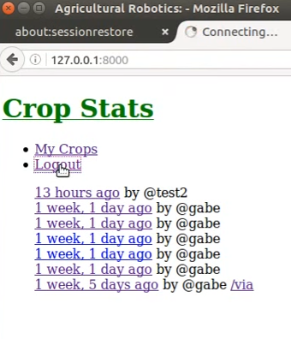
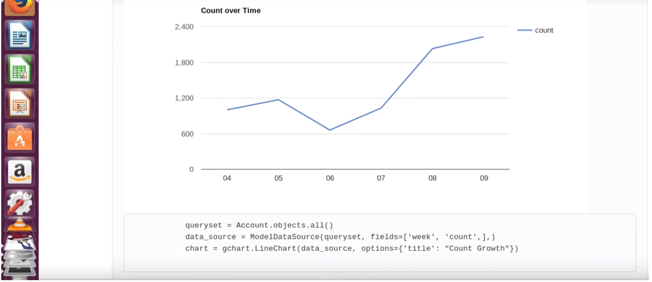
FruitTREC: Agricultural Robotics 1.0
Senior Project, 2016, Fall
School of Computing & Information Sciences
Student: Miguel Chateloin (FIU) - Mentors: Dr. Leonardo Bobadilla (FIU), Dr. S.S. Iyengar (FIU) Dr. Wagner Vendrame (UF) - Instructors: Mohsen Taheri (FIU), Masoud Sadjadi (FIU)
Problem
Requirements
Overusing using pesticides and fertilizer is expensive, and has negative environmental impacts.
Efficient use requires up-to-date horticultural characteristics (HC).
Recording crop statistics is a tedious and time consuming processing.
Current System
Create a user-friendly mobile application that manages drone and flight related information.
Provide an interface to view and manage analytical reports generated on the server.
Must be compatible with the AR Drone 2.0.
Android 5.0+ supported
Ability to read navigation and sensor related information off of the drone in real-time.
Supported modules built for manual control, and autonomous flight paths for a drone.
Flight-related data is initially stored on the device with the intention of later storing it on the server for review.
Ability to take emergency control of a drone with a piloting interface.
Solution
Delegate HC collection to an inexpensive AR Drone 2 by using computer vision techniques process fly-by videos of fruit trees. Provide a mobile application that pilots the drones autonomously, and persists flight data to a web server to generates statistical reports.
My Contributions:
Object Design
Mobile App Development
Drone Operation Features
User Interface
System Design & Implementation
Server
HTTP Server
The FruitTREC webserver was written in Python modules driven by forms and models. Storage was done by an FIU Ubuntu VM and schemas were based in PostgreSQL currently. The Django Framework played a huge role in the facilitating web development in terms of database concurrency and debugging views.
API
DB
Vision Module
HTTP
Ubuntu OS
UI (React Native)
The React-Native framework was chosen to reduce development time in the user interface and business level. React-Native allowed the team to write more application code using already mastered web technologies (JavaScript, and JSX) and sets up future teams to reuse that same code to support iOS. For this iteration Android was the supported platform of choice due to its accessibility and the devices available for testing.
The AR Drone 2.0 was provided by Parrot. It was chosen for its cost-effectiveness and its enabling ability to quickly prototype our system. For our purposes, we treat it as a black box. These are some of its specs:
Client
Service Layer (Android)
Grower
AT Commands (UDP)
TCP&UDP
Video Stream (TCP)
Video Stream (TCP)
VGA Downward Camera: 360p (640x360 Upscaled) or 720p (1280x720 Upscaled) @ 60fps (downward facing)
HD Forward Camera: 360p (640x360 Downscaled) or 720p (1280x720 Native) @ 30fps (92°wide angle lens)
NavData/Telemetry: Sent 15 times per second in demo mode, 200 times per second in full (debug) mode.
Encryption: None/Open
Processor (CPU): 1GHz ARMv7 Processor rev 2 (v7l)
Digital Signal Processor (DSP): 800MHz video DSP TMS320DMC64x
Memory (RAM): 1Gbit DDR2 RAM at 200MHz
Memory (Permenant): 32Mb of NAND Flash
Communications: Wireless (WiFi) 802.11b/g/n Atheros (6103?) Chip [2]
Sensors: 3 axis accelerometer +/- 50mg precision, 3 axis gyroscope 2000°/second precision, Pressure sensor +/- 10 Pa, 40kHz Ultrasonic sensors (0-20ft range), Liquid
Repellant (Hydrophobic) to avoid aqueous infiltration
Power: 11.1v 3-element 1,000 mAh LiPo, 10c discharge capacity, Approx. 12 minutes flight time per charge
Approx. 90 minutes to charge stock battery
Motors: Brushless 14.5 watt, 28,500 RPM, 8 MIPs AVR CPU each
Altitude: Stable at up to 6m - 20ft. Controllable up to 50m - 160ft (due to WiFi Range)
Speed: up to 18 km/h (11 miles/hr)
:5556
:5555
:5555
Drone
AR Drone 2.0 API
FTP Server
Built by Parrot
Busy Box Linux OS
Verification
Screenshots
Test Case 1
Test Case 5
Purpose: To test that telemetry information ncan be displayed in UI in realtime.
Preconditions: Device is connected to the drone's Wi-Fi
Input: User selects the NavData demo menu button
Expected: NavData including altitude, attitude, gps, etc. is displayed on screen and immediately starts updating to reflect the precise readings coming from the drone.
Actual: As expected
Purpose: To test that the application bocks control inputs when drone is in emergency mode
Preconditions: Device is connected to the Drone's Wi-Fi, user is on the piloting view, drone is in emergency mode
Input: User taps the Forward button
Expected: The drone should not respond. It should continue the process.
Actual: As expected
Summary
This first version of FruitTREC lays the groundwork for building a system that enables growers to autonomously pilot drones for crop sampling, generating and sharing reports from flights plans, and tracking horticultural statistics. The system follows the client-server approach, whereby a mobile application operates the drone via its generated Wi-Fi network, and sends and receives data to an API server via HTTP. Reports designed to be generated on server backend, including the image processing that is performed by the Computer Vision Module.
Acknowledgements
The material presented in this poster is based upon the work supported by Miguel Chatleoin. I am thankful to the help that I received from my group members, Franklin Abodo, Gabriel Barrs and Irma Castillo Koelig, as well as the mentorship I received from Dr. Bobadilla, Dr. Vendrame, and Dr. Iyengar.
Notes:
‹#›

