Slide 1







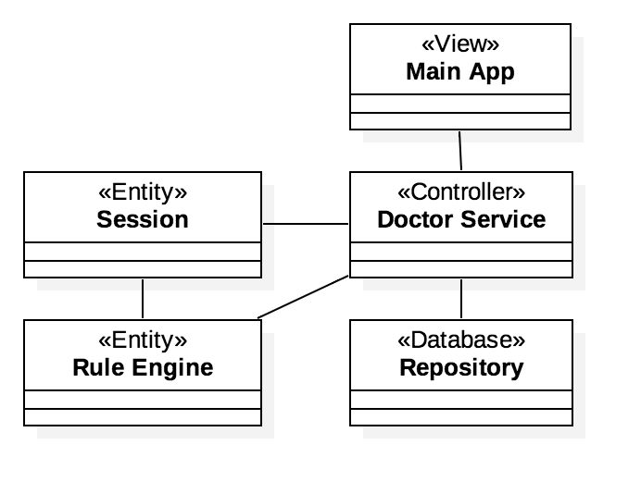
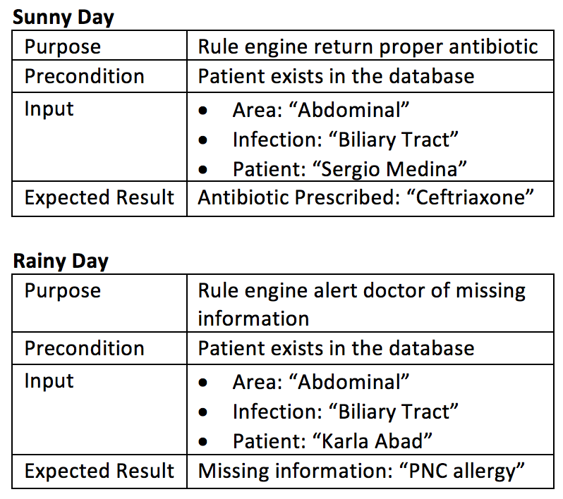
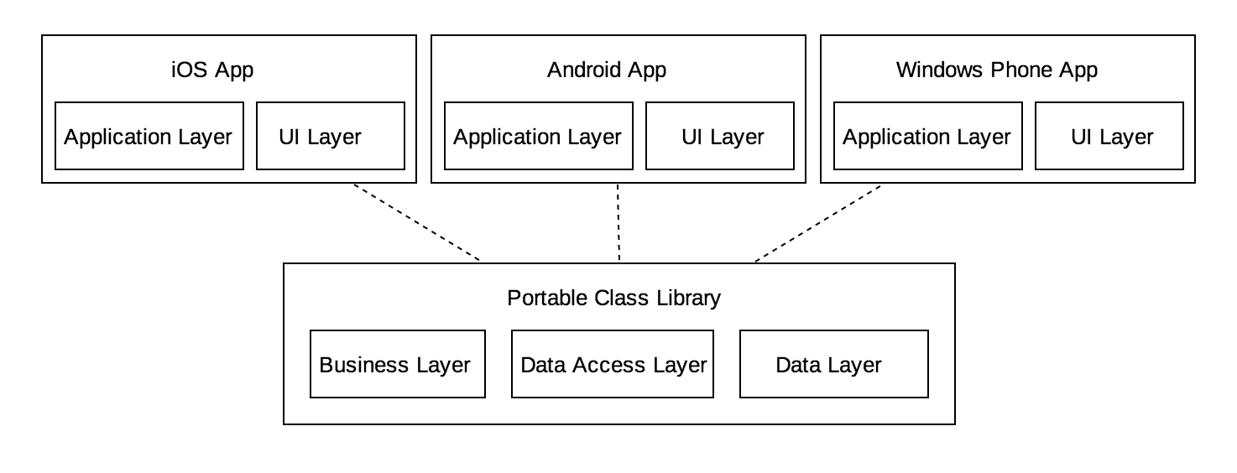
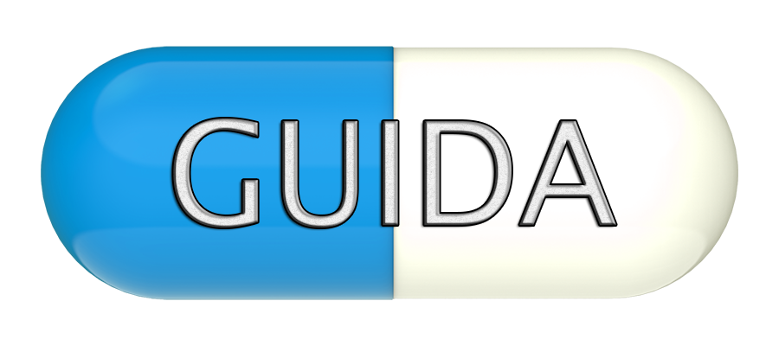
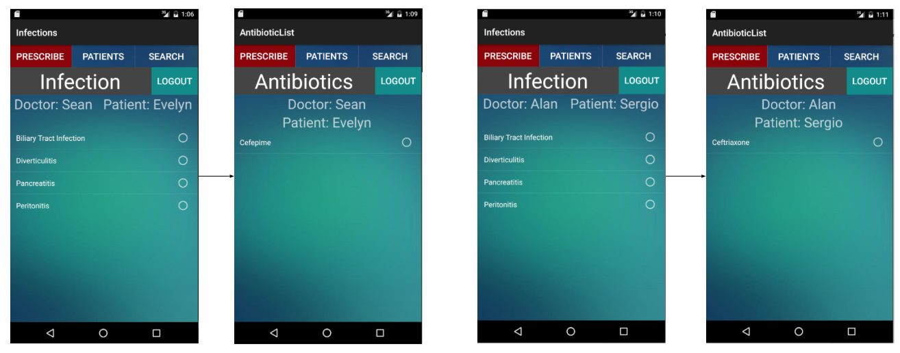
School of Computing & Information Sciences
Senior Project, 2016, Summer
Antibiotic Drug Prescription
Student: Alan Nieto, Florida International University
Mentor: Giri Narasimhan, Florida International University
Instructor: Masoud Sadjadi, Florida International University
Problem
Current System
Requirements
Antibiotic resistance is a major issue confronting healthcare providers and their patients. Changing antibiotic resistance patterns, rising antibiotic costs and the introduction to new antibiotics have made selecting optimal antibiotic regimens more difficult now than ever before.
The current system allows a doctor to login, view patients, and search for an antibiotic. After the doctor have selected a patient, he can start using the rule engine to prescribe a specific antibiotic. The result of the inference engine depends on the rules and the patient information already stored in a repository.
Create a cross-platform mobile application
User-friendly
User-specific patients, that can be selected and evaluated
Intelligently suggests the proper antibiotic to be prescribed for evaluated patient
Object Design
Verification
Implementation
Xamarin and C# were used to create a cross-platform mobile app
Rules are stored in an SQLite database in (almost) plain english
Rule engine breaks down rules using a regular expression
Regex groupings correspond to data in the knowledge base(patient database)
By comparing rules with the knowledge base the truth of a given rule is determined
True rules are associated with an antibiotic, which is then displayed
System Design
Screenshots
Summary
This project is the first release of Antibiotic Drug Prescription. The result provided by the rule engine can be modified after collecting data from the users. If patients start to gain resistance to a specific antibiotic, it is only matter of changing the set of rules currently stored on the repository.
Acknowledgement
The material presented in this poster is based upon the work supported by Alan Nieto. I am thankful to the help that I received from my group member, Sean Iamartino, mentors, Giri Narasimhan , Trevor Cickovski, our instructor, Masoud Sadjadi, and his assistant, Mohsen Taheri.
Notes:
‹#›

