Slide 1







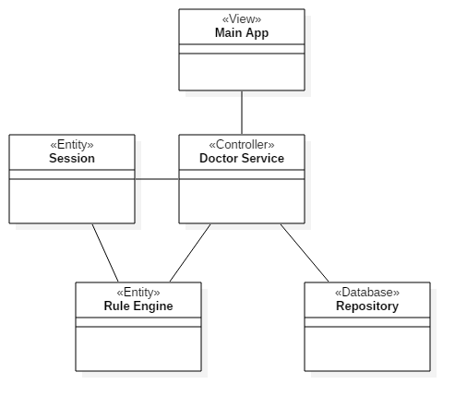
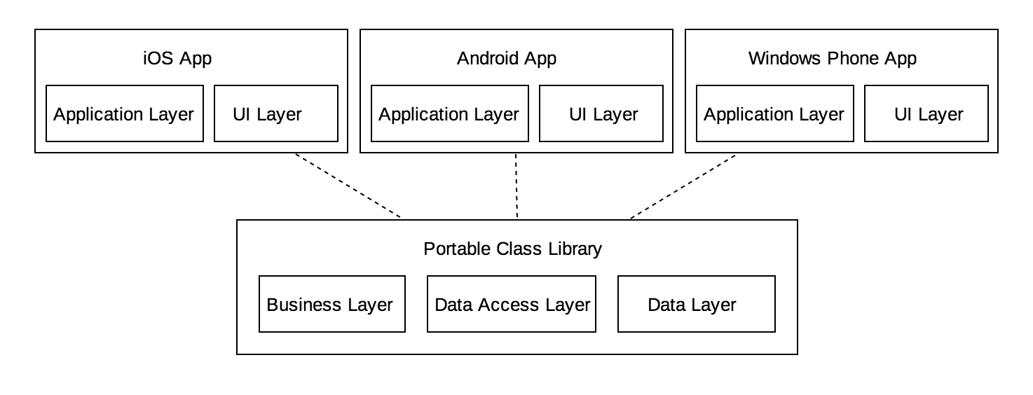

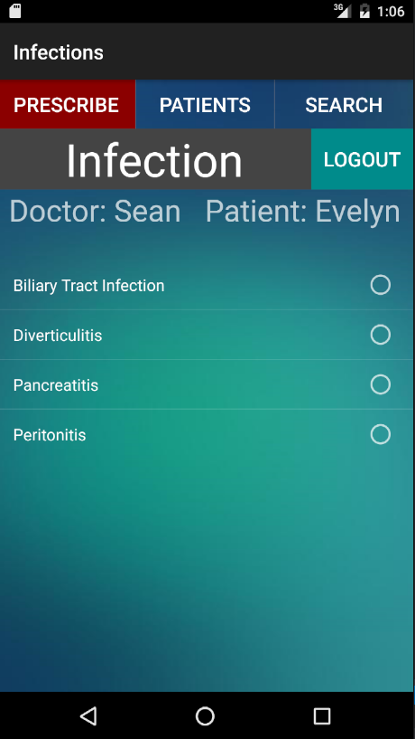
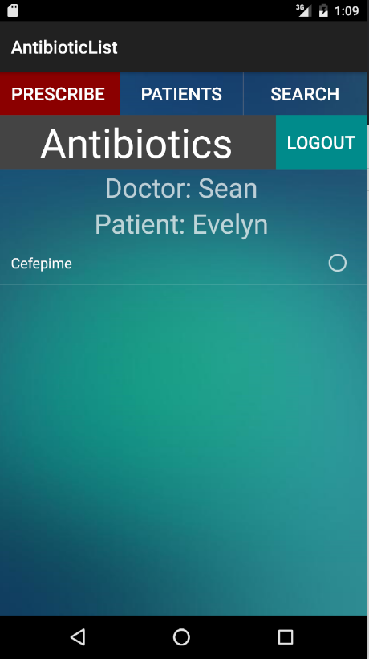
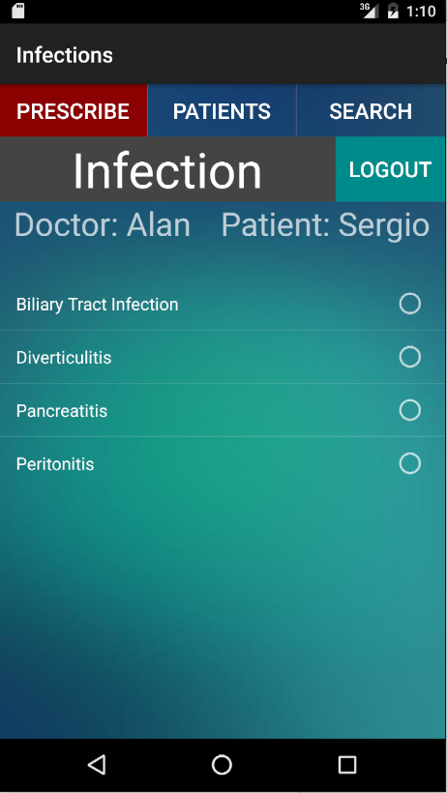
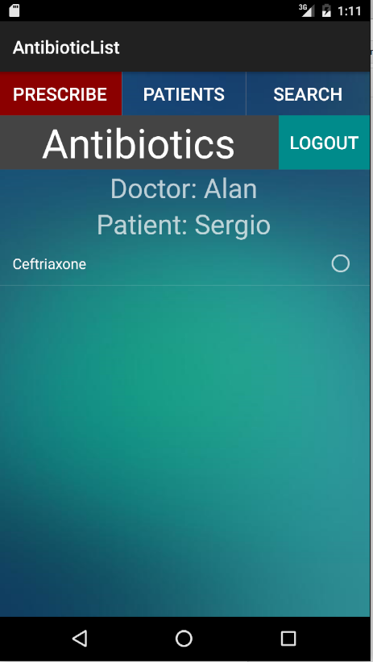
School of Computing & Information Sciences
Senior Project, 2016, Summer
Antibiotic Drug Prescription
Student: Sean Iamartino, Florida International University
Mentor: Giri Narasimhan, Florida International University
Instructor: Masoud Sadjadi, Florida International University
Problem
Current System
Requirements
Antibiotic resistance is a major issue confronting healthcare providers and their patients. Changing antibiotic resistance patterns, rising antibiotic costs and the introduction to new antibiotics have made selecting optimal antibiotic regimens more difficult now than ever before.
Rule-based system
Allows user to select a patient
Uses patient information as knowledge base
Suggests the proper antibiotic to be prescribed
If no antibiotic was found, informs user what patient data was missing
Create a cross-platform mobile application
User-friendly
User-specific patients, that can be selected and evaluated
Intelligently suggest the proper antibiotic to be prescribed for selected patient
Object Design
Implementation
Xamarin and C# were used to create a cross-platform mobile app
Rules are stored in an SQLite database in (almost) plain english
Rule engine breaks down rules using a regular expression
Regex groupings correspond to data in the knowledge base(patient database)
By comparing rules with the knowledge base the truth of a given rule is determined
True rules are associated with an antibiotic, which is then displayed
System Design
Screenshots
Summary
A cross-platform prototype application that is able to suggest the proper antibiotic to use for a selected patient has been created. With this system, rules can be added, removed, and modified as antibiotic medicine changes.This application shows the potential of this project to be useful to physicians, versatile, and expandable. Future projects may be able to expand on the rule base, collect data about antibiotic usages to help prevent bacterial resistances, connect to existing patient databases, and more.
Acknowledgement
The material presented in this poster is based upon the work supported by Sean Iamartino. I am thankful to the help that I received from my group member, Alan Nieto, mentors, Giri Narasimhan , Trevor Cickovski, our instructor, Masoud Sadjadi, and his assistant, Mohsen Taheri.
Notes:
‹#›

