Slide 1



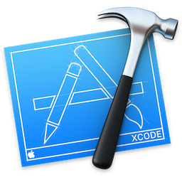


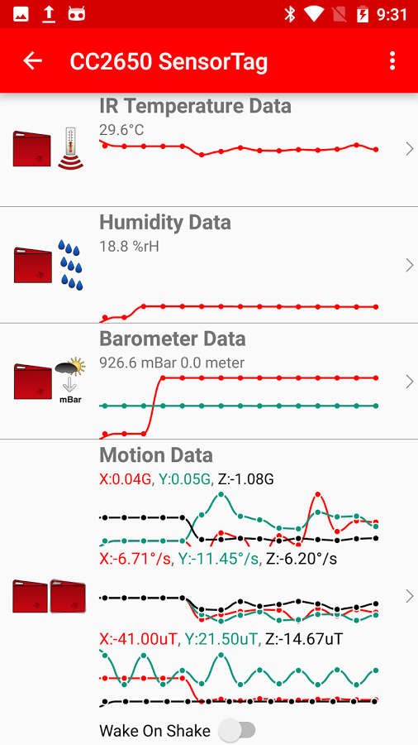
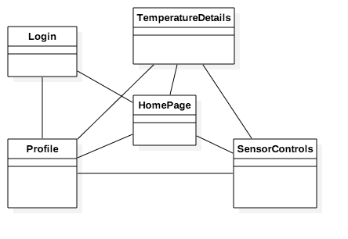
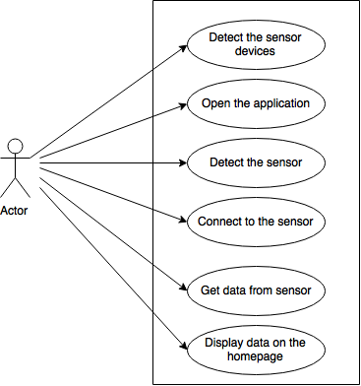
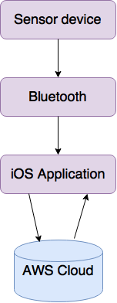
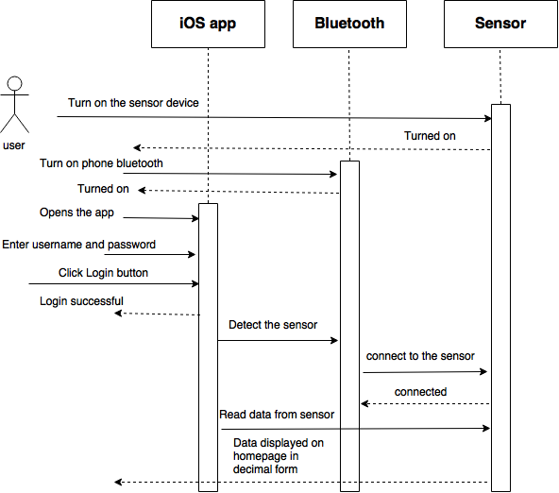
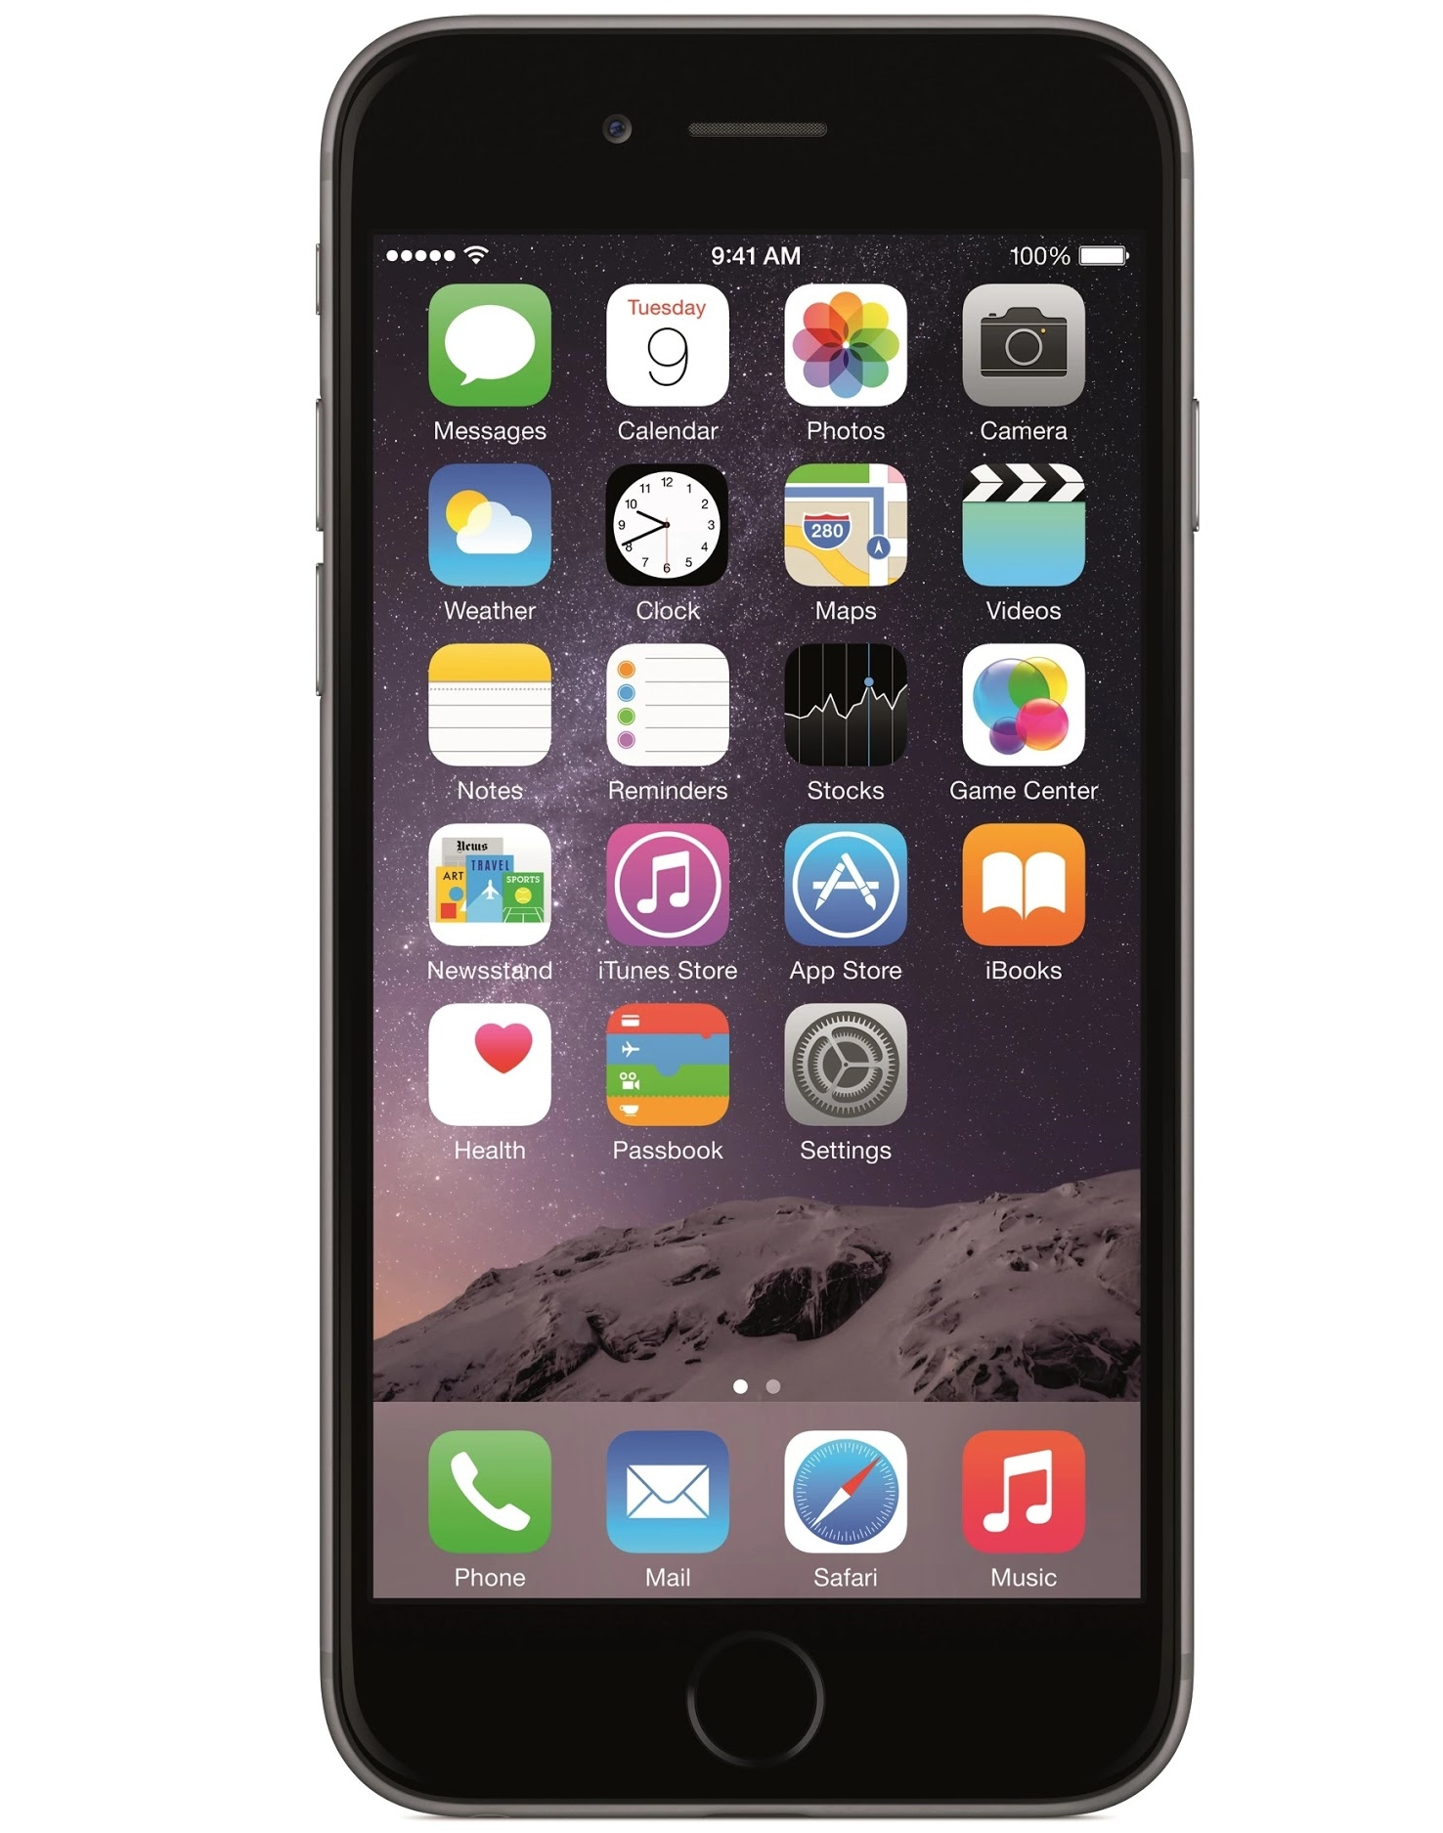
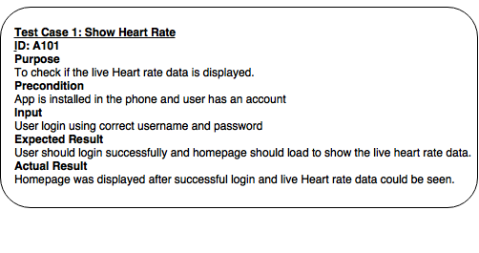
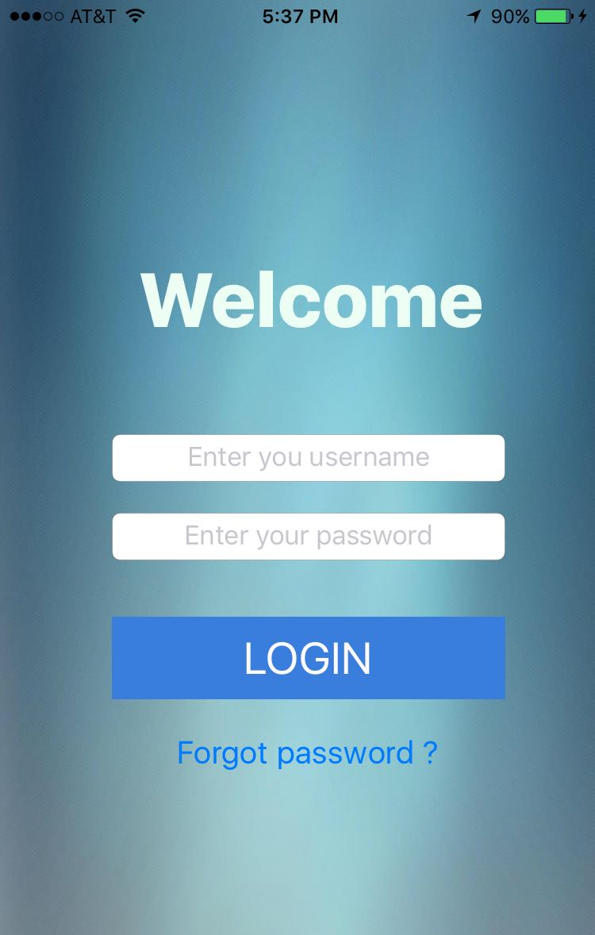
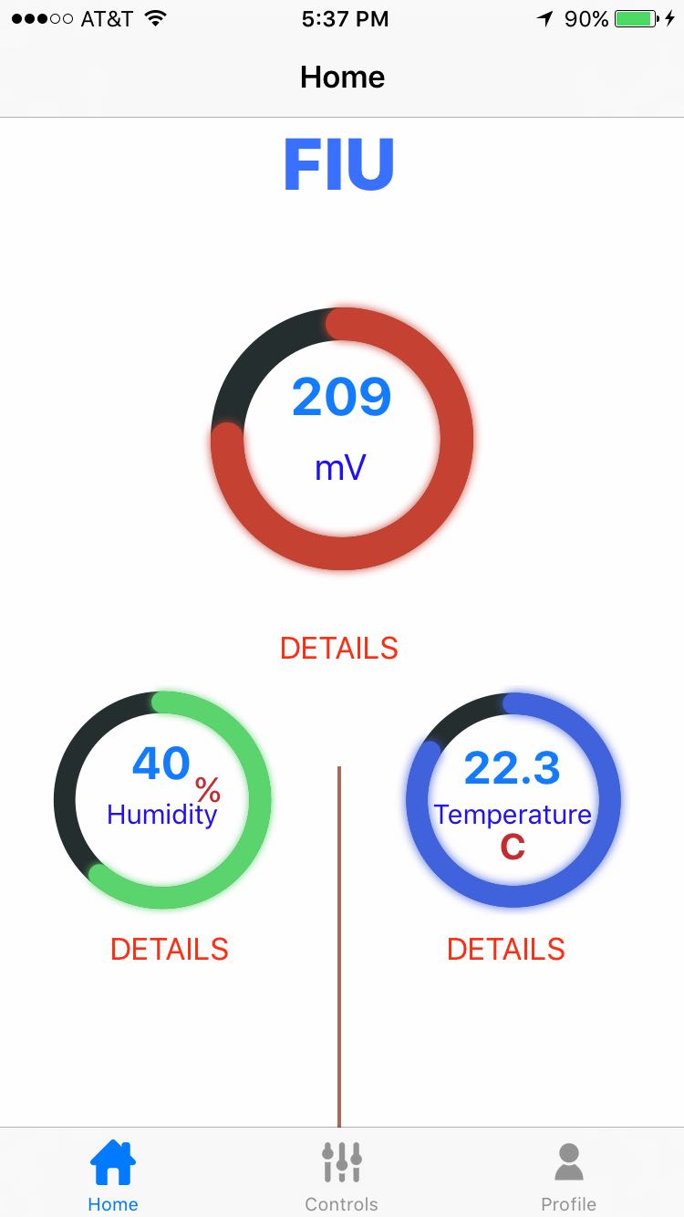
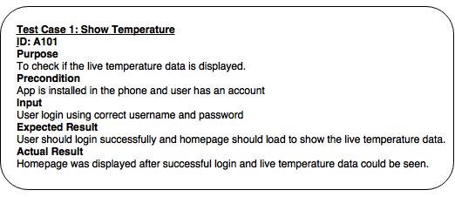
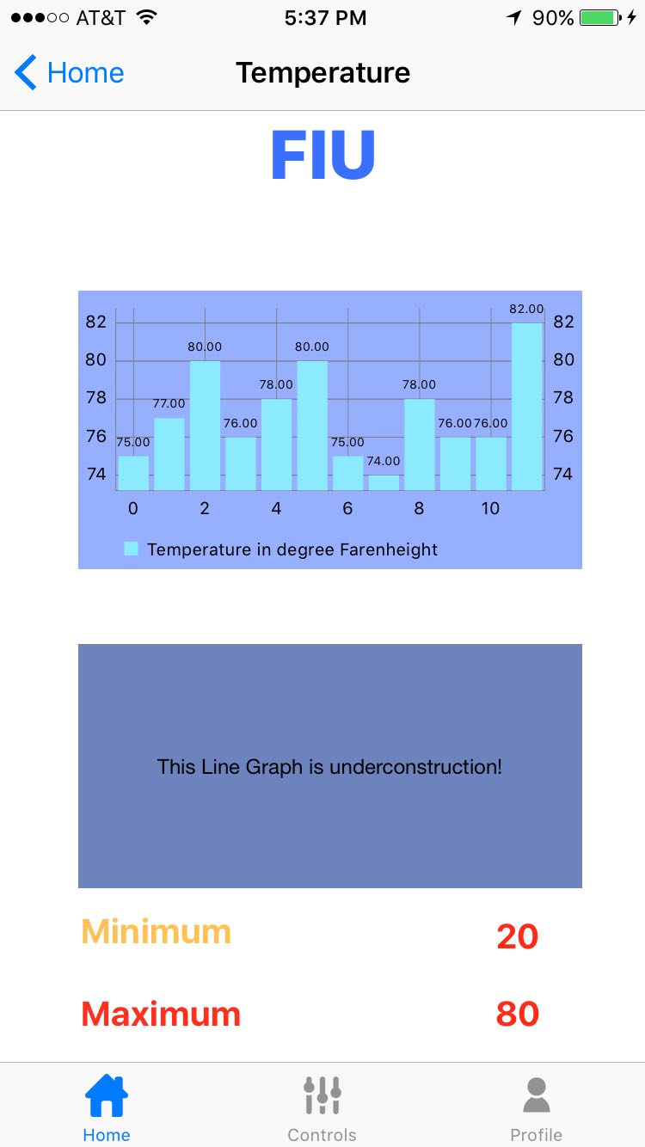
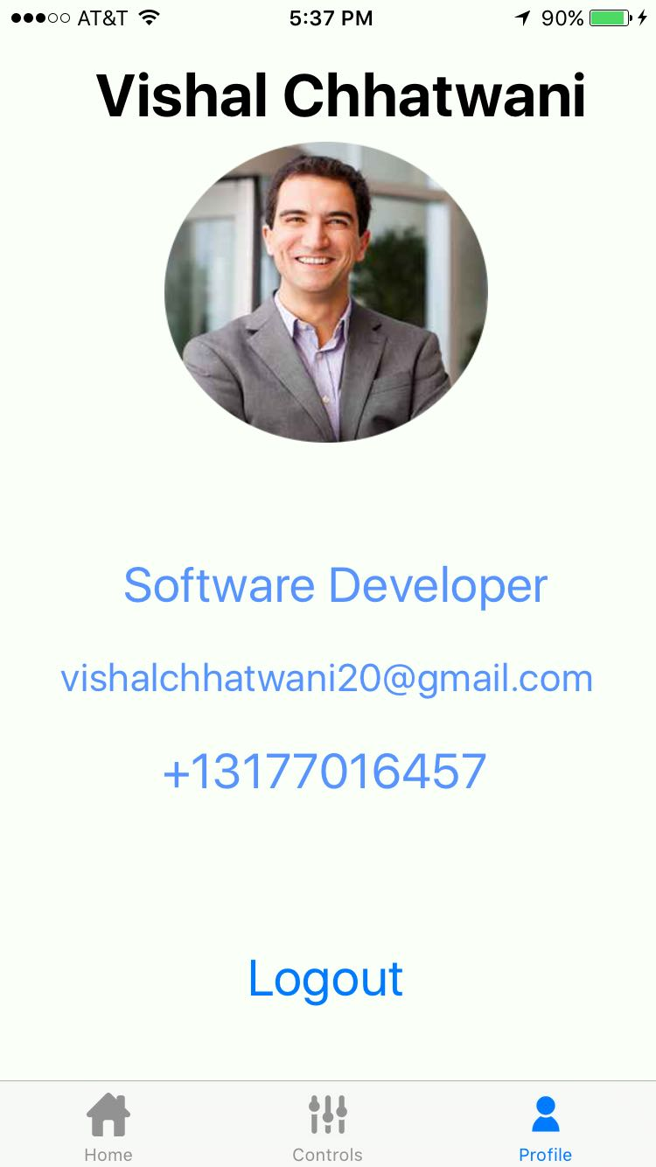
School of Computing & Information Sciences
Advanced Software Engineering, 2016, Fall
Biosensor 1.0
Student: Vishal Chhatwani, Florida International University
Mentor: Dr. Shekhar Bhansali, Florida International University
Mohsen Taheri, Florida International University
Instructor: Masoud Sadjadi, Florida International University
Problem
Current System
Requirements
People with heart issues and other such problems have to be monitored very carefully and continuously by their doctors.
They have to visit the doctor on regular basis and still there is a chance that doctor might not get some of the information.
There is an app from sensortag manufacturer which
only shows the raw data
not very user friendly
not customizable
This system had to be made from scratch. It has many requirements:
Login/Logout feature
HomePage to show all the sensor data
Separate Circle to show data from each sensor on Homepage
Profile page
Details page for each sensor data to show graphs and other stuff.
Line chart in Details page
Solution
1. Develop a mobile application that could use different biosensors like heart rate, alcohol level, sugar level etc.
2. Read the data from sensor, process it and show the final result.
System Design
Object Design
Implementation
Layered Architecture
Used xcode for the development of iOS app
Used swift for programming
Used iPhone device to test the application
Verification
Screenshots
Summary
Responsible for developing an iOS application.
Created the login feature
A Home page was created to show the data from two sensors currently used. i-e heartrate and temperature
Profile page has been design
I read the data from sensor and converted into a proper format
Created a details page for the graphs and detailed view
Created a page for sensor control so that you can control the sensor device from the app
Acknowledgement
The material presented in this poster is based upon the work supported by Dr. Shekar Bhansali. I am thankful to the help that I received from my group members, Xin Zhao and Zhiyuan She
Notes:
‹#›

