Slide 1




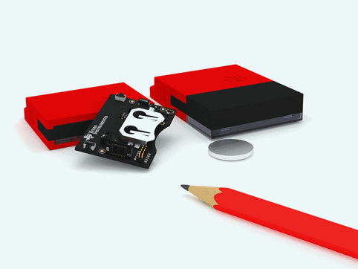
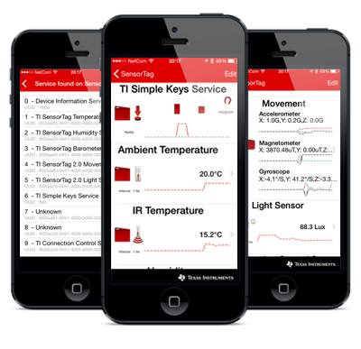
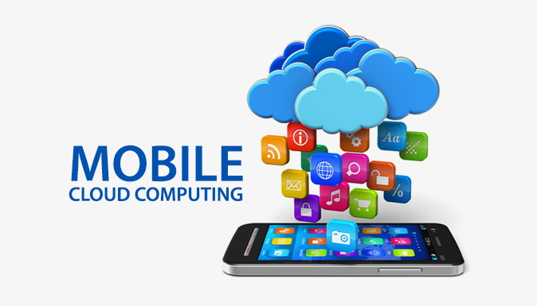
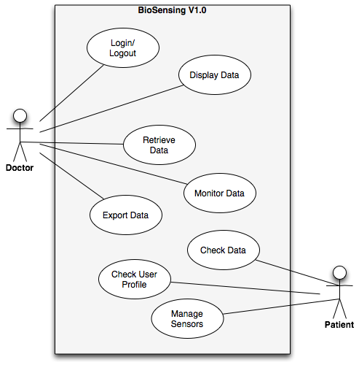

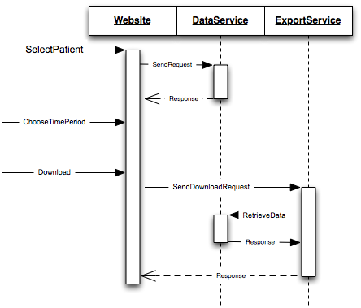
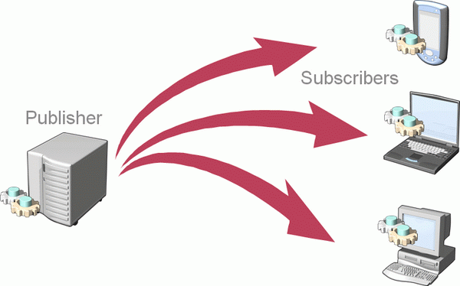



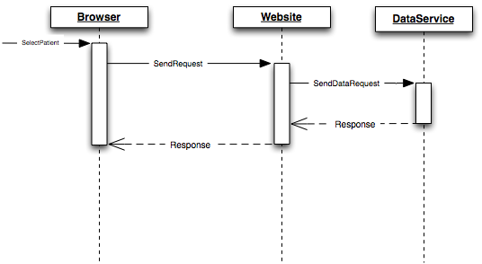
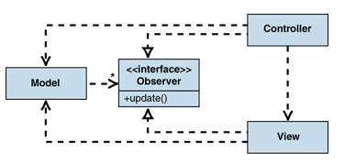


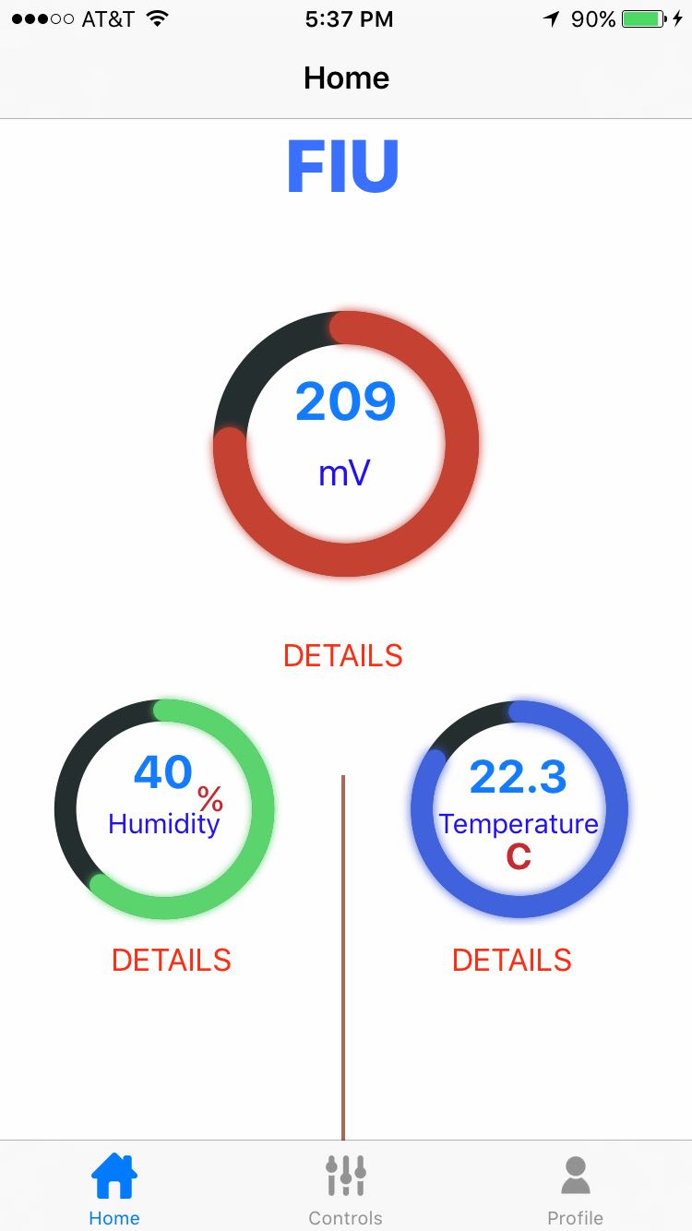
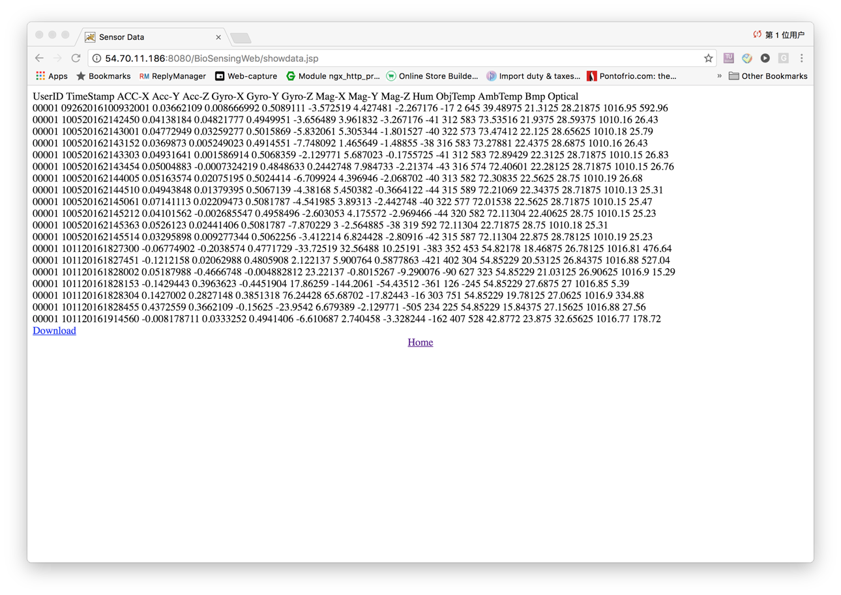
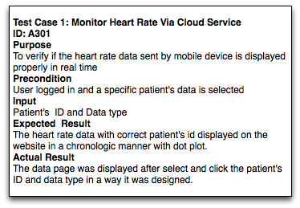
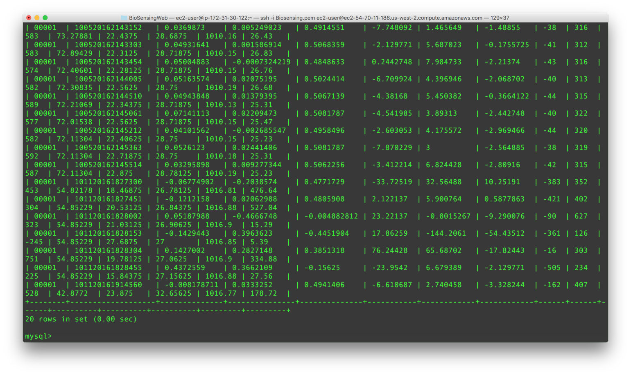
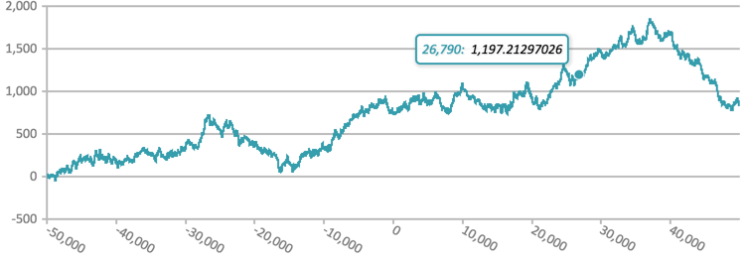
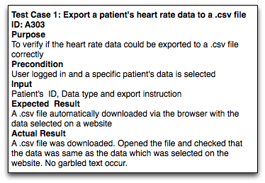

School of Computing & Information Sciences
Advanced Software Engineering, 2016, Fall
Biosensing Ver 1.0
Student: Xin Zhao, Florida International University
Mentor: Dr. Shekhar Bhansali, Florida International University
Mohsen Taheri, Florida International University
Instructor: Masoud Sadjadi, Florida International University
Problem
Biosensing App is a system which combines biosensor device, mobile application and cloud service together to detect, calibrate and analyze individual patient’s different kind of analyte such as blood pressure, heart rate or alcohol level for clinical purpose.
The patient’s status should be monitored continuously
Doctor wish to monitor the patient’s data remotely
Patient’s want to check his/her status automatically
Doctor want to analyze a patient’s data remotely
Current System
Currently, there is no such a system to fulfil the requirements. But there are distinct parts which could be used to build the system:
Biosensor with bluetooth module to detect the analyte and send the data
A manufacturer's mobile app to display the data collected from sensor tag
Requirements
General
User Administration
Mobile Application
Check a patient's data from mobile application
Check a patient’s profile from mobile application
Manage biosensors on mobile device
Calibrate data on mobile device
Cloud Service
Retrieve a patient’s data via cloud service
Monitor a patient’s data via cloud service
Analyze a patient’s data via cloud service
Export a patient’s data via cloud service
Solution
Build a service to communicate with biosensors
Develop a mobile application to display useful data
Develop and deploy a cloud service to retrieve, monitor and analyze data
System Design
Object Design
Implementation
Mobile-Cloud Infrastructure
Subscriber/Publisher for wireless communication
MVC for the mobile application
Verification
Screenshots
Summary
Communication with product owner on system requirements
Infrastructure of the entire system
Implementation of the cloud service
Management of the development progress
Acknowledgement
The material presented in this poster is based upon the work supported by Dr. Shekhar Bhansali. I am thankful to the help that I received from my group members, Vishal Chhatwani and Zhiyuan Shi.
Notes:
‹#›

