Slide 1
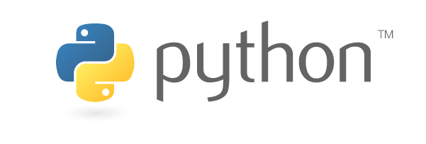




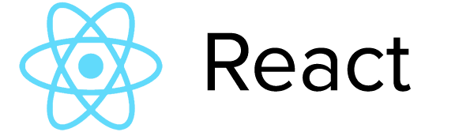




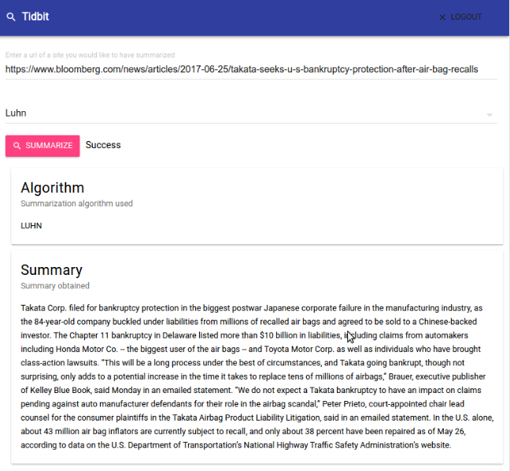
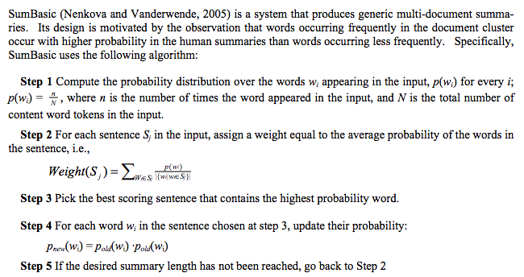
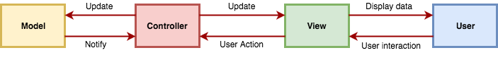
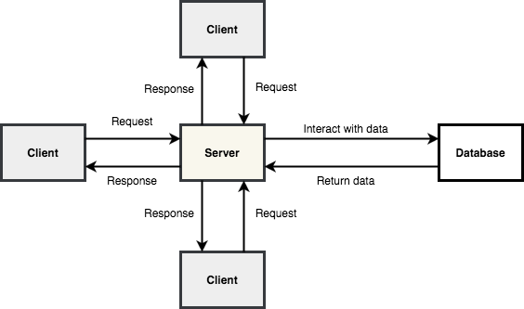
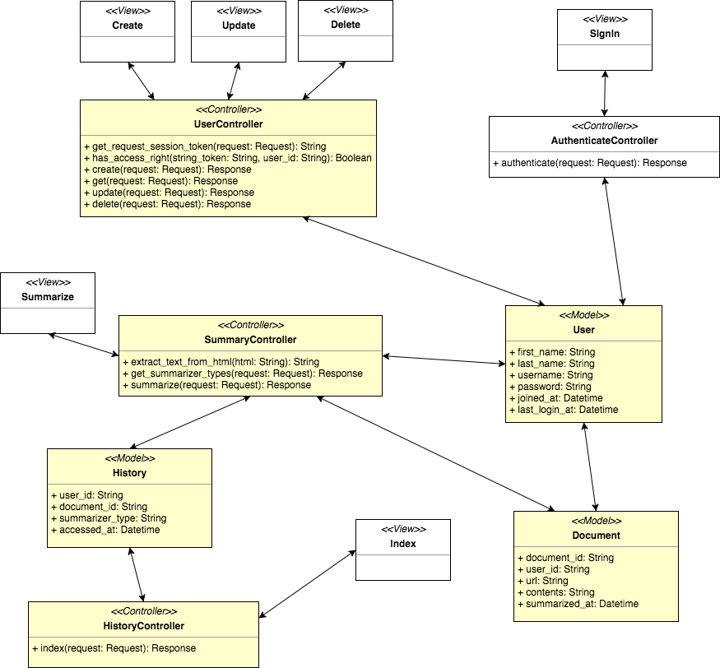
School of Computing & Information Sciences
Senior Project, 2017, Summer
Tidbit: Automated Document Summarization 1.0
Student: Alberto Mizrahi, Florida International University
Mentor: Nagarajan Prabakar, Florida International University
Instructor: Masoud Sadjadi, Florida International University
Problem
During the course of their day, professionals have to constantly read articles and documents to keep their knowledge up to date.
This process requires a great deal of effort as well as a significant time investment.
Solution
An application that would summarize articles and documents would save a tremendous amount of time and energy.
For ease of use and efficiency, the application should allow the user to provide a URL that points to the article.
The system should then present the user with a concise summary of the most important ideas of the document.
Tidbit is a web application that takes the URL of an article, extracts its contents and then summarizes it using Natural Language Processing (NLP).
Tidbit’s backend contains a powerful API and its frontend provides a user-friendly interface that connects to it.
Current System
Implemented the NLP summarization algorithms: frequency-based, Luhn’s algorithm and SumBasic.
Developed the summarization functionality to the backend API.
Created comprehensive test suites for the backend functionality.
Coded the article extraction and tokenization algorithms using NLP.
Screenshots
Contributions
Reference: Vanderwende, Lucy, Hisami Suzuki, Chris Brockett, and Ani Nenkova. "Beyond SumBasic: Task-focused Summarization with Sentence Simplification and Lexical Expansion." Information Processing & Management 43.6 (2007): 1606-618. Web.
Requirements
Implementation
The application must be able to accept a URL that points to the document to be summarized.
The system must then be able to extract the main content of the web page.
The system should allow the user to choose from multiple NLP summarization algorithms.
Using the chosen algorithm, the system must then summarize the document into a few sentences.
The team decided to design Tidbit using the Model-View-Controller (MVC) paradigm as well as the Client-Server architecture.
Tidbit’s backend was implemented as an API with Python, Flask and PostgreSQL.
Tidbit’s frontend was developed with HTML, Bootstrap and React.js.
The system implements three NLP summarization algorithms in Python: frequency-based, Luhn’s algorithm and SumBasic.
System Design
For backend testing, Python’s default Unit testing framework, unittest, was utilized and for the frontend, Selenium IDE was used.
To test the asynchronous sections of the server’s I/O code, Python’s Asynctest package was used.
The NLP summarization algorithms were thoroughly and rigorously tested on various online websites.
Tidbit is a web application that utilizes advanced NLP algorithms to summarize documents and articles.
Robust testing suites ensure Tidbit’s correct functioning.
This author contributed to the implementation of the backend, NLP algorithms and testing.
Verification
Object Design
Summary
Figure. The class diagram of the application. The classes in yellow are the ones this author contributed to.
Acknowledgement
The material presented in this poster is based upon the work supported by Prof. Nagarajan Prabakar, Prof. Masoud Sadjadi and Ms. Leila Zahedi. I am thankful to the help that I received from my teammate Alastair Paragas.
Notes:
1

