Slide 1








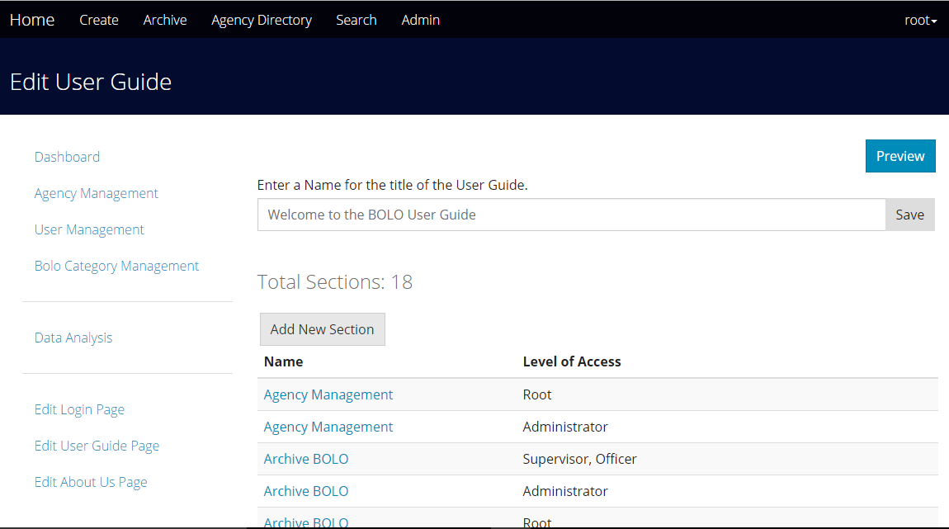
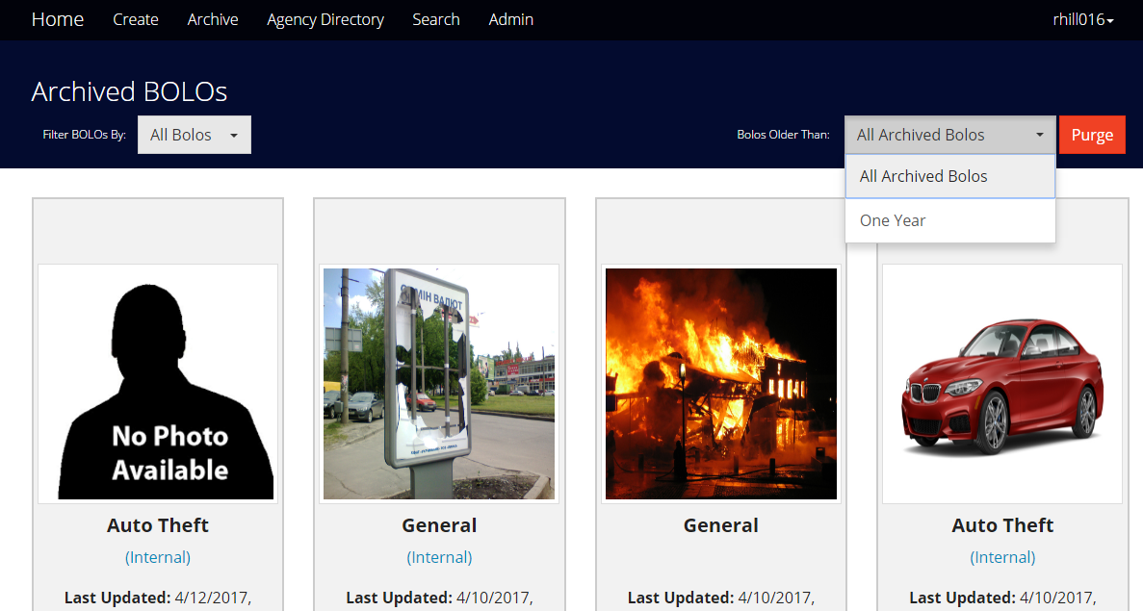
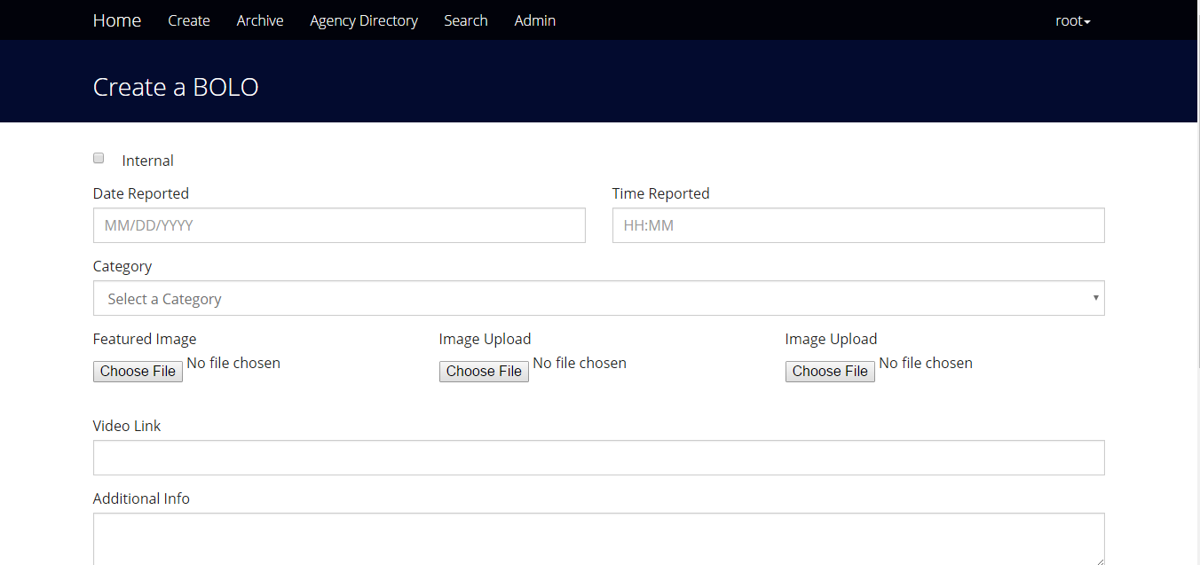
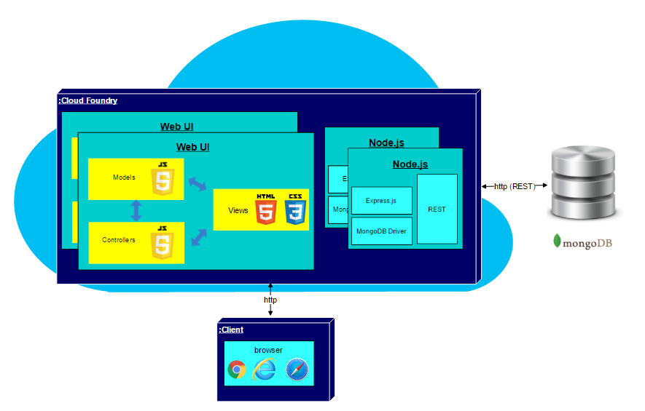
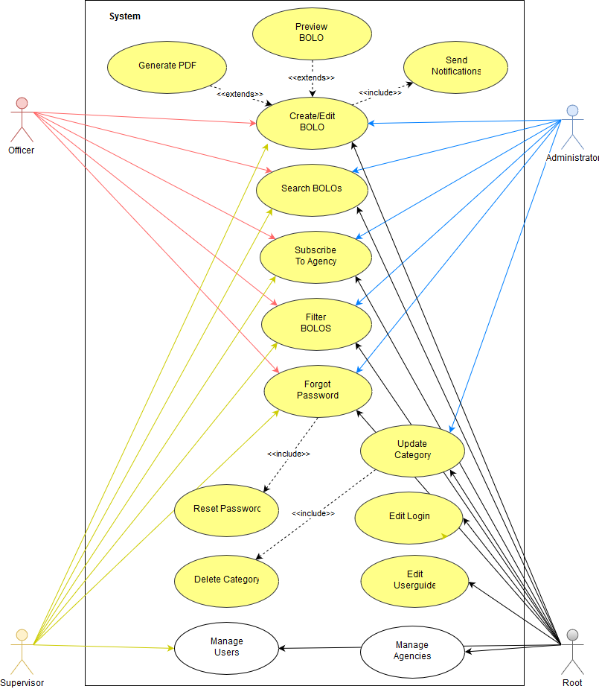
Senior Project, Spring 2017
BOLO Flier Creator – Version 7
Student: Rachel Hill Mentors: Jason Cohen, Frank Alvarado Instructor: Masoud Sadjadi
Problem
The Pinecrest Police Department faces a difficult challenge when it comes to sending out information about wanted persons or recent crimes. They rely on the use of fax machines and bulletin boards to distribute “Be On the Look Out” (BOLO) flyers. This process is slow and unreliable, posing a risk to the safety of police officers and the public.
Solution
The creation of the BOLO web-application will allow police officers to create and update BOLO flyers in real-time using any mobile device. It aims for scalability, security, and efficiency when sending out BOLOs to officers on duty as well as any officers in the neighboring jurisdictions.
Current System
The current system, BOLO-6.0, works but is not stable enough for deployment. The server could shut down at any moment due to the existence of fatal bugs. It is also not user friendly, requiring support from programmers to complete simple tasks such as updating the User Guide. The newer system, BOLO-7.0, looks to correct these issues by redesigning the interface and fixing most bugs.
Screenshots
Requirements
The functional requirements for BOLO-7.0 include the following: The system will allow BOLOs marked as internal to be available strictly within the agency. The system will not remove the original BOLO until the updated BOLO is confirmed. The system will allow users to reset a forgotten password. The system will allow root users to delete archived BOLOs within a given date range. The system will allow root users to edit the User Guide.
System Design
BOLO-7.0 uses a combination of the three-tier and Model-View-Controller (MVC) architectures.
Implementation
The implementation design for BOLO-7.0 include the following: The BOLO-7.0 server could run on a Windows- or Linux-based platform. MongoDB was the NoSQL database of choice. HTML 5 and CSS 3 were used for the frontend, along with Bootstrap and Bootswatch theming. Pug and JavaScript were used for the backend to display the HTML elements. Node.js, with express, held application logic and provided website routing. SendGrid sent out any emails created by the BOLO application.
Verification
In order to verify that the system met the requirements, unit tests were created and fully-documented. The unit tests were performed manually, utilizing different user scenarios to test both the normal behavior and the exceptional behavior of each system feature.
Object Design
Summary
The BOLO Flier Creator can be used on any mobile device, including but not limited to cellphones, laptops, and tablets. The web application makes it easier for police officers to share information. Users can now specify whether they want a BOLO to be visible in other agencies. BOLO-7.0 is currently running on a server at the Pinecrest Police Station. We are looking to expand to other jurisdictions within Miami-Dade.
Acknowledgment: The material presented in this poster is based upon the work supported by the Village of Pinecrest Police Department and Florida International University. I am thankful to the help that I received from my teammates , Mario Siu and Victor Estopiñán.
Notes:
1

