Slide 1
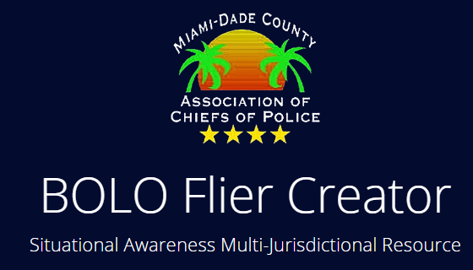









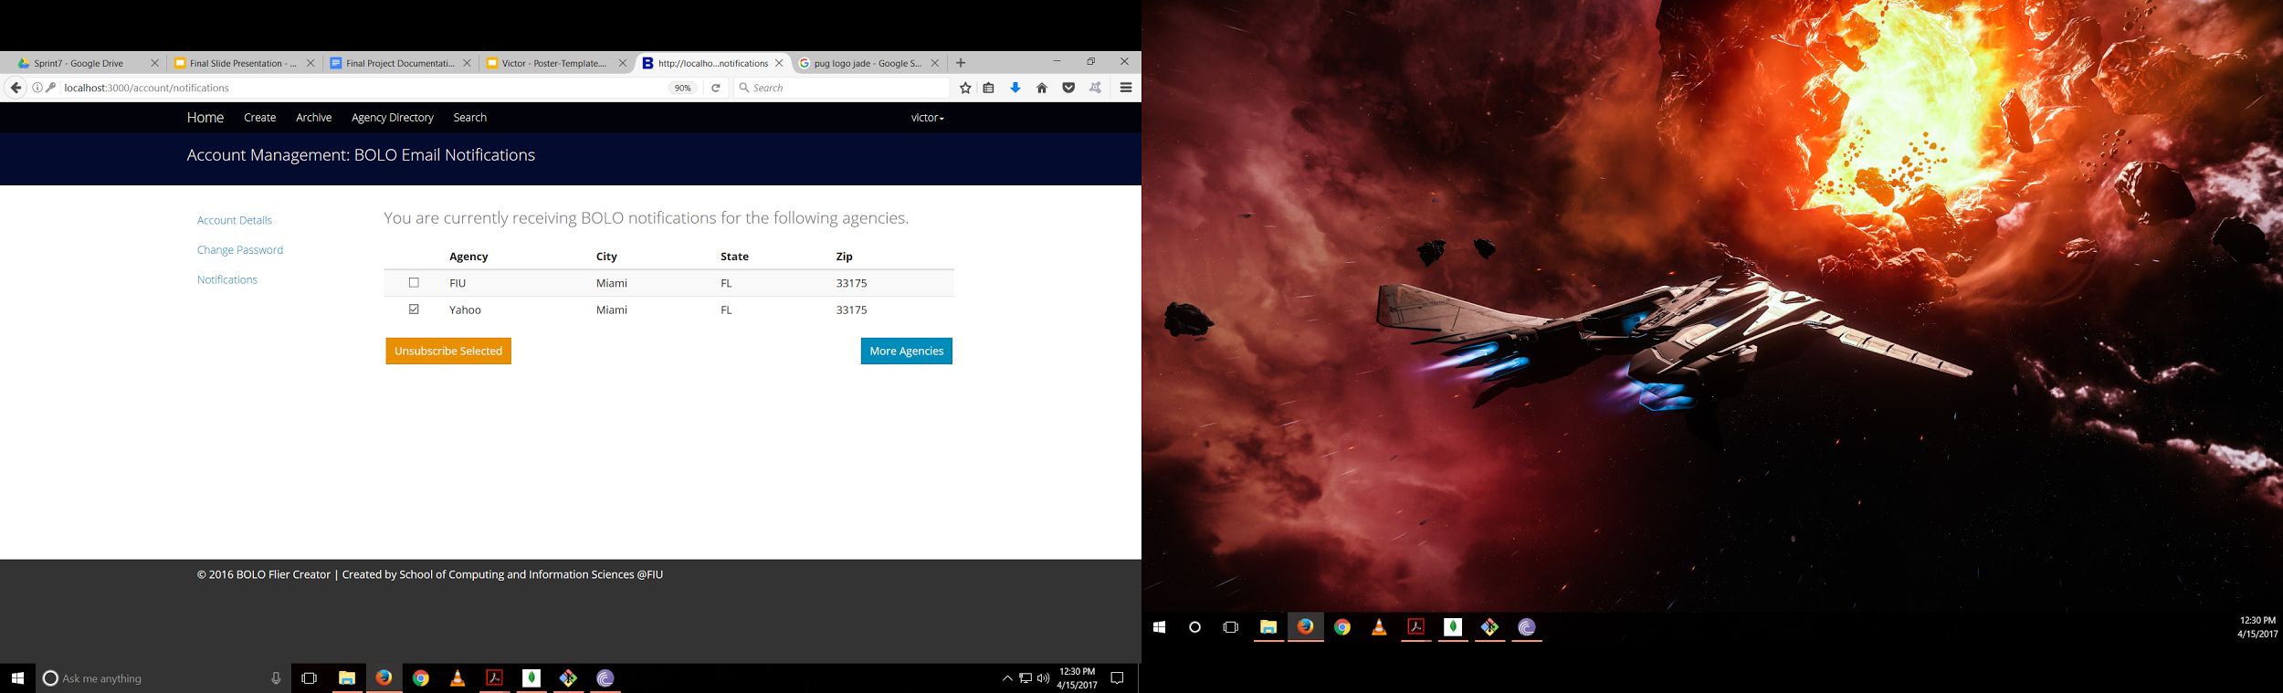
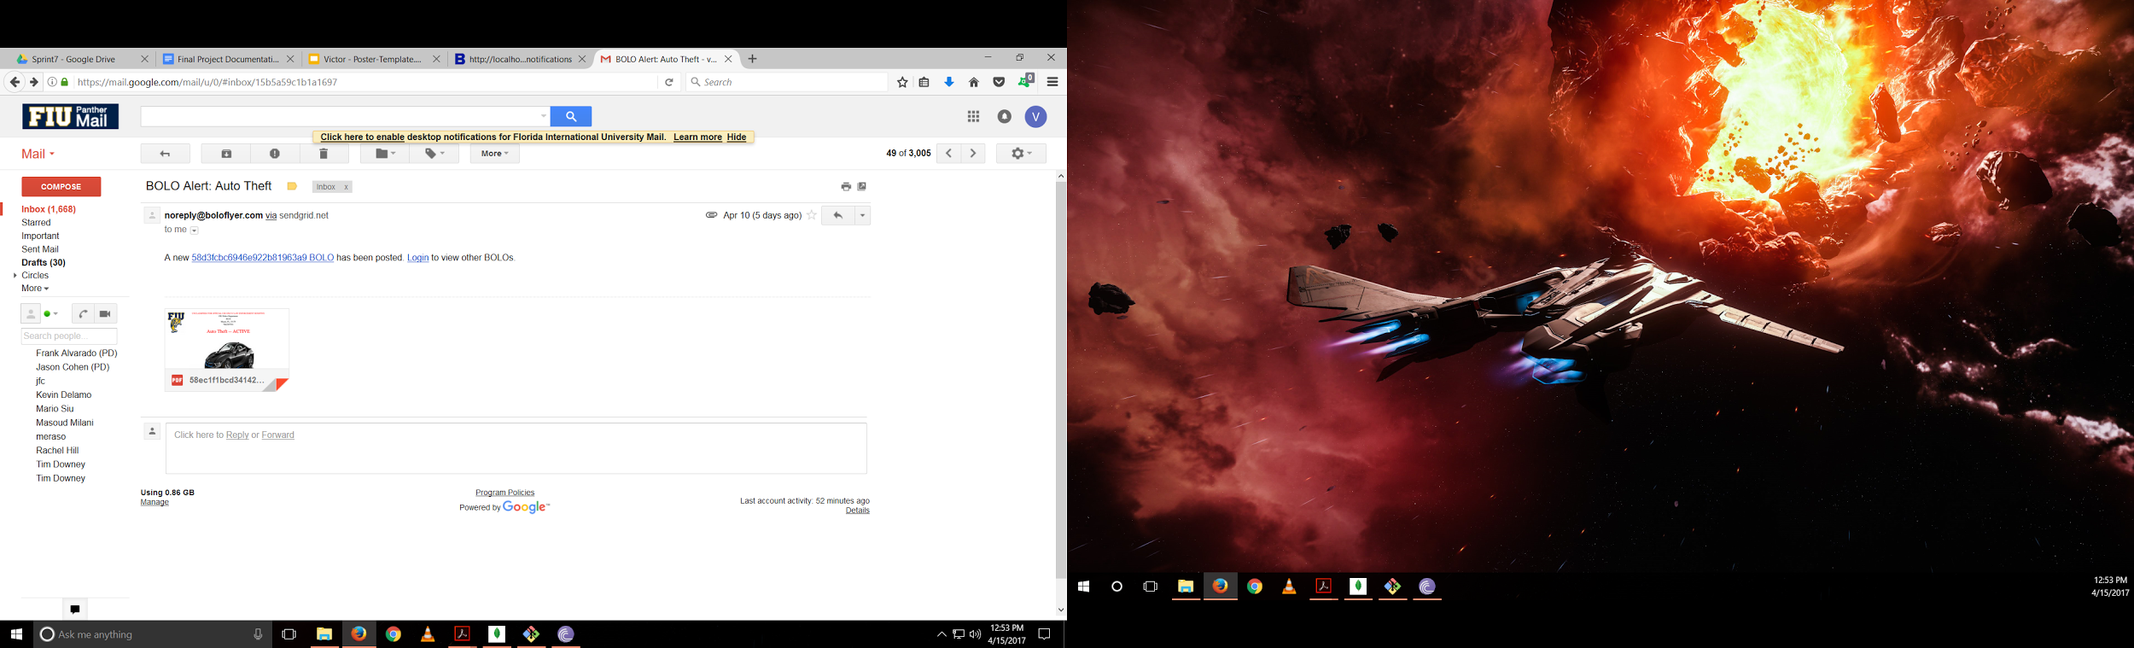
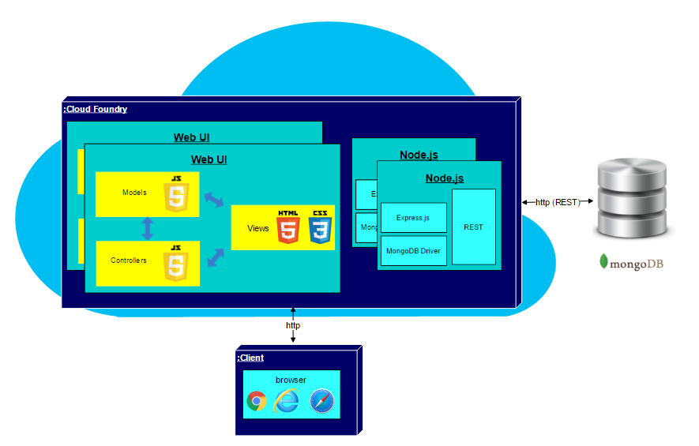
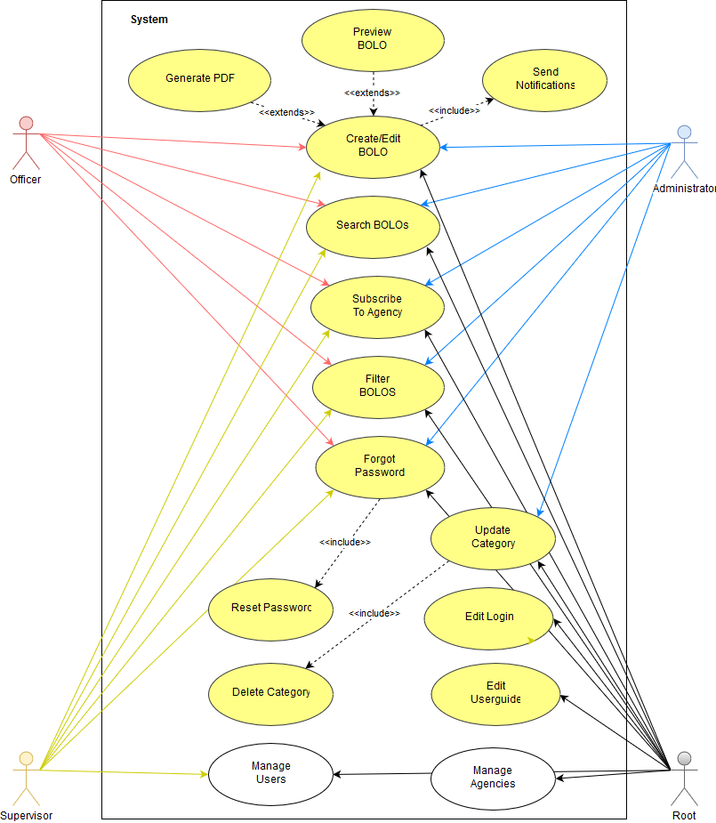
School of Computing & Information Sciences
CIS 4911, 2017, Spring
BOLO Flier Creator - Version 7.0
Student: Victor Estopiñán, Florida International University
Product Owner: Jason Cohen, Pinecrest PD
Instructor: Masoud Sadjadi, Florida International University
Problem
Current Pinecrest Police Department flier distribution method is inefficient
Criminal flier reports must be written in paper and sent to agencies
Officers are unaware of current crimes until they pick the BOLO flier
Older fliers tend to be forgotten and crimes unsolved
Solution
A secure and fast Flier Creator web app named BOLO was developed on 2015
Previous iteration, BOLO - 6.0, was buggy and unreliable
BOLO - 7.0, was developed on top of previous version
Main priority was fixing all errors
Current System
Uses Node.js as Backend
Uses MongoDB as Database
Uses Pug as Frontend
Fixes most bugs from previous version
Adds new important features
Improves previous implementations
Screenshots
Unsubscribing from agencies Receiving notification of new BOLO
Requirements
Ability for any user to subscribe or unsubscribe from an agency
Notify subscribe users with a pdf when a BOLO is created or updated
Fix password validation
Entering a date should be validated to US date format
PDFs must not show N/A attributes
Impede users from clicking other tabs when resetting password
Ability to delete categories not being used by a BOLO
System Design
System uses a combination of three-tier and Model-View-Controller architectures
MVC architectural pattern resides in the application tier
Implementation
BOLO - 7.0 can run on Windows and Linux systems
MongoDB stores all users, agencies, and BOLOs data
HTML 5, CSS 3, and Pug render the app’s user interface
Bootstrap was used as the application’s theme
All emails notifications are handled by Sendgrid
Node.js and other open source modules manage most of the server requests and logic
Verification
Object Design
Summary
BOLO - 7.0 was managed using Scrum development process on 7 springs
Adds more user-friendly features
Fixes most of BOLO - 6 faults and bugs
Ensures a faster response to alerts from Pinecrest Police officers
Test ID: BOLO_Notifications_4
Purpose: Create a BOLO and click confirmation email to check if users subscribed receive notification emails.
Preconditions: User must be log in. At least one user must be subscribed to the BOLO’s agency.
Input: User receives confirmation email and clicks confirmation link. System receives confirmation. System send a notification email to the BOLO author and to any user that is subscribed to the BOLO or to the BOLO’s agency. Users receive notification email
Expected Output: Notifications emails are received for each subscribed user plus the author.
Acknowledgement
The material presented in this poster is based upon the work supported by Victor Estopiñán, Mario Siu, and Rachel Hill .I am thankful to the help that I received from my group members, Mario Siu and Rachel Hill.
Notes:
‹#›

