Slide 1









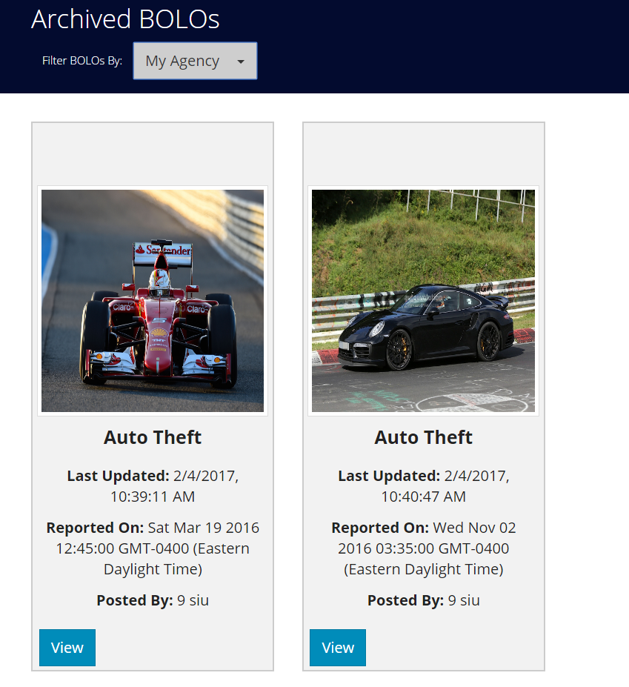
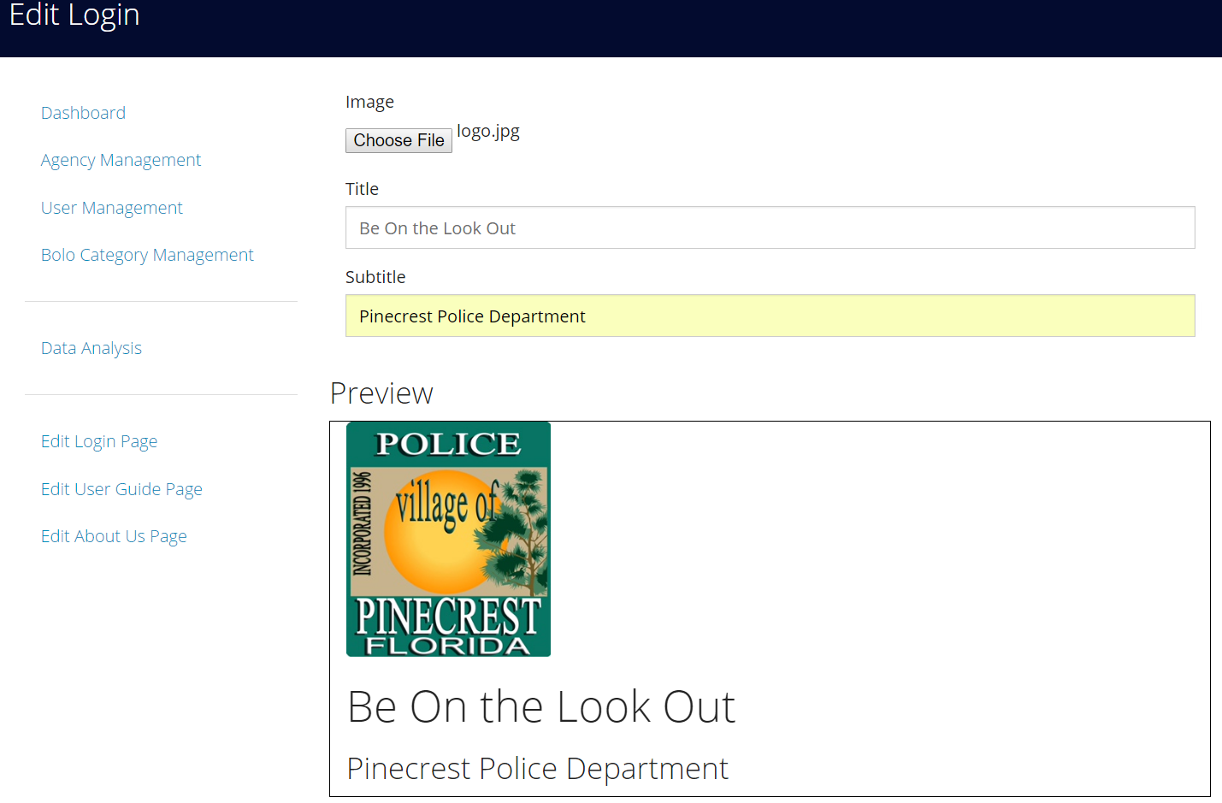
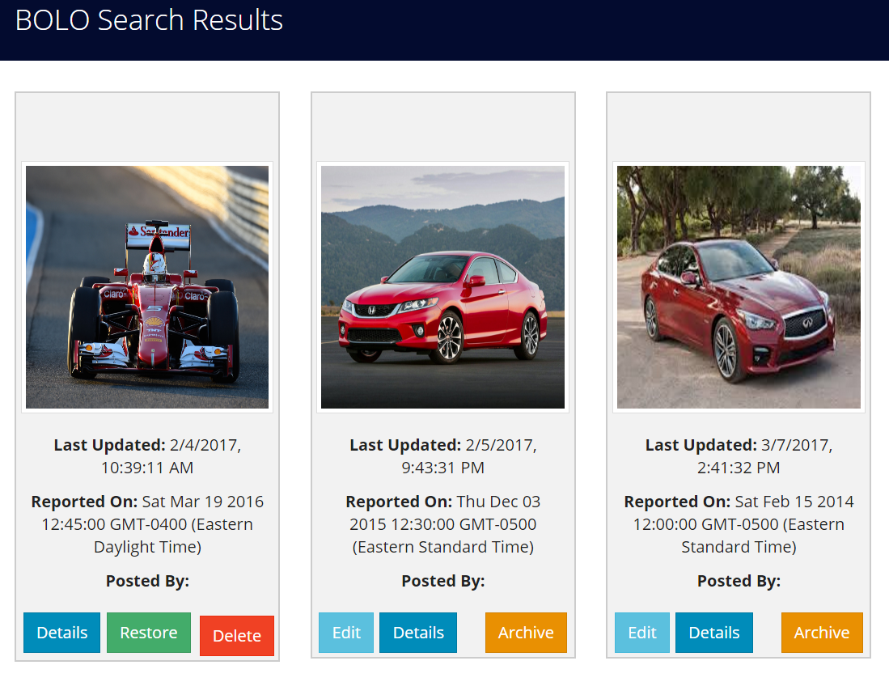
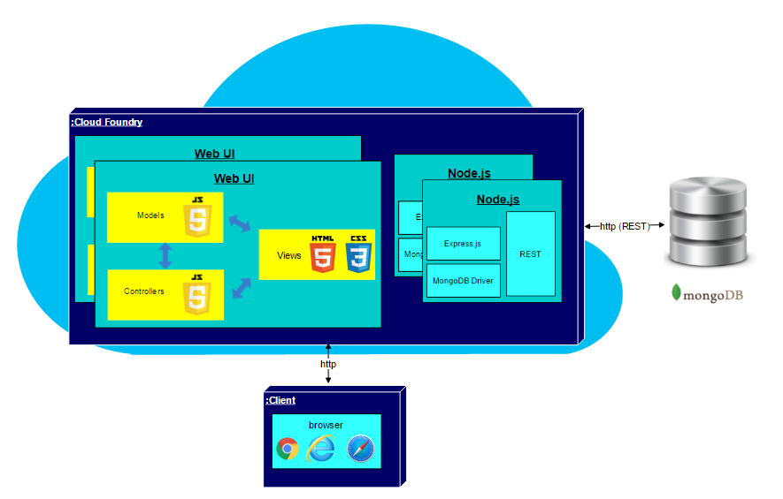
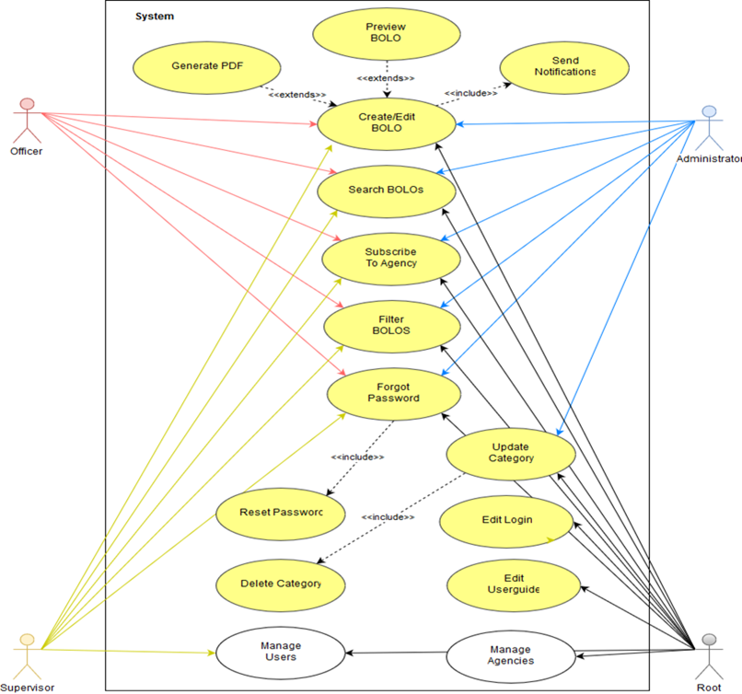
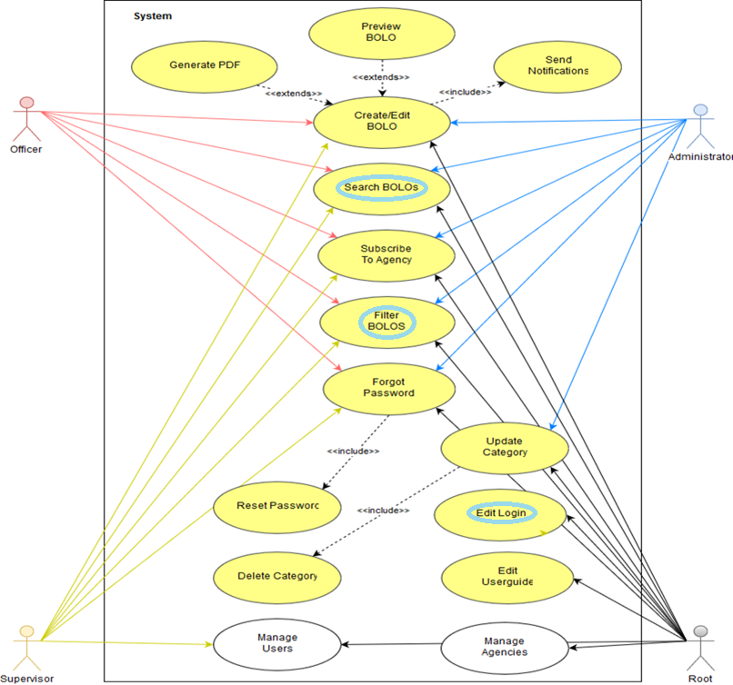
School of Computing & Information Sciences
Senior Project Spring 2017
BOLO Flier Creator – Version 7.0
Student: Mario Siu Florida International University
Mentor: Jason Cohen Pinencrest PD, Frank Alvarado Pinencrest PD
Instructor: Masoud Sadjadi, Florida International University
Problem
Misconducts, thefts and crimes are targets of police officers of Pinecrest Police Department 24 hours a day 7 days a week. The faster and more secure the information is distributed through all officers, the most efficiently they can work and our community will be safer. Be On the Look Out (BOLO) is a solution to this problem, allowing officers to obtain all the required information in a world where the technology and the community services must be done together.
Solution
The solution is to provide students and faculty a way to develop BOLO system and improve it as much as the needs of Pinencrest Police Department are required.
Current System
BOLO System is hosted on a Linux or Windows server running
Node.js 6.10 for the Backend
Express
Pug for Frontend
MongoDB that is a noSQL database that can be hosted in a private server
Requirements
Requirements on the web application includes the following:
Login with a user account
Create, search, and View BOLOs
Filter active and archived BOLOs
Upload Photos for BOLOs and Agencies
Ability To create different categories for different bolos
Add internal option to create BOLO form
Can Activate / Deactivate Users and Agencies
Have a permanent Root user that has full control
Edit webpages, such as “About Us”, “User Guide” and “Edit Login Page”
System Design
The system is designed using the Model-View-Controller and 3-tier architecture.
Implementation
BOLO-7.0 the update to the previous version (BOLO-6.0) and can run in Windows or Linux platform
BOLO-7.0 is managed by the root user to add several user interfaces for administrators, supervisors and officers.
The database used in BOLO-7.0 is MongoDB, which is an open source and fulfils the secure storage requirement.
The client side requirements are implemented by Javascript, CSVtoJSON and Pug, while the server side requirements are fulfilled by Node.js and Express.
Sengrind handles in a safely way any email for BOLO confirmation or creation
Verification
Unit Test
ID: BOLO_EditLogin_4
Purpose: Edit Logo or Title or Subtitle of LogIn Page
Preconditions:
The user should has root access
The root should be Logged In
The root should get into the Admin menu
Input:
The root should log In
The root should get into the Admin menu
The root should click on the Edit Log In Page
The root should change the title, subtitle, logo or any combination of them
The root should save the changes by clicking in the SAVE button
Expected Output:
The root should be able to edit the Title, Subtitle or logo or any combination of them of the login page
Object Design
BOLO System Functionality
Web Usability
BOLO app shows strong usability with respect to the elements of its design. The app itself is a novel idea for helping improve communication between users on the police departments. With some minor improvements could even represent an ideal application of web usability for a clearly defined user base.
Summary
BOLO-7.0 will allow the police department to interact with the application quickly and easier. We contributed to develop the functionality and hope the future versions will do it in the same way.
Acknowledgement
The material presented in this poster is based upon the work supported by Rachel Hill, Victor Estopinan and Mario Siu. I am thankful to the help that I received from my group members, the Village of Pinecrest Police Department, Chief Samuel Ceballos Jr, Major Jason Cohen and IT Administrator Frank Alvarado. Special thanks go to our instructors Francisco Ortega, Mohsen Taheri and Masoud Sadjadi.
Notes:
ure
1

