Slide 1













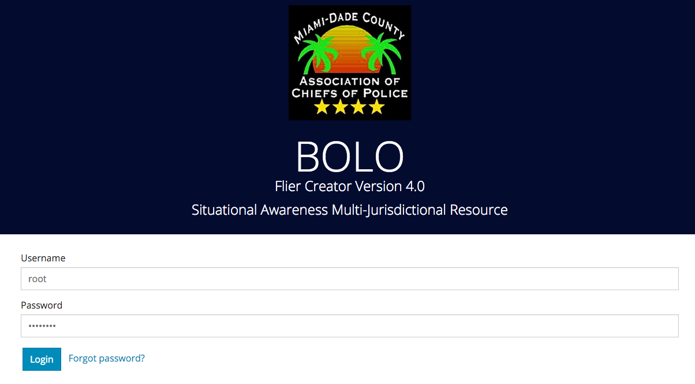
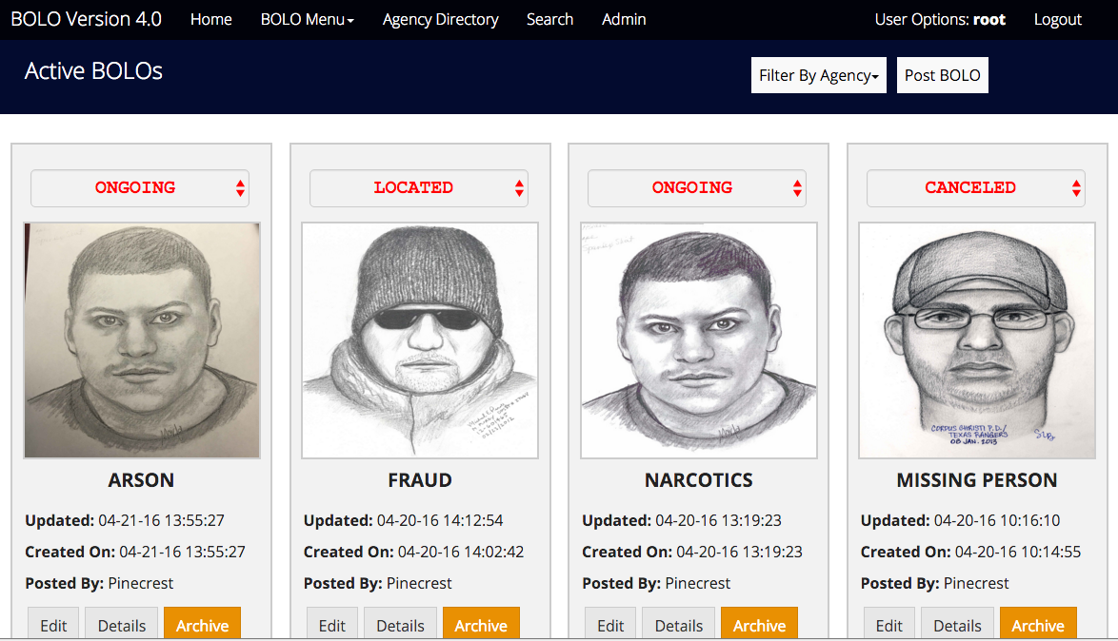
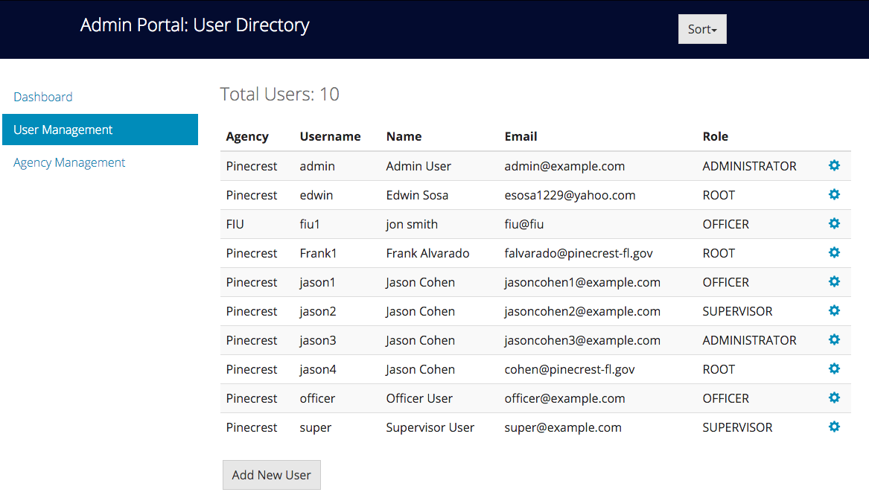

School of Computing & Information Sciences
Senior Project, 2016, Spring
BOLO Version 4.0
Student: Leonardo Martin, Florida International University
Mentor: Juan Caraballo, IBM
Instructor: Masoud Sadjadi, Florida International University
Problem
Current System
Requirements
The Pinecrest Police Department needs a new way of creating and distributing Be On the Lookout information (BOLOs). This type of information, which is sensitive and can save lives if distributed quickly and on a large scale, is naturally difficult to manage.
The current system (BOLO 2.0) is an older system written in PHP. It contains older technologies and is thus less secure. BOLO 2.0 also requires many features that are necessary for making it easier to create/distribute BOLOs. On top of this old system, strategies still used by the department include alerts over police radio which may or may not be heard, computer aided dispatch software which requires that officers are equipped with specific hardware, and finally paper documents created in a word processor and printed out.
BOLO v4.0 was required to take the current system and make it more secure and scalable. Also, more features were to be added so that it could be approved by the Pinecrest police department for deployment. Specifically, the new system needed a RESTful implementation, a rework of the user permissions for the system (for more security), and a way to be able to automate the creation of BOLO PDFs so that they can be shared and spread out throughout the police department through an automated notifications system.
Solution
A robust, scalable system that would allow for easy BOLO creation and automates the distribution of BOLOs through notifications and PDF creation.
System Design
Object Design
Implementation
A hexagonal architecture was chosen for the design as it centers the system around the specified domains. It is beneficial to use this as there are only three different domains. The rest of the application utilizes the domains in order to structure the system. Outside of the application layer, other adapters play the role of separate microservices that interact with the system.
Object design is structured around three different types of objects: a router, service and a repository. This separates the different tasks of the application and makes it easier to understand how the system handles requests. Routers handle any incoming HTTP requests. Any operations that must be carried out are handled by the services, and any database operations are handled by the repositories.
BOLO v4.0 is implemented on top of v3.0 which was created but never used.
The system is built on NodeJS with ExpressJS for server-side requirements and PassportJS for user authentication.
HTML5, CSS3 and Javascript are all utilized for client-side requirements.
For persistence, the system uses CloudantDB which provides a CouchDB NoSQL interface.
For notifications, the system utilizes the SendGrid service hosted on IBM Bluemix.
Finally, CloudFoundry hosted on IBM Bluemix is what provides the infrastructure.
Implemented utilizing routers for catching requests, services for handling functions, and repositories for handling the connections to database.
This allows for scalability and a way to add to the system without changing the core functionality.
Verification
Screenshots
Summary
In order to verify the behavior of the application, unit and integration tests were written for 85% of all functions in the code. These were written using the mocha testing framework for NodeJS and the chai assertion library. The Cloudant connection was also tested alongside the repository files to assure that each repository function did what they were required to do. Apart from this, the system was manually tested extensively by the product owner.
In order to facilitate the distribution of information amongst police officers of Pinecrest PD, BOLO Flier Creator v4.0 was created. The system builds on top of v3.0, keeping the same robustness and scalability, but also brings back some features and feel of v2.0 that the product owners longed for. This new system automates creation of PDFs for new BOLOs and the distribution of notifications for BOLOs within agencies. All of this is accomplished with a more flexible system that is easy to manage and faster to use.
Acknowledgement
The material presented in this poster is based upon the work done by Leonardo Martin, Alejandro Henao, Piero Messarina, and Edwin Alvarez Sosa. This project was supported by The Village of Pinecrest Police Department, Major Jason Cohen, and Chief Samuel Ceballos. Extra thanks go to our mentors Juan Caraballo and Robert Loredo, and our instructor Masoud Sadjadi and his assistant Mohsen Taheri.

