Slide 1
















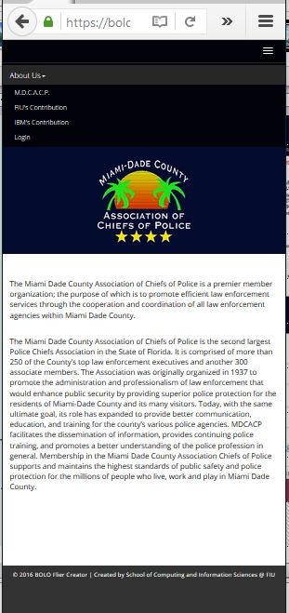
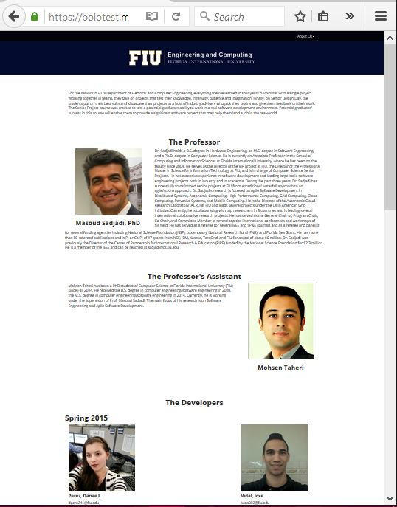
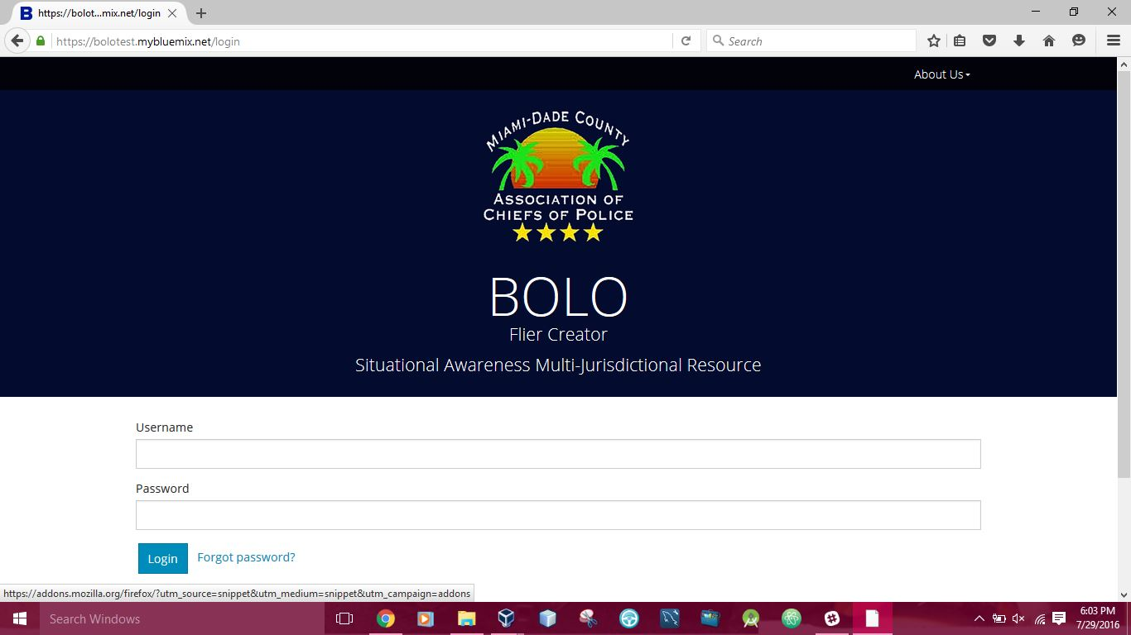
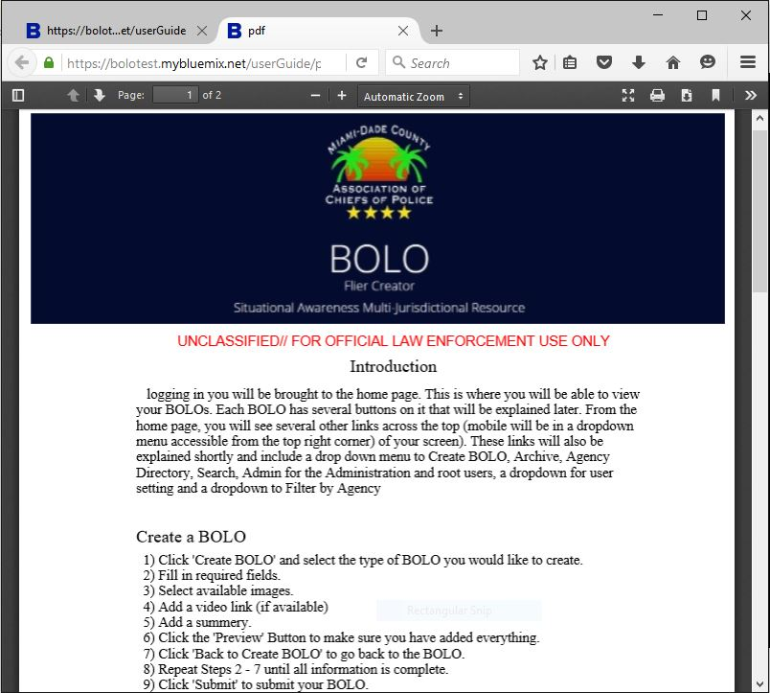
School of Computing & Information Sciences
Senior Project, 2016, Summer
BOLO Flier Creator - Version 4.0
Student: John Burke, Florida International University
Mentor: Juan Caraballo, IBM; Robert Loredo, IBM
Instructor: Masoud Sadjadi, Florida International University
PROBLEM
CURRENT SYSTEM
REQUIREMENTS
The distribution of “Be On the Look Out” (BOLO) flyers can take up to 48 hours to reach officers in the field in a single department from creation. The same system is used today that was used over 150 years ago in many agencies, a bulletin board and paper flyers. This is up to 48 hours an suspect has to cover up their crime. Currently, there is no efficient system that is scalable, secure, and provides the ability to quickly create BOLO posters while immediately disseminating them to officers in the field & neighboring jurisdictions.
BOLO 4.0, a prototype iteration, fulfills functional requirements but does not meet scalability and critical security requirements. The currently employed system uses BOLO creation and dissemination strategies such as: alerts over police radio, computer-aided dispatch that is dependent on antiquated hardware, and paper printed posters for manual distribution.
The main requirements for this version were to port over features from previous implementations of the system to the highly secure IBM Bluemix platform. The BOLO system seeks to streamline the issuance process, increase dissemination, and mitigate human error. In order to accomplish these goals the application must allow users to easily create and manage BOLOs from many types of devices and various situational environments.
SYSTEM DESIGN
IMPLEMENTATION
The system uses the hexagonal architecture, a variation of three tier. Sometimes called ports and adapters, the hexagonal architecture allows the design to evolve the ports and adapters into well defined micro-services Essential to the system, the adaptability to newer technology is realized via the isolation of the domain layer from the adapters.
BOLO v5.0 is implemented on top of v4.0, an unemployed implementation
The system leverages the IBM Bluemix Cloud Platform (PaaS) that supports Node.js and Express.js which fulfill the server-side requirements
HTML5, CSS3, Jade Templates, Javascript and PDFkit fulfill client-side requirements
Cloudant, a NoSQL distributed database as a service (DBaaS) fulfills the persistent storage requirements
Sendgrid, a cloud based micro-service fulfills the notification by email requirements
OBJECT DESIGN
The system objects are conceived using ideas from the Domain Driven Design approach by Eric Evans. The Agency, User, and Bolo entities make up the domain layer with concrete Cloudant repository objects handling persistence of such entities. Not only do services realize features like email notifications, PDF generation, and image compression, but they also interact with adapters connecting with external systems.
USER INTERFACE
VERIFICATION
SUMMARY
Unit and integration tests are implemented using the mocha testing framework for Node.js and the chai assertion library. The Cloudant connection is tested with repository files to assure that each repository behaves as intended. The system has undergone extensive exploratory testing by domain experts, Chief Samuel Ceballos and Major Jason Cohen. The Village of Pinecrest Police Department leads pilot verification testing of the system.
BOLO Flier Creator is the first cloud based system in Florida that enables officers to quickly create and manage searchable BOLO reports in the field while providing immediate dissemination to all other officers in their agency and neighboring jurisdictions. The system components meet the security and scalability requirements needed for production. Ultimately, BOLO Flier Creator keeps our communities and neighboring communities of Miami-Dade County safer.
“This is a new paradigm in policing” – Chief Samuel Ceballos
ACKNOWLEDGEMENT
The material presented in this poster is based upon the work done by John Burke, Emmanuel Gonzalez, Jorge Medina and Nilton Muñoz. This project was supported by The Village of Pinecrest Police Department, Chief Samuel Ceballos, and Major Jason Cohen. Special thanks go to our mentors, Juan Caraballo, Robert Loredo, our instructor, Masoud Sadjadi, and his assistant Mohsen Taheri.

