Slide 1
















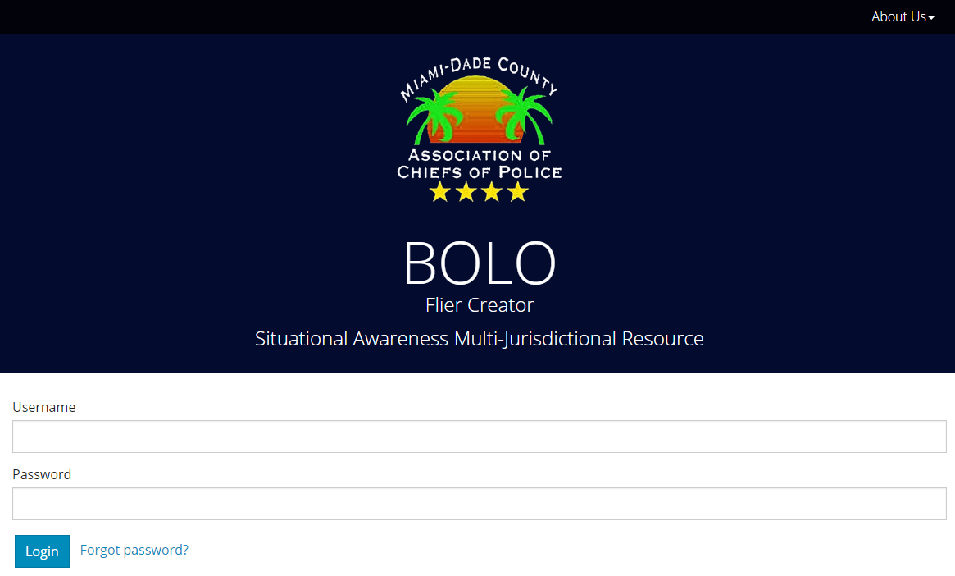
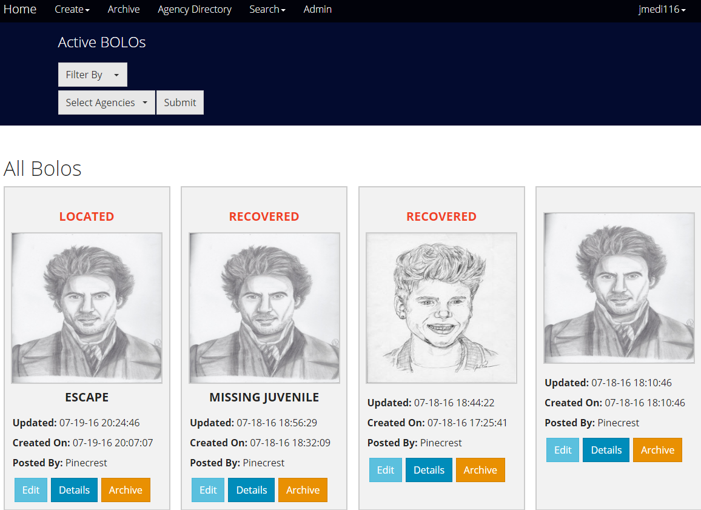
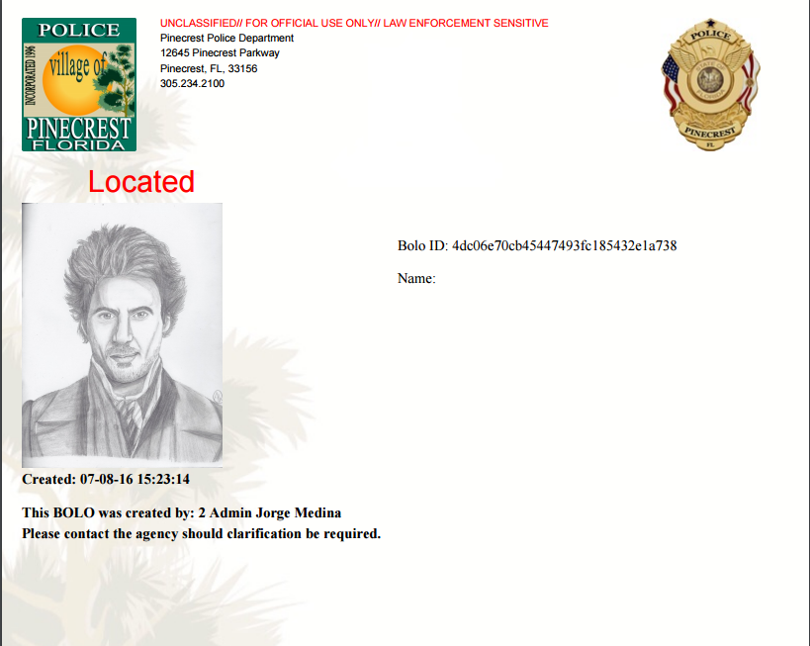
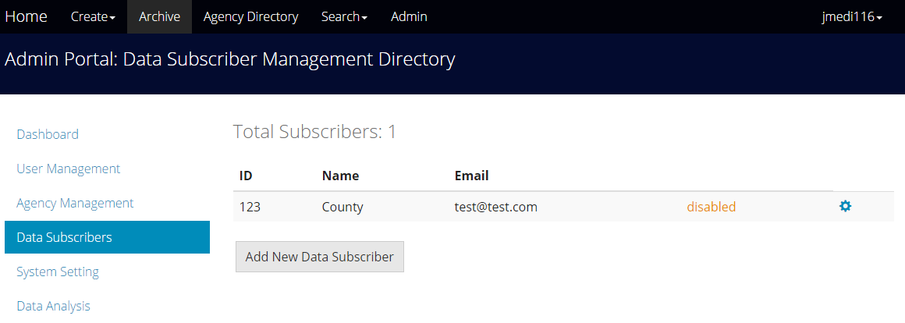
School of Computing & Information Sciences
Senior Project, 2016, Summer
BOLO Flier Creator - Version 5.0
Student: Jorge Medina, Florida International University
Mentor: Juan Caraballo, IBM; Robert Loredo, IBM
Instructor: Masoud Sadjadi, Florida International University
PROBLEM
CURRENT SYSTEM
REQUIREMENTS
The system currently in use to distribute information among Police officers is too slow. More than 24 hours may pass before all officers in the field receive the paper report of the offense. Pinecrest Police Department needs a new mechanism to share BOLOs more efficiently. In addition, Police Agencies need to be able to share BOLOs with each other in order to have all officers up to
BOLO 4.0 fulfills most functional requirements but does not meet critical security features. It also lacks the ability to interact with other systems . It lacks customizations for additional BOLO templates. The currently system sued by Police officers uses BOLO creation and dissemination strategies such as: alerts over police radio, computer-aided dispatch that is dependent on antiquated hardware, and paper printed posters for manual distribution.
The main requirements for this version were to improve security by preventing inactive users from submitting or editing existing BOLOs. In order to pilot the application a service needed to be implemented to feed all BOLO data to third party agencies. All images loaded to the application required compression in order to reduce the cost of maintaining the app. At the same time, application required visual enhancements to the PDF flyers and templates.
SYSTEM DESIGN
IMPLEMENTATION
The system uses the hexagonal architecture, a variation of three tier. Sometimes called ports and adapters, the hexagonal architecture allows the design to evolve the ports and adapters into well defined micro-services Essential to the system, the adaptability to newer technology is realized via the isolation of the domain layer from the adapters.
The system runs in IBM Bluemix Cloud Platform (PaaS) that supports Node.js and Express.js which fulfill the server-side requirements.
HTML5, CSS3, Jade Templates, and JavaScript fulfill client-side requirements
Cloudant, a NoSQL database (DBaaS) fulfills the persistent storage requirements
Sendgrid, a cloud based micro-service fulfills the notification by email requirements
JIMP, a NodeJS module, asynchronously fulfills the compression of all images loaded to the application.
OBJECT DESIGN
The system objects were conceived using ideas from the Domain Driven Design approach by Eric Evans. The Agency, User, Data Subscriber and Bolo entities make up the domain layer with concrete Cloudant repository objects handling persistence of such entities. Not only do services realize features like email notifications, PDF generation, and image compression, but they also interact with adapters connecting with external systems.
SCREENSHOTS
VERIFICATION
SUMMARY
BOLO 5.0 has been deployed to Pinecrest’s Bluemix Instance to be piloted in the field. All new features have been tested by domain experts from several Police Agencies using test environment created for Pinecrest. Mocha testing framework and chai assertion libraries were included for Unit and Integration testing. JSON feed to Data Subscribers has been tested using Sendgrid email service. The Cloudant connection has been tested through repository files to ensure all entities behave as expected.
BOLO Flier Creator v5.0 enables officers to quickly create and manage searchable BOLO reports in the field while providing immediate dissemination to all other officers in their agency and neighboring jurisdictions. BOLO5.0 has added essential features to the project, such as email confirmations for BOLOs and the ability to feed external systems with BOLO data. This is the first iteration that allows custom templates by BOLO category. It has also enhanced the layout of BOLO flyers by adding Agencies’ watermarks. BOLO 5.0 is the first iteration of the application that is ready to be piloted in Production.
ACKNOWLEDGEMENT
The material presented in this poster is based upon the work done by Jorge Medina, John Burke, Emmanuele Gonzalez and Nilton Munoz. This project was supported by The Village of Pinecrest Police Department, Chief Samuel Ceballos, and Major Jason Cohen. Special thanks go to our mentors, Juan Caraballo, Robert Loredo, our instructor, Masoud Sadjadi, and his assistant Mohsen Taheri.

