Slide 1















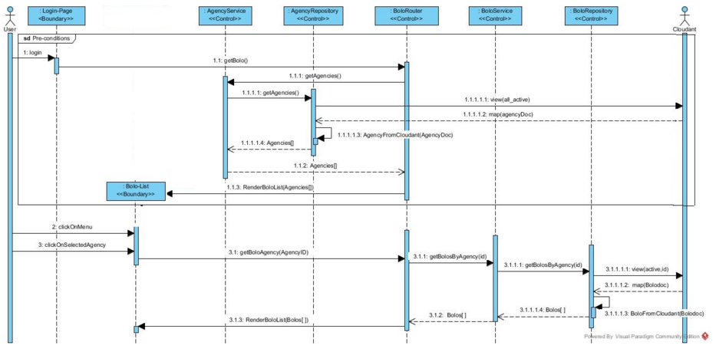
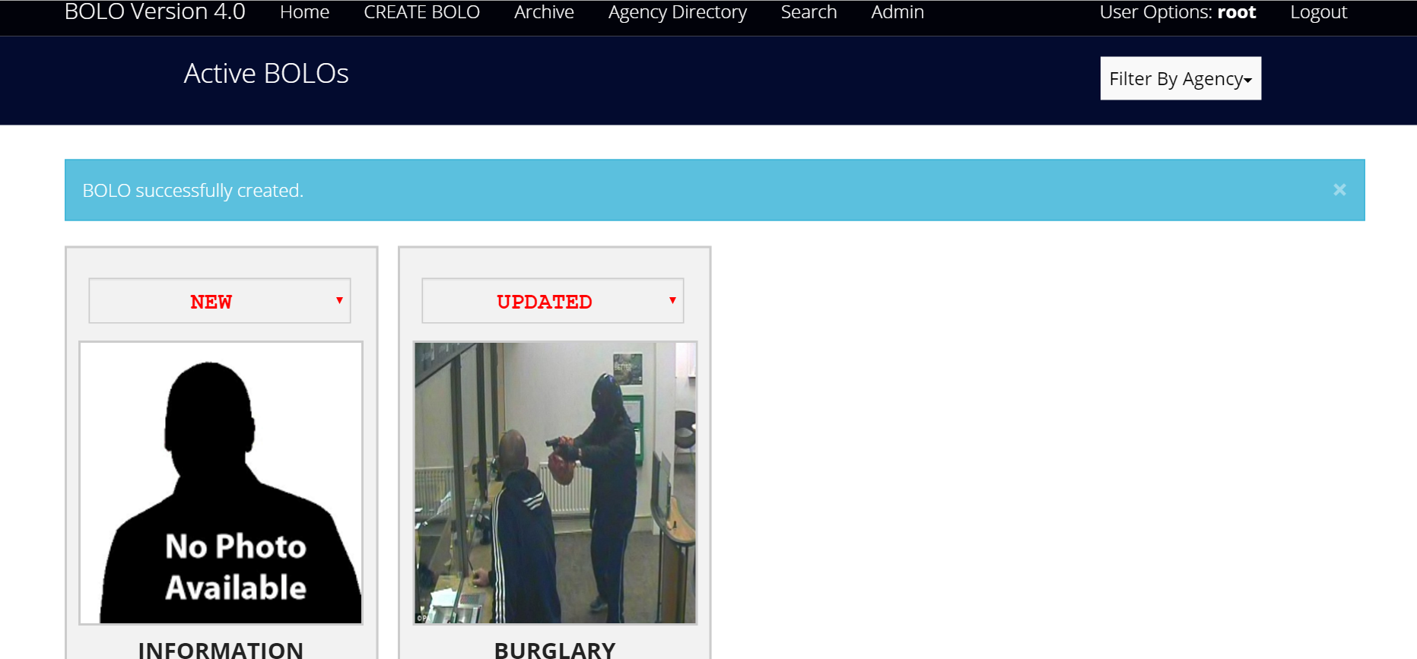
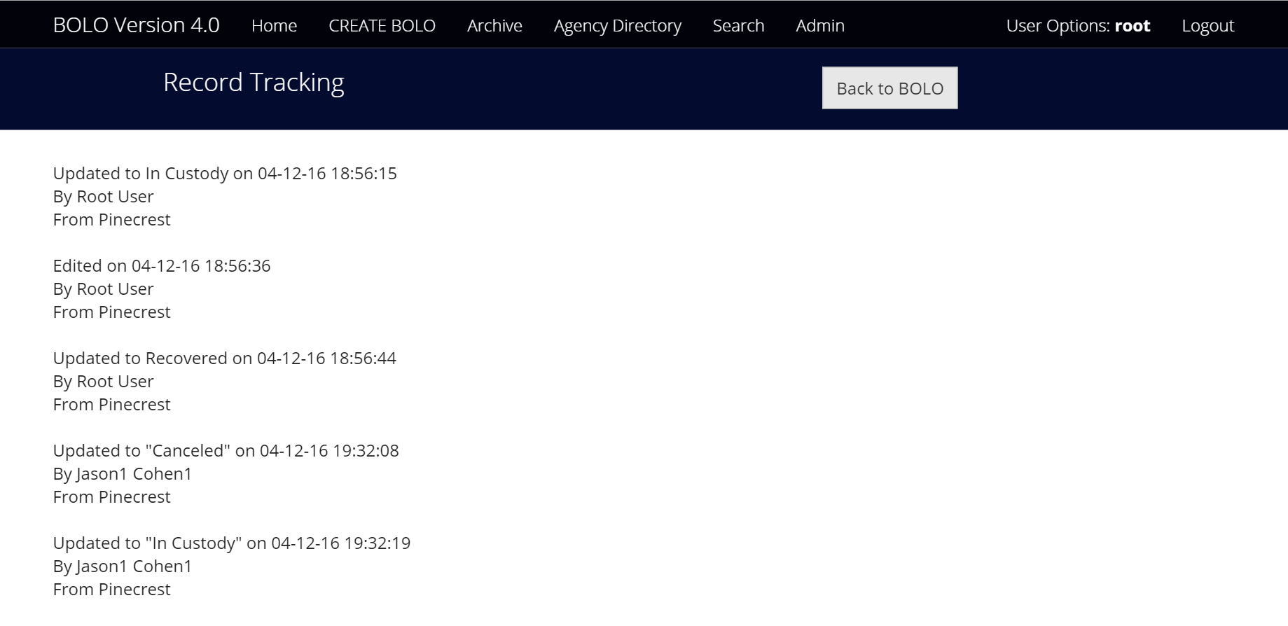
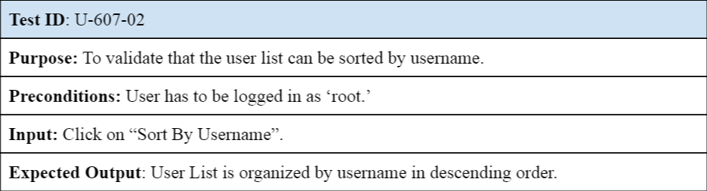
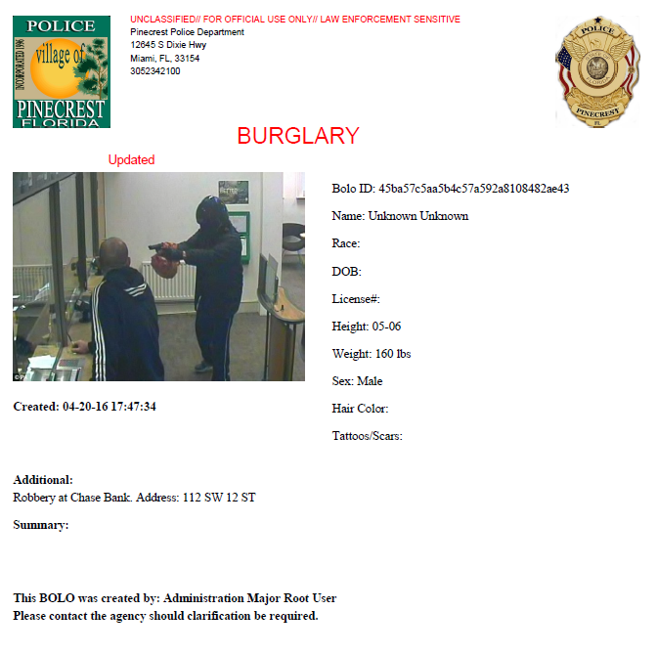
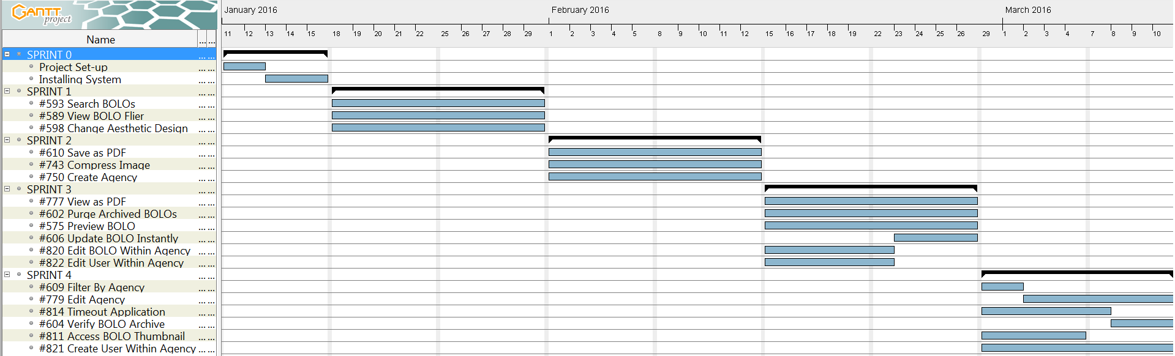
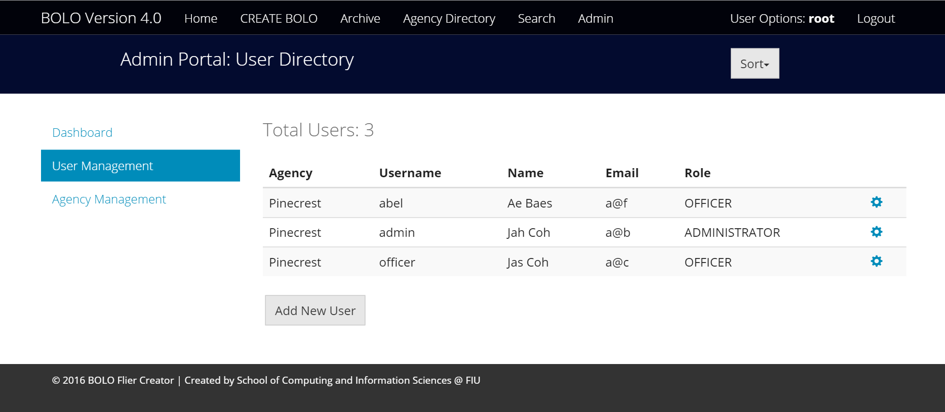
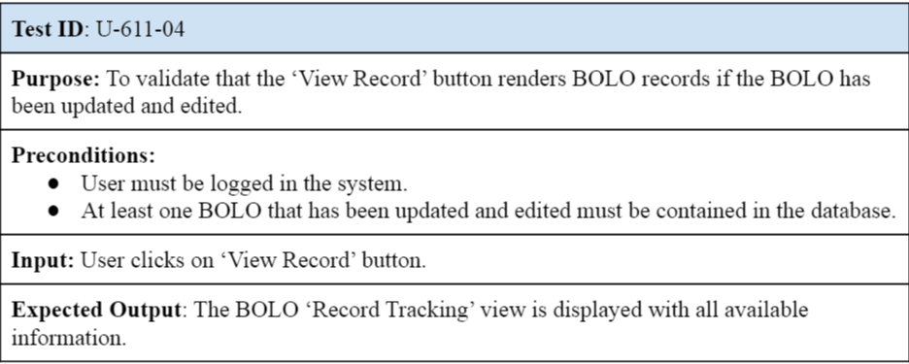
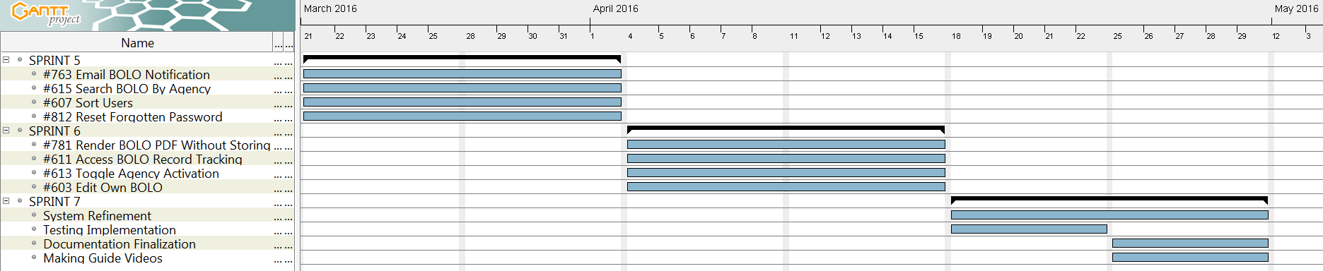
School of Computing & Information Sciences
Senior Project, 2016 , Spring
BOLO 4.0
Student: Piero Messarina, Florida International University
Mentors: Juan Caraballo, Robert Loredo, IBM
Instructor: Masoud Sadjadi, Florida International University
Problem
Current System
Requirements
The Pinecrest Police Department needs to quicken the way in which crime reports are generated and distributed given that the current system is slow and costly. Furthermore, BOLO(Be On the Lookout) flyers that are posted in the Miami-Dade area are issued sparsely, causing some of them to be ignored. Therefore, law enforcement agents in the region wish to consolidate BOLO circulation in a single, interactive electronic container, which is able to grant instant access, permanent security, comfortable interfaces, and fluid scalability.
Currently, when a crime occurs in Miami-Dade County, a police officer is sent to the scene. A report is produced on paper and given to a supervisor in order to be checked for quality. After this is done, the edited report goes to bookkeeping, where detectives or other field officers can access it if required.
Sometimes, a detective will use the information from the report to put together a BOLO flyer, which is sent via email to an available list of contacts.
The main focus for the current version of the system is scalability and security:
-Compliance with IBM cloud services such as Bluemix and Cloudant is necessary to guarantee security.
-Expansion capability is essential given that the system is intended to keep growing into a scale that has not been determined yet.
-Compatibility with devices and browsers for field operations, mainly Internet Explorer and Android phones, is crucial.
System Design
Object Design
Implementation
At the heart of BOLO 4.0, three main components can be found; agencies, users, and bolos. These form the system’s domain, which is the entity that shapes all available functionality. This is why a hexagonal architecture was chosen.
This also allows for the system to be scalable as the service adapters lie at the external layer of implementation. This provides adaptability to other services in case that further expansion is needed. Thus, a hexagonal architecture is believed to be adequate for BOLO 4.0.
BOLO 4.0 has three major subsystems; Agency, User, and Bolo, each representing a main component. All three follow similar patterns of execution from the interface to the data storage. The following design patterns were applied:
-Repository: Data storage interaction can be modified without having to alter multiple segments of the rest of the code.
-Adapter: Specific frameworks lie at the external layer so that more can be added.
-Observer: Protects the organization of asynchronous calls so that they can be executed without integration issues.
BOLO 4.0 was produced using several technologies at each level, JavaScript being the main language.
The user interface views were developed with Jade(HTML framework) and CSS.
The application layer was made using NodeJS. Express and Body-Parser were widely utilized for request handling. For the service adapters, libraries such as PDFKit, Passport, Sendgrid, and Image offered multiple alternatives.
In terms of data storage, the Cloudant API and JSON format were applied.
Verification
Screenshots
Summary
The system was dynamically verified through the use of Mocha, a JavaScript framework, that allows for asynchronous testing. Law enforcement agents from Pinecrest were also deeply involved in acceptance testing, which provided immediate results that were taken care of with promptitude.
BOLO 4.0 was created to speed up crime information distribution.
It was developed specifically to be hosted on a cloud server provided by IBM, where security is prioritized.
Over twenty new features were added to the current version of the system:
Acknowledgement
This material was supported by the work of Edwin Alvarez, Leonardo Martin, and Alejandro Henao, my teammates. Also, special thanks to my mentors, Robert Loredo and Juan Caraballo, who supplied essential information on IBM tools. Best wishes to the program instructor, Professor Masoud Sadjadi, and his assistant, Mohsen Taheri, who refined my software engineering skills. Thanks to Ryan DelRosario, who supported the team during a hard adaptation process. And most importantly, my sincere gratitude to Chief Samuel Ceballos and Major Jason Cohen, the masterminds behind this project, who have inspired me to put my knowledge and abilities to the service of others.

