Slide 1











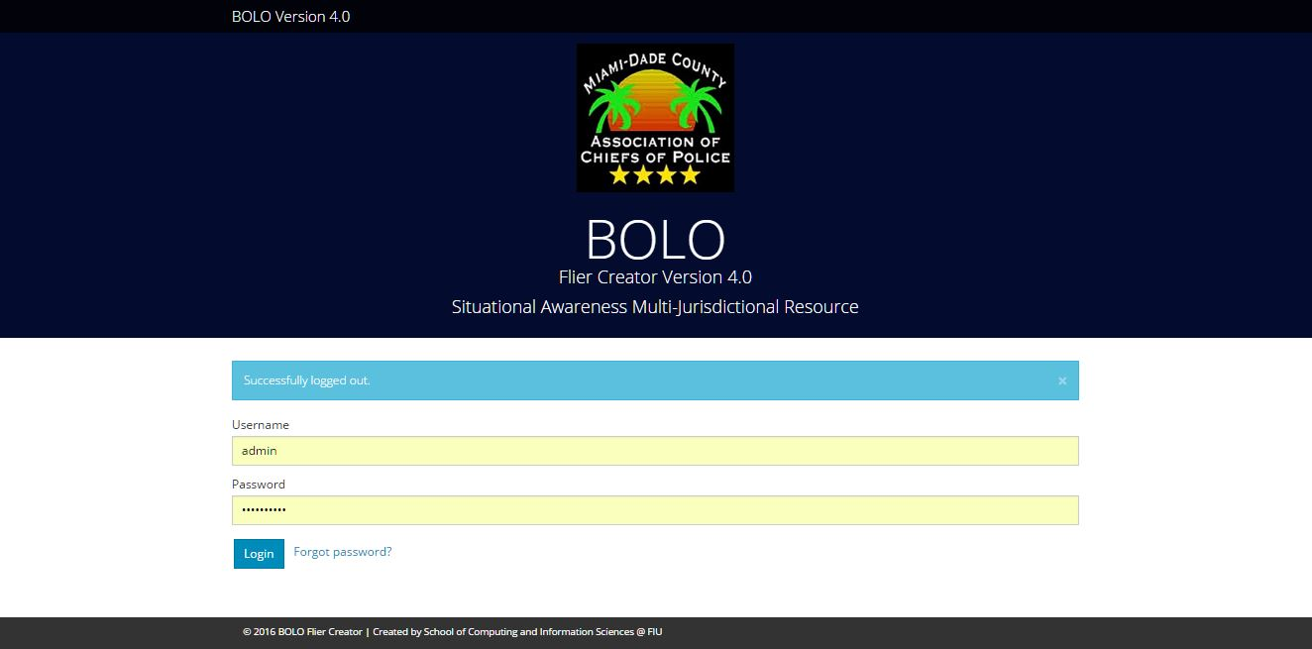
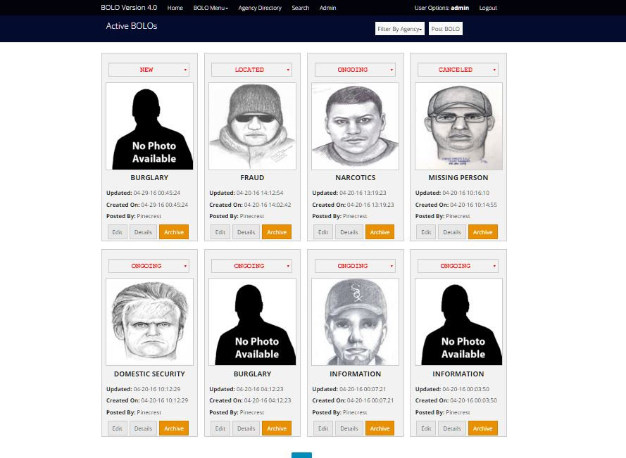
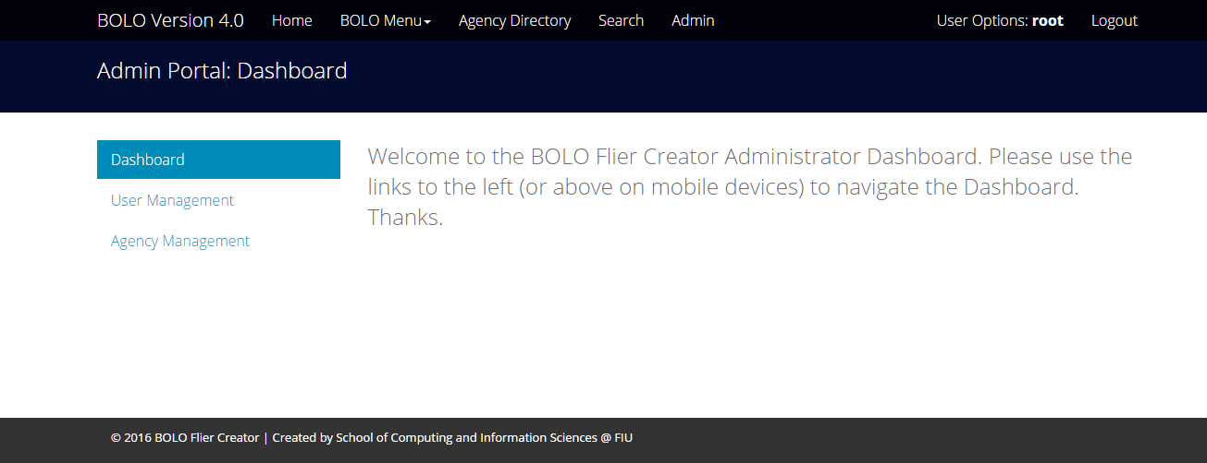
School of Computing & Information Sciences
Senior Project, 2016, Spring
BOLO Version 4.0
Student: Edwin Alvarez Sosa, Florida International University
Mentors: Juan Caraballo, IBM & Samuel Ceballos, Pinecrest
Instructor: Masoud Sadjadi, Florida International University
Problem
Current System
Requirements
The process in which information related to a crime is distributed to varying officers and agencies often takes much longer than is expected, often involving a turnover time of up to a few hours. This lag in information relay leads to delays and sometimes missed opportunities for apprehending a criminal.
The current system employs a variety of strategies for creating and disseminating BOLO (Be On the Lookout) information to agencies and officers. Some of these strategies include alerts over police radio, computer aided dispatch software which requires that officers are equipped with specific hardware, and finally paper documents created in a word processor and printed out. While these systems currently work, a more accessible solution is desired.
The requirements for version 4.0 of the BOLO web application were to continue transferring the remaining functionality that was missing from version 3.0 but present in it’s prior iterations. This included but is not limited to BOLO search functionality, PDF generation, and reestablishing the look and feel of the original versions of the app. Other requirements involved adding new features to the application in the form of system wide image compression, a new 4 tiered user scheme, and a password retrieval system.
Solution
The solution to this issue is to create a modern approach to the old fashioned concept of BOLOs in the form of a secure web application with the ability to provide a centralized database of all active and archived BOLO records, as well as alert officers when new BOLOs are issued.
Object Design
The BOLO 4.0 system has 3 categories of objects, the entity objects, the boundary objects, and the control objects. The entity objects make up the domain portion of the application and holds the schema and validation methods for the objects that exists within the system. The boundary objects provide the views that the user interacts with and the control objects represent the services and routers that handle most of the logic for the application.
Implementation
The current version of the BOLO application has been shifted from a WordPress/PHP environment to a JavaScript frontend and NodeJS/Express backend. The application will be deployed on the IBM Bluemix Paas(Platform as a service) for added security and service providing. IBM Cloudant is used as the NoSQL database for storing the varying forms of entity documents found within the BOLO system. SendGrid is used as the application’s email service for alerting officers of the creation/update of a BOLO. Users are authenticated using the PassportJS library and implements cookie based sessions. Other security features are built into the application including Cross site request forgery protection and enforcing https requests when enabled.
System Design
The hexagonal architecture chosen for the system creates a distinction between three layers, the user interface, the application layer, and the domain layer. The User interface layer provides the boundary objects for the user, the application layer encapsulates the control objects, and the domain layer contains the entity objects. The outer layer also accepts adapters for the micro services that interact with the system.
Screenshots
Summary
BOLO Flier Creator v4.0 builds on top of previous semester iterations which have all attempted to provide a modern, robust solution to the world of policing. This new version aims to bring the application to the level where it will have all the necessary features and improvements to be ready for a full pilot by the Pinecrest Police Department. The ultimate goal of this application is to aid officers in their day to day operations and eventually make the streets a little bit safer for everyone.
Verification
Unit tests are written for all system core classes and modules. The team uses the Mocha testing framework as a test runner with the Chai assertion library for writing tests. Integration tests were also written using the same tools. For acceptance tests, Selenium IDE is used to automate front-end browser interactions.
Acknowledgement
The material presented in this poster is based upon the work supported by the Village of Pinecrest Police Department, Major Jason Cohen, and Captain Samuel Ceballos along with Juan Caraballo and Robert Loredo from IBM. I am also grateful for the assistance received from my team members Alejandro Henao, Leonardo Martin, and Piero Messarina.
Notes:
1

