Slide 1







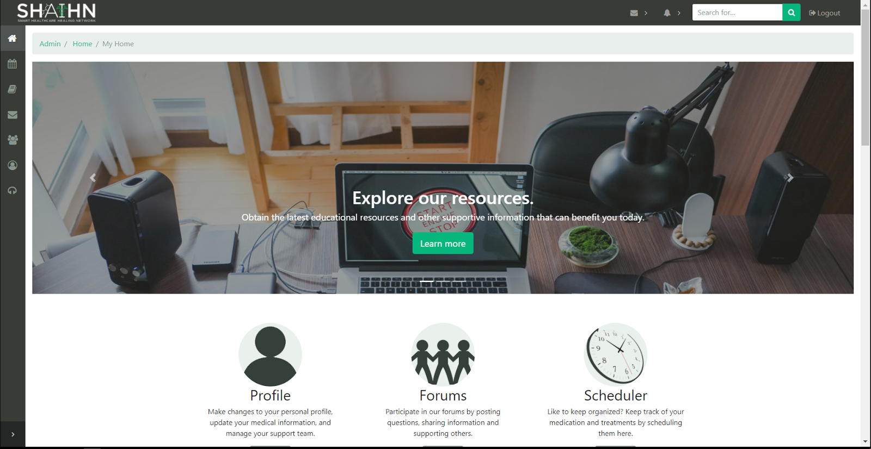
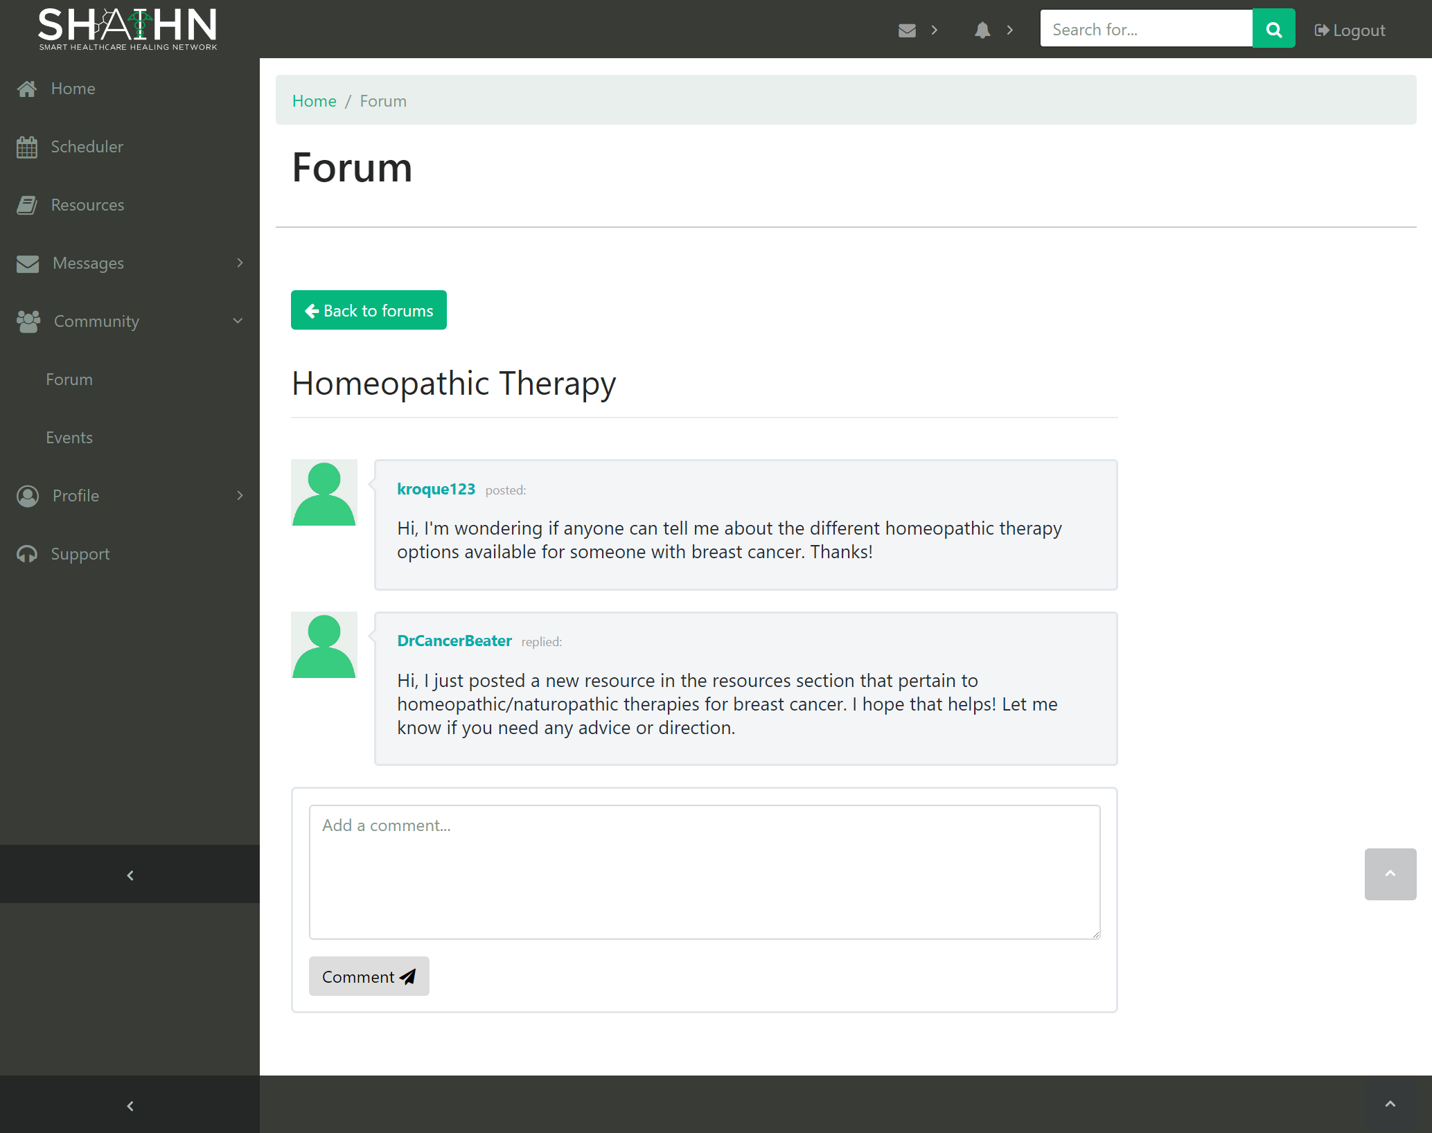
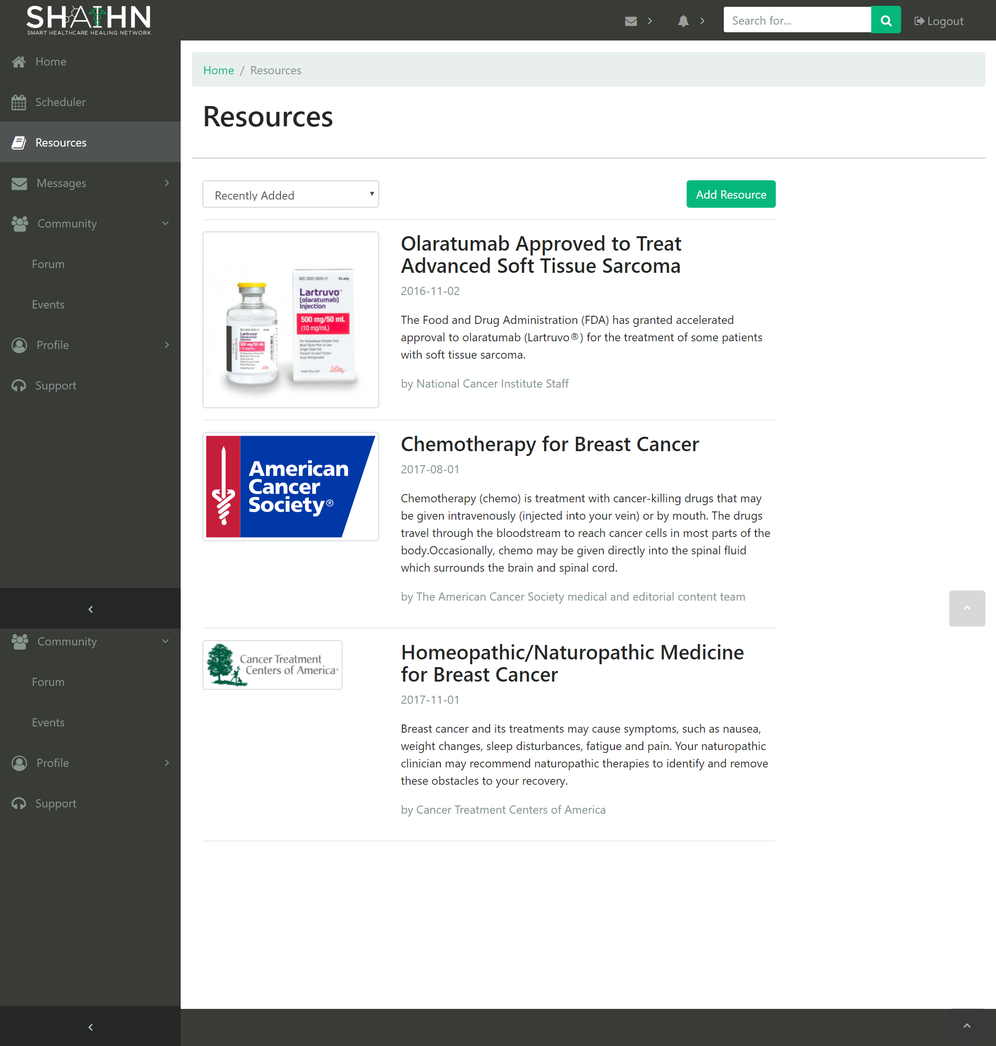
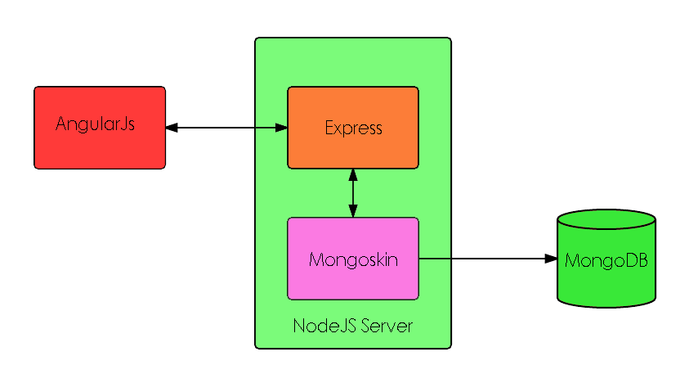
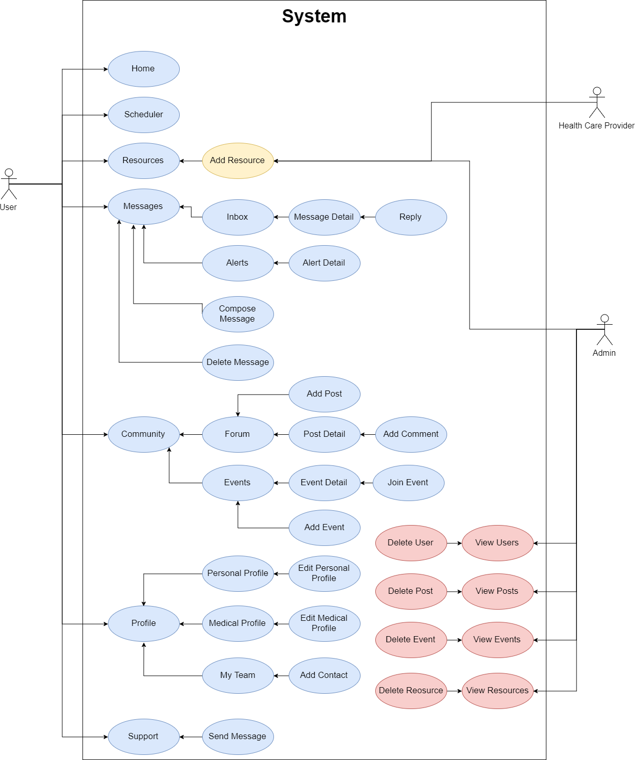
School of Computing & Information Sciences
Senior Project, 2017, Fall
Smart Healthcare Healing Network 1.0
Student: Kyle Roque, Florida International University
Mentor: Annette King, Product Owner
Professor: Masoud Sadjadi, Florida International University
Problem
Currently, many patients, specifically cancer patients, often feel isolated or alone in their struggle because of the stigma that’s been historically associated with the disease. This feeling causes some patients to not share their experiences or concerns with others like themselves, which hinders their ability to learn more about their options and outcomes.
Solution
SHAIHN was built to be an online community where patients, their caregivers, and verified healthcare providers to discuss and share their experiences, advice, insights in regards to their disease, treatment options, and the everyday problems they encounter.
Current System
Users include patients, caregivers, and healthcare providers
Topic-specific forums are available for all users to post content and comments
Users can create and join events
Healthcare providers can post beneficial/educational resources for other users
Calendar feature to track appointments and medicine schedules
Screenshots
Requirements
MongoDB v3.2 installed
NodeJS and NPM installed
ExpressJS, AngularJS, and MongoSkin dependencies injected
Compatible Internet Browsers: Google Chrome, Firefox, Safari, Internet Explorer
System Design
Implementation
MEAN stack: MongoDB, ExpressJS, AngularJS, NodeJS
JQuery, HTML5, CSS3, JavaScript
MVC-like architecture
Instead of models, services layer used for data access and business logic
Development Environment: Visual Studio Code
Validation/Verification
Manual testing performed for each user story by developers
UI/Usability testing performed by potential users
Application was demoed to Product Owner after each sprint so they could validate its functionality
System Design
Summary
SHAIHN 1.0 is the first iteration of this web application
Team developed from scratch using the MEAN tech stack for full stack web development
Allows users with similar health conditions to connect in a supportive environment
Acknowledgement
The material presented in this poster is based upon the work supported by Annette King. I am thankful to the help that I received from my group member, Alvaro Villa
Notes:
1

