Slide 1


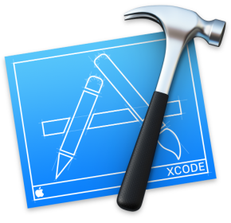
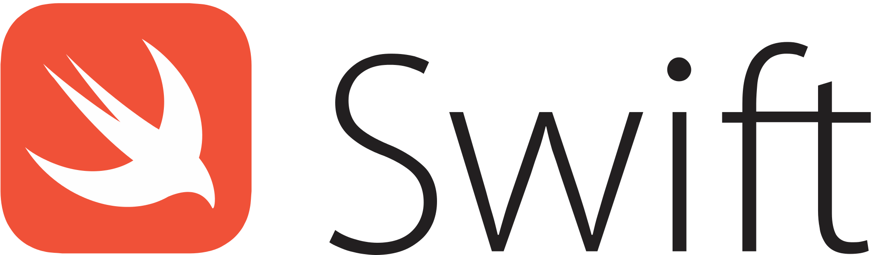
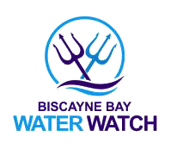
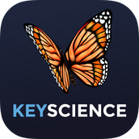



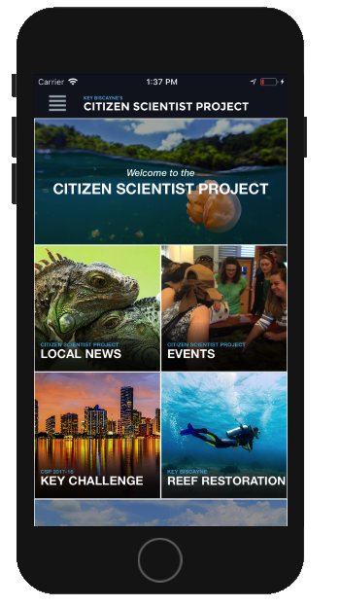
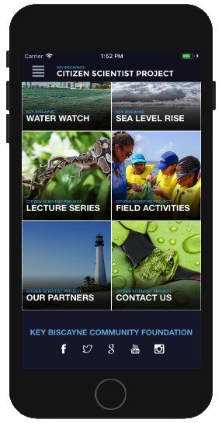
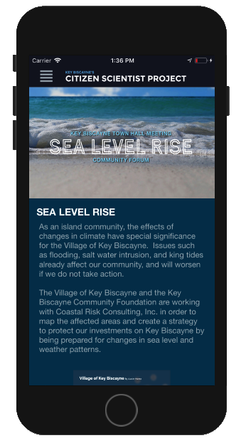
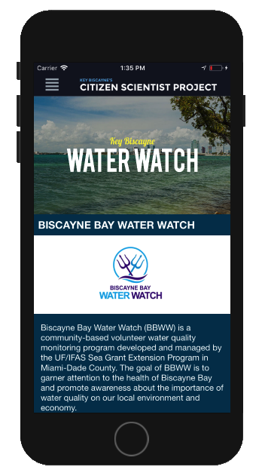
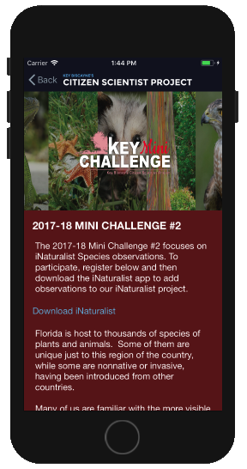
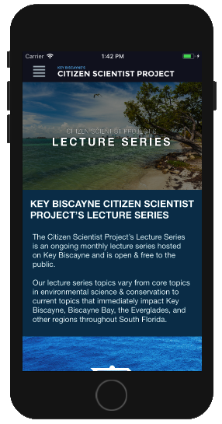
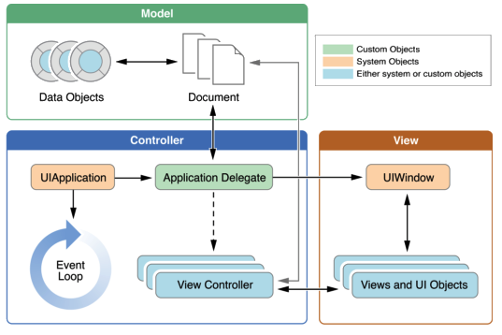

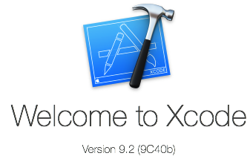



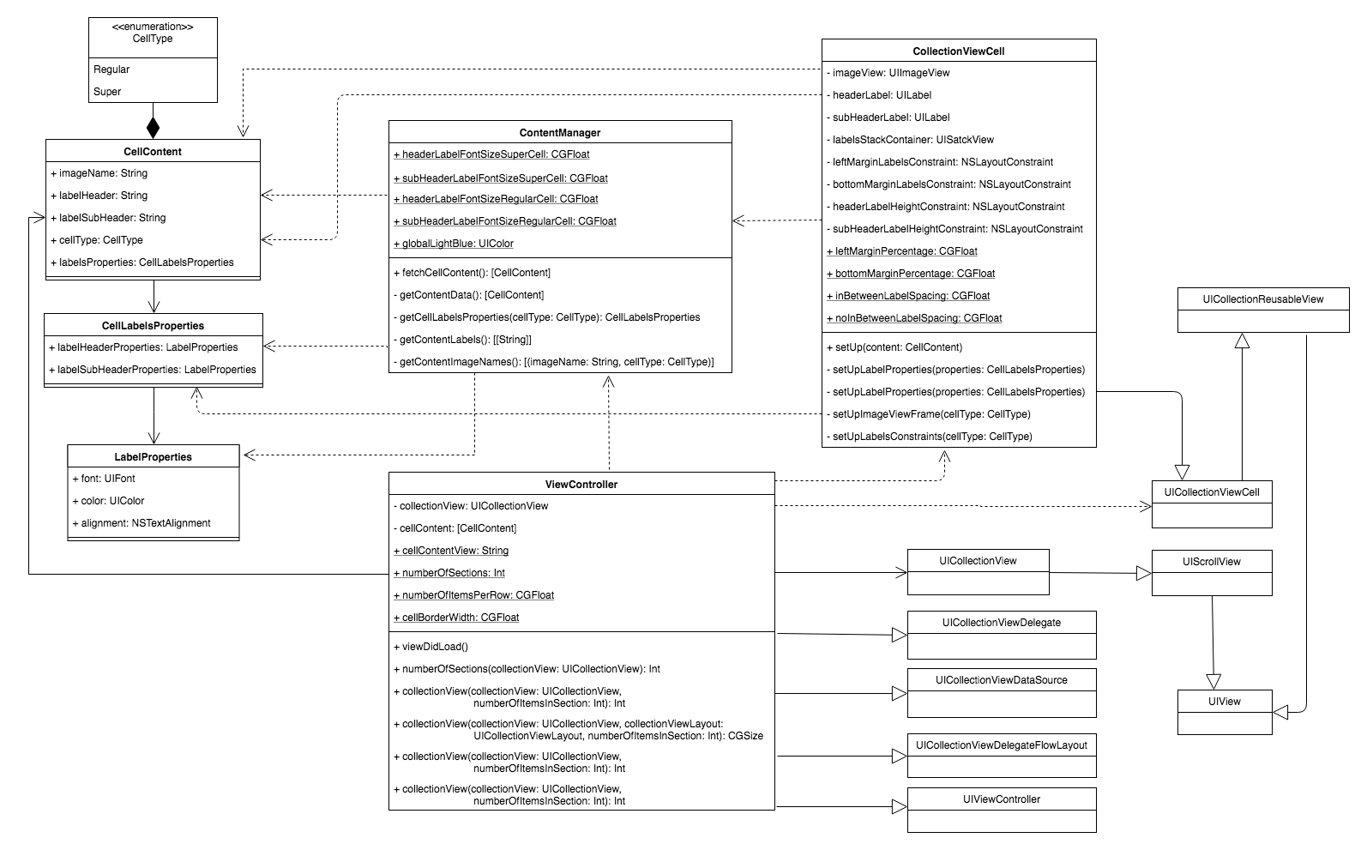

School of Computing & Information Sciences
Senior Project, Spring 2018
Citizen Scientist Project iOS App 1.0
Student: David Gonzalez, Florida International University
Mentors: Nathan Moyer, Light Made Liquid, LLC
Professor: Masoud Sadjadi, Florida International University
Problem
Solution
Current System
The Key Biscayne Community Foundation strives to raise awareness about the natural resources of Key Biscayne and Virginia Key with the intent to preserve the environment and protect its wildlife.
Environmental education is an essential aspect of the global and local response to climate change. It helps citizens and young folks understand and address the impact that human actions have on ecosystems. It's a call of encouragement to our community to change our attitudes and behavior to live in a more sustainable society.
KeyScience iOS App. provides a medium to reach out to and notify users with the latest local news, events, and programs taking place in Key Biscayne area.
Volunteer programs such as Key Challenge and Field Activities encourage citizens to participate in on-hand learning experiences while exploring different areas of the Key.
With an enhance user experience, the application allows members of the community and professional scientists to record and share relevant up-to-date information about the most critical natural resources.
Supports application navigation through the homepage and navigation page.
Lays out the application structure using storyboards and MVC architectural pattern.
Implements reusable views and controllers, e.g. footer, horizontal sliders, and collection view items.
Contains several static pages from the Citizen Scientist Project (CSP) website with an enhanced interface design and better mobile support.
Incorporates scientific resources about critical natural resources in the Key area.
Requirements
System Design
Implementation
Most of the work planned for this semester include creating the skeleton of the application and implementing those pages from the CSP website with static content.
Deployment Target
IDE
Homepage
Navigation Page
Reusable Header
Reusable Footer
Sea Level Rise
Water Watch
Reef Restoration
Key Challenge
Mini Challenge
Previous Winner
Lecture Series
Field Activities
Our Biomes
Our Partners
About Us
GeoHunt Game
Programming Language
Source & Version Control
Verification
Object Design
Summary
 | CSP_UITest _002_SeaLevelRise_03
Purpose | Verify and validate that the “Fact Sheet” pdf resource is loaded and correctly displayed when clicking the corresponding button in Sea Level Rise page.
Precondition | 1. User must navigate to the Sea Level Rise page. 2. (1st Townhall Community Forum, November 10, 2016) section must be expanded (children elements must be visible)
Test Setup | 1. Launch the KeyScience app. 2. On the top-left corner click the navigation menu button icon. 3. In the navigation page, scroll down and select Sea Level Rise section. 4. In Sea Level Rise, scroll down until (1st Townhall Community Forum, November 10, 2016) section is visible and click it.
Input | 1. Click on “Fact Sheet” link from the (1st Townhall Community Forum, November 10, 2016) section.
Expected Output | User is be redirected to a web-view page. After ~1-3 seconds Fact Sheet pdf document is loaded and displayed.
The Key Biscayne Citizen Scientist Project mission is to have citizens and professional scientists monitor and protect natural resources by sharing the most critical information about the Key Biscayne and Virginia Key settings. The KeyScience iOS app. is a portal to the many components operating to realize the Key Biscayne Community Foundation mission, and will become the launch pad for CSP Lecture Series and CSP Field Activities programs. News and Events feeds keep residents informed about and engaged with Key Biscayne local natural resources.
Acknowledgement
The material presented in this poster is based upon the work done by Emmanuel Malave and David Gonzalez. This project was supported by the Key Biscayne Citizen Scientist Project and the Key Biscayne Community Foundation. Special thanks to our mentor Nathan Moyer and to Juan Caraballo and Masoud Sadjadi.
Notes:
1

