Slide 1









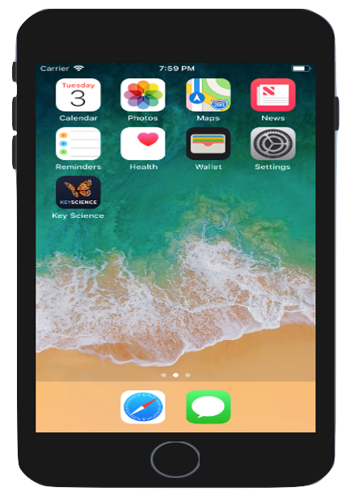
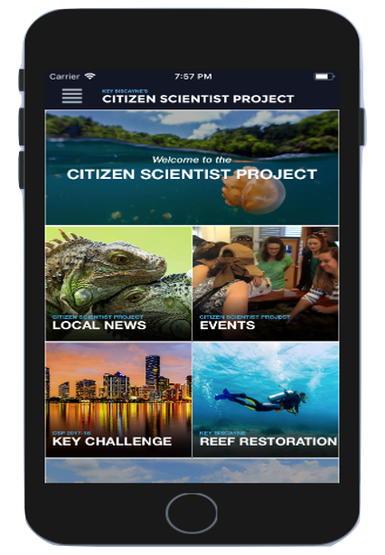
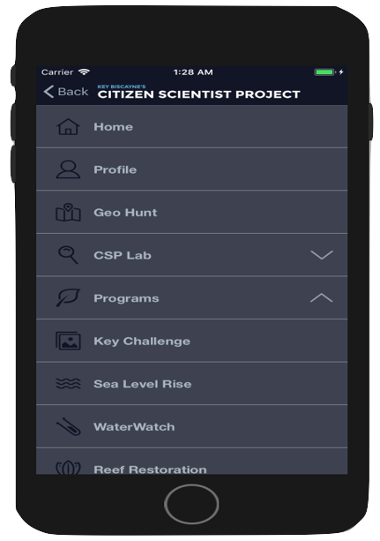
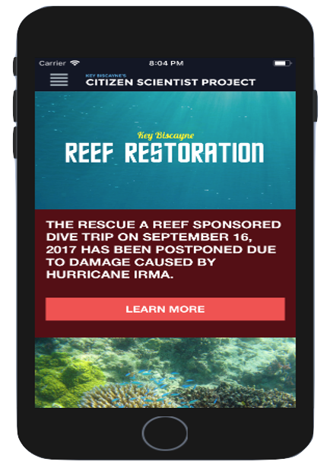
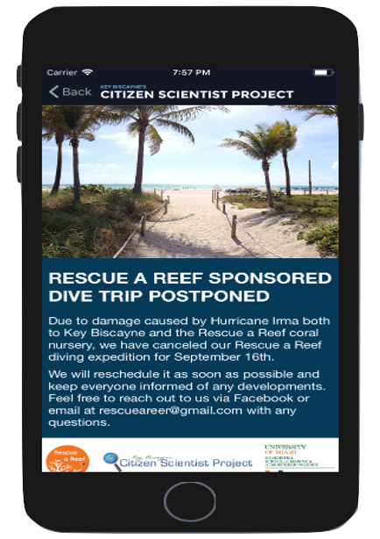
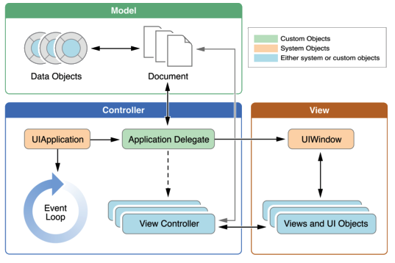




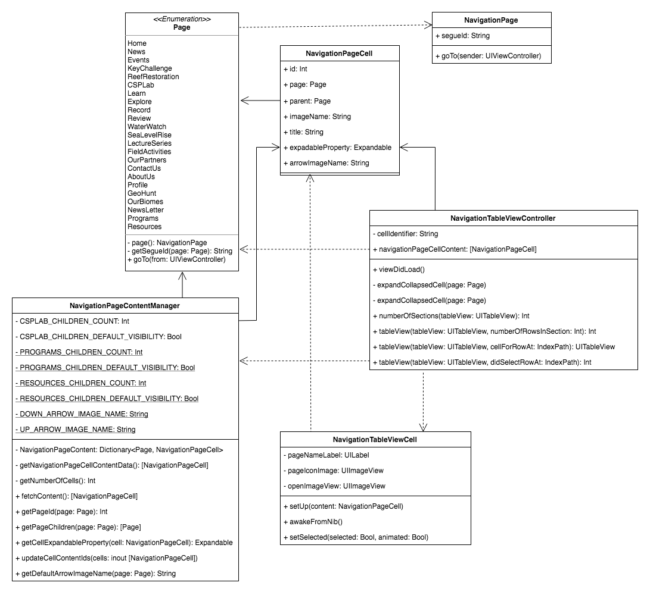
School of Computing & Information Sciences
Senior Project, Spring 2018
Citizen Scientist Project iOS App 1.0
Student: Emmanuel Malave, Florida International University
Mentors: Nathan Moyer, Light Made Liquid, LLC
Juan Caraballo, Florida International University
Professor: Masoud Sadjadi, Florida International University
Problem
Solution
Current System
The Key Biscayne community is characterized by its diverse and stunning natural resources. The Key Biscayne Citizen Scientist Project(CSP) was started to help monitor, protect and share information on these resources. Currently, members of the community can access the CSP resources through their website. Unfortunately, this website has some accessibility issues such as:
Requires Internet communication to access any of the resources
Uncomfortable mobile user interface in certain pages
Difficult implementation of a geo-hunting game
With the current website’s shortcomings, an iOS application was proposed as an alternative new system. This system would give users access to all the key features on the current website but without any of the accessibility flaws, in such allowing for new features to also be implemented. These features include support for offline viewing, an easier to use mobile user interfaces, implementation of user profiles, implementation of a notification system and an integrated geo-hunting game.
Implements a user interface, which focuses on mobile design
Provides offline support for main application pages
Supports navigation throughout the application, which can be easily inferred by users
Contains reusable views and frameworks to standardize the design among the different pages of the application.
Details various resources users can use to learn about relevant environmental information including: videos, scientific papers, volunteer opportunities, etc.
Screenshots
Requirements
System Design
Implementation
The main requirements for this iteration included access to:
A friendly and easy to use interface
Static pages from the CSP website
Home Page
Programs pages – Key Challenge, Sea Level Rise, Water Watch, Reef Restoration, Lecture Series, Field Activities, Mini Challenge and Previous Winners
Resources pages – About Us, Our Biomes, Our Partners
Requirements for future iterations include:
Integration of user profiles and notification system
Creation of the geo-hunting game
Creation of an Android port
Give access to dynamic content
Deployment Target
IDE
XCode 9
Programming Language
Source & Version Control
Verification
Object Design
Summary
Sample Test Case:
Sample Class Diagram:
The Citizen Scientist Project iOS App 1.0 is the first release of an application that will take approximately another three releases to be fully complete. In this release the application’s core user interface, navigation and main pages were designed, developed and filled with data. With a completed version of the application, The Key Biscayne Citizen Scientist Project will be able to expand their reach by integrating a new system into their platform which allows users to be able to monitor, protect and share information on the most critical natural resources of Key Biscayne.
Test Case ID: | Navigation_Unit_Test_04
Purpose: | From the Navigation page, the user should be able to press on any table cell that references another page and afterwards get redirected to that page.
Preconditions: | The user must have a running version of the application on their phone The application must be running and in view The user must be viewing the Navigation page
Expected Results : | View changes to referenced page when the table cell is pressed in the Navigation page
Actual Results: | After the user presses a table cell their view gets changed to the view referenced in the table cell, this includes the table cells: “Home”, “Profile”, “Geo Hunt”, “Learn”, “Explore”, “Record”, “Review”, “Key Challenge”, “Sea Level Rise”, “Water Watch”, “Reef Restoration”, Lecture Series”, “Field Activities”, “Events”, “News”, “About Us”, “Our Biomes”, “Newsletters”, “Out Partners” and “Contact Us”.
Status: | Passed
Acknowledgement: The material presented in this poster is based upon the work supported by The Key Biscayne Community Foundation and The Key Biscayne Citizen Scientist Project. I am thankful to the help that I received from my teammate David Gonzalez, our mentor Nathan Moyer and to our professors Juan Caraballo and Masoud Sadjadi.
Notes:
1

