Slide 1
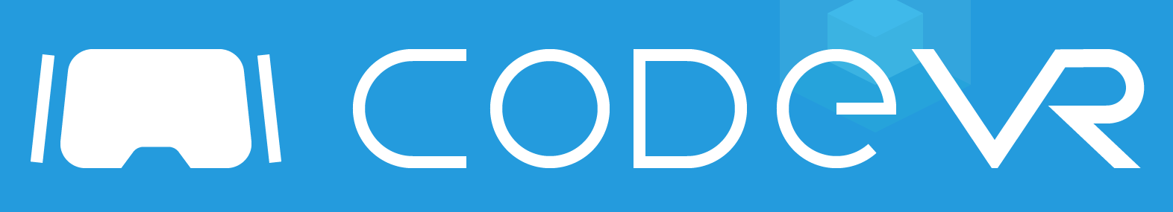


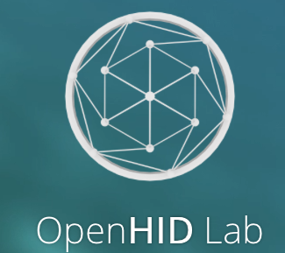
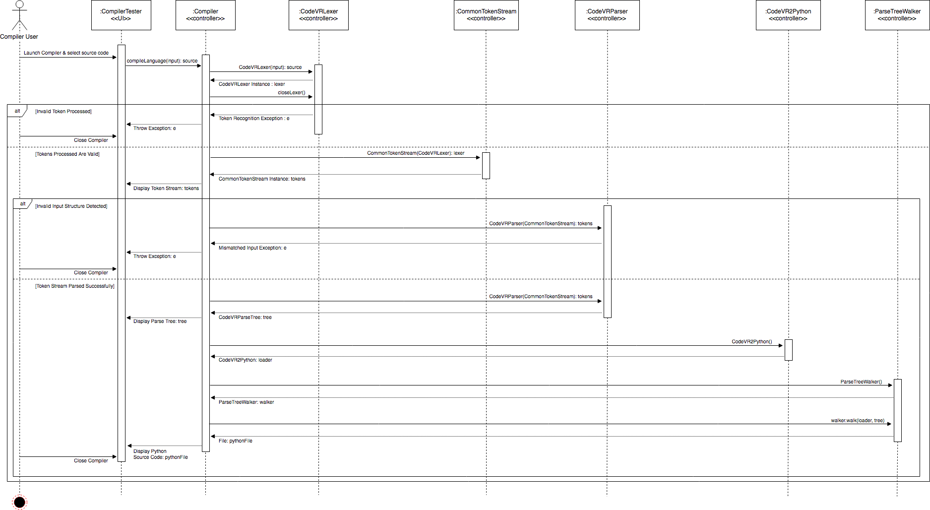
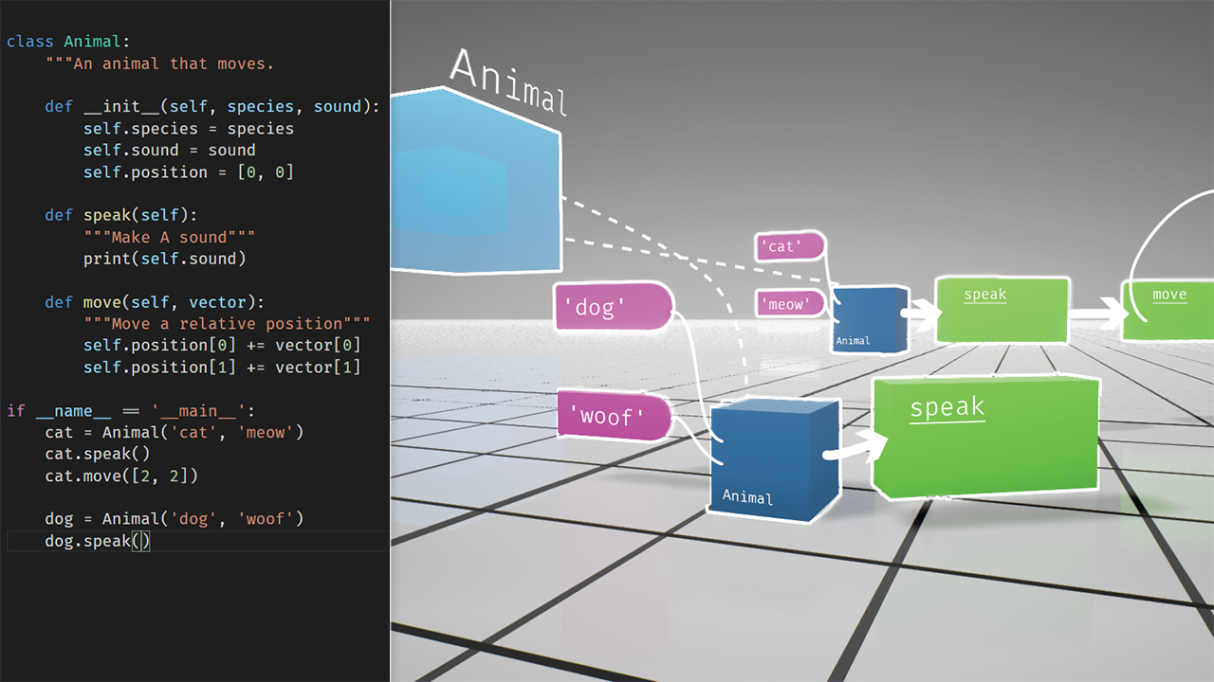
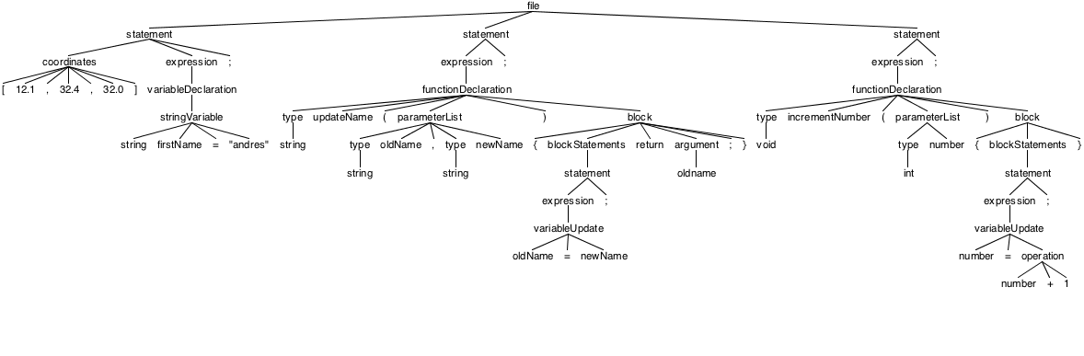

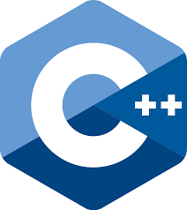



OpenHID Lab: CodeVR 1.0
VIP Senior – Spring 2018
Student: Andres J. Chalela, Florida International University
Mentor: Dr. Francisco Ortega, Florida International University
Professor: Dr. Francisco Ortega, Dr. Masoud Sadjadi, Florida International University
FOLLOW US @ FIUCIS
School of Computing
& Information Sciences
Purpose
Solution
Current Status
Visualization of CS concepts & fundamentals
Programming Languages are complex and can seem daunting to learn to beginners
Hard to trace relationships and functionality between different programming structures
3D visual interactive programming application with domain specific CodeVR language
Creation and manipulation of virtual programming language constructs
My Contribution: CodeVR Language Design and source-to-source compiler
Language application runs successfully
Successful execution of Lexical Analysis on source input
Generation of CodeVR Parse Tree via token stream
High-level source-to-source translation from CodeVR Language to Python
Requirements
System Design
Token stream generation via Lexical Analysis
Parser validates token stream syntax structure
Valid parse tree is generated for source-to-source language application
Traversal of parse tree nodes via parse tree walker
Generation and export of Python source code via parse tree listener
CodeVR
Source Code
Lexer
Token Stream
CodeVR
Language
Recognizer
Parser
Parse Tree
Source-to-Source
Language Application
Translated Python Source Code
Figure 1: CodeVR Source to Source Compiler Sequence Diagram
Figure 2: CodeVR Source-to-Souce Compiler
Execution Flow
Figures
Figure 3: CodeVR 3D Object Visual Representation Concept
Figure 4: GUI Representation of
CodeVR Source to Source Compiler Generated Parse Tree
Future Work
Implementation
Expansion of CodeVR Lexer & Parser Grammar Rules
Integration with 3D application to allow generation and export of CodeVR source code
Expand compiler support for translation into additional high level languages - C++, Java, JavaScript
Importation of premade CodeVR source code into 3D environment
Implementation of 3D interactive blocks-based programming application
Implementation of CodeVR compiler and source-to-source language application
Acknowledgement
The material presented in this poster is based upon the work supported by my mentor, Dr. Francisco Ortega. I am thankful for the help that I received from my group members, Miguel Jardines and Rolf Gilet .
Notes:
1

