Slide 1






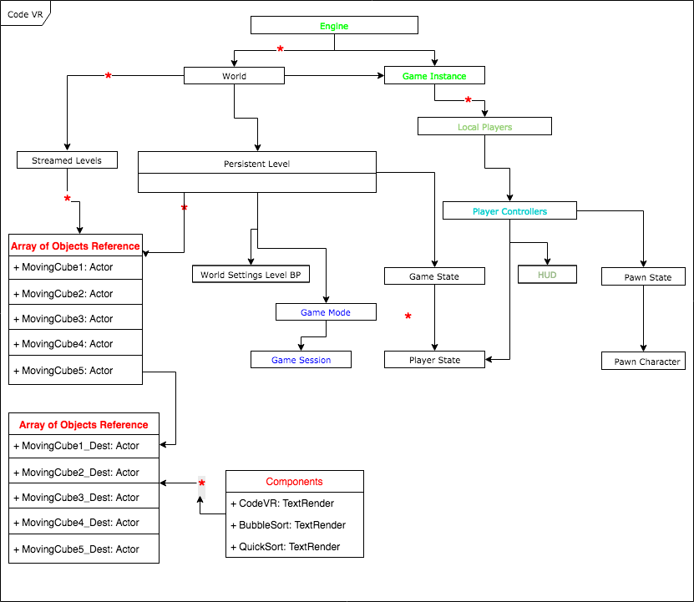
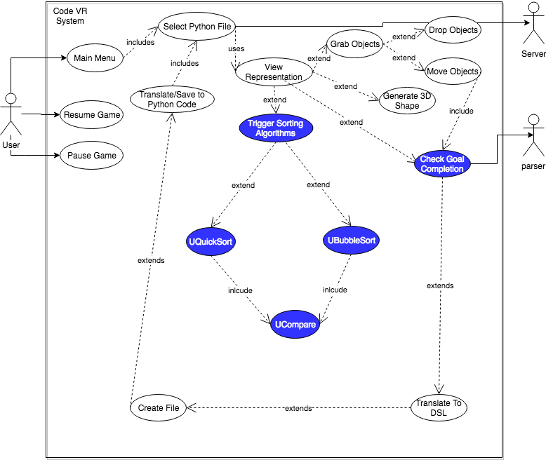
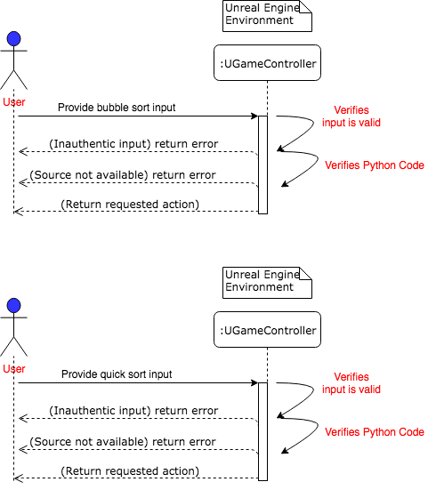
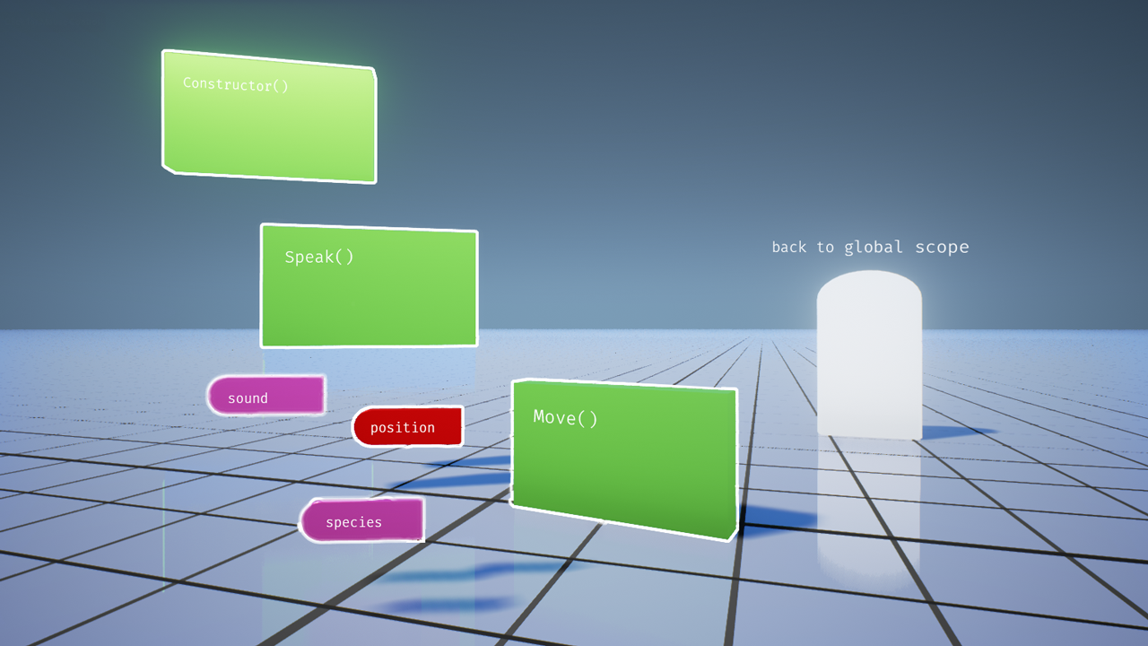
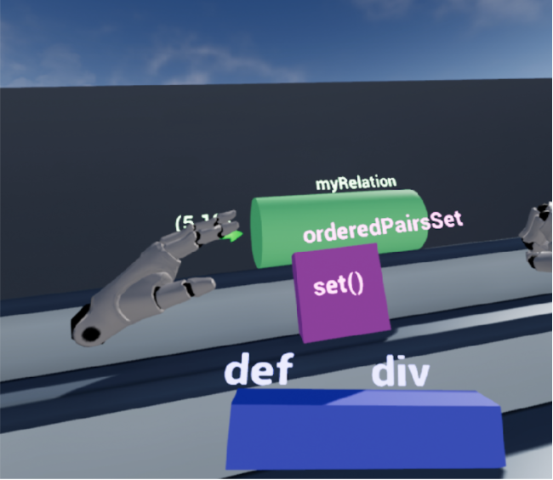
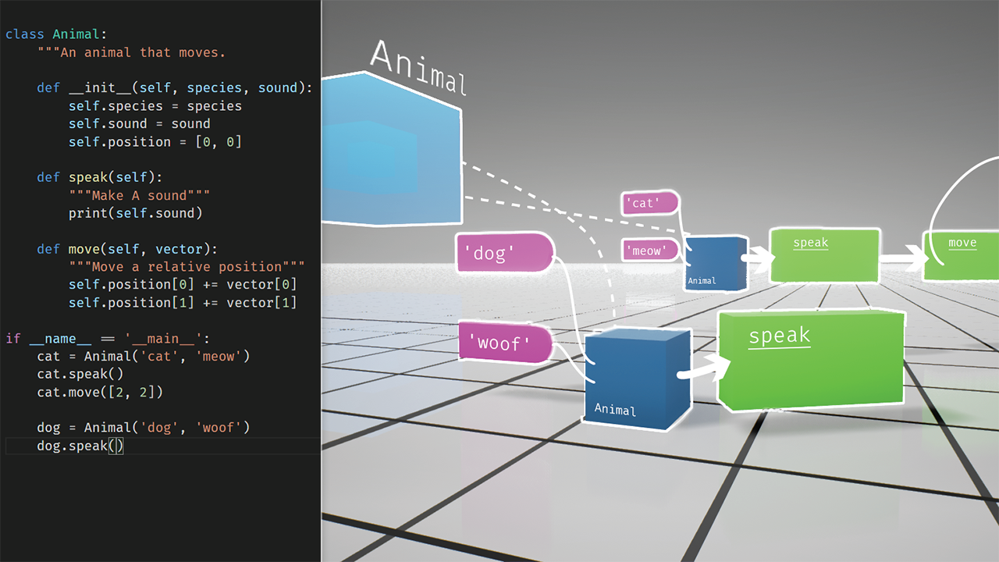
School of Computing & Information Sciences
VIP Senior Project, 2018,Spring
CodeVR 1.0
Student: Miguel A. Jardines, Florida International University
Mentor: Francisco Ortega, Product Owner
Professor: Masoud Sadjadi, Florida International University
Problem
By 2024, the US will be unable to fulfill approximately 1 million computing positions.
Computing and Information Sciences majors are the least popular amongst students due to the abstraction involved in learning fundamental courses.
We need more innovative individuals to join computing majors.
Solution
Dedicated VR App to help beginners understand fundamental concepts about Object Oriented Programming.
%65 of students are visual learners, thus Code VR provides interactive algorithm visualizations dynamically generated from source code.
Intuitively solvable visuals aimed for users to grasp data structure concepts. (e.g the sorting of an array of integers)
Requirements
General users can choose python file, trigger generation of visuals, interact with visuals and compare code to visuals.
By using CodeVR 1.0 the user has access to a shape generator tool for interaction between user and Visual shapes.
Additionally, the system allows user to generate Code VR Domain Specific code from already generated visuals.
Solution
Dedicated VR app for visualization and manipulation of objects.
Computing and Information Sciences majors are the least popular amongst students due to the abstraction involved in learning fundamental courses.
We need more innovative individuals to join computing
Current System
User has access to Python code from 2D Menu.
User can trigger shape generation from selected python file.
User can observe shapes and related class, constructor, and methods pertaining to Python file.
User can distinguish unique properties and relationship between generated shapes.
Object Design
Unreal Engine Class Diagram
Object references determine initial and final position of shapes representing components from source code.
Destinations are determined by conditions pertaining to the current algorithm and data structure being translated from python code.
Game Controller Instance controls instances of spawned shapes and relationships
Implementation
Unreal Engine 4.18.3 for UX/UI design in first person template.
C++ and blueprint scripting for triggers and interactions between user and CodeVR.
HTC Vive VR system with Controller allow the user to interact intuitively with actors in the VR game by using gestures and Realistic HD haptic feedback.
Figure 1. CodeVR 1.0 User Interaction Design
System Design
Summary
CodeVR 1.0 simplifies understating of programming concepts.
Immersion into CodeVR provides user with unique interactive experience.
US immediately needs CIS majors.
CodeVR 1.0 lets the user interact, visualize and compare visual elements as opposed to only text.
Figure 3. Trigger Bubble Sort Interaction
Verification
Figure 4. Trigger Quick Sort Interaction
Test Case Id: | Code-VR_Obj_Interaction_001
Description/Summary of Test: | To test spawning of objects and interactions when triggered by user.
Pre-condition: | User is wearing VR set User is at position and there exists a set of 3d objects that successfully appear in Code VR environment Bubble Sort text successfully appears after user input controller triggers interactions tools.
Expected Results: | All Static Meshes appear at begin play Message showing “Bubble Sort”appeared. User can triggered interactions with Bubble sort animation. User successfully completes interaction
Actual Results: | All Static Meshes appear at begin play Message showing “Bubble Sort”appeared. User cannot triggered interactions with Bubble sort animation. User successfully completes interaction and continue coding.
Status (Fail/Pass): | Fail
One user interacts with VR system:
User wearing HTC Vive while CodeVR is running has access to all interactions shown in the use case diagram of CodeVR system.
Figure 2. CodeVR 1.0 User Interaction Design
Screenshots
Figure 5. CodeVR 1.0 prototype
Figure 6. CodeVR 1.0 prototype
Figure 7. CodeVR 1.0 prototype
Acknowledgement
The material presented in this poster is based upon the work supported by Dr. Francisco Ortega, Dr. Juan Caraballo and OpenHID Lab. I am thankful to the help that I received from my group members, Andres Chalela, Rolf Kinder. Most specially to the School of Computing and Information Sciences at FIU for such a remarkable learning experience.
Notes:
PRESENT YOURSELF: Name and Team name
==============================
Computer Science has a big impact on Society
Improved Communication
Fast Access to Information
AND it is a big deal in Developing Education
Theses days is hard to imagine education without computer software and the internet.
As technology evolves, meeting continuous and more demanding customer needs in the software industry, ultimately depends on the amount of inspired folks who decide to join and work in our field.
The US. Desperately needs more computer science majors
1 million open computing jobs by 2024
The App association represents more than 5,000 app companies and IT technology firms across the mobile technology.
“Believe half of what you see and none of what you hear. Of course, unless you are a auditory listener”
$400 million dollars Silicon Valley fund to support startups in Miami
We obviously need more people in Computer Science
=========================================
NEXT
Solution:
A virtual reality application that:
provides the user with a real time visualization of source code as a flowchart of 3D objects
that can better represent the flow of data, relationship between objects and memory behavior
The main goal is to provide the user with a visual user experience that allows for a better understanding of the flow of data in a running program, connections between objects the swapping of memory in a bubble sort algorithm,
Tools we used:
Unreal Engine for the VR environment
C++ libraries for animations and physics
Biggest Challenge
Provide a unique 3d representation for the whole Python Library
For that I:
am building static animations of all sorting algorithms to THEN perform the translation
from source code to flowchart in a dynamic way

