Slide 1










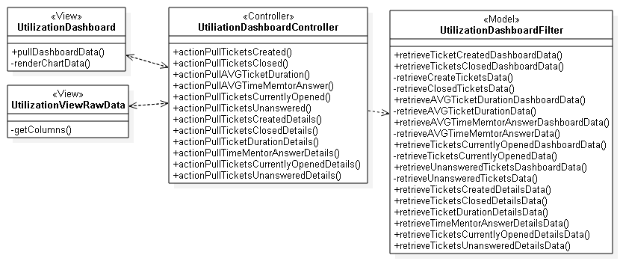
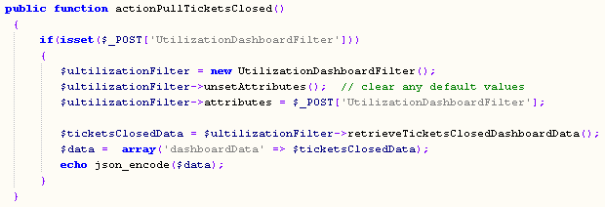
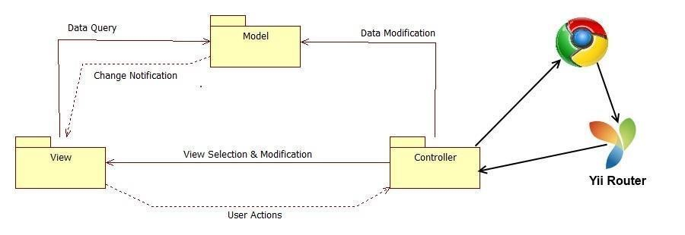
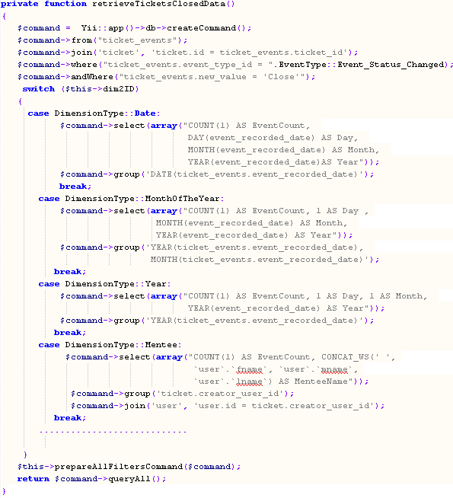
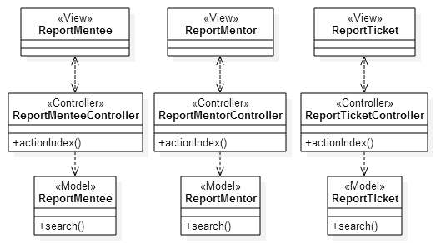
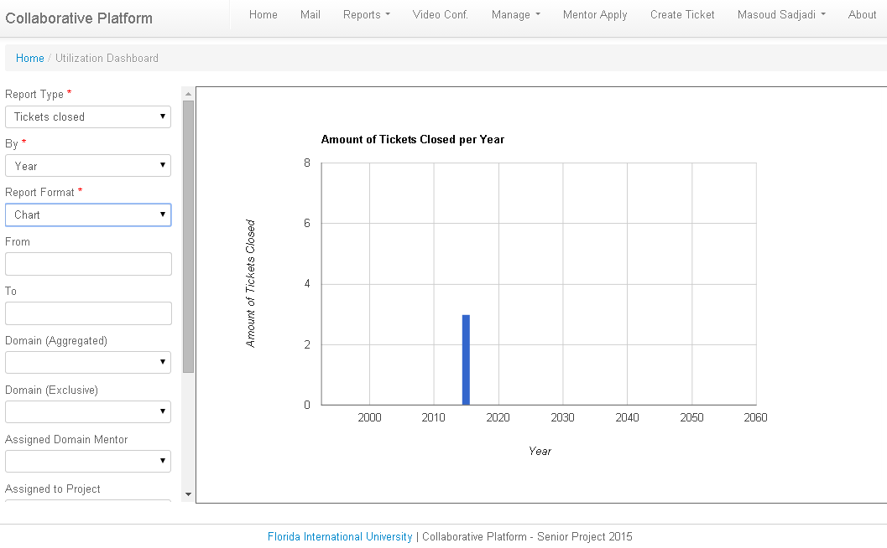
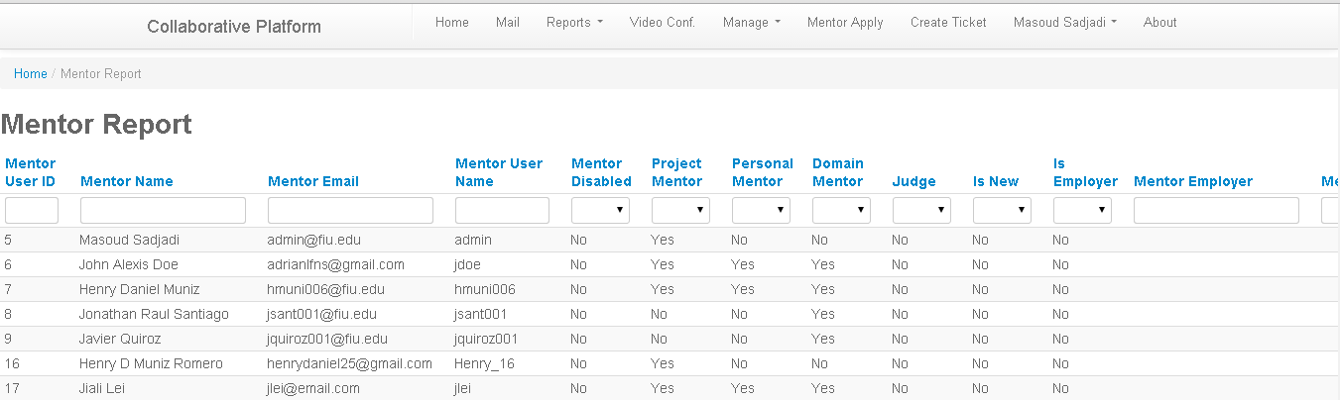
School of Computing & Information Sciences
Senior Project, 2015, Spring
Collaborative Platform
Student: Adrian Alfonso, Florida International University
Mentor: Juan Caraballo, IBM
Instructor: Masoud Sadjadi, Florida International University
Problem
Current System
Requirements
Current students lack a reliable source for answering questions related to their classes or capstone projects. Students may rely on several internet sources, often unreliable, inaccurate and incomplete. In efforts to solve this issue FIU SCIS have decided to develop the Collaborative Platform in order to connect students (mentees) with the right experts (mentors).
A challenge that may arise while providing a platform for mentoring, is the availability of the right expertise. If the platform is not able to manage the demand of questions that mentees may have, the tool may be worthless. Reporting and analytics can offer a tool in order to provide smart decisions and optimize the mentoring process.
Right now students are able to interact with professors and experts via email, chat, video conference and using person to person interaction. These way of communications are not optimal for several reasons:
Mentor and mentee conflicting schedules
Lack of a standard way of electronic communication (i.e. Student may use google chat and mentor may use Yahoo chat)
Difficulty matching the correct mentor for the right question
Other sources for answering questions may include online forums. Those sources are often unreliable. Additionally there are cases where the forums doesn’t provide the answer.
In order to facilitate the decision making process and the management of the Collaborative Platform the system should allow for pulling reports on:
Mentors
Mentees
Tickets
Amounts of tickets created.
Amounts tickets closed.
How long to close a ticket (AVG in hours)
The time that takes mentors to answer (AVG in hours)
Amounts of tickets currently open.
Amounts of unanswered tickets.
Suggestions on what kind of mentors to find.
System Design
Object Design
Implementation
The Collaborative Platform is powered by Yii framework which provides a model-view-controller (MVC) design pattern. The model represents data, business logic and rules. The view represent the presentation. Finally, the controller accepts input and provides bridge of communication between models and views.
UtilizationDashboardControllerr.php
UtilizationDashboardFilter.php
Verification
Screenshots
Summary
The reporting subsystem was verified by using several dataset prepared for every test case. The dataset presented specific data characteristics for the test scenario and the report data and charts have to render according to the dataset.
The Collaborative platform provides a tool for answering questions that students may have; effectively and in a timely manner.
The tool by itself doesn’t work alone. It is necessary the correct amount of the right mentors in order to control all the process of the Collaborative Platform.
An integrated set of reporting and analytics tools may be able to solve the problem of having the right pool of mentors in order to answer the questions that may arise. Reporting may also measure the productivity and the utilization of the system.
Test Case ID | CPv5-TC012
Purpose | Testing accuracy of the report Tickets Closed by year.
Test Setup | Set the database with 4 tickets, each ticket created during the first 4 days of April 2015. Three of the 4 tickets should be closed.
Input | Admin user clicks on the menu report and then clicks on the sub-menu Utilization Dashboard. The user sets the field Report Type with “Tickets Closed”. The user sets the field “By” (second dimension) with “Year”.
Expected Output | The system should display a chart with one bar indicating that there are three tickets closed.
Actual output | The system displayed a chart with one bar indicating that there are three tickets closed.
Acknowledgement
I am thankful to the help that I received from my group member, mentors and my family support. Special thanks to Sandye Palacios.

