Slide 1











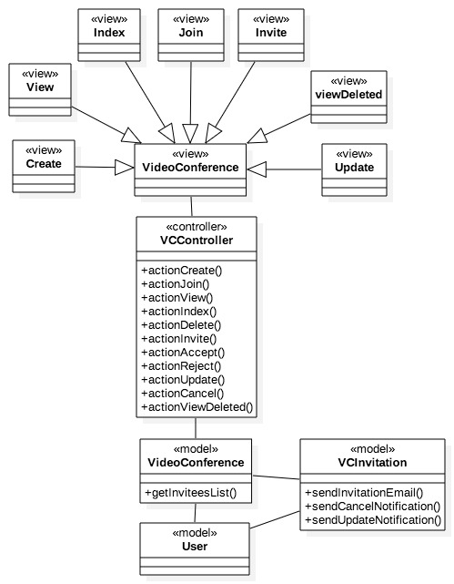
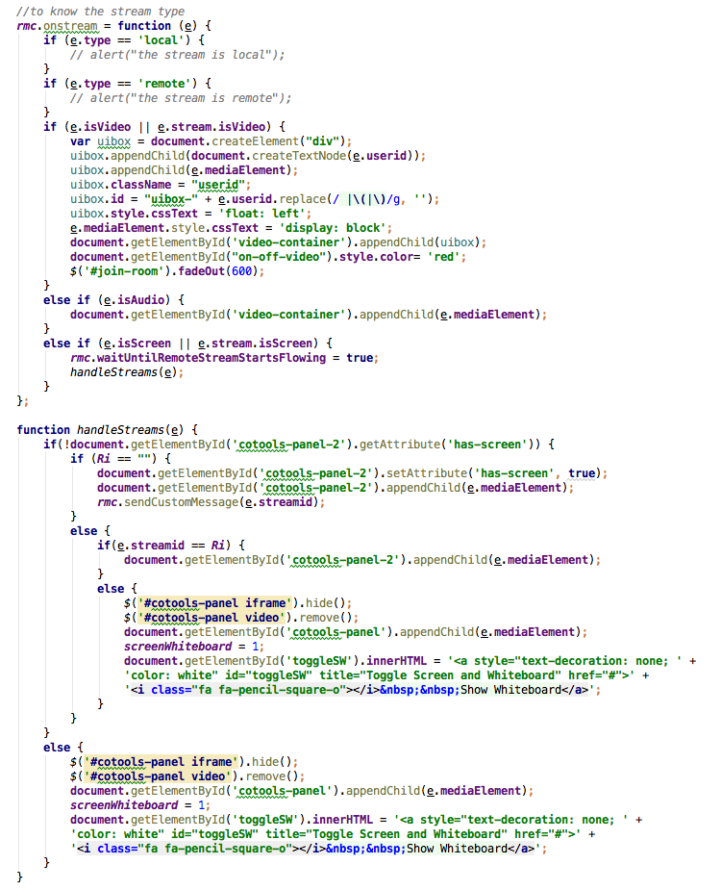
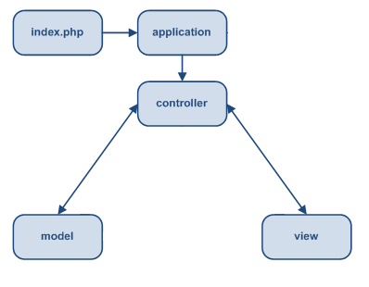
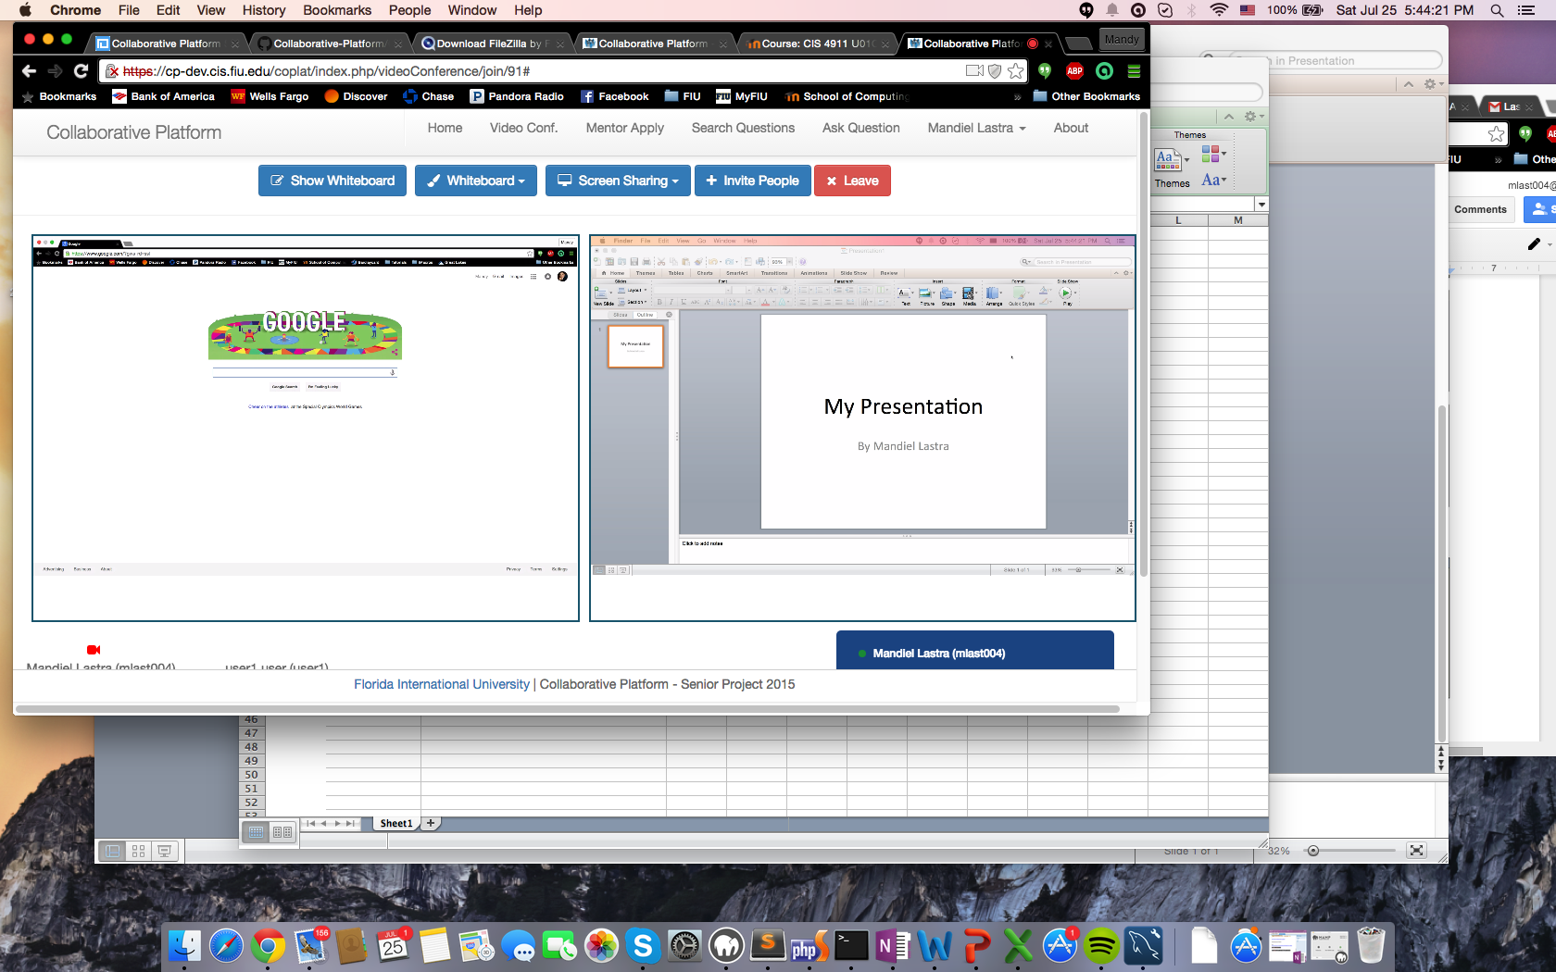
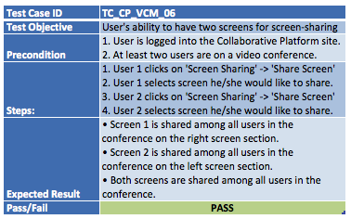
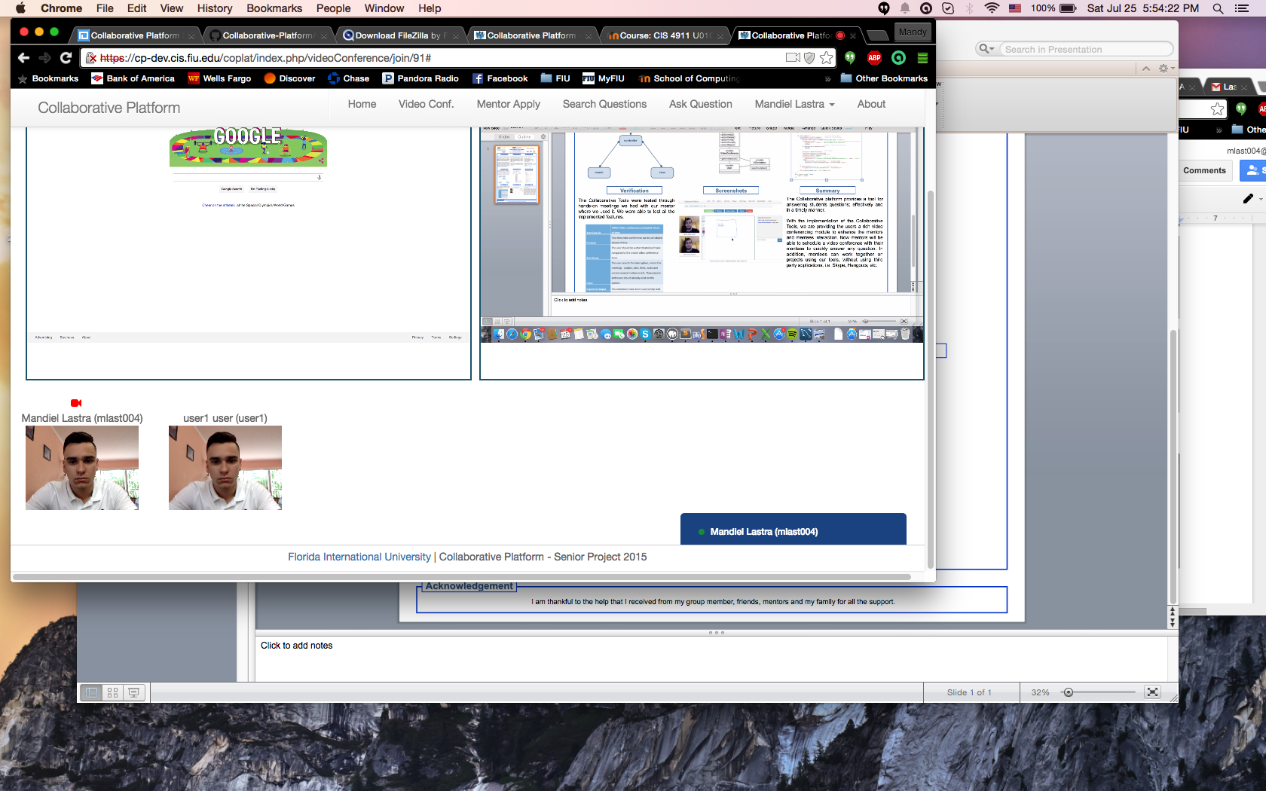
School of Computing & Information Sciences
Senior Project, 2015, Summer
Collaborative Platform
Student: Mandiel Lastra, Florida International University
Mentor: Juan Caraballo, IBM
Instructor: Masoud Sadjadi, Florida International University
Problem
Current System
Requirements
Current students lack a reliable source for answering questions related to their classes or projects. At times students rely on internet sources that are often unreliable, inaccurate and incomplete. In efforts to solve this issue FIU SCIS decided to develop the Collaborative Platform in order to connect students (mentees) with the right experts (mentors).
To improve the interaction between mentors and mentees, a video conferencing tool that allows users to do video calls, chat, and screen sharing was needed. Ideally, this tool would make the meetings scheduling process more pleasant to the user. The maintenance of this tool and the development of new features was my task during the semester.
The current system consists of a web application that allows mentees to post questions (tickets) that can be solved by a mentor. In the system, administrators can group mentees by project and mentors by domain to better assign the right mentor to a ticket. In addition, the system provides users with a video conference tool where they can collaborate with other users by taking advantage of the different features it offers.
However, users of the collaborative tools lack functionalities that will allow them to have a more pleasant experience when using this tool for collaboration and a more robust video conference room.
To provide users with a more robust video conference module I developed new features that will allow users to:
During Video Conferences
Present on one screen while other users share their screen in a second section for screen sharing.
Easily toggle between the screen being shared and the virtual whiteboard.
Turn their webcam on/off in order to conserve bandwidth.
Scheduling Video Conferences:
Edit a scheduled video conference.
Invite users by name so they do not have to remember email addresses.
System Design
Object Design
Implementation
The Collaborative Platform is powered by Yii framework which provides a model-view-controller (MVC) design pattern. The model represents data, business logic and rules. The view represents the presentation. Finally, the controller accepts input and provides bridge of communication between models and views.
Verification
Screenshots
Summary
The Collaborative Tools were tested through hands-on meetings we had with our mentor as well as other projects that also used it for video conferencing. We were able to test all the implemented features.
The Collaborative platform provides a tool for answering students’ questions; effectively and in a timely manner.
With the improvement of the Collaborative Tools and the integration of the new features, users can take advantage of a more robust Video Conference room. Users now have two sections for screen sharing, one which they can toggle between the screen being shared and the virtual whiteboard. In addition, mentees can work together on projects using our tools, without the need for third party applications, i.e. Skype, Hangouts, etc.
Acknowledgement
I am thankful to the help that I received from my group member, friends, mentors and my family for all the support. Special thanks to my love Yaneidy Boentes.

