Slide 1









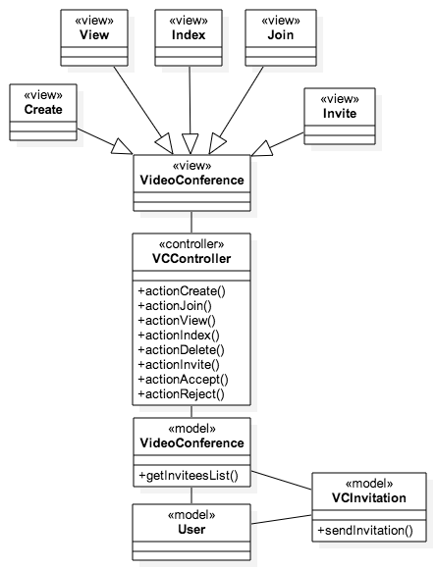
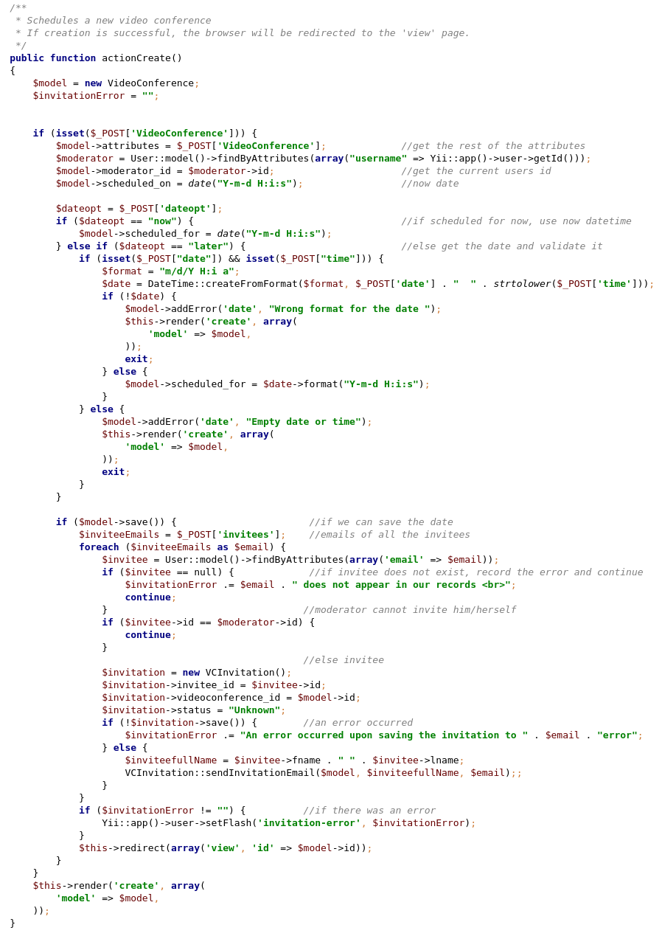
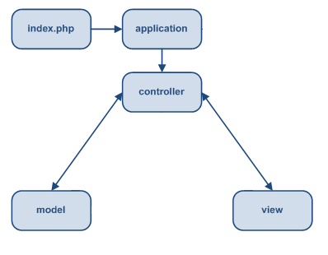
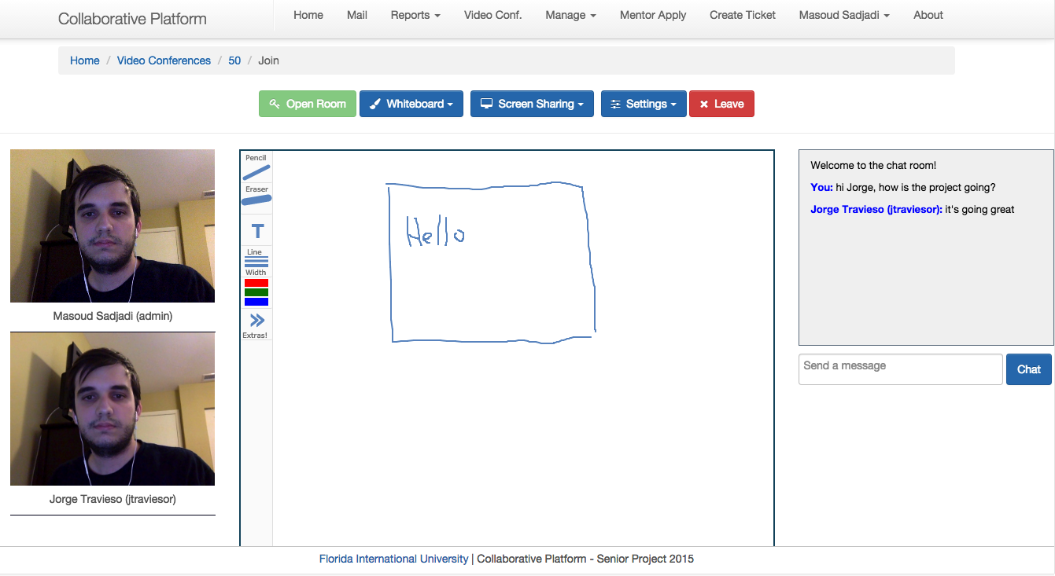
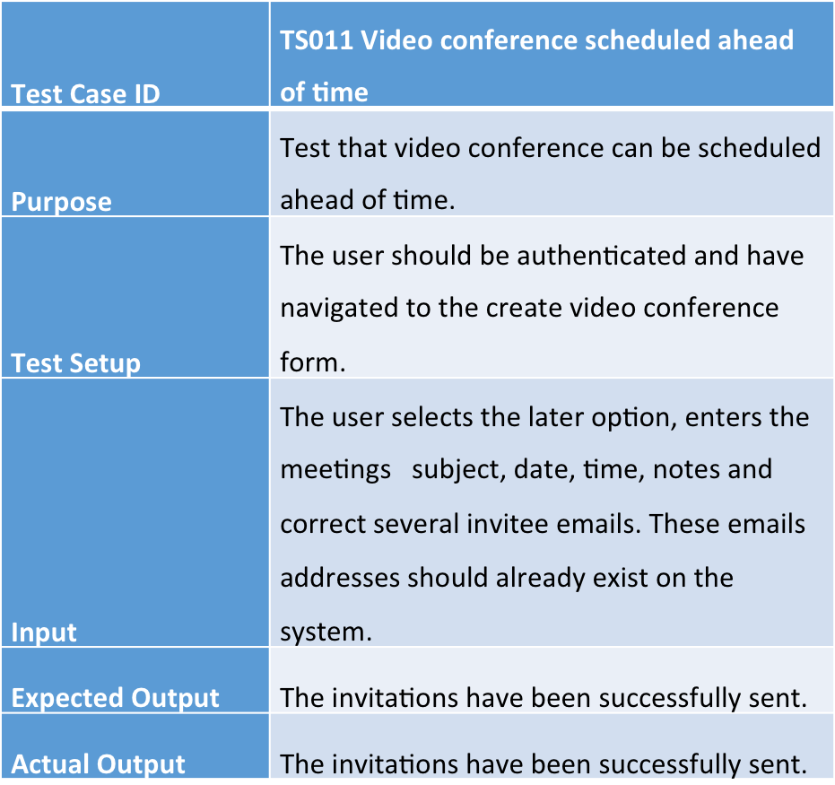
School of Computing & Information Sciences
Senior Project, 2015, Spring
Collaborative Platform
Student: Jorge Travieso, Florida International University
Mentor: Juan Caraballo, IBM
Instructor: Masoud Sadjadi, Florida International University
Problem
Current System
Requirements
Current students lack a reliable source for answering questions related to their classes or projects. At times students rely on internet sources that are often unreliable, inaccurate and incomplete. In efforts to solve this issue FIU SCIS decided to develop the Collaborative Platform in order to connect students (mentees) with the right experts (mentors).
To improve the interaction between mentors and mentees, a video conferencing tool that allows users to do video calls, chat, and screen sharing was needed. Ideally, this tool would make the meetings scheduling process more pleasant to the user. The development of this tool was my task during the semester.
The current system consists of a web application that allows mentees to post questions (tickets) that can be solved by a mentor. In the system, administrators can group mentees by project and mentors by domain to better assign the right mentor to a ticket. In addition, administrators have many options to manage registration applications, tickets, projects, etc.
However, users of the system lack of a standard way of communication that could allow them to have online meetings where they can collaborate.
To provide users with a video conferencing module, we developed the Collaborative Tools, which will allow users to:
During Video Conferences
Communicate through video calls
Share their screens
Use a virtual whiteboard for sketching
Use a chat room
Scheduling Video Conferences:
Easily schedule from a ticket or on-demand
Accept or reject a video conference invitation
Cancel a video conference
System Design
Object Design
Implementation
The Collaborative Platform is powered by Yii framework which provides a model-view-controller (MVC) design pattern. The model represents data, business logic and rules. The view represents the presentation. Finally, the controller accepts input and provides bridge of communication between models and views.
VideoConferenceController.php
Verification
Screenshots
Summary
The Collaborative Tools were tested through hands-on meetings we had with our mentor where we used it. We were able to test all the implemented features.
The Collaborative platform provides a tool for answering students questions; effectively and in a timely manner.
With the implementation of the Collaborative Tools, we are providing the users a rich video conferencing module to enhance the mentors and mentees interaction. Now mentors will be able to schedule a video conference with their mentees to quickly answer any question. In addition, mentees can work together on projects using our tools, without using third party applications, i.e. Skype, Hangouts, etc.
Acknowledgement
I wanted to thank my group member, friends, mentors and my family for the support.

