Slide 1

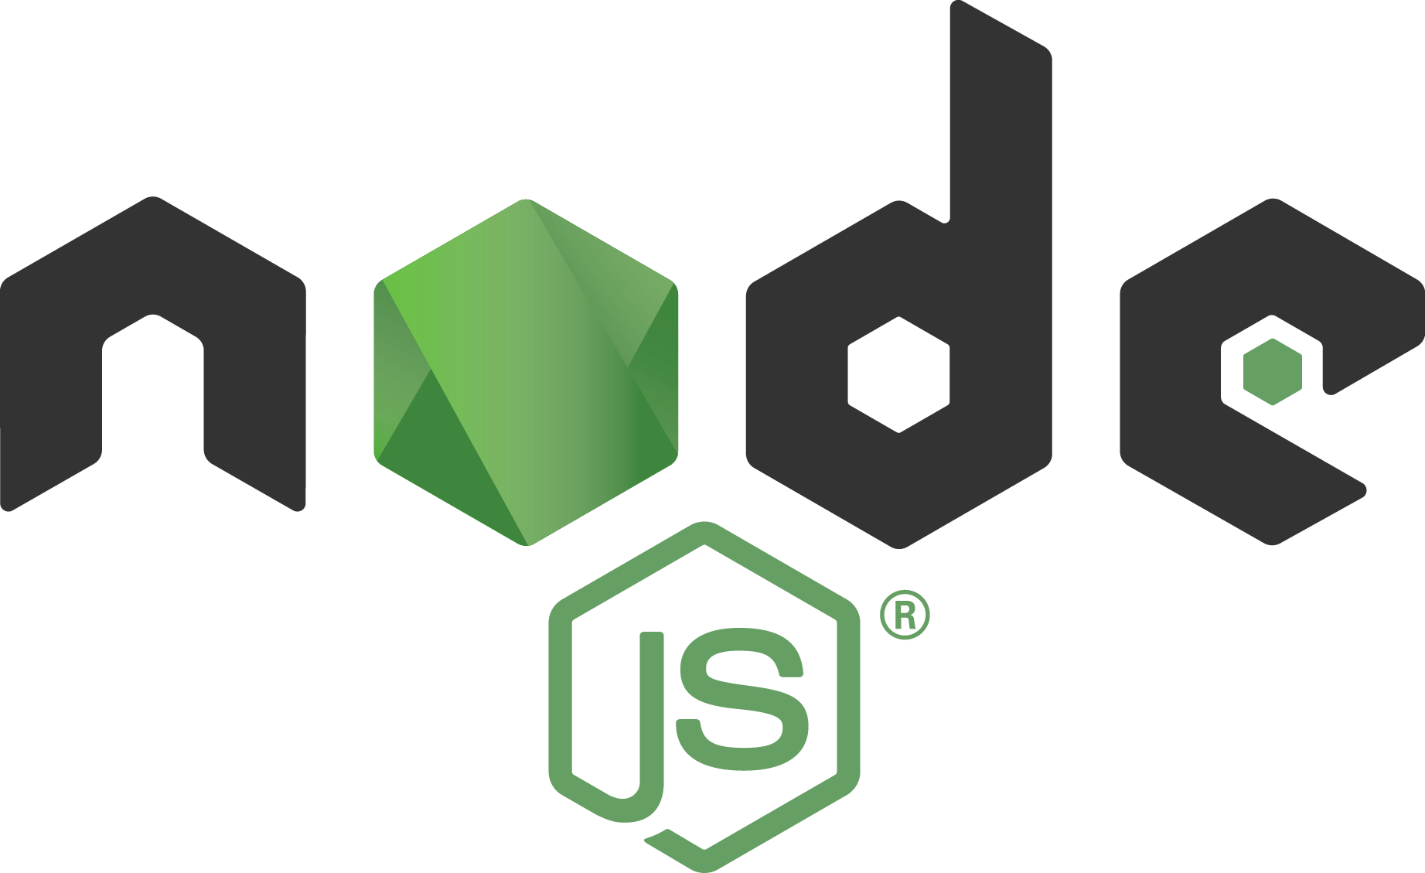

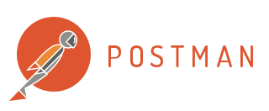



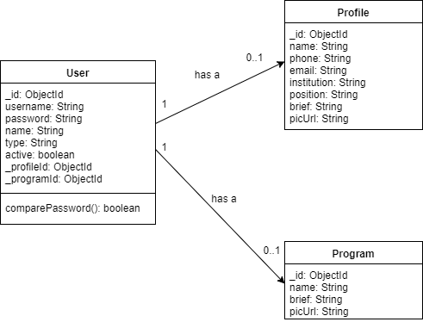
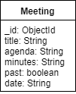
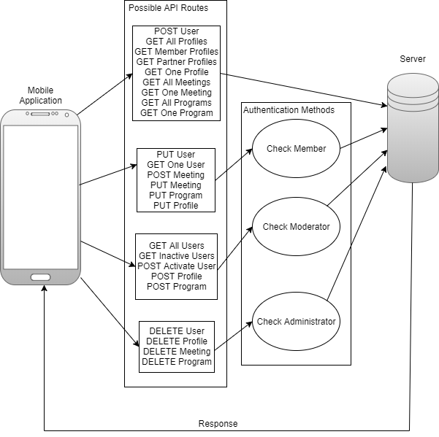
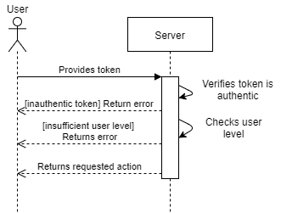
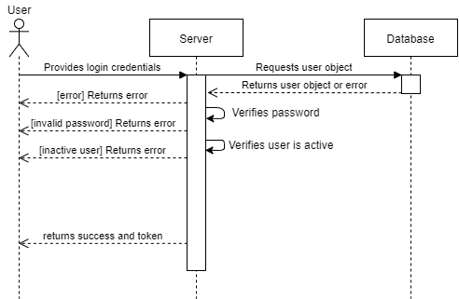
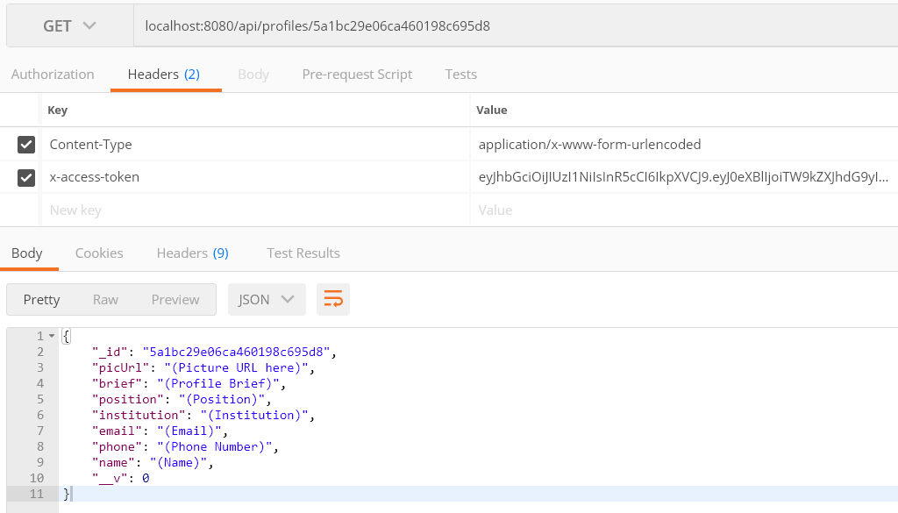
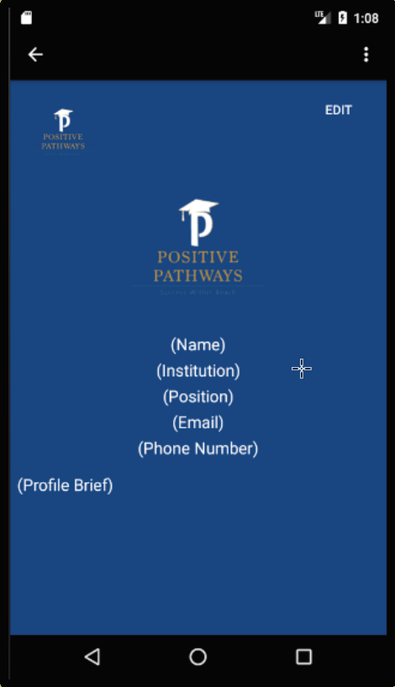
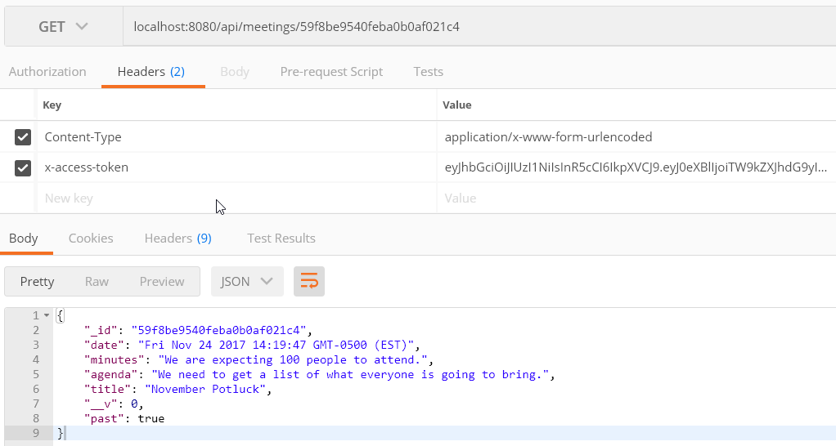
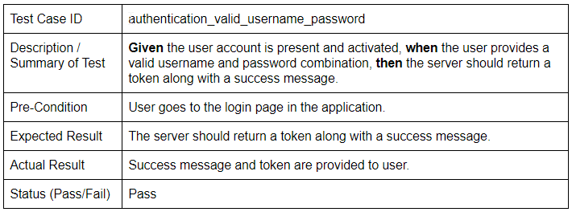
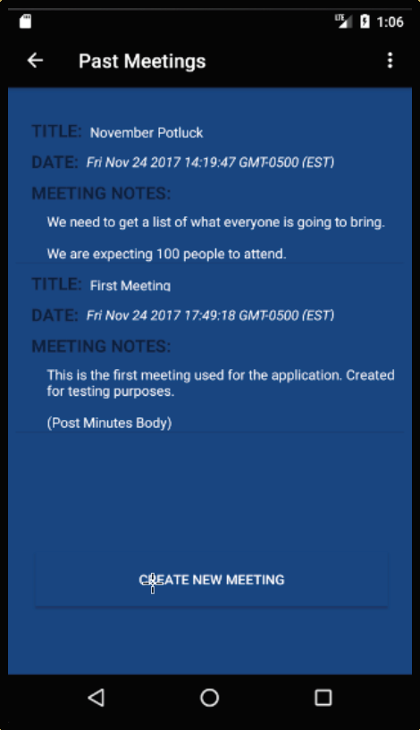
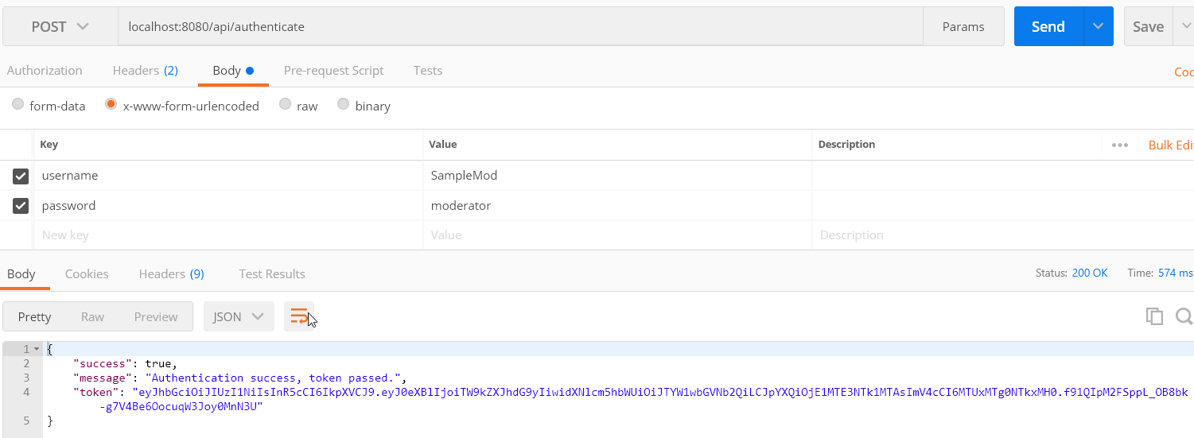
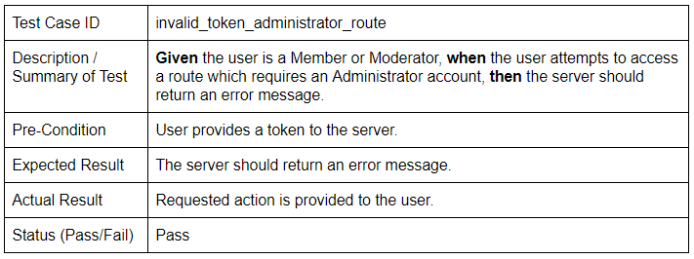
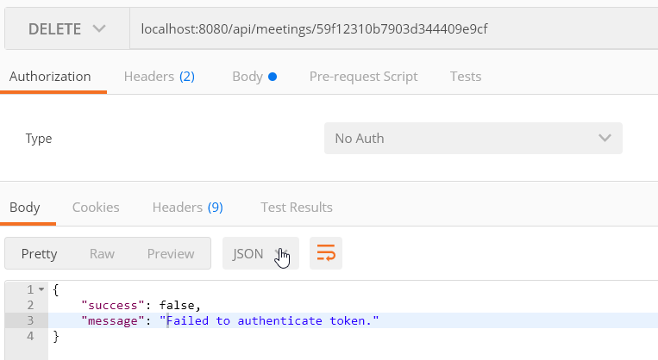
School of Computing & Information Sciences
CIS4911, 2017, Fall
CREATivators: Web and Mobile Development for Advertisement 1.0
Positive Pathways Mobile Application
Student: Alejandro Thornton, Florida International University
Mentors: Margo Berman & Francisco Ortega, Florida International University
Professor: Masoud Sadjadi, Florida International University
Problem
Members currently use traditional communication methods such as e-mail and phone.
No dedicated repository of information about the Positive Pathways Program (PPP).
Agendas and minutes of monthly meetings are not centralized.
Solution
Dedicated mobile application for communication and information.
Pages dedicated to the programs, members, partners, and other information about PPP.
Agendas of future monthly meetings and minutes of past meetings collected in one location.
Requirements
General users can view profiles, programs, partners, and training materials without an account.
With an account, Members can edit their individual profile pages as well as their respective program pages.
Additionally, Members can view and edit meeting agendas and minutes.
Implementation
MongoDB for database organization.
Mongoose for database operations.
mLab for remote database hosting.
Express for routing requests and responses to/from server.
NodeJS for server operations.
Object Design
Four entities in database: User, Profile, Program, and Meeting
A User may have up to one Profile and/or Program associated with it.
Summary
General users may find information about Positive Pathways’ programs, partners, members and meetings.
Members may edit their profiles, programs, and meetings.
Application data guarded against tampering through user authentication system.
Fig. 1: User entity with Profile and Program associations.
Fig. 2: Meeting entity.
System Design
Three types of Users determine access:
Members – Modify associated profile and program as well as meetings.
Moderators – Approve new accounts, associate users with profiles and programs, and make modifications.
Administrators – Modify any entity in database, including performing deletions.
Administrators may perform Member and Moderator actions, Moderators may perform Member actions.
Fig. 4: Token Verification Sequence Diagram
Fig. 5: User Authentication Sequence Diagram
Verification
Postman used to test API calls.
Fig. 3: Authentication Design.
Screenshots
Fig. 6: Example Test Case and Result for User Authentication
Fig. 7: Example Test Case and Result for Token Verification
Fig. 8: GET Singular Profile
Comparison: API Test
vs. Application.
Fig. 9: GET Singular Meeting
Comparison: API Test vs. Application.
Acknowledgements
The material presented in this poster is based upon the work supported by Drs. Steven Rios, Margo Berman, and Francisco Ortega. I am thankful to the help and support that I received from my group members: Mikaila Daniel and Michael Quiros. I am also thankful to the Advertising and Public Relations VIP group for their considerable contributions to the project: Maria Baralt, Jean-Paul Cajina, Tonya Cornish, Nicolle Cruz, and Ryan Mignagaray.
Notes:
1

