Slide 1










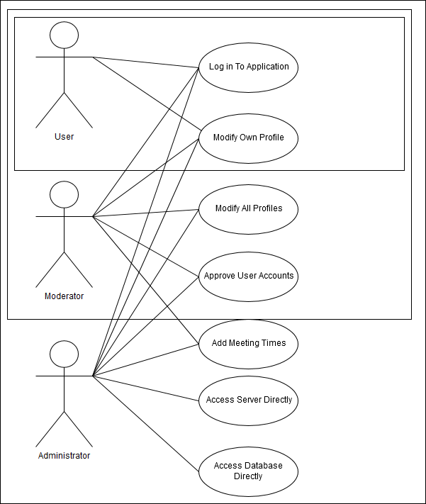
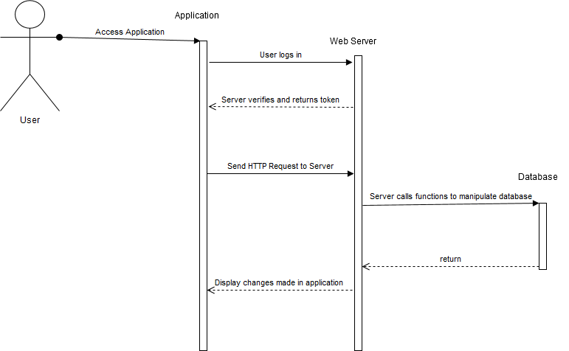
Senior Project, Fall 2017
Creativators: Web and Mobile Development for Advertisement 1.0
Student: Michael Quiros, Florida International University
Mentor: Francisco Ortega & Margo Berman, Florida International University
Instructor: Masoud Sadjadi, Florida International University
Problem:
University liaisons affiliated with Positive Pathways do not have access to an easy to use and convenient tool to find contact information for other Positive Pathways members
Positive Pathways also lacks a central hub for communication and announcements
Solution:
Design a phone application in which information for all liaison’s will be posted publicly for other liaisons and interested students to search
This phone application will also be able to announce meeting times and provide links to ongoing and future meetings
Current System:
The application is made of containers for data stored in a separate server and database
The database contains all profile information, images, meeting information
The database can be manipulated by the application or web server
Development Idea:
Create central server.
Store all profile information, program information, and meeting information in database on server.
Host all profile images on server.
Connect each user’s application development progress to central server for unified testing space.
In Progress:
Create a web page interface for administrator only access. This will be used as an easier to manage control station for approving user accounts and editing information
Connect all development of application on a central server
Quality of life changes
Improvements:
Create a survey for a wide array of users to test the application and provide feedback for user interface and functionality improvement
Document storage on server
Create iOS version of application
General Bug-fixing
Acknowledgement:
The material presented in this poster is based upon the work supported by Dr. Francisco Ortega, Dr. Margo Berman, and Dr. Steve Rios. I am also thankful to the help that I received from my group members Mikaila Daniel & Alejandro Thornton along with the help received by our co-group members Maria Baralt, Jean-Paul Cajina, Tonya Cornish, Nicolle Cruz, and Ryan Mignagaray.
Notes:
1

