Slide 1





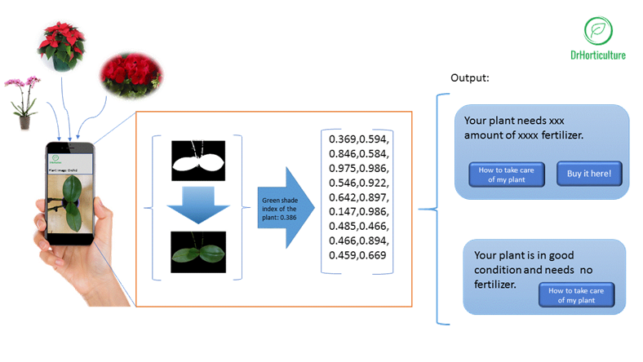
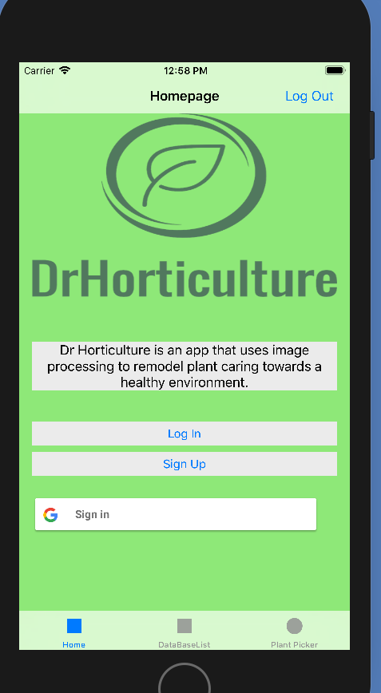
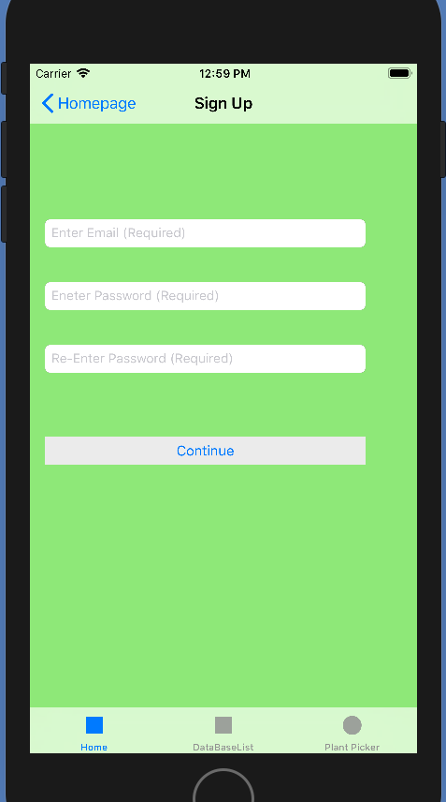
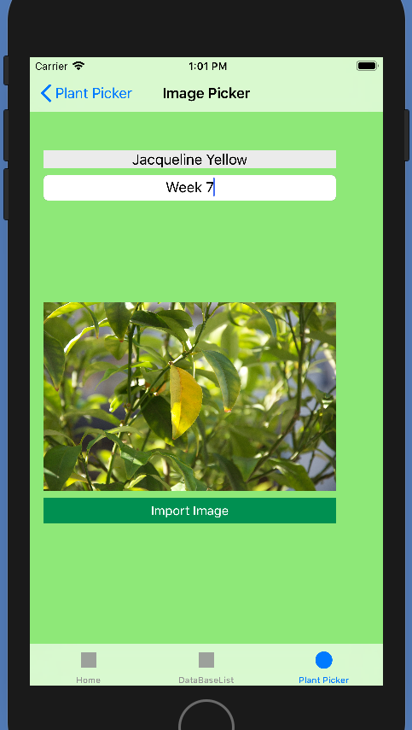
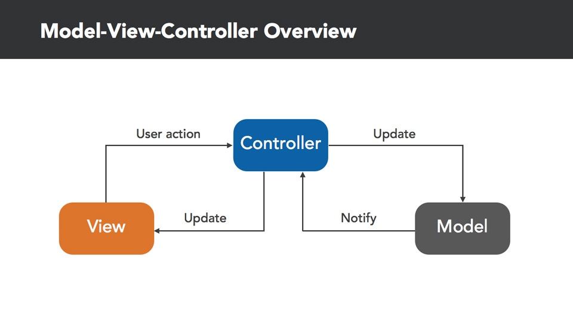
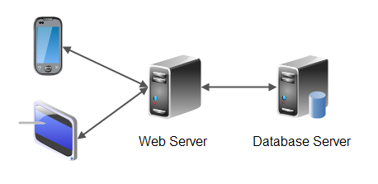
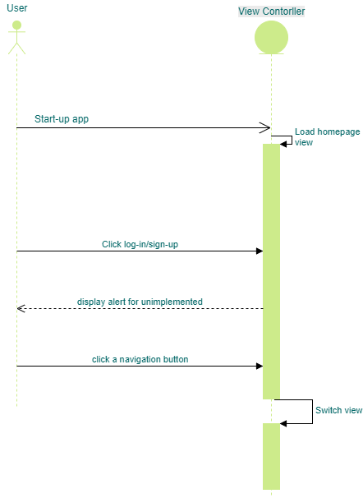
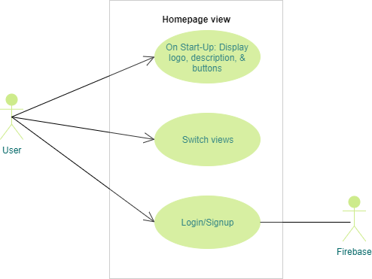
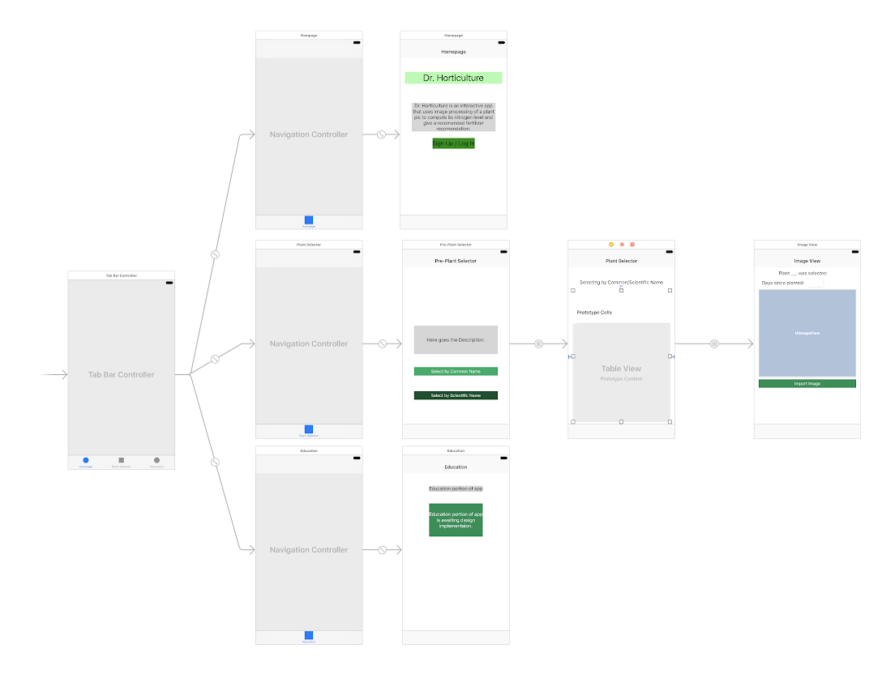
School of Computing & Information Sciences
Senior Design, 2018, Spring
Dr Horticulture 1.0
Student: Jose L. Nunez, Florida International University
Mentor: Dr. Khoddamzadeh, Product Owner
Professor: Masoud Sadjadi, Florida International University
Problem
Over use of fertilization:
Leads to environmental problems such as water contamination from algal blooms
Wasteful in terms of both fertilizer and money
Current methods of analyzing fertilizer needs for plant are very time consuming and expensive
Solution
Dr Horticulture App:
Uses image processing technology to analyze plant fertilizer needs from image
An inexpensive and faster alternative to using existing lab techniques
Helps to mitigate cost of fertilizers and environmental impact
Current System
First iteration of the app
Built from the ground up
Capable of receiving and analyzing image to return results
Login/Signup not yet implemented
Screenshots
Requirements
Allow users to signup/login
Invoke camera for image taking
Allow for image selection from gallery
Connect to server and process image at server
Results for fertilizer returned to user and saved in profile
Database to store user info as well as plant research data
System Design
Implementation
Dr Horticulture app built using
Language: Swift v4.0
IDE: Xcode v9.2
Database: Firebase v4.11
Cocoapods
Front-end is a set of view for user navigation. The ap connects to firebase for user authentication and to specify the particular species of plant for analysis. Back-end further composed of server to perform image processing to return DGIC
Model-View-Controller Design
The model view controller architecture was used to design the application interface. Design consist of tab-bar controller with an embedded navigation controller in each tab.
Client-Server model
The client server model is used to ensure that user data is independent of device and that image processing speed is fast and not dependent on user device.
Verification
Test Case 1
purpose:
Ensure that the app can select an image and the server returns DCGI value of image
precondition:
Server is up and running, user has an image to upload
input:
User navigates to plant image selector view, selects image and then presses upload button
Expected Result:
Server converts rgb values to hue-brightness-value and performs filtering on each to obtain DCGI value and returns value to app
Actual Result:
Server returned DGCI value as expected
Object Design
Summary
Dr Horticulture is an IOS app that uses image processing to give fertilizer recommendations to solve the issue of over fertilization. In its current state it is working with cre functionality able to give specified recommendation based on plant species. Future implementations hope to add further functionality to the app.
Acknowledgement
The material presented in this poster is based upon the work supported by Dr. Khoddamzadeh, I am thankful to the help that I received from my group members, Cesar Reyes
Follow Us @FIUSCIS
Notes:
https://seniorproject.cis.fiu.edu/wp-content/uploads/sites/7/2016/12/Hector-Cen.jpg
1

