Slide 1










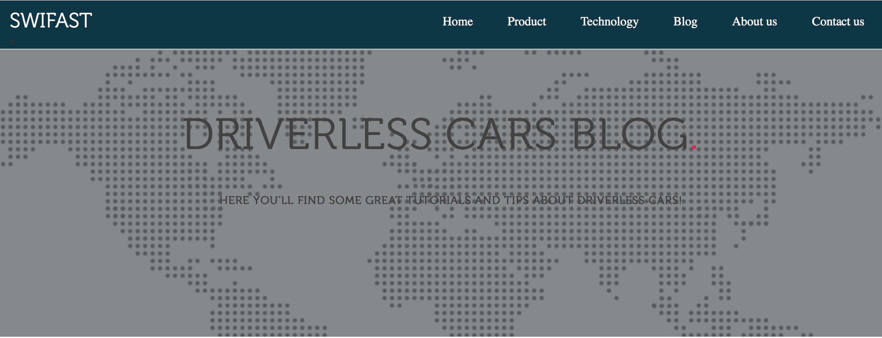
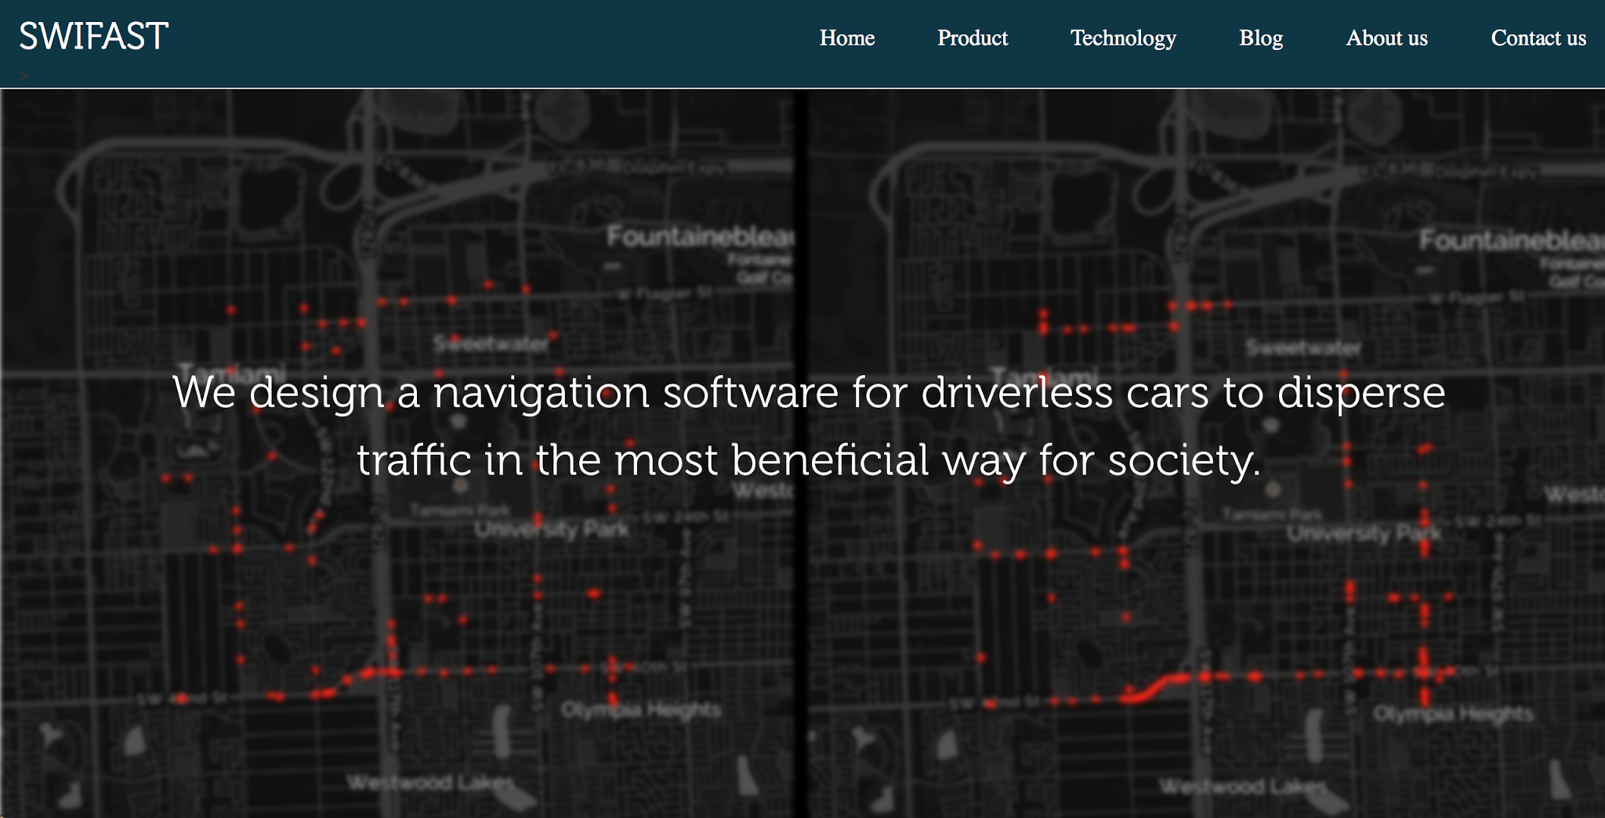
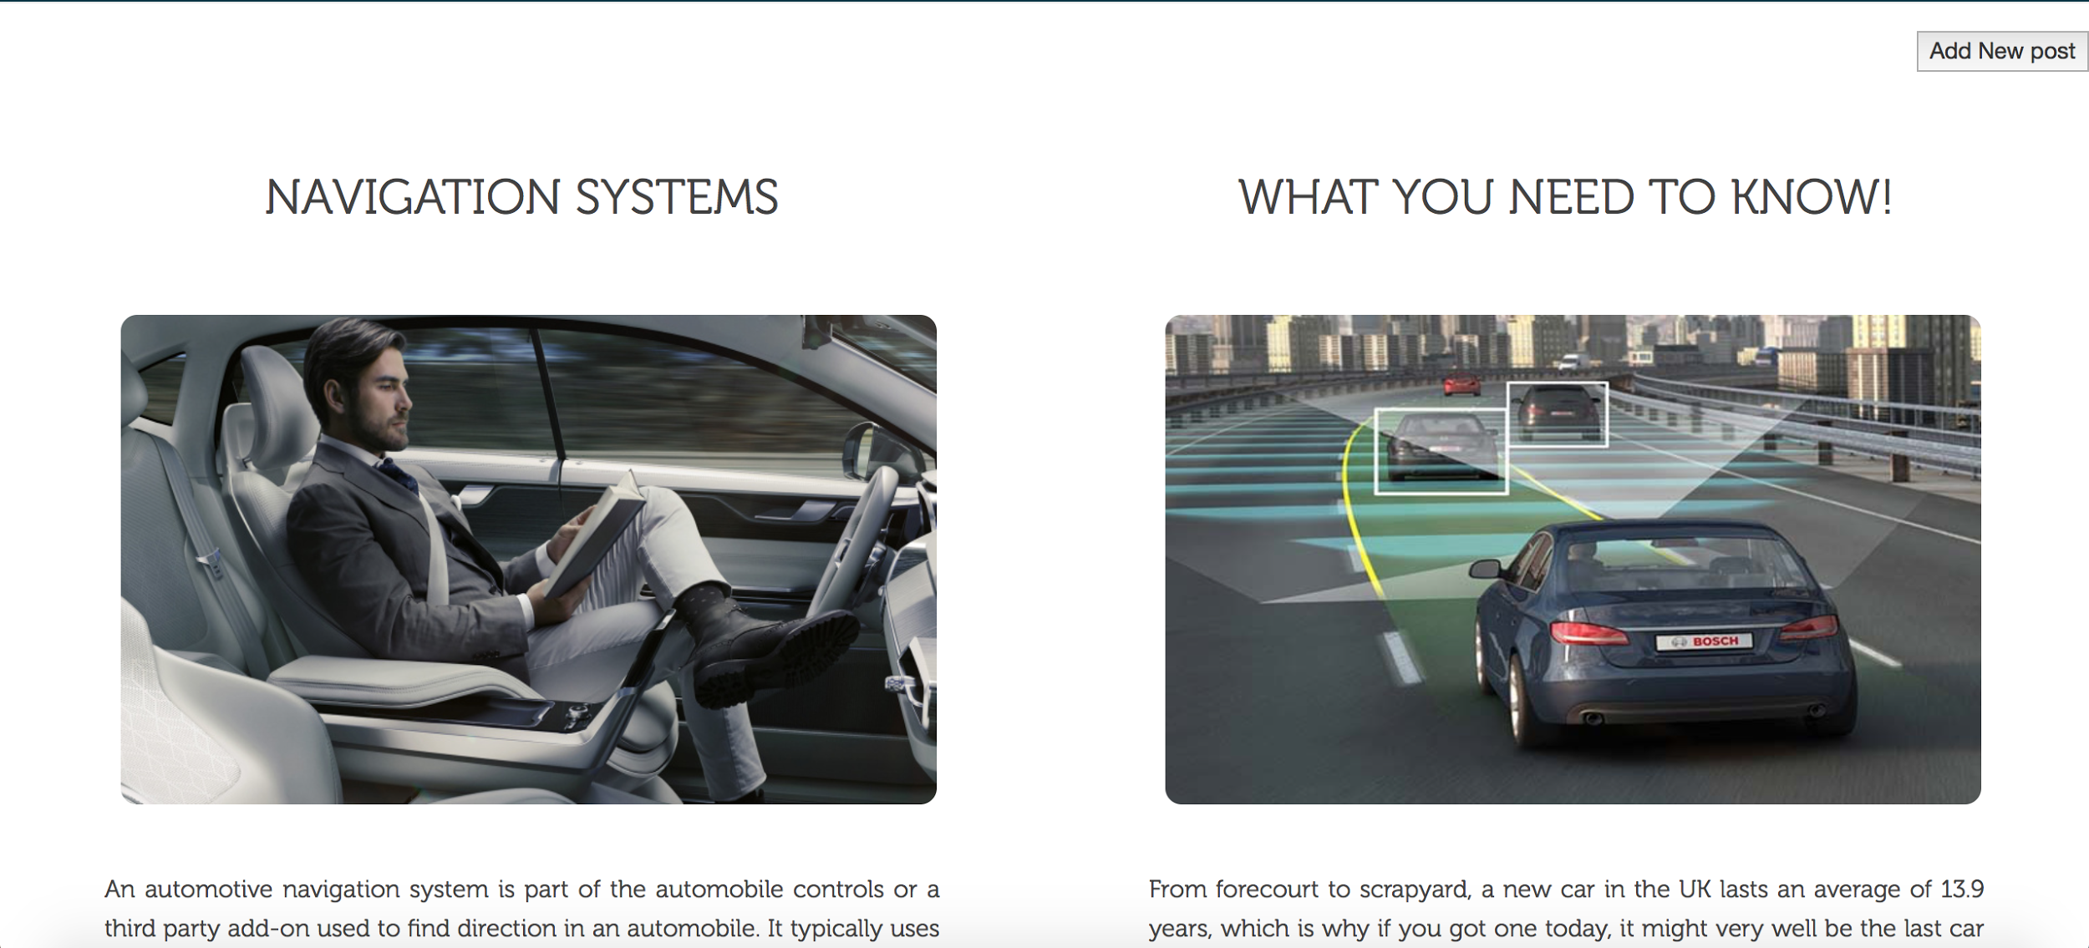
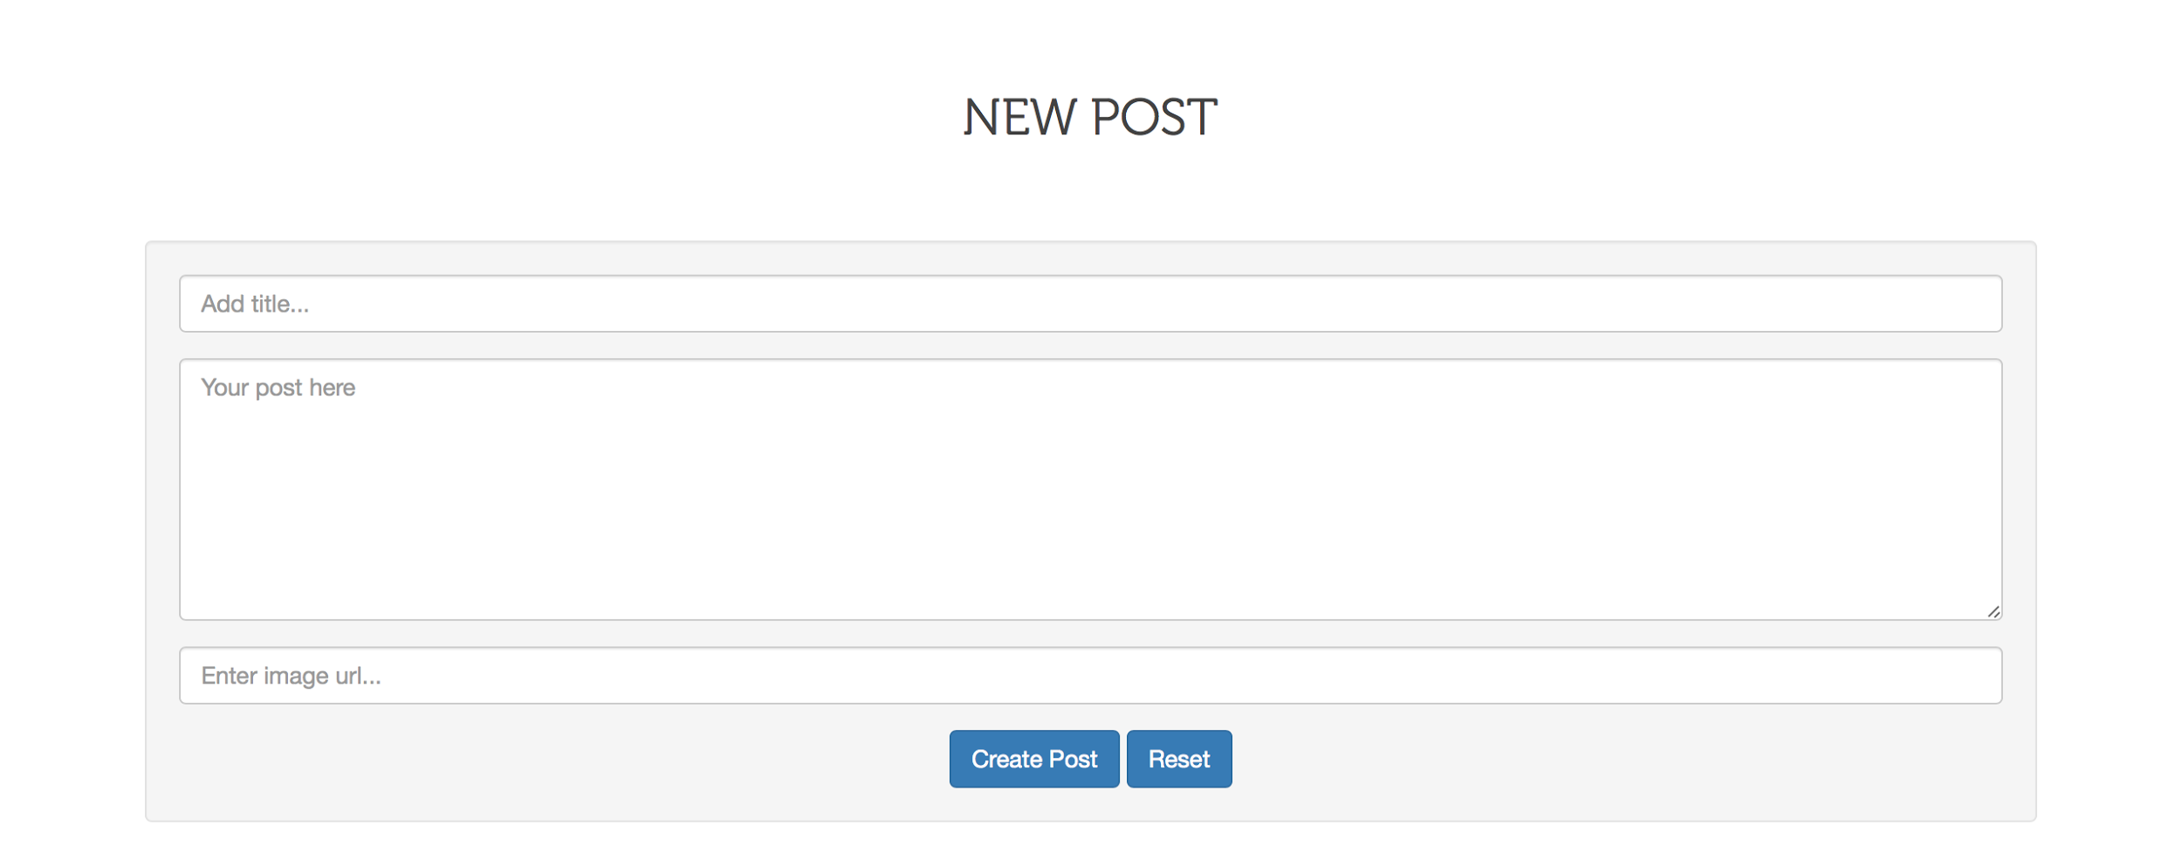

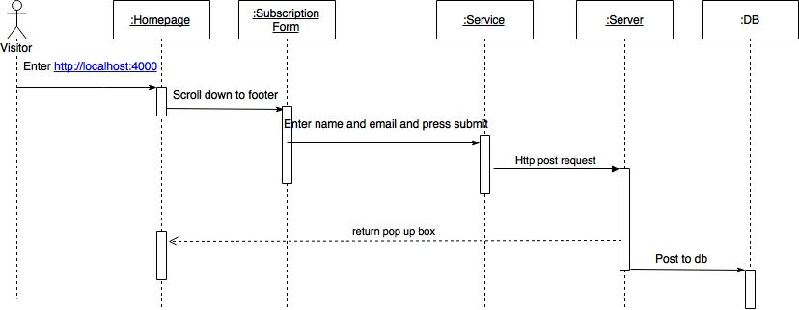
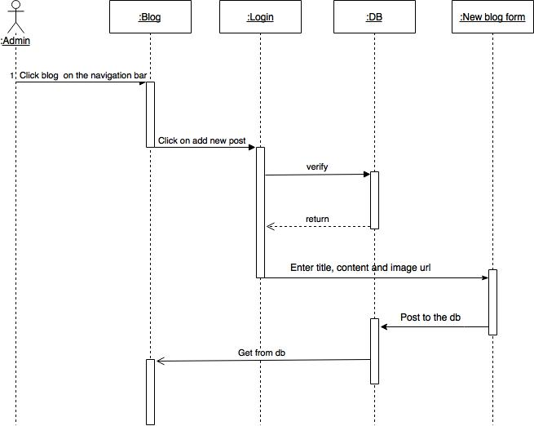
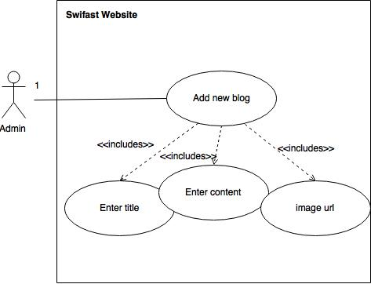
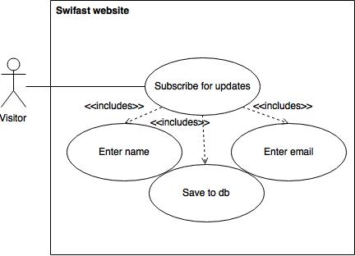
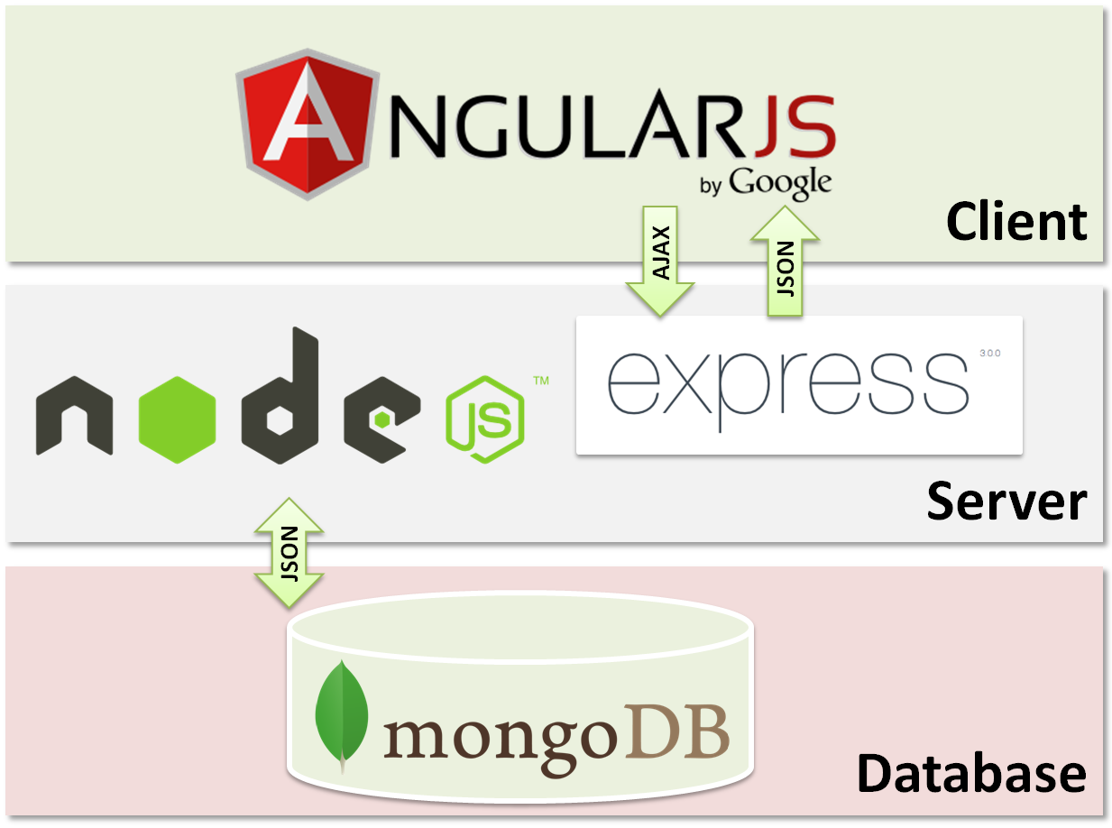
School of Computing & Information Sciences
Senior Project, 2017, Spring
Swifast Website 1.0
Student: Nathally Perez, Florida International University
Mentor: Kianoosh G. Boroojenu, Mohsen Taheri, Florida International University
Instructor: Masoud Sadjadi, Florida International University
Problem
Technology for driverless cars is evolving in this competitive market and the best way to promote and attract potential customers is by providing a high tech, modern and efficient application. Swifast website provides an easier way to promote navigation software.
Solution
Create a website that showcase our navigation system to the users with a very high-tech look. The website should provide useful information to the customers and allow the admin to post articles to the page and users to subscribe to receive updates about our page.
Current System
Currently our system is :
A responsive application
User-friendly application
A modern application
Provides enough information about the product and the company.
Offers MVP(minimum viable product)
Implementation
Swifast is implemented using:
Client/server
MongoDB-- NoSQL
Express-- Framework for Node js
Angular 2 -- Frontend
Node js -- Web server
HTML -- Frontend
TypeScript -- Frontend
CSS -- Frontend
Requirements
System shall..
Showcase the navigation software
Allow user to see blog
Allow user to contact us
Allow user to subscribe to the webpage
Allow users to see demo
Allow admin to add blog post
Allow admin to login
Save blog post to the database
Save subscribers information to the database
Object Design
Verification
System Design
Summary
This is the first version of Swifast website and the purpose was to provide a modern look website where customers can easily find navigation software for driverless cars while providing them useful information of our company and allowing customers to communicate with us.
 | Sunny Day
Description | Ensure that the subscriber information is being stored to the db properly.
Precondition | The server is running on the localhost Visitor is in the homepage Visitor scrolls down to footer Visitor enters: a. name b. email 5. Visitor clicks on subscribe button
Expected Result | Subscription form is sent correctly
Actual Result | Subscription form was sent successfully
Status | PASSED
 | Rainy Day
Description | Visitor leaves a field empty
Precondition | The server is running on the localhost Visitor is in the homepage Visitor scrolls down to footer Visitor enters: a. name 5. Visitor clicks on subscribe button
Expected Result | Subscription form is not sent correctly since email was not enter
Actual Result | Subscription form was not able to subscribe successfully
Status | PASSED
Acknowledgement
The material presented in this poster is based upon the work supported by Nathally Perez. I am thankful to the help that I received from my group member, Mariana Sebastian, mentors, kianoosh G. Boroojeni, Mohsen Taheri, and our instructor, Masoud Sadjadi.
Notes:
1

