Slide 1








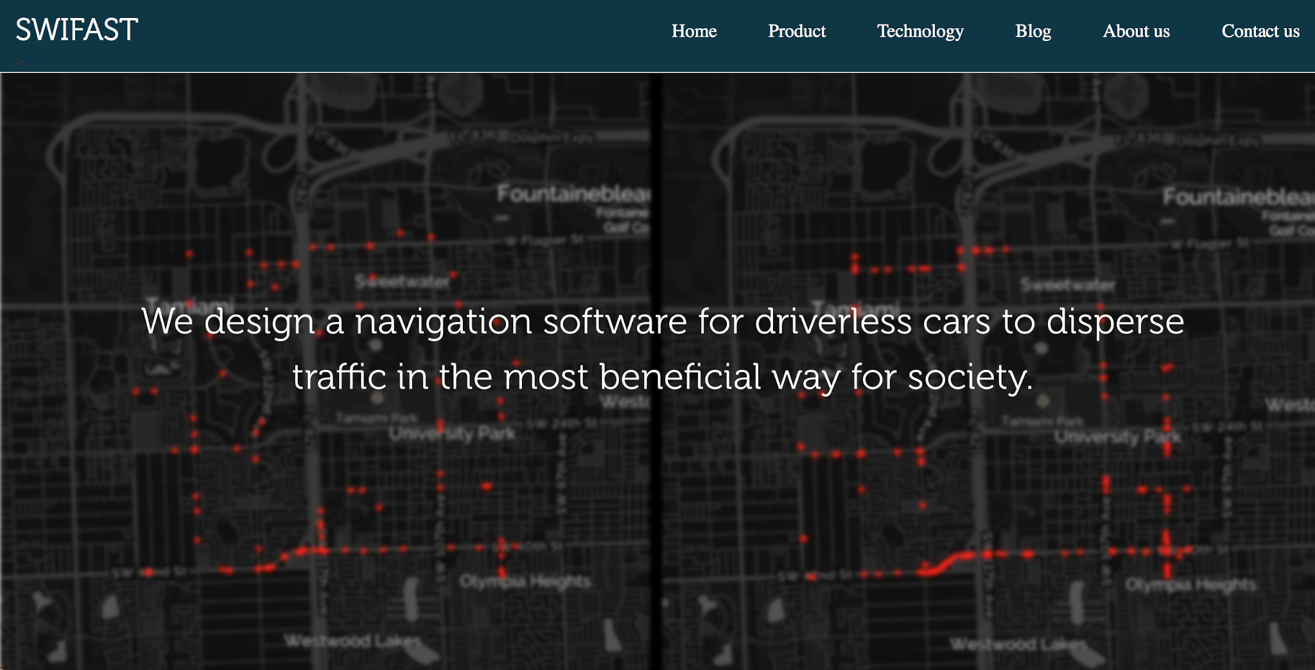
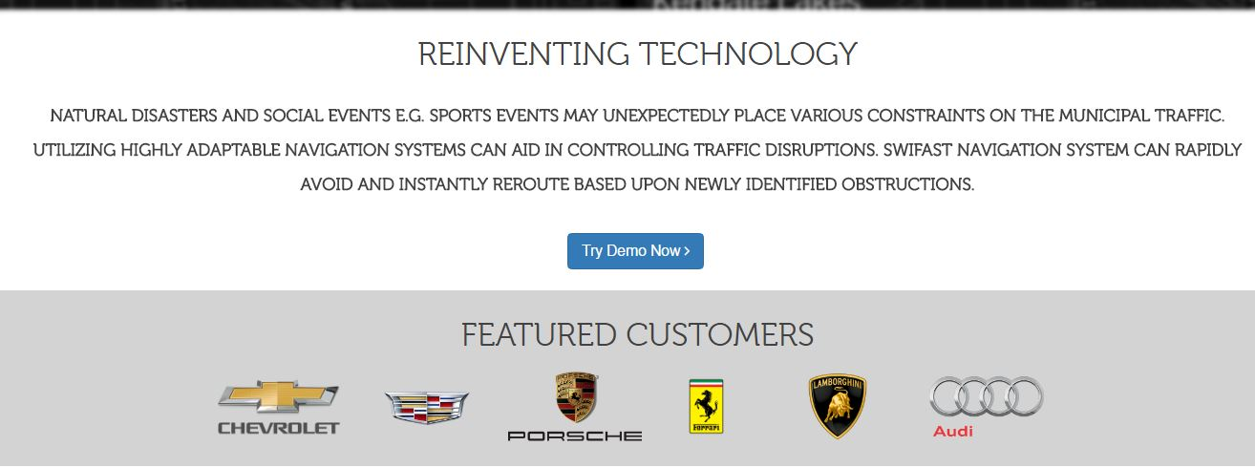
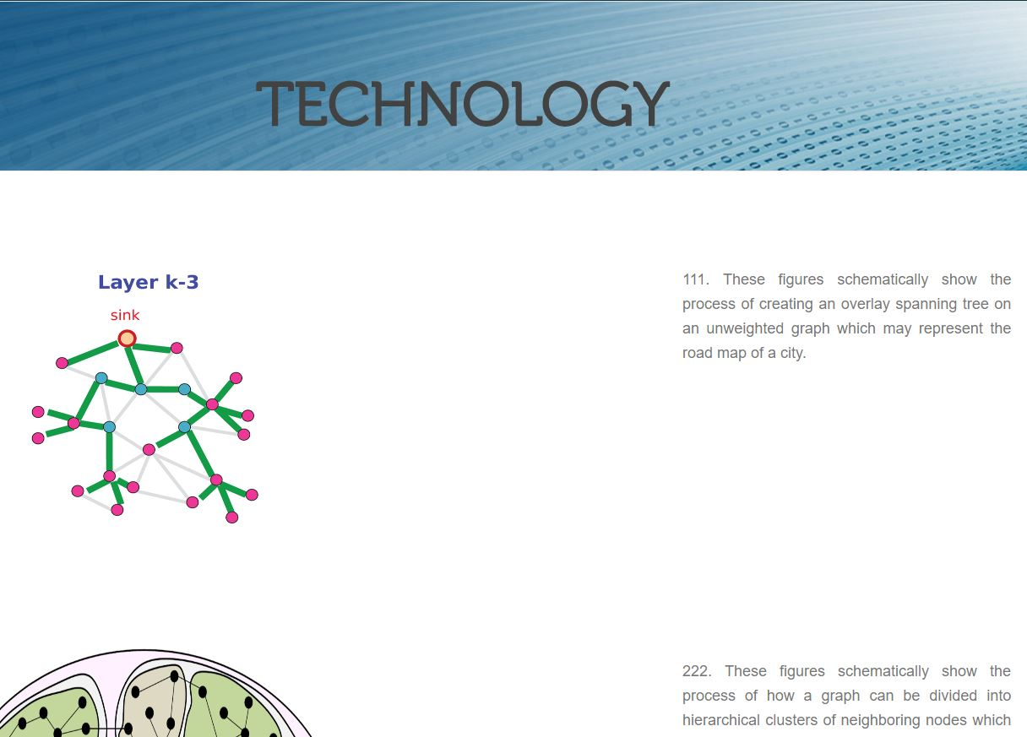
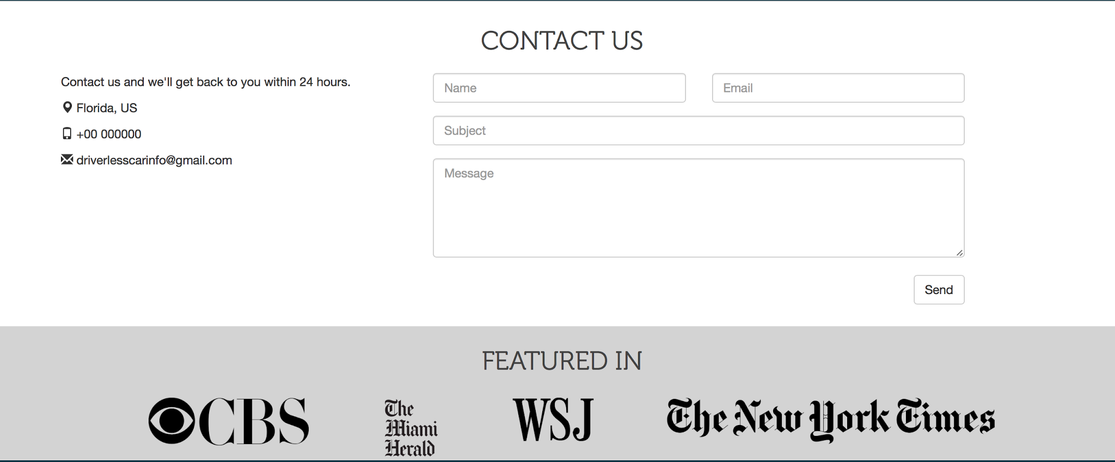
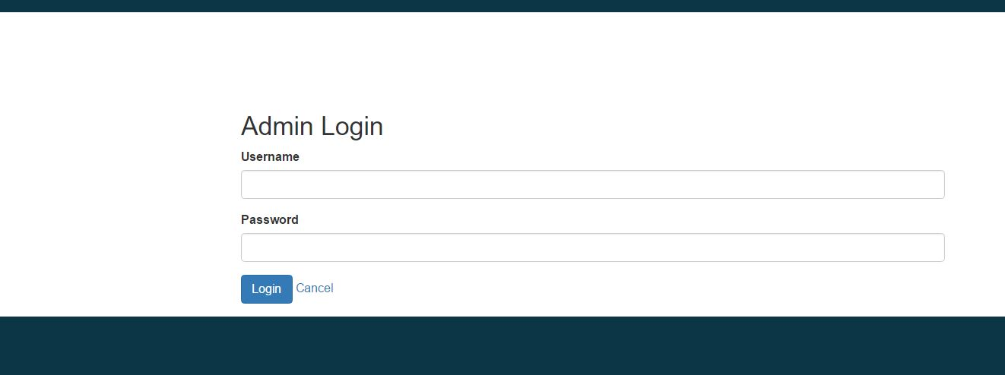
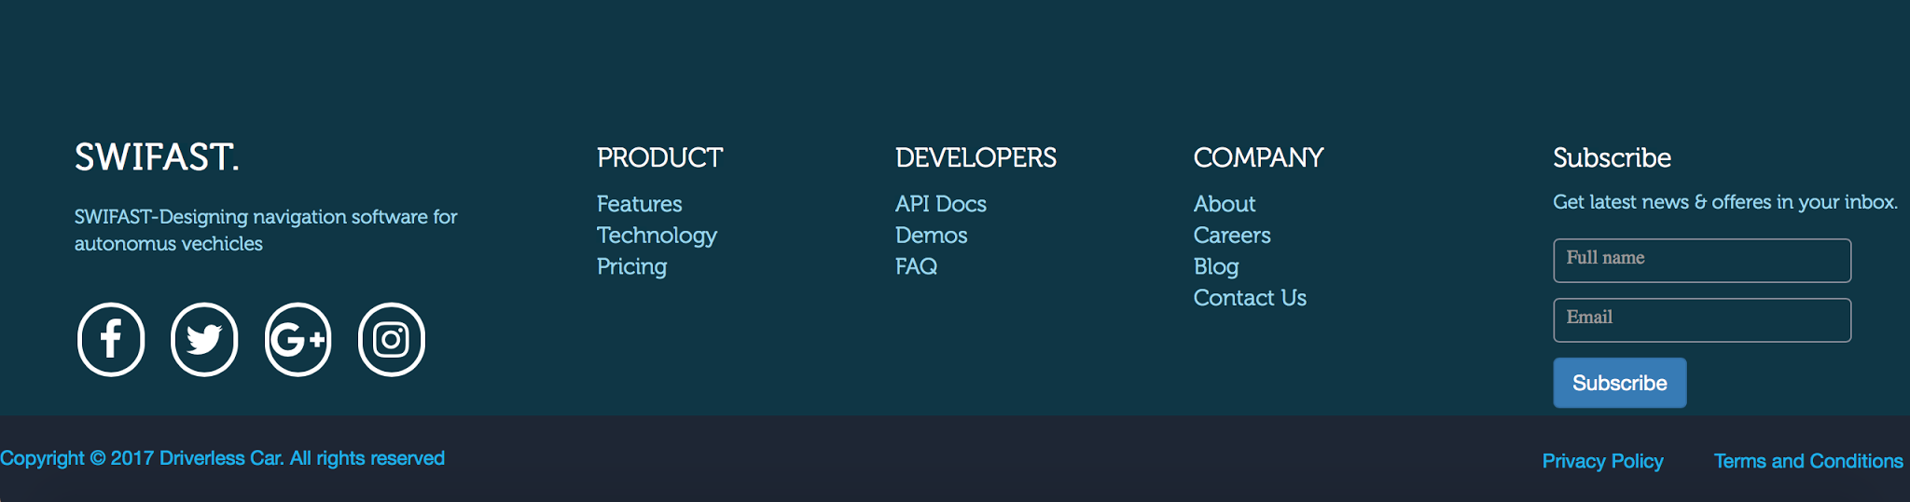
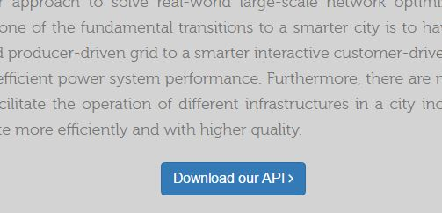
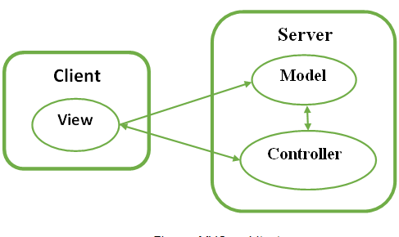
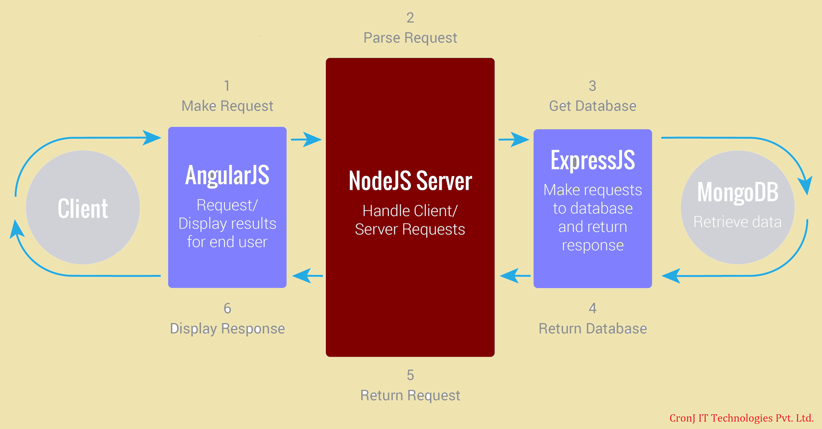
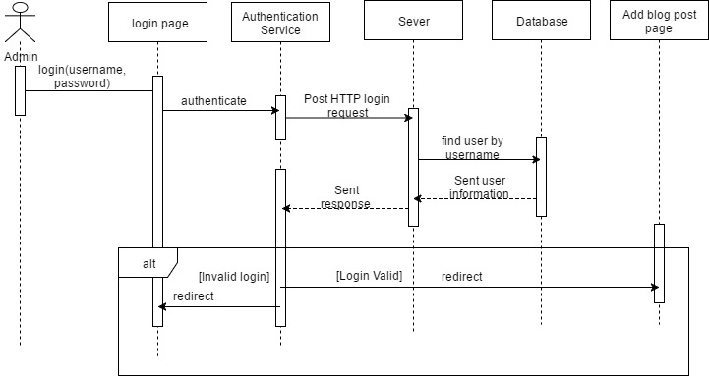
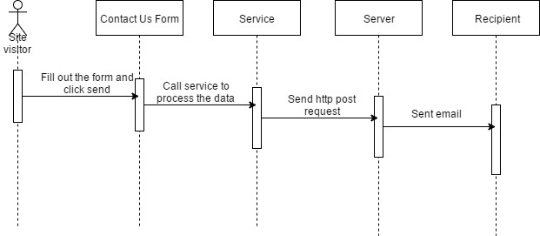
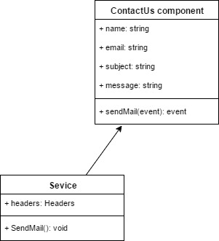
School of Computing & Information Sciences
Senior Project, 2017, Spring
Swifast Website 1.0
Student: Mariana Sebastian, Florida International University
Mentor: Kianoosh G. Boroojeni, Mohsen Taheri, Florida International University
Instructor: Masoud Sadjadi, Florida International University
Problem
Technology for driverless cars are evolving in this competitive market and the best way to promote and attract potential customers is by providing a high tech, modern and efficient application. Swifast website provides an easier way to promote navigation software for driverless car.
Solution
The solution is to:
Provide modern/high tech look website.
Provide details about the navigation software.
Inform customers with new articles about product and the company.
Allow users to contact for more information.
Watch demo and download mvp
Current System
The current system provides responsive application that allow users to view demo and details about the navigation software for driverless car. Swifast also presents a blog page with new articles, subscription form, and a contact us form.
Screenshots
Implementation
Swifast is developed in:
1-Frontend
-HTML,CSS, Angular 2
2.Backend
Express, NodeJs
3. Database
MongoDB
Requirements
System provides following functionality:
Contact us form.
Allows admin to add new blog post.
Allow users to view product page and technology page.
Allow users to see about us page.
Allow users to subscribe.
Allow users to view demo and download mvp.
System Design
Verification
Test case 1(Sunny Day):
Test case ID:Contactus_001
Description: To test the contact us form submitted successfully.
Precondition: The use case starts when the user is connected to localhost port 4000.
User clicks contact us tabs or scroll down to contact us form section.
User enter:
Name: Alice Walter
Email: alicewalter@gmail.com
Subject: New Mail
Message: Hi, would like to know more about the product;
3.User clicks send button
Expected Results: Message is sent to the driverlesscarinfo@gmail.com
Actual Result: Message is sent to the driverlesscarinfo@gmail.com
Status: PASSED
Test case 2(Sunny Day):
Test case ID:Login_001
Description/Summary of Test: To test if admin can login with correct credentials.
Precondition: Use case starts when the user is connected to http://localhost:4000
1..Admin click blog menu tab.
2. Admin click add post button
3. .Admin enters:
Username: admin
Password: 1234
Expected Results: Admin gets logged in and redirect to the add new blog post form.
Actual Result: Admin gets logged in and redirect to the add new blog post form.
Status (Fail/Pass): PASSED
Test case 3(Rainy Day)
Test case ID:Login_002
Description/Summary of Test: To test if admin can’t login with incorrect credentials.
Precondition: Use case starts when the user is connected to http://localhost:4000
1.Admin click blog tab from the homepage
2. Admin click add post button
3..Admin enters:
Username: admin
Password: kkkk
Expected Results: Displays an error message saying “Username or password is incorrect”.
Actual Result: Displays an error message saying “Username or password is incorrect”.
Status (Fail/Pass): PASSED
Object Design
Summary
This project is the first version of the system.
Presents a high tech look webpage.
Presents users with information about the navigation software.
Allow users to send email to the company.
Allows only admin to post new blogs to the blog page..
Offers users with demo and a downloadable mvp.
Acknowledgement
The material presented in this poster is based upon the work supported by Mariana Sebastian. I am thankful to the help that I received from my group member Nathally Perez, mentors Kianoosh G. Boroojeni and Mohsen Taheri ,and our instructor Masoud Sadjadi.
Notes:
1

