Slide 1





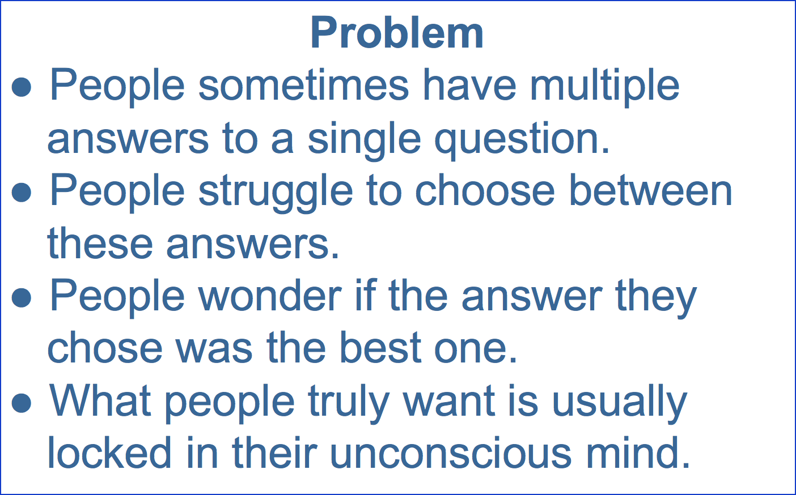
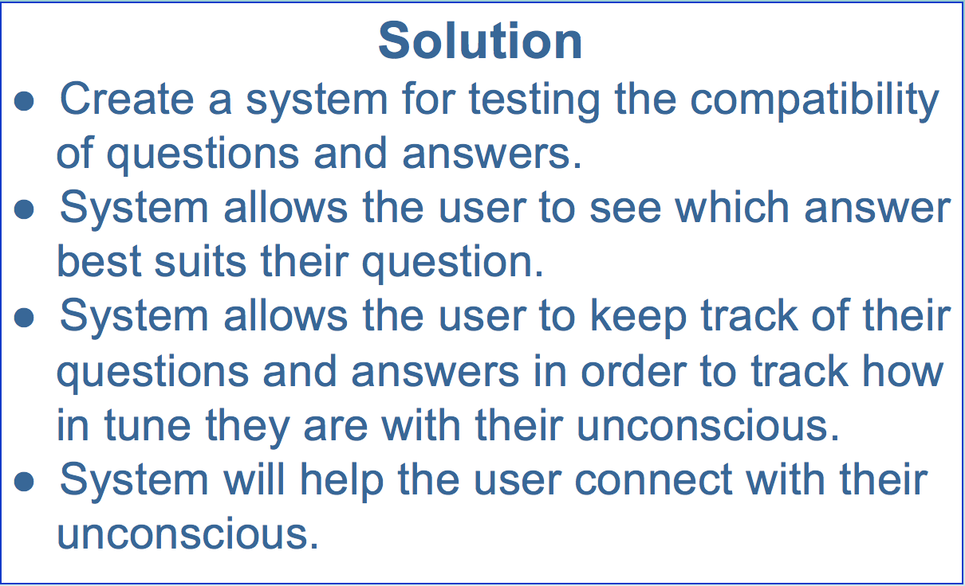
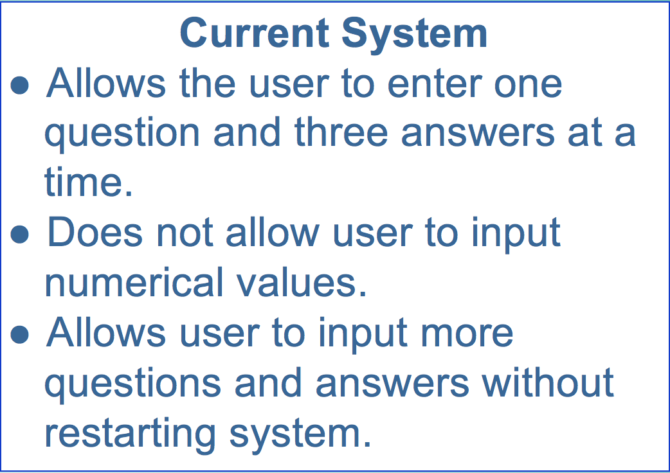
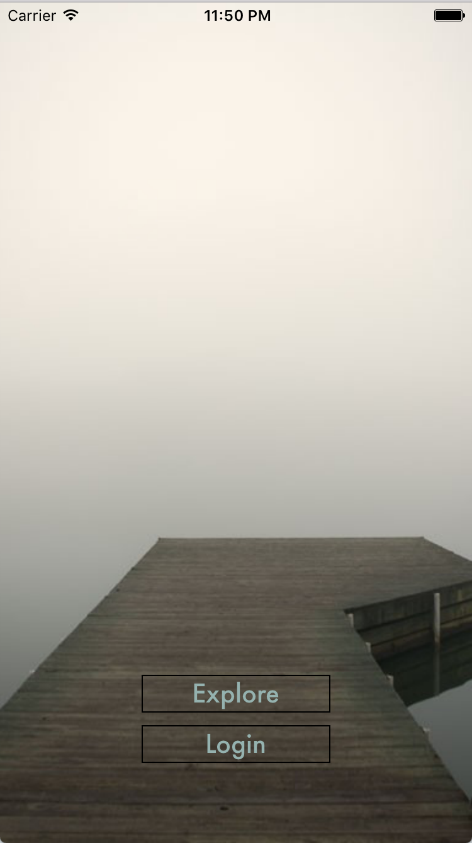
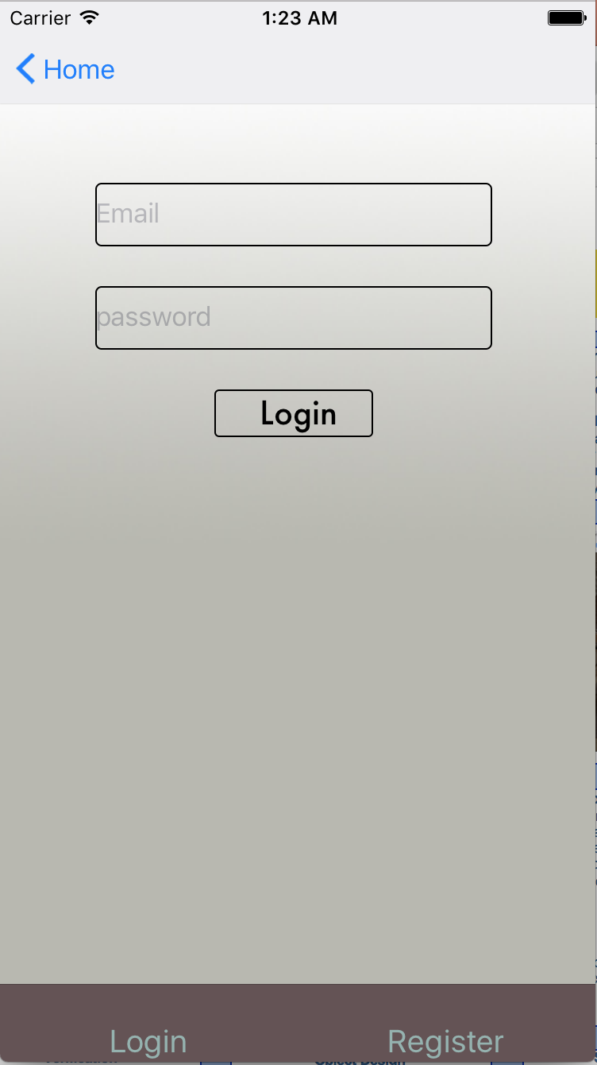
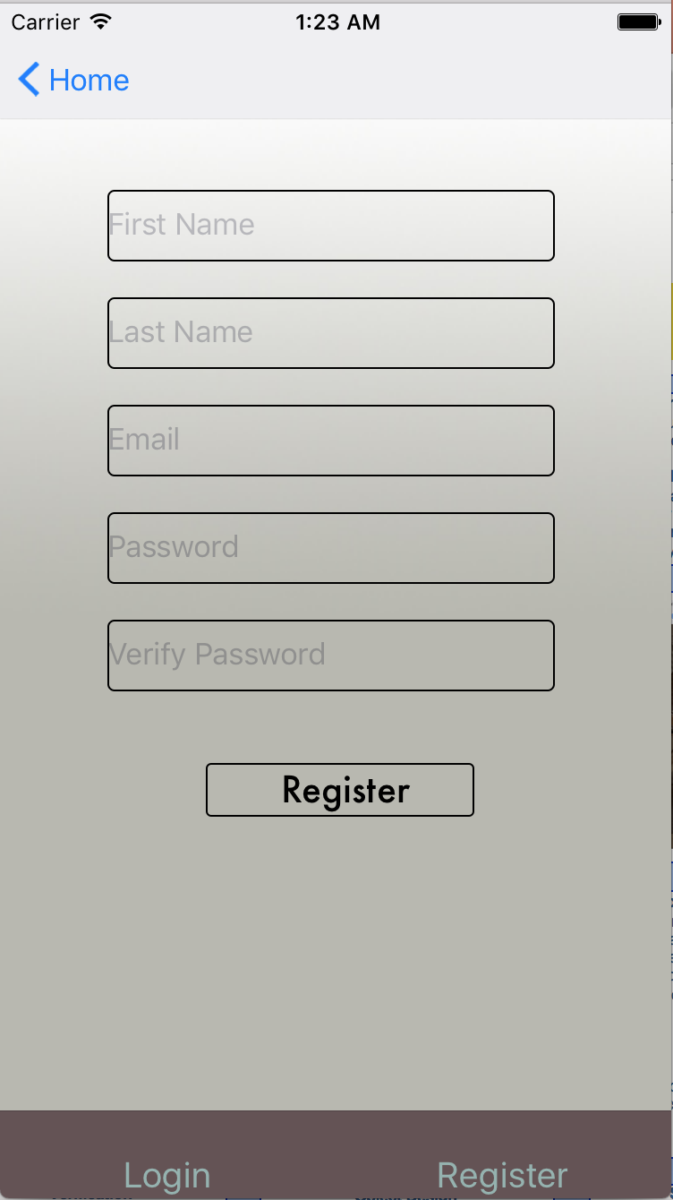
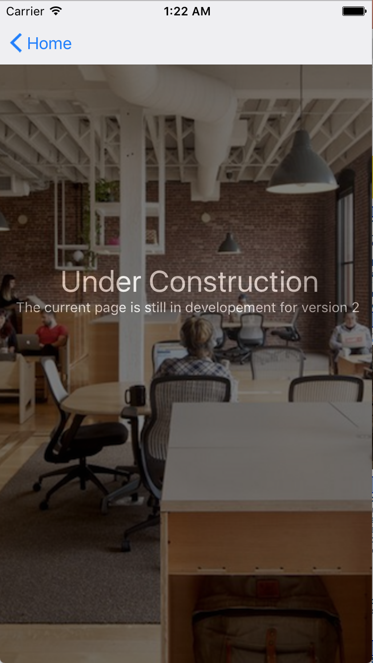
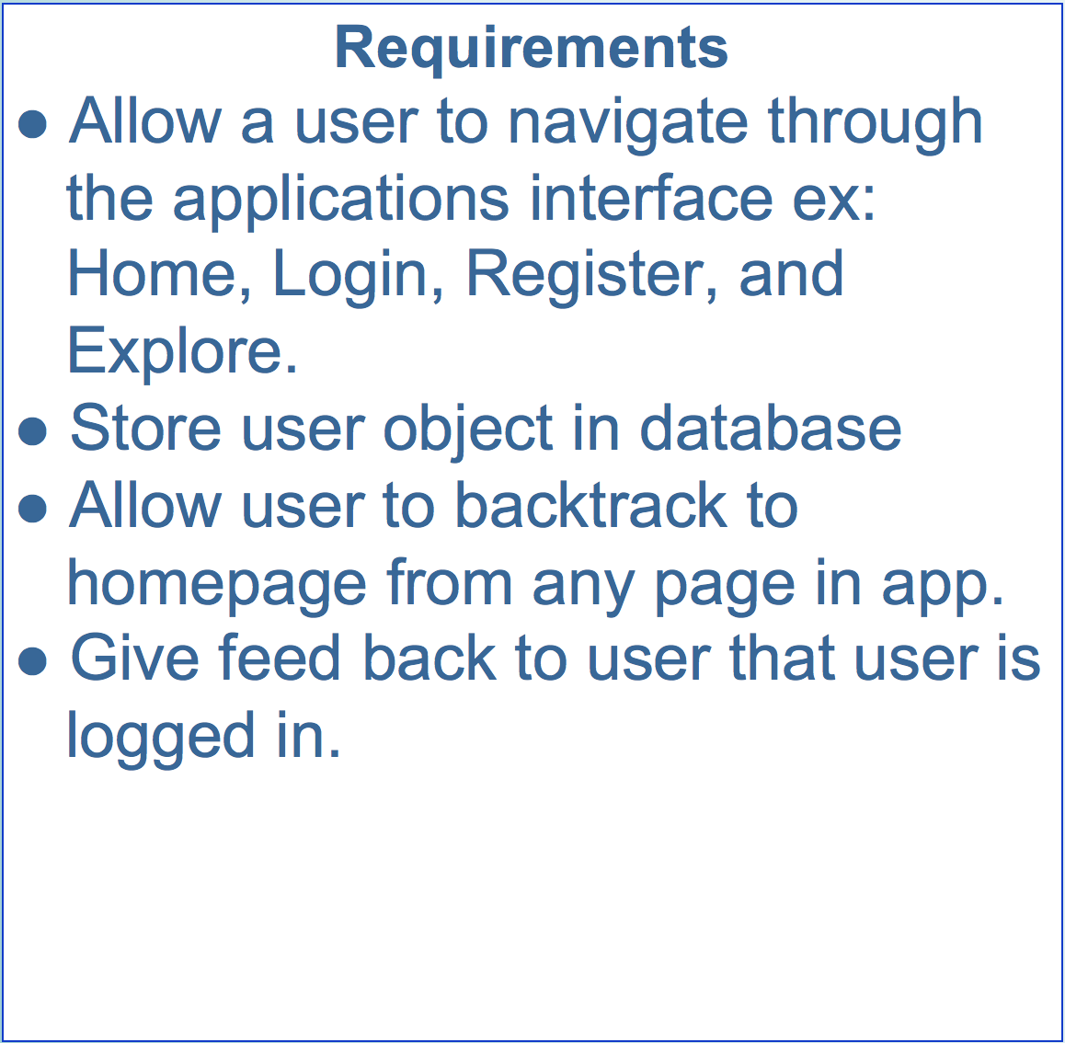
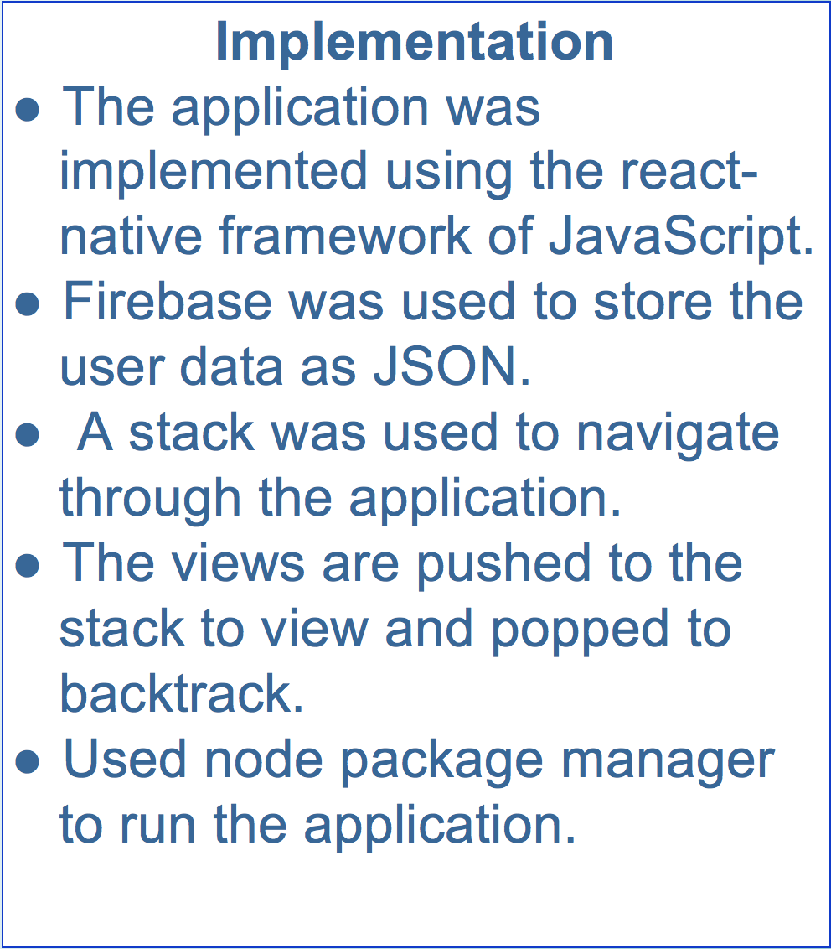
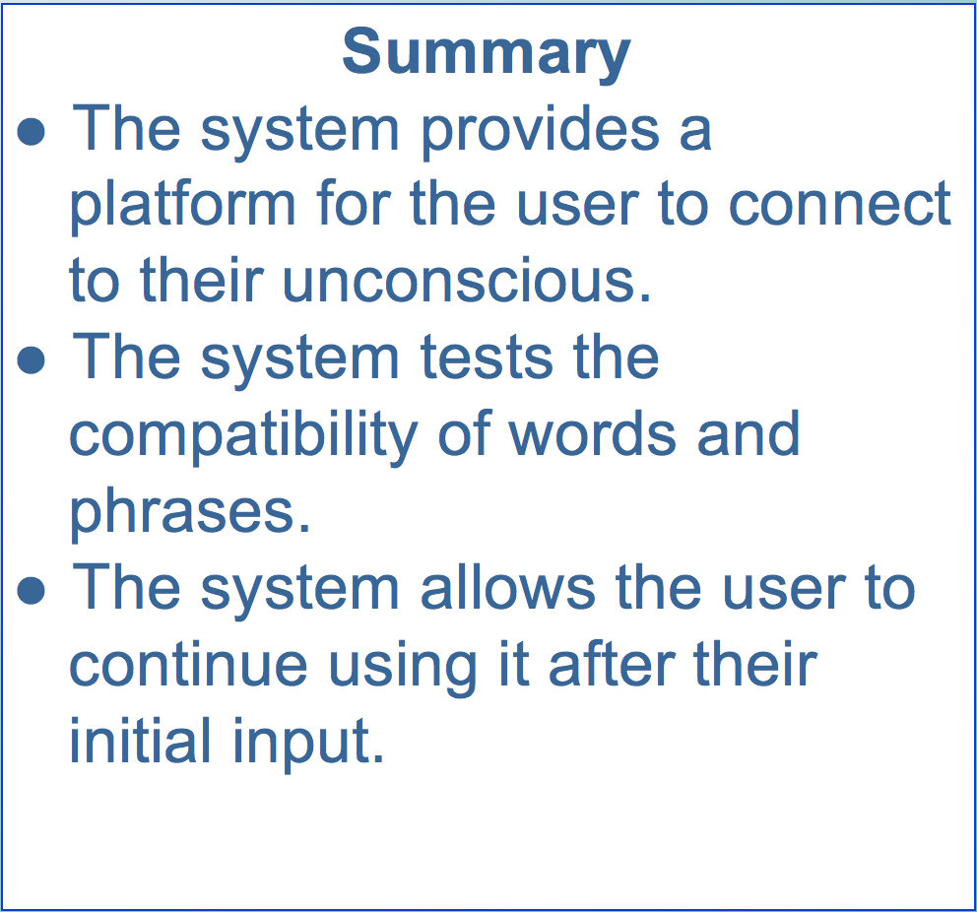
School of Computing & Information Sciences
Senior Project, 2017, Summer
Exploring the Unconscious
Student: Daniel B Antonio, Florida International University
Mentor: Mario Eraso, Florida International University
Instructor: Masoud Sadjadi, Florida International University
React-Native
Screenshots
System Design
Verification
Object Design
Test Case ID | Purpose | Results
Test 1 | Tests navigation through application. | PASS
Test 2 | Tests if user object is being created and stored in database. | PASS
Test 3 | Test if user can log in with credentials. | PASS
Test 4 | Can User credentials be retrieved from database | PASS
Test 5 | Test whether user can log out | FAIL
Test 6 | Test to see if user email is a valid email | FAIL
Acknowledgement
The material presented in this poster is based upon the work supported by Mark Mohr and Mario Eraso. Thank you for the contributions from my teammate Ruben Valdes
Notes:
1

