Slide 1










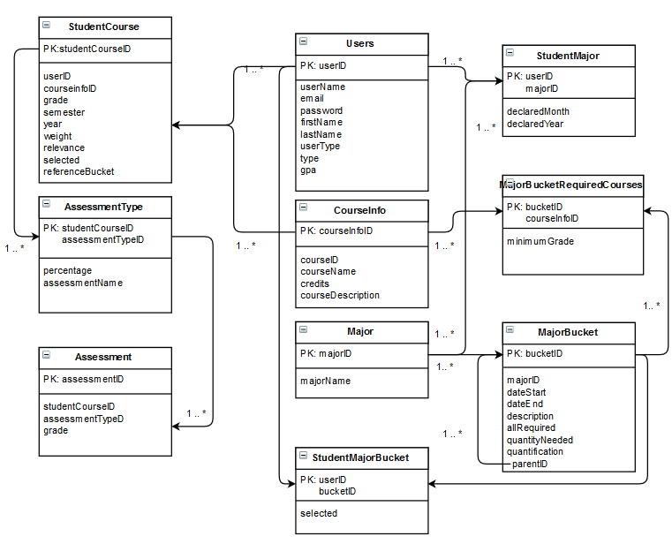


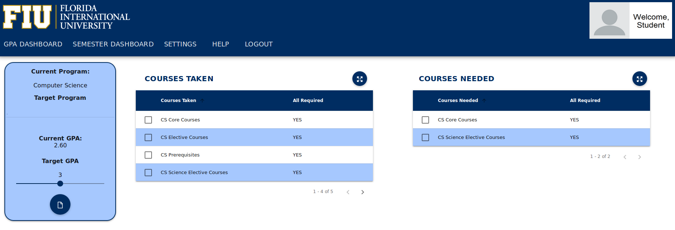
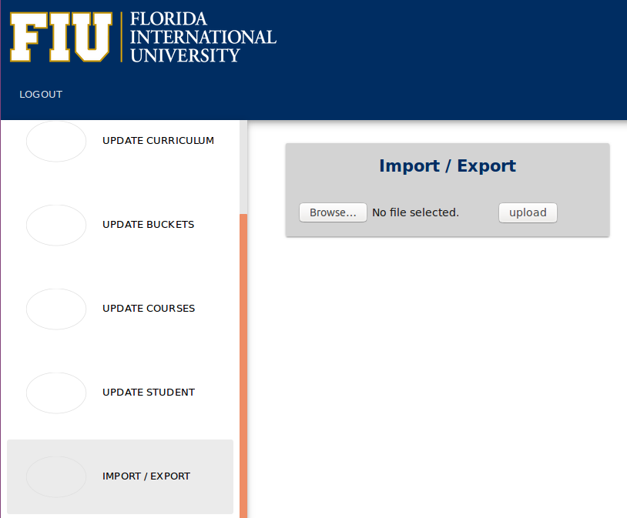
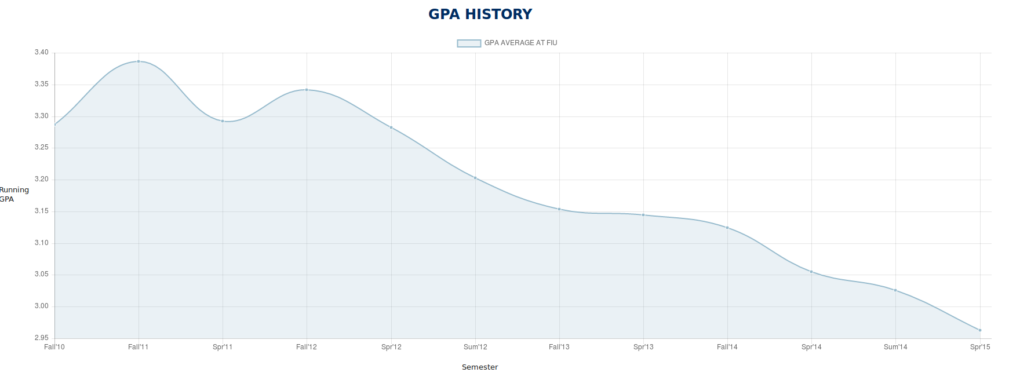
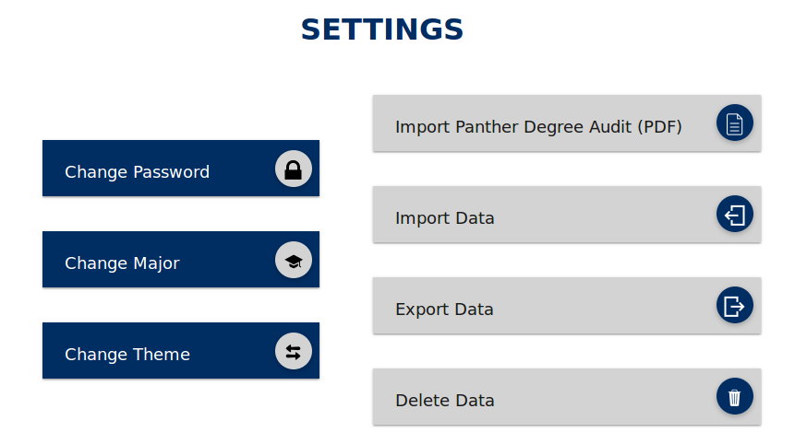
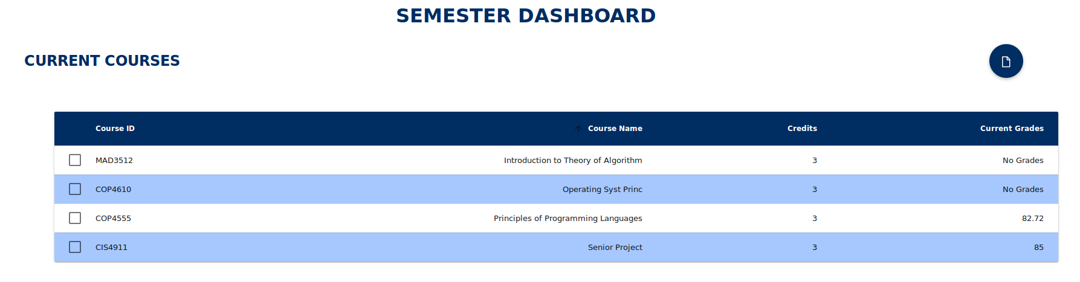

School of Computing & Information Sciences
Senior Project, 2016, Fall
FIU GPA Tracker and Forecaster
Student: Camila Perez, Florida International University
Mentor: Johann Henao, Florida International University
Mentor: Mohsen Taheri, Florida International University
Instructor: Masoud Sadjadi, Florida International University
Problem
Current System
Requirements
Students are uncertain of how to achieve a goal GPA in order to get into graduate school.
GPA calculations are tedious.
Students may have trouble keeping track of their performance on each class every semester.
Students can import their Panther Degree Audit, from which the system determines a student’s needed courses and GPA history.
Students can input the weight and relevance for each course.
The forecast reports will advise the students on the grades they need to get to achieve their goal.
The system provides a graph displaying the student’s GPA history and projection.
The system partially has a modern look and feel.
Admin user can add major programs.
The system should allow students to export their data to their PC, completely delete their data from the website, and import a backup.
The system’s look and feel should be consistent throughout the website.
Admin users should have the ability to generate different curriculums and import them to the database.
The website should have minimum security standard configuration.
The system should keep an error log with different error levels.
Solution
System will help students on how well to do on their classes in order to achieve/maintain a goal GPA.
System computes where the student needs to go, how to get there, and projecting where they’re headed.
System Design
Object Design
Implementation
Controller
Front-end implementation:
The website is implemented using HTML, CSS, and AngularJS.
AngularJS was used in place of jQuery in order to give the website a modern look and feel.
The creation of curriculums uses a user interface that is implemented using jQuery.
Back-end implementation:
Both the website and the curriculum generation page use PHP to communicate to the database.
View
Model
The MVC pattern was used as it allows the separation of the backend logic from the frontend.
Screenshots
Verification
Unit tests were performed on the system using PHPUnit. This allowed the automation of tests for the continued testing as new features were added to the website
Integration tests were conducted as well using sunny and rainy day test cases.
Summary
The FIU GPA Tracker and Forecaster represents a useful tool for students who want to attain a goal GPA in order to graduate, get into graduate school, or simply improve their GPA.
Acknowledgement
The material presented in this poster is based upon the work supported by Johann Henao.
Notes:
1

