Slide 1





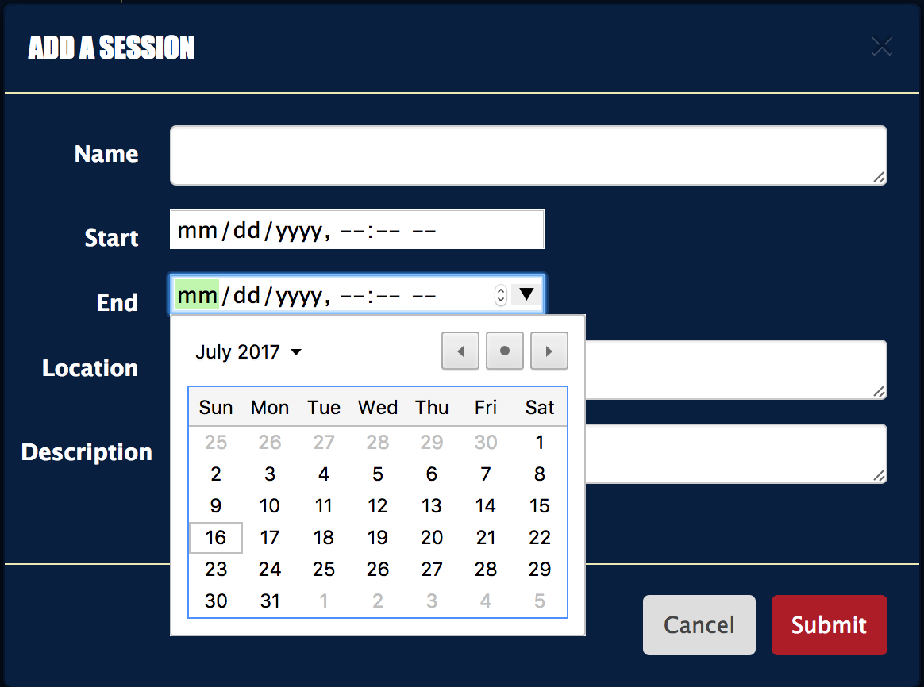
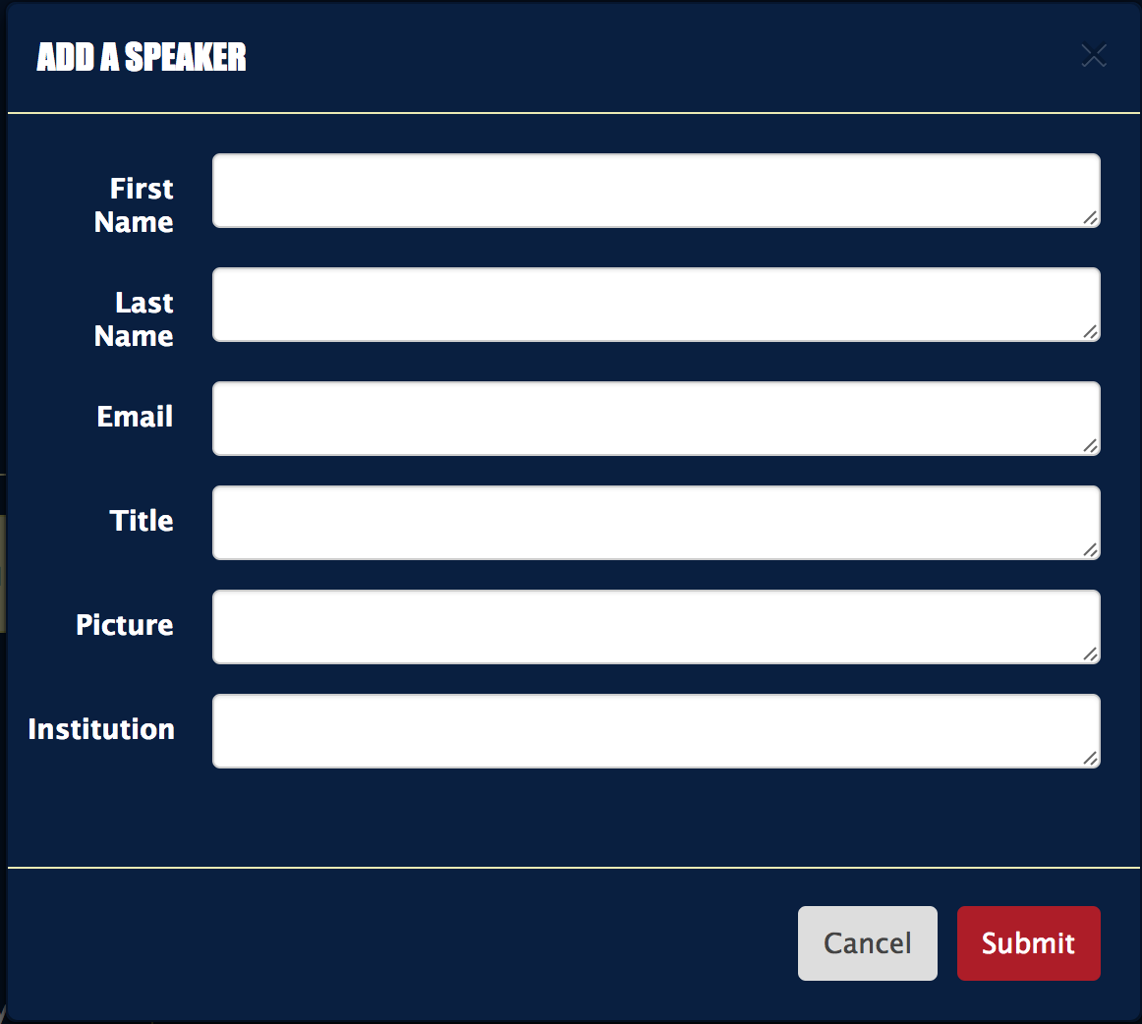
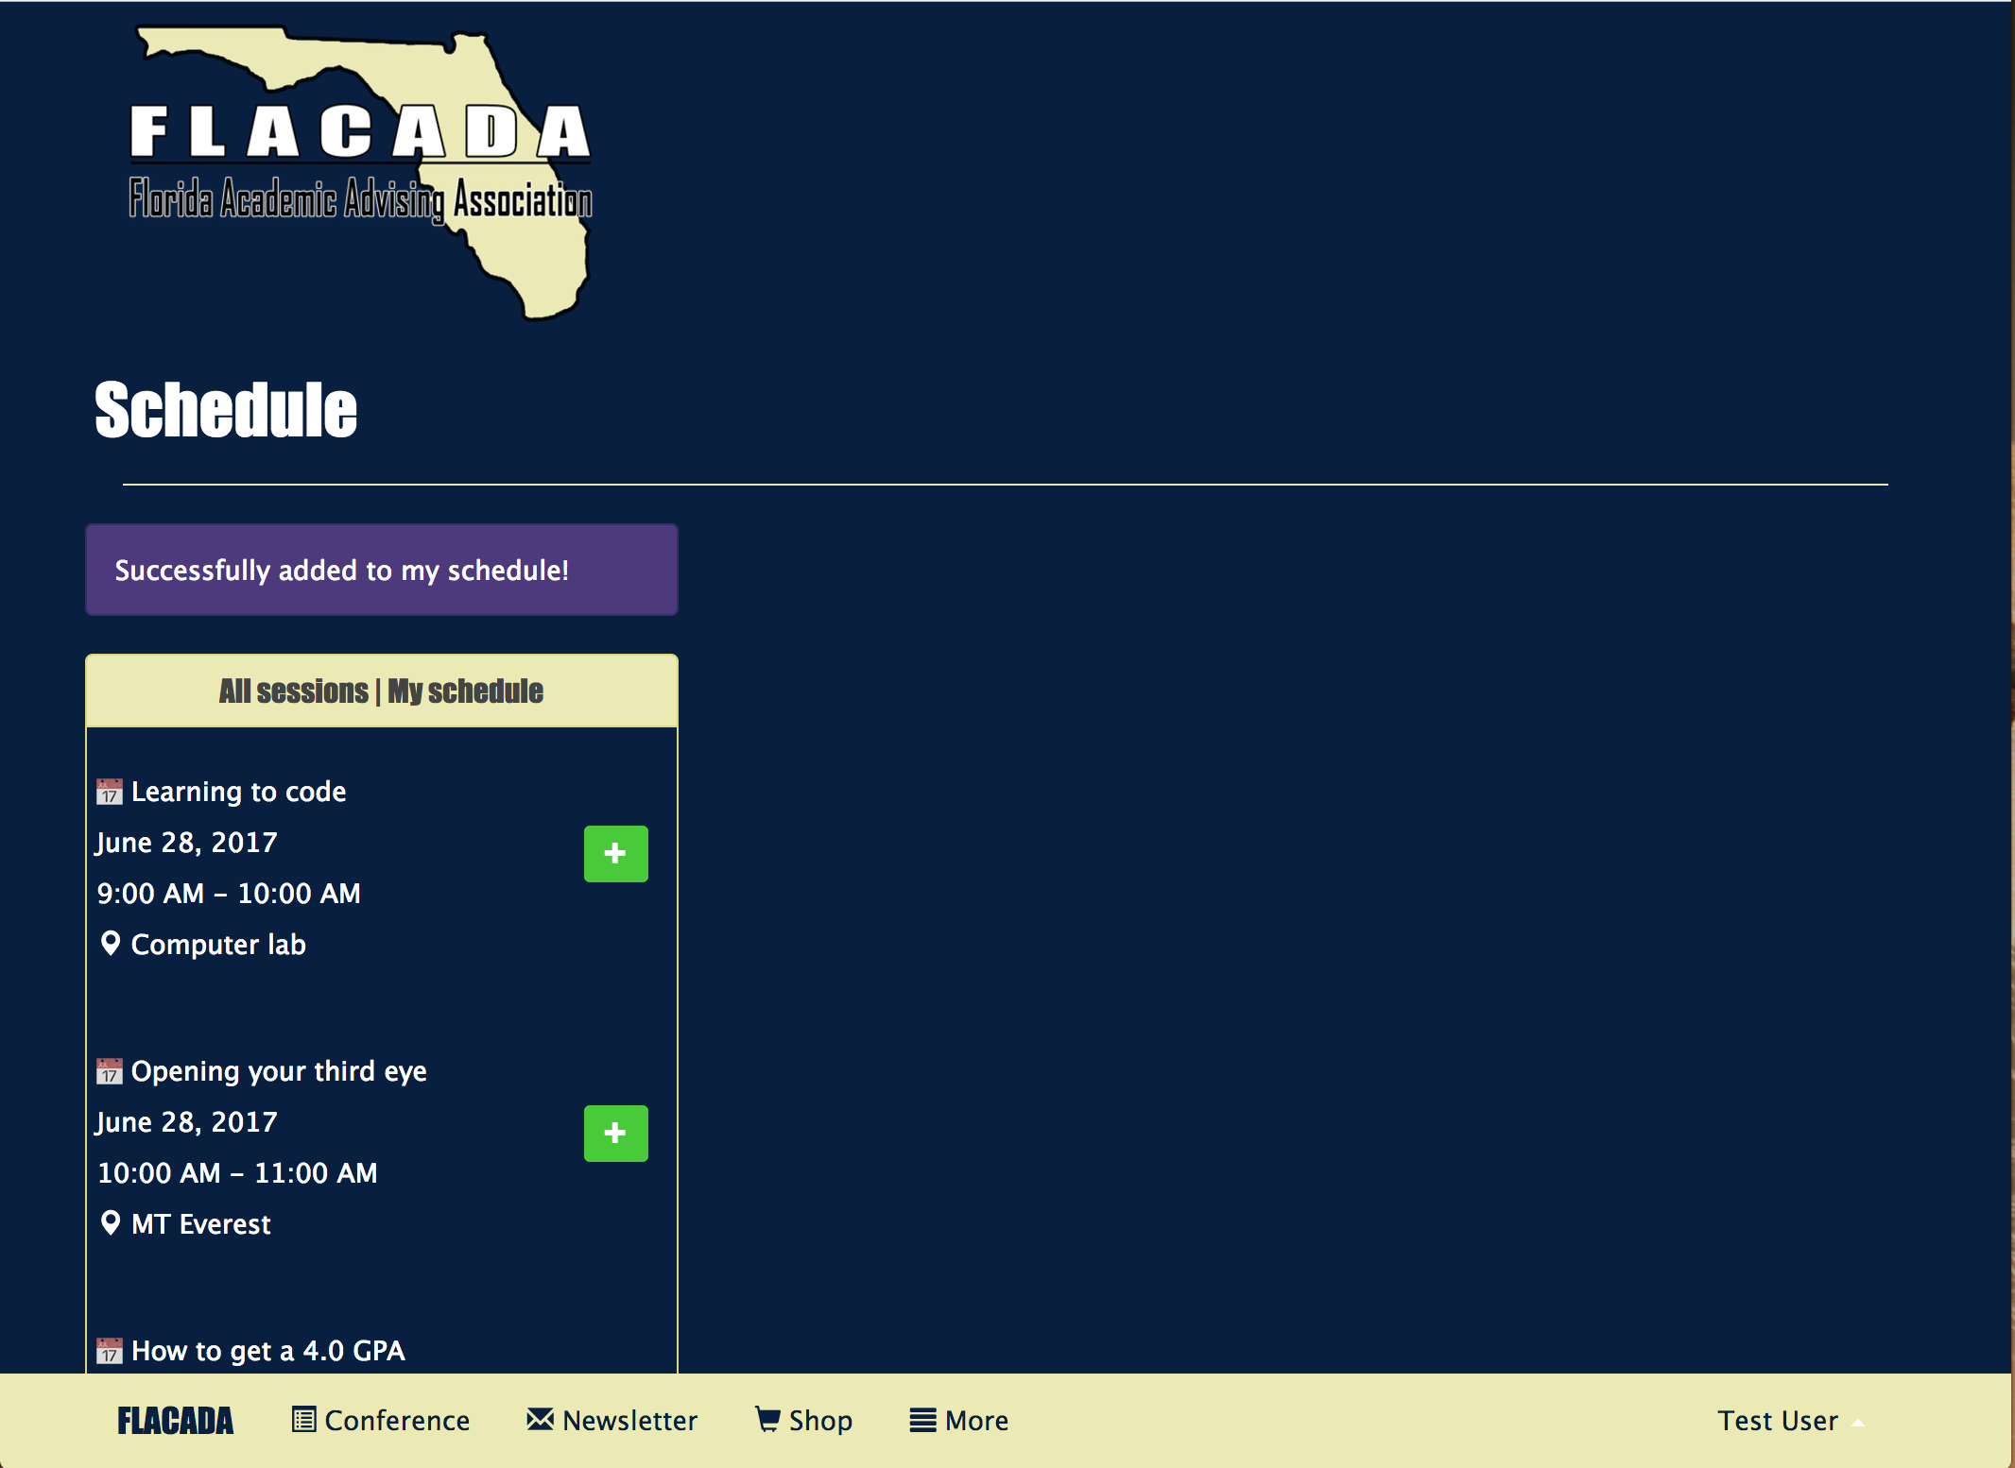
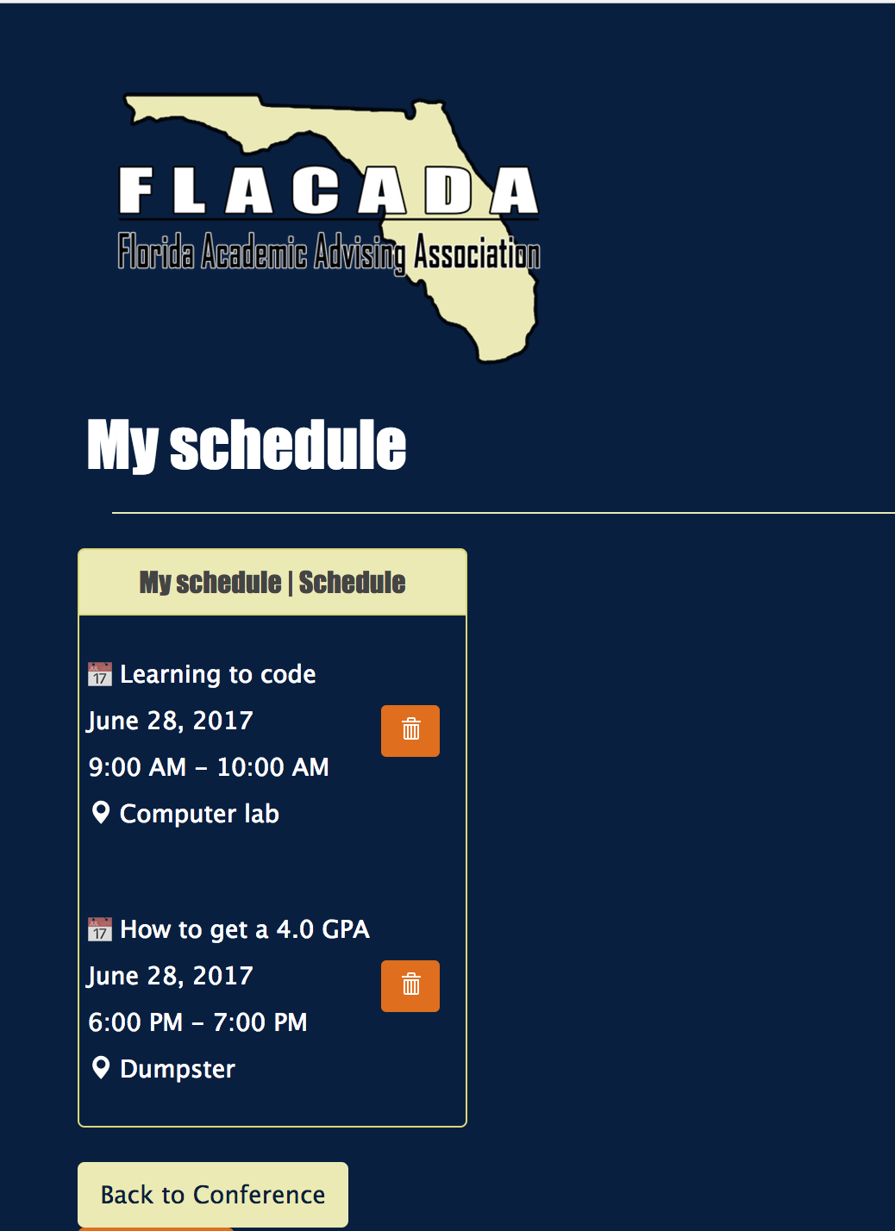
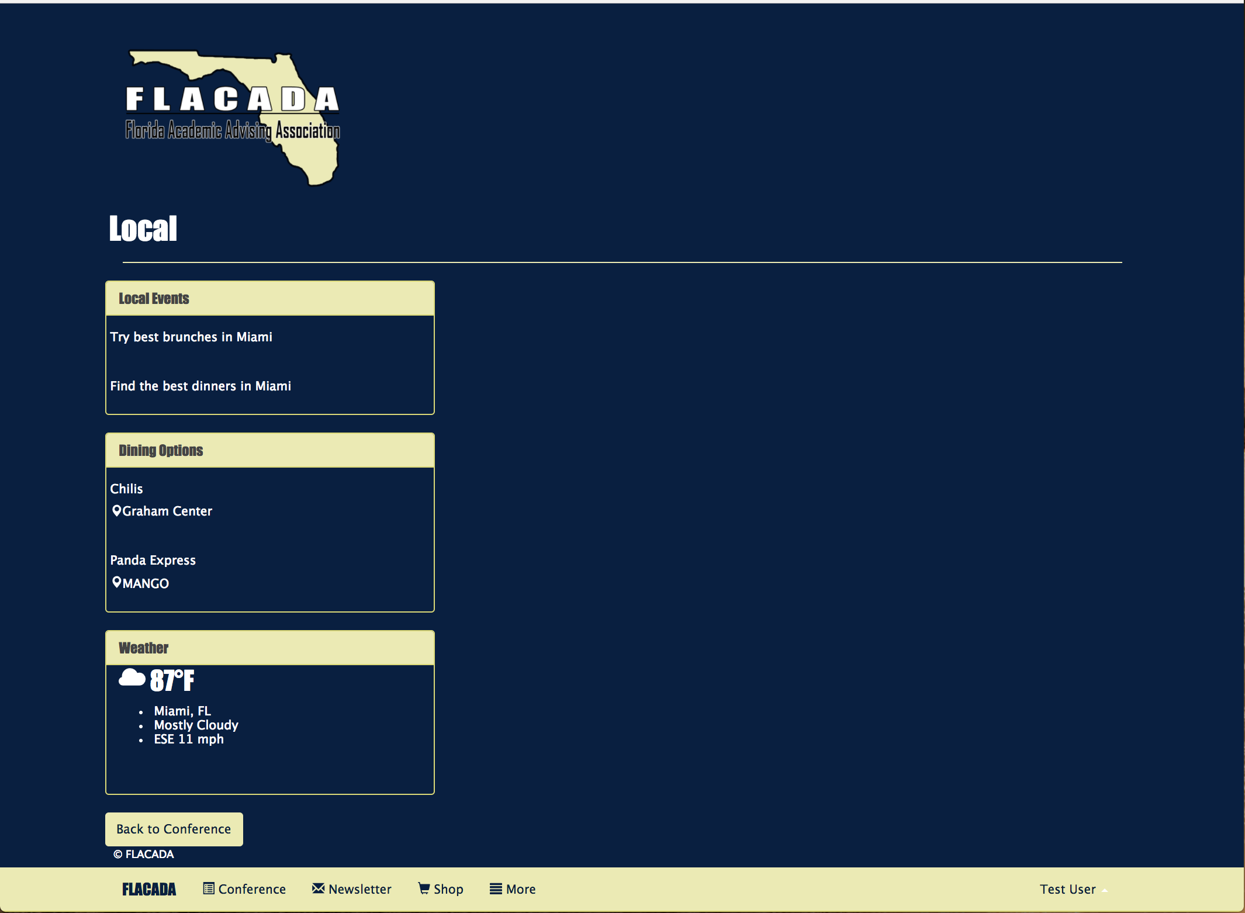
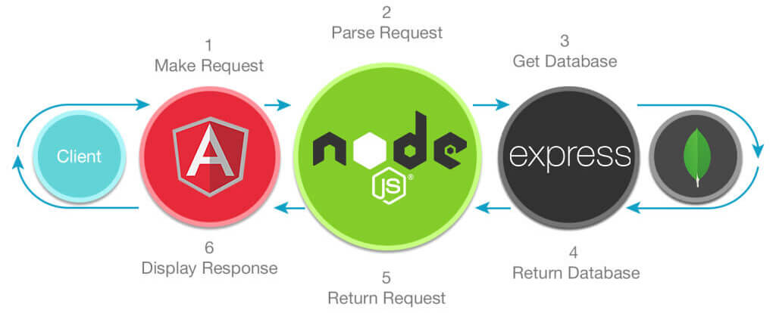
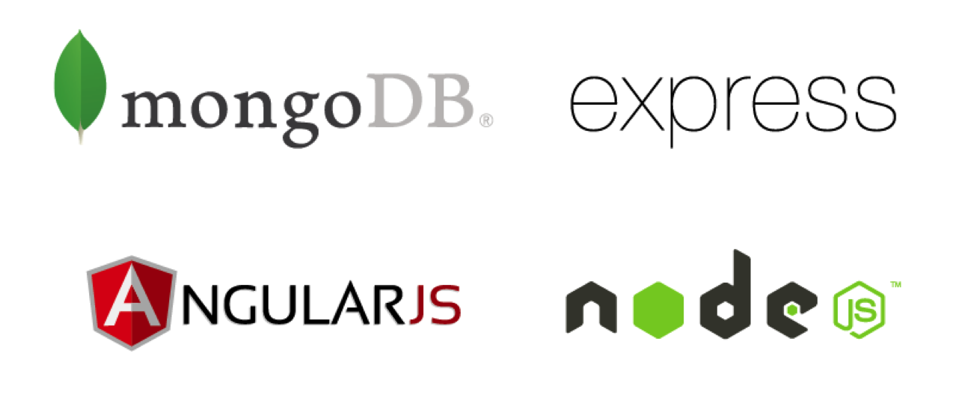

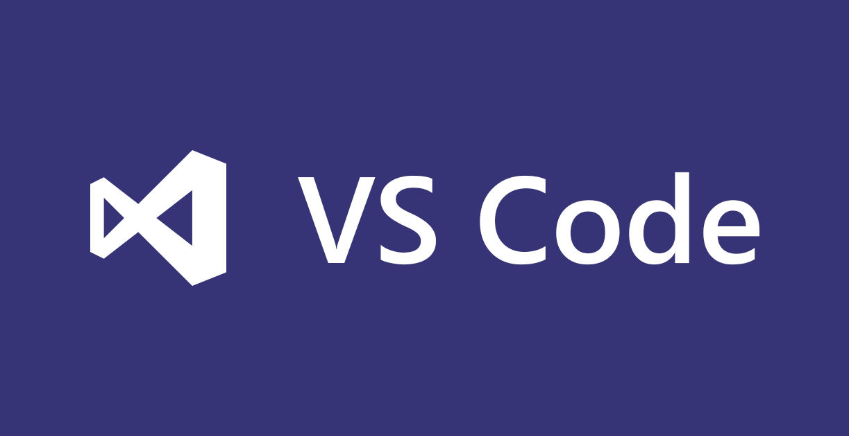
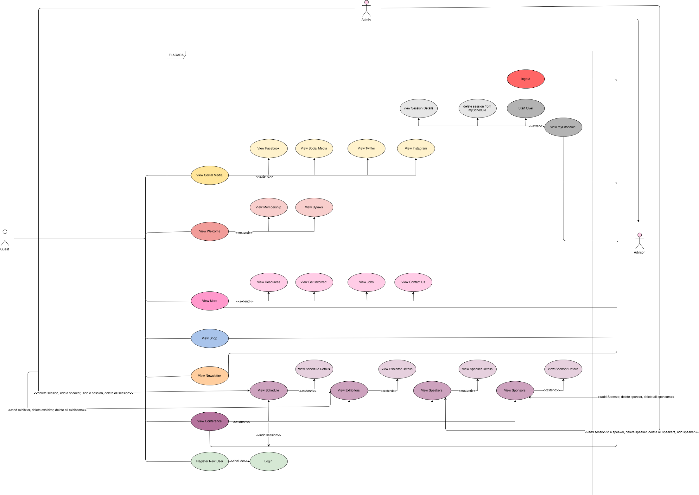
School of Computing & Information Sciences
VIP, 2017, Summer C
FLACADA 1.0
Student: Nickolas Morales, Mabel Amaya, Florida International University
Mentor: Helen Gonzalez, Product Owner
Instructor: Masoud Sadjadi, Florida International University
Problem
An application is needed that allows FLACADA admin to add and delete all exhibitors, sponsors, sessions and speakers from a conference. Also add sessions to existing speakers and add speakers to existing sessions.
Solution
FLACADA 1.0 is the first iteration of this app. Supports adding sessions in general or to an existing speaker (figure 1) . Also for adding a general speaker or adding to an existing session (figure 2). . Schedule management (figure 3 & 4) and access to local information (figure 5).
Current System
Live database is maintained through mLab using MongoDB hosted by Amazon Web Services.
In order to abstract the object model, Mongoose was used.
FLACADA 1.0 routing is also abstracted by ExpressJS.
Screenshots
Figure 1 Figure 2 Figure 3 Figure 4 Figure 5
Requirements
MongoDB installed
NodeJS / NPM installed
Express, Mongoose and Angular dependencies injected
Heroku cloud services
mLab using Amazon Web Services as live DB
Internet Browser
System Design
Implementation
This project was built in Javascript using:
Develop with:
Verification
Test case: Create a new session and add a speaker to that session.
Purpose: To test the relationship within the API of speakers to sessions and vice versa..
Action: Fill out the create new session form and add a speaker to that session by filling out the form.
Expected result: New session with a new speaker added to it.
Object Design
Summary
FLACADA 1.0 is the first iteration of this app, we started from scratch using the MEAN stack framework for full stack web development.
Allows users to see all exhibitors, sponsors, sessions and speakers from the conference.
The architecture is scalable and easy to change based on desired changes in functionality. All of our functions are fully integrated and hosted in our cloud service platform: ‘Heroku’ using ‘Mlab with Amazon Web Services’.
Acknowledgement
The material presented in this poster is based upon the work supported by Helen Gonzalez. I am thankful to the help that I received from my group members, Nickolas Morales, in the process of creating this software. Special thanks to Stackoverflow for bug fix help and the documentation for the respective technologies mentioned above.
Notes:
1

