Slide 1








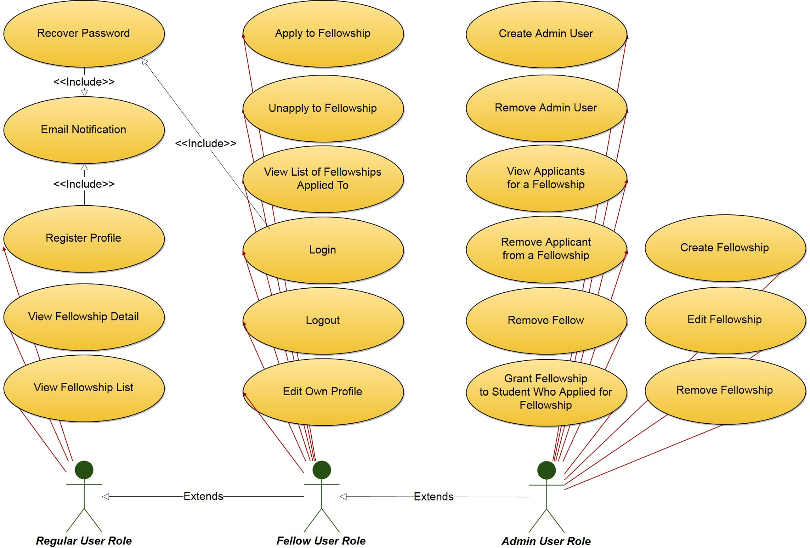
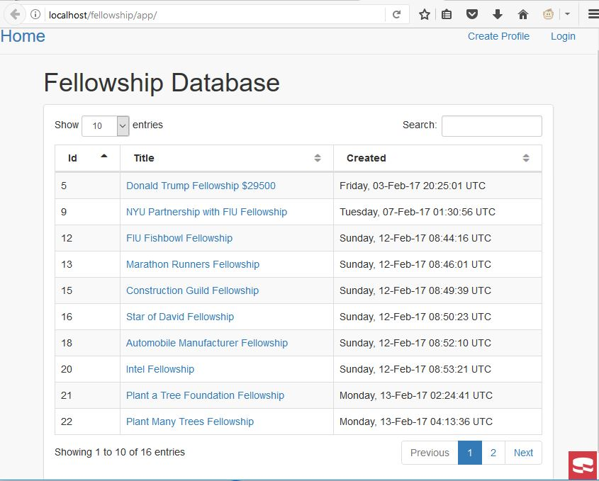
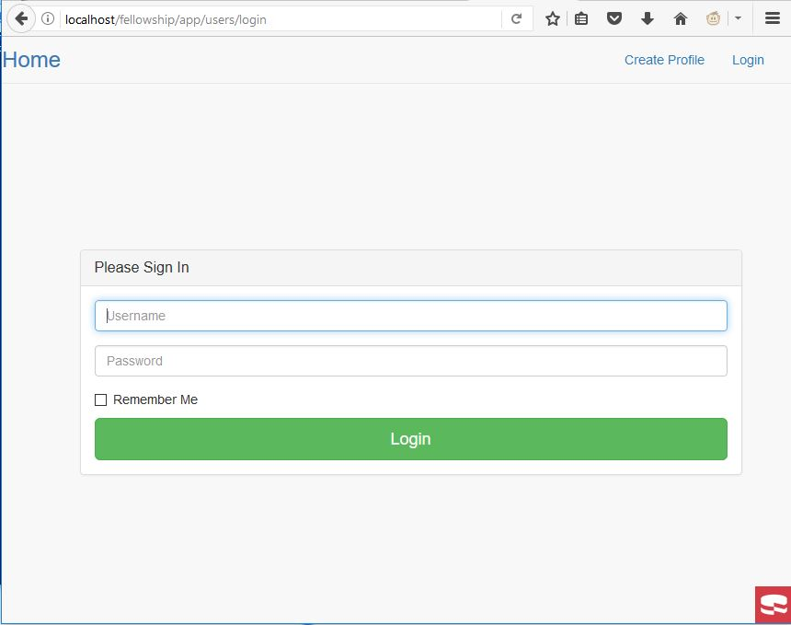
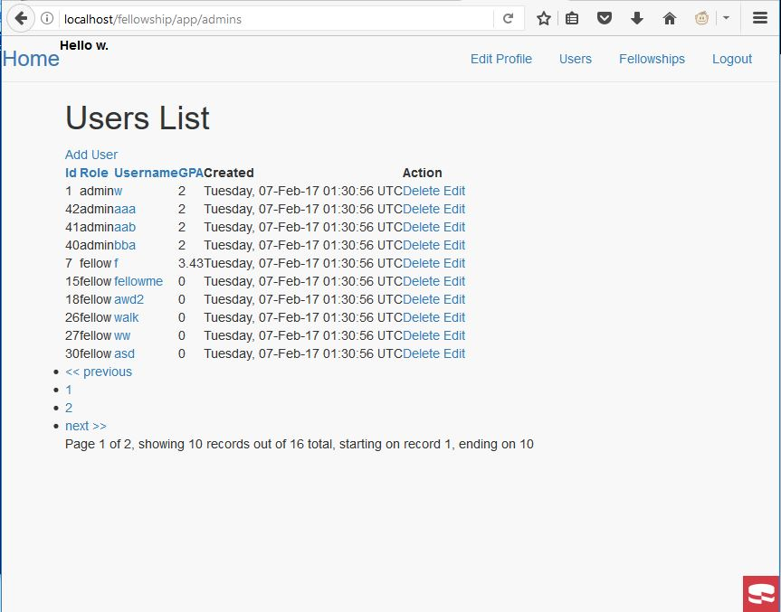
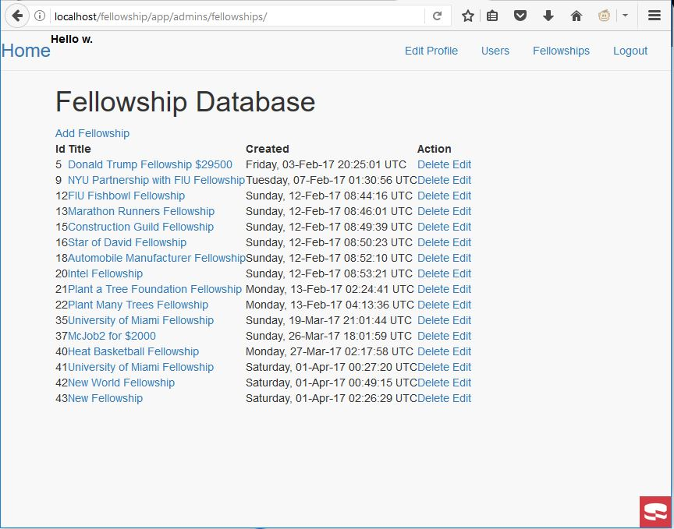
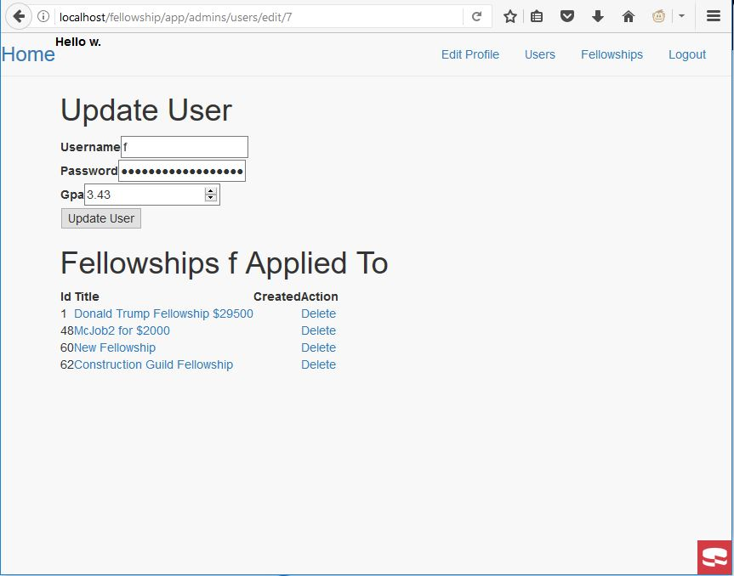
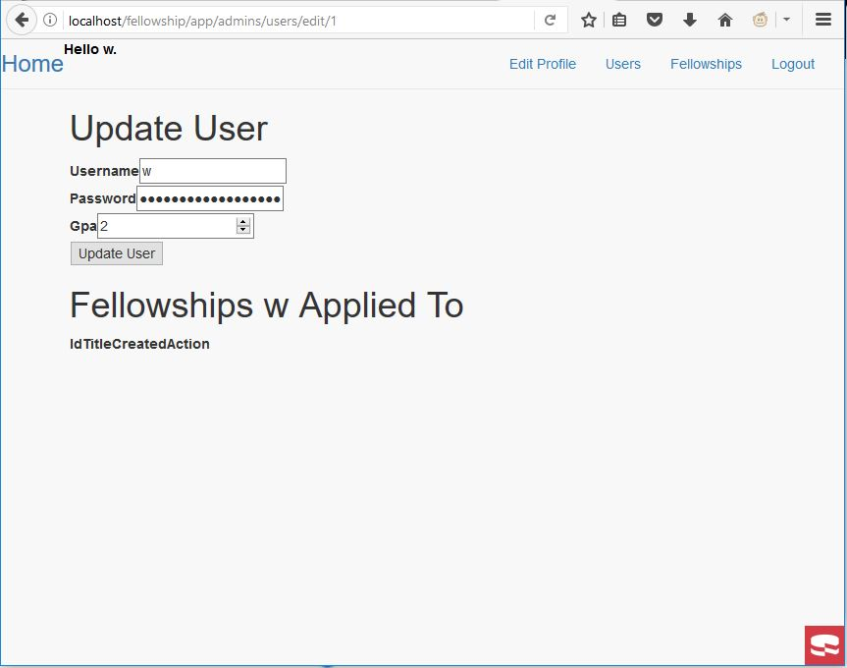
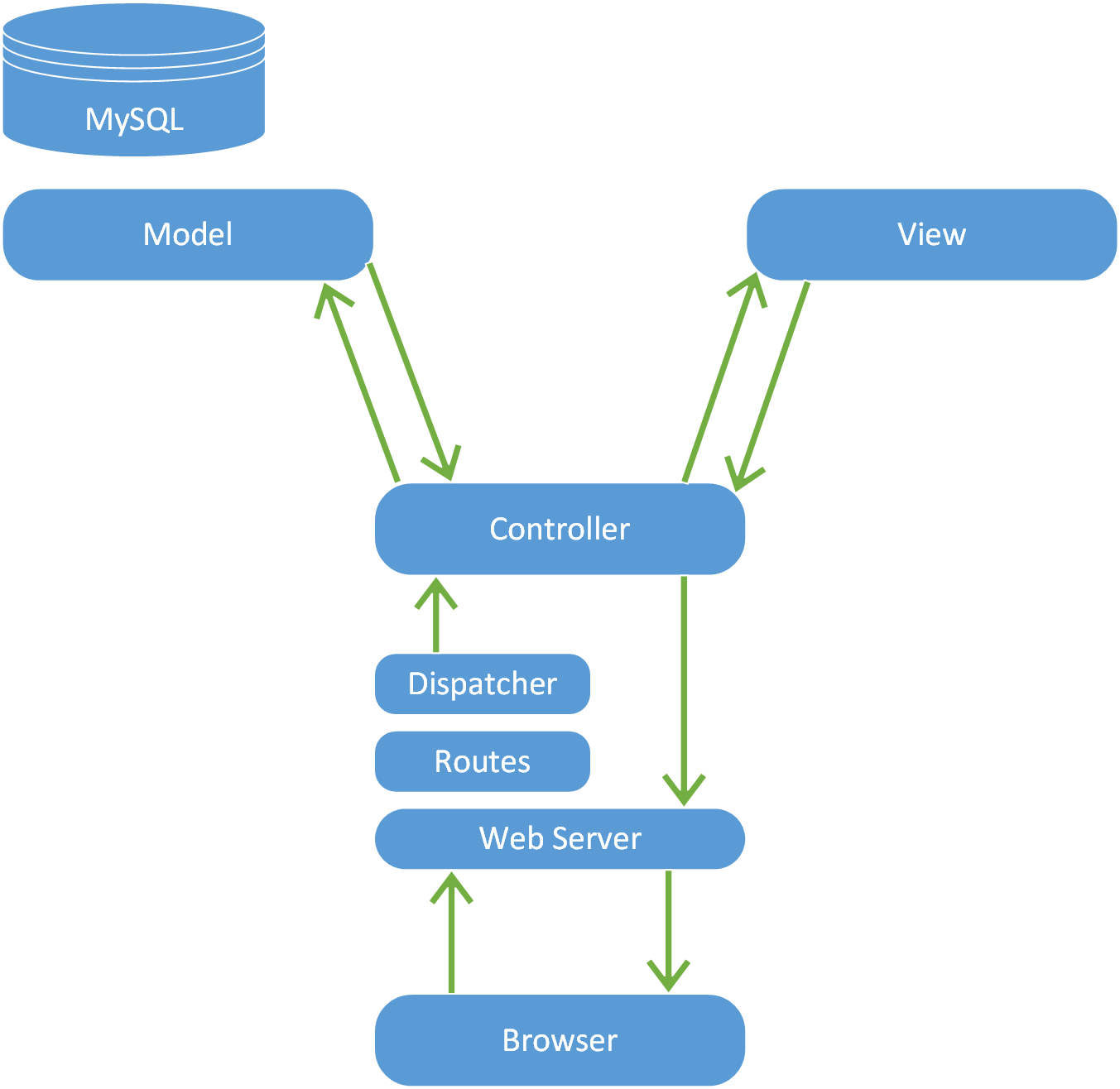
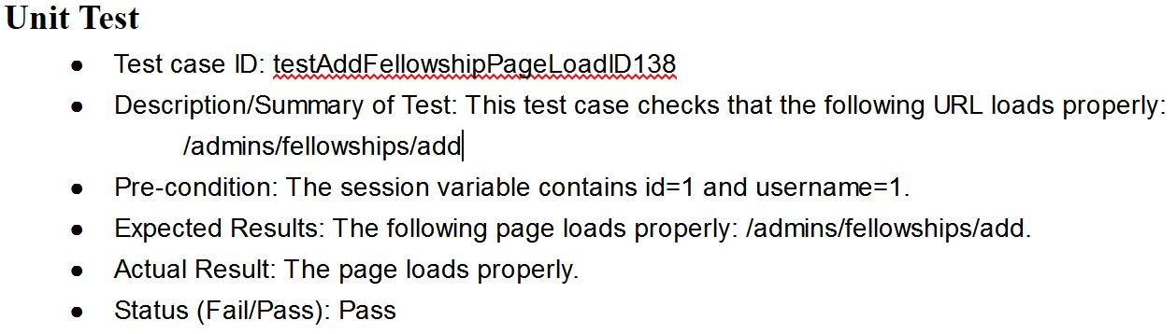
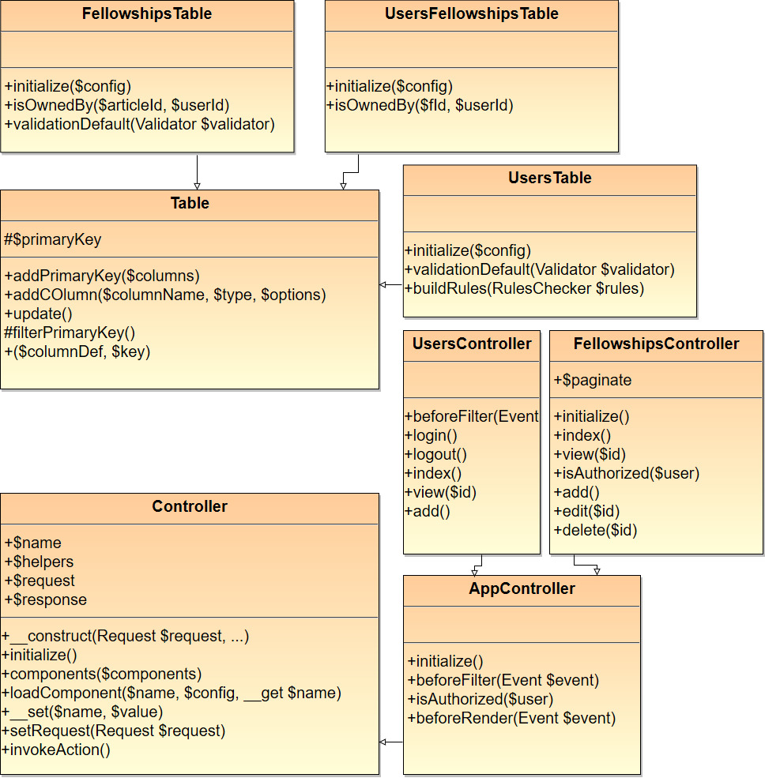
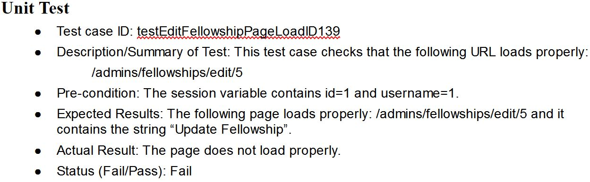
School of Computing & Information Sciences
Senior Project, 2017, Spring
Fellowship Management 1.0
Student: Winicius Siqueira, Florida International University
Mentor: Mohsen Taheri, Florida International University
Instructor: Masoud Sadjadi, Florida International University
Problem
Owner is unable to show list of fellowships to students.
Owner needs a system to show list.
Owner needs a system for students to apply to fellowships.
Owner needs to provide solution that is easy to use for both students and administrator.
Solution
Owner has set of requirements that can be implemented using many different software.
Student has chosen Windows, Apache, MySQL, and PHP as the software combination to implement owner’s requirements.
Current System
Static website
Requires knowledge of HTML
HTML is hard to read
Screenshots
Requirements
The system shall allow for users, depending which role that user has, to be able to
Create Fellowship
Remove Fellowship
Update Fellowship
Delete Fellowship
Create User
Remove User
Update User
Delete User
Apply to Fellowship
Unapply to Fellowship, and etc.
System Design
Implementation
Windows is an operating system.
Apache is a web server.
MySQL is the world’s most popular open-source database.
PHP is a popular general-purpose scripting language that is especially suited to web development.
CakePHP 3 is a web development framework running on PHP 7.1 (min. PHP 5.6.0).
Verification
Object Design
Summary
Using SCRUM software engineering methodology Fellowship Management 1.0 was created.
Development of this project began with a feasibility study which lead to requirements elicitation and documentation followed by system design.
Acknowledgement
The material presented in this poster is based upon the work supported by Robert Zurita. I am thankful to the help that I received from my group member, Alfredo Morales.
Notes:
‹#›

